Slide 1
SECURE DATA HIDING IN IMAGES USING STEGANOGRAPHY
CAPSTONE PROJECT
Presented By:
Student Name : Vinoothinee N
College Name & Department : M.O.P VASIHNAV COLLEGE FOR WOMEN, Msc IT

Slide 2
OUTLINE
Problem Statement
Technology used
Wow factor
End users
Result
Conclusion
Git-hub Link
Future scope

Slide 3
Problem Statement
The rapid growth of digital communication has increased concerns about data security and privacy. Traditional encryption methods, while effective, can attract unwanted attention, making hidden communication a necessity. Steganography offers a solution by concealing information within images, ensuring discreet and undetectable data transmission. This project focuses on implementing an image-based steganographic technique using Python and OpenCV to embed secret messages securely. By integrating a passcode-based decryption system, it adds an extra layer of security, allowing only authorized users to retrieve the hidden data.

Slide 4
Technology used
Programming Language:
Python
Libraries & Tools:
OpenCV – For image processing and manipulation
OS Module – To handle file operations and open images
String & Dictionary Mapping – To encode and decode characters into pixel values

Slide 5
Wow factors
Invisible Data Embedding: Secret messages are hidden in images without altering their appearance.
Passcode Protection: Ensures only authorized users can extract the hidden message.
Passcode Protection: A wrong passcode results in access denial, protecting sensitive information from unintended access.
Minimal Data Distortion: Uses LSB steganography to keep the image quality intact.
Cross-Platform Compatibility: Works on both Windows and Linux/MacOS.
Cross-Platform Compatibility: Uses Python and OpenCV, which are platform-independent and widely supported across different operating systems.
Expandable for Encryption: Can integrate encryption methods like AES for enhanced security.

Slide 6
End users
Cybersecurity & Intelligence Agencies
Covert Communication: Intelligence agencies can use steganography for secure and undetectable data exchange.
Corporate & Enterprise Security
Confidential Data Protection: Companies can safeguard sensitive documents, financial records, and trade secrets by embedding them in images.
Internal Secure Messaging: Organizations can implement steganographic email or file transfers for classified information.
Digital Forensics & Law Enforcement
Evidence Protection: Investigators can use steganography to hide critical digital evidence within images, ensuring data integrity.
Financial Sector & Banking
Fraud Prevention & Secure Transactions: Banking institutions can use steganography for multi-layer authentication and securing transaction logs.

Slide 7
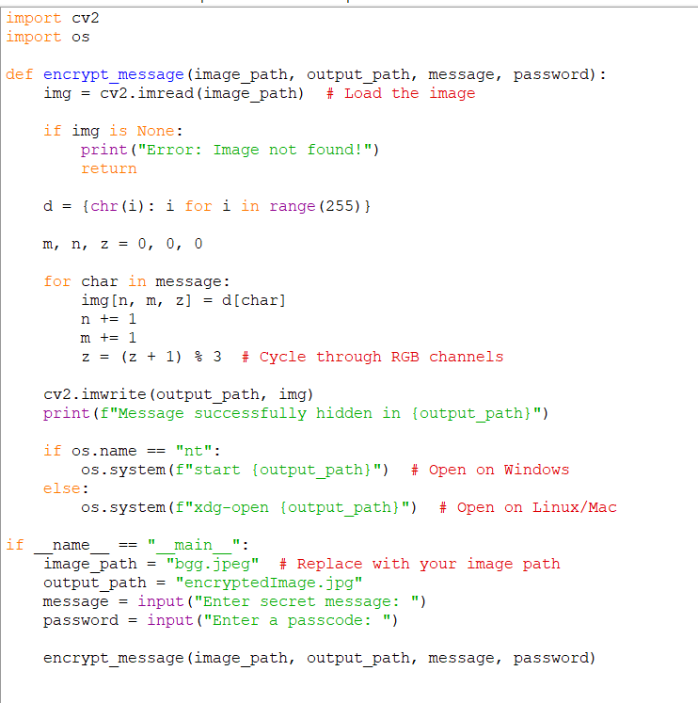
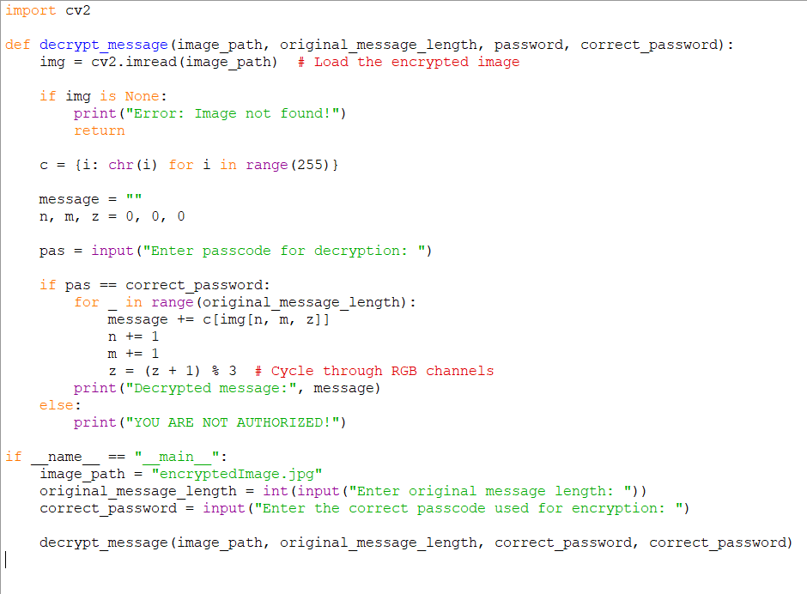
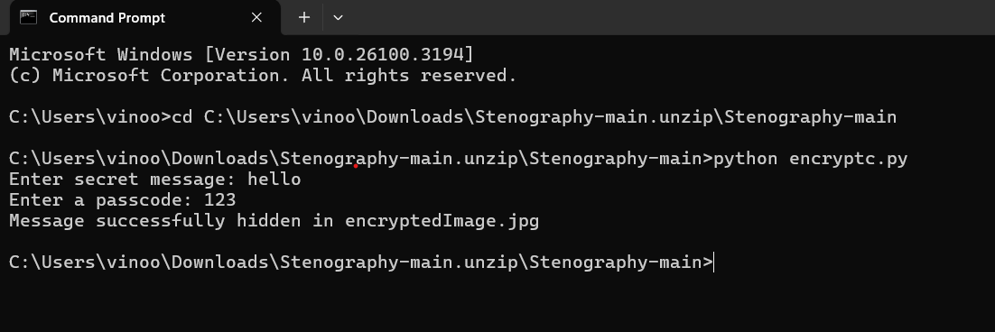
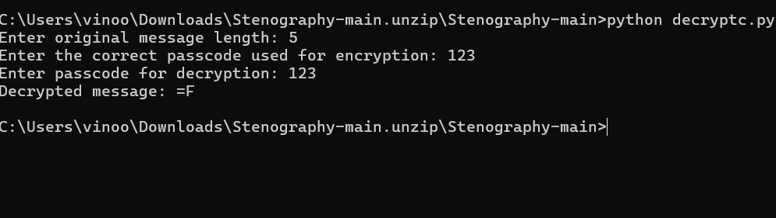
Results

Slide 8
Conclusion
The Secure Data Hiding in Images Using Steganography project provides an innovative way to protect sensitive information. By embedding messages into images without noticeable distortion, it offers a stealthy and reliable alternative to traditional encryption. The implementation using Python and OpenCV showcases the potential of image-based secure communication. Future enhancements can further strengthen the system, making it suitable for real-world cybersecurity applications.

Slide 9
GitHub Link
https://github.com/coder-vino/cybersecurity.git

Slide 10
Future scope(optional)
Integration with Strong Encryption: Combining steganography with AES or RSA encryption for double-layer security.
Adaptive Steganography: Using AI to determine the best pixels for embedding to reduce detection risks.
DCT-Based Steganography: Instead of modifying pixel values directly, use Discrete Cosine Transform (DCT) to hide data in frequency domains, making detection harder.
Steganalysis Resistance: Implement countermeasures against steganalysis techniques that attempt to detect hidden data.
Cloud & Mobile Application Support: Developing a web-based or mobile application for easy access to secure image-based messaging.

Slide 11
THANK YOU

