Slide 1
CREW OPS ADVISOR · DCORTEX AIR, HUB BLR
An advisor that a controller can actually trust at 6 a.m.
The model classifies and writes prose. Deterministic code computes every number, verdict, cost and ranking — and checks the model's own words before a controller sees them.
FIVE THINGS THAT ARE EASY TO SKIP — AND WHAT A JUDGE WILL ASK IF YOU DO
Not tuned to the sample data
Rules read live from rules.json, not copied from the answer key. Regenerates and re-checks on unseen seeds.
“Did you just hard-code the demo?”
A confidence signal, not just a score
A second suite sends real English through the live agent (94.7%) — not only code calling code (100% by construction).
“Is that 100% real, or rigged to pass?”
Says “I'm not sure” out loud
Policy calls and compound disruptions are declined with a reason and a next step — never a confident guess.
“What happens when it doesn't know?”
Explainable by construction
Every legality verdict carries the rule id and the exact arithmetic — not a model's paraphrase of one.
“Can I trust the number, or just the sentence?”
Traced end to end
Every tool call, fact and rule evaluation is logged, and one run can be replayed and diffed byte for byte.
“Can I audit what it actually did?”
Crew Ops Advisor · dCortex Air, hub BLR
1

Slide 2
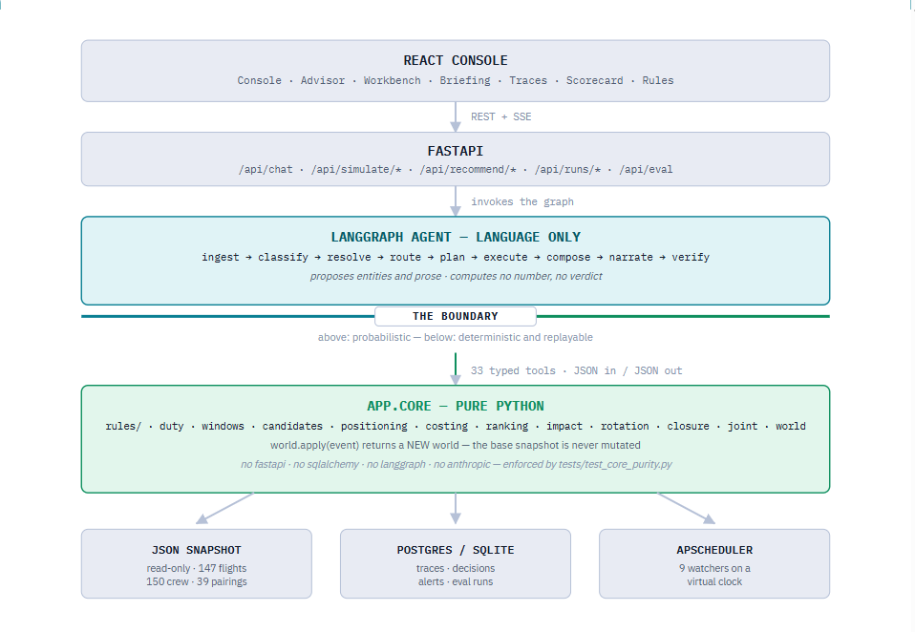
CREW OPS ADVISOR · DCORTEX AIR, HUB BLR
Crew Ops Advisor · dCortex Air, hub BLR
1

Slide 3
ARCHITECTURE
The full pipeline — LangGraph nodes, decisions and the trace
LLM step
Deterministic (app.core)
Decision / gate
Abstain / clarify
Downgrade
ROUTE
plan exists?
INGEST
normalise the question
CLASSIFY
LLM proposes an intent
RESOLVE
code validates every id
PLAN
compiled tool sequence
EXECUTE
app.core — 33 tools
out of scope
compound / missing id
ABSTAIN
names what it CAN answer
CLARIFY
asks for the missing piece
VERIFY
grounded in the fact ledger?
ANSWER
+ full trace
NARRATE
LLM writes from facts only
COMPOSE
pure code — no model
fails once
retry
DOWNGRADE
engine's own figures
REPAIR
one retry, violation named
fails again
Every node above is a Python function in app/agent/graph.py — the graph is fixed; only EXECUTE's tool choice changes with the question's tier.
Crew Ops Advisor · dCortex Air, hub BLR
2

Slide 4
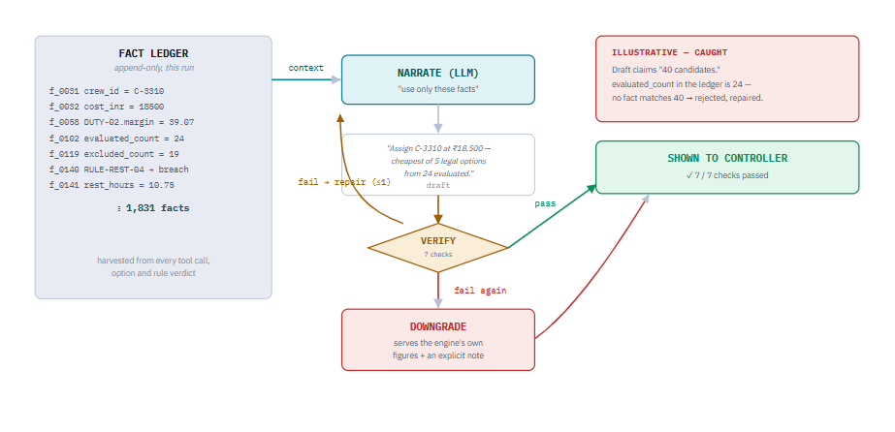
ARCHITECTURE
Every node above is a Python function in app/agent/graph.py — the graph is fixed; only EXECUTE's tool choice changes with the question's tier.
Crew Ops Advisor · dCortex Air, hub BLR
2

Slide 5
REASONING DEPTH
Tier 2 vs Tier 3 — same engine, a bigger question
TIER 2
TIER 3
Consequence — what breaks
Recommendation — what to do
TOOLS CALLED
TOOLS CALLED
simulate_crew_unavailable
simulate_station_closure · simulate_delay
check_legality
enumerate_cover_candidates
resolve_disruption · solve_joint_assignment
REASONING
REASONING
Fork the world once, ask a single question: what does this event break, right now and downstream? No ranking, no cost — just the honest blast radius of one disruption.
Take Tier 2's opening and run every active crew member of the right rank through the full seven-rule engine — not just reserves. Then cost and rank whatever survives.
“Captain sick — which flights are uncrewed today, and which duty breaks REST-04 tomorrow?”
“...so who should cover it, legally, cheapest first — and why not the other 19?”
Same seven-rule engine both times. Tier 3 doesn't reason differently — it just asks the Tier 2 question of every legal candidate, then prices and ranks the answers.
Crew Ops Advisor · dCortex Air, hub BLR
3

Slide 6
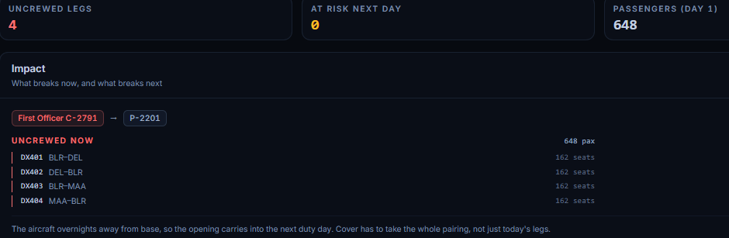
CASE STUDY
A sick call, traced — who does what, in order
“Captain C-1042 calls in sick for pairing P-2291 on 15 Sep.”
LLM
CLASSIFY Proposes intent SICK_IMPACT · tier 2 · confidence 0.93.
LLM→CODE
RESOLVE “C-1042” and “P-2291” are proposed, then checked against the dataset — both exist → accepted.
CODE
EXECUTE simulate_crew_unavailable forks the world: DX412, DX413, DX588 uncrewed · 486 passengers · C-2087 would breach RULE-DUTY-02 by 1h20m.
Live capture — the impact panel, same shape as this trace
THE NARRATED ANSWER
CODE
COMPOSE Assembles the structured impact payload straight from those tool outputs. No model involved.
“C-1042's sick call leaves DX412, DX413 and DX588 uncrewed, affecting 486 passengers. C-2087 is the nearest substitute but would breach RULE-DUTY-02 by 1h20m.”
LLM
NARRATE Drafts the sentence a controller reads — built only from the facts COMPOSE just produced.
CODE
VERIFY DX412, DX413, DX588, 486, C-2087 and RULE-DUTY-02 in the draft are each checked against the fact ledger — all grounded → passed.
every id and number above — verified
—
ANSWER Delivered with the full trace attached — replayable end to end.
Crew Ops Advisor · dCortex Air, hub BLR
4

Slide 7
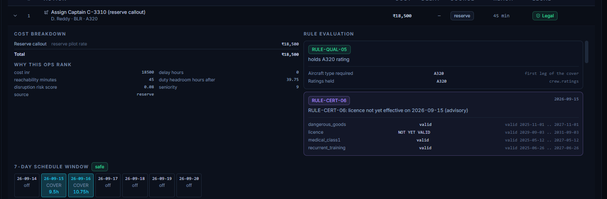
EVERY ACTION, MADE CONCRETE
“Assign C-3310” isn't the answer — their new week is
Every ranked option carries the candidate's own 7-day schedule — before and after — built from the same timeline the legality engine itself judged. Not a description of the change: the change.
A visible safe / conflict badge
so a controller isn't left to re-derive it from four numbers.
Live capture — top-ranked option, cost breakdown, rule evaluation and the 7-day schedule window
The same picture for rejections
why 19 of 24 candidates were excluded — the rule and the arithmetic, not prose.
No LLM in this computation
the schedule, the cost and the rule verdicts are app.core output; the model only narrates them.
Crew Ops Advisor · dCortex Air, hub BLR
5

