Slide 1

We4Tech HACKATHON
01
Amey Vanjare
LOAN ELIGIBILITY PREDICTOR
02
Nikhilesh Mishra
03
Rahul Mayekar
04
Swati Sahai
05
Tushar Shukla
TEAM SAR-NT
23 January 2022

Slide 2
TEAM SAR-NT
Analyse customer eligibility for home loan on factors
such as income, education level, dependents etc.
Problems in existing loan origination stages
1. Lack of transparency in loan eligibility checking
2. Time consuming process
3. Presence of human bias
4. Paper-pen approach makes it difficult to track
Loan origination stages
Factors affecting customers eligibility for loan
1. Pre-qualification process
2. Loan application
3. Application processing
4. Underwriting process
5. Credit decision
6. Quality check
7. Loan funding
1. Applicant's income
2. Co-applicant's income
3. Credit score
4. Job stability
5. Employment type
6. Property type

Slide 3
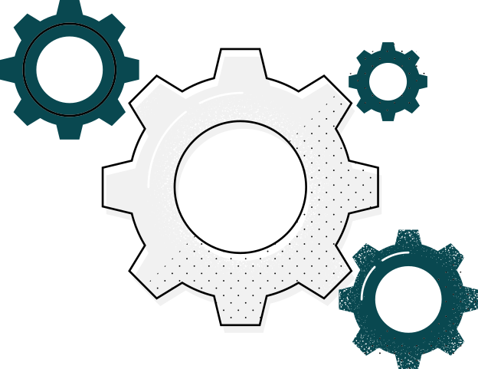
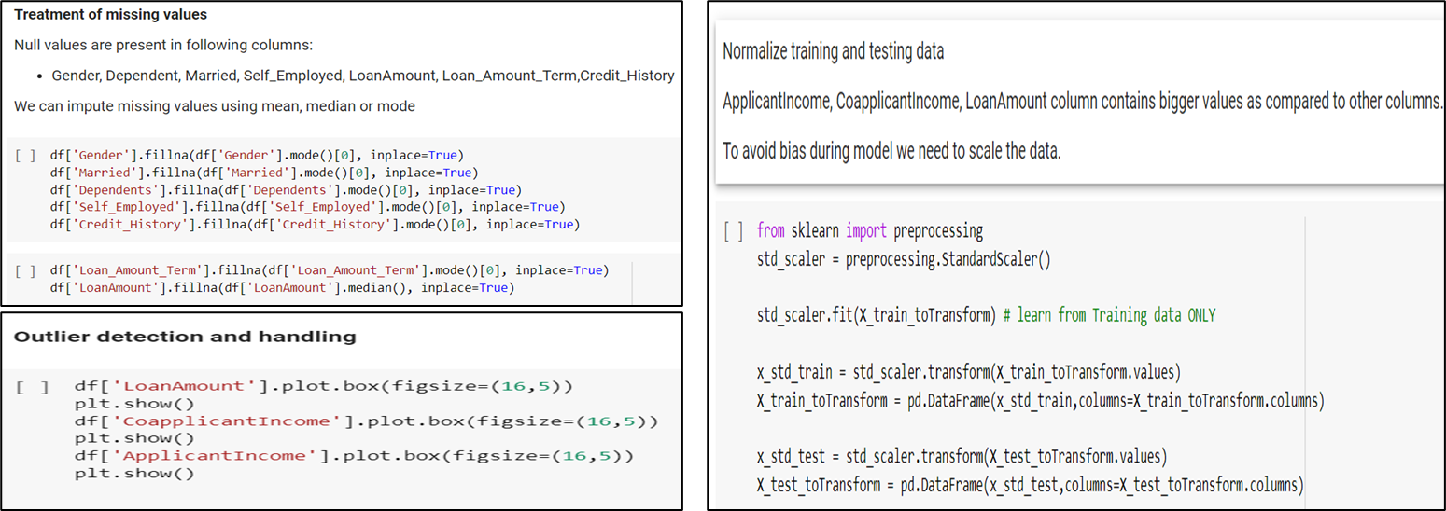
Data Pre-processing
Data Pre-processing is a crucial step in data mining because loosely controlled data gathering methods result in out-of-range values, missing values, outliers and impossible combinations. It is a technique which is used to re-shape the raw data into neat, practical and efficient structure by manipulating or dropping-off garbage data. It involves following steps:
Data Cleaning
•Treatment of Missing Values
•Outlier detection and handling
Feature Engineering
(Data Reduction)
•Dropping-off garbage/insignificant data
•Data compression
Data Transformation
•Normalization of data
•Generalization of data
•Manipulation of data

Slide 4

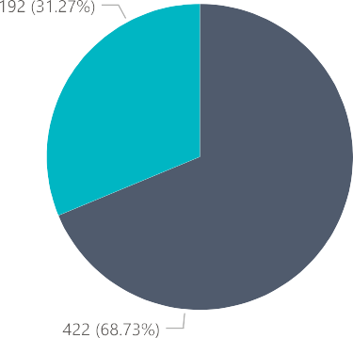
Exploratory Data analysis

Slide 5


Slide 6
Model Making: Logistic Regression
We will be using Python for this along with libraries :
pandas
seaborn
Sklearn
Reading Data
Read data from train and test file
train = pd.read_csv(‘Dataset/train.csv’) train.head()
Understanding Data
Understand data using columns ,dtypes and shape function
Train.columns
train.dtypes
train.shape
Missing value imputation
Count of missing values
train.isnull().sum()
Fill the missing values:
For numerical variables: imputation using mean or median
For categorical variables: imputation using mode

Slide 7
Outlier Treatment
It can be seen that having outliers often has a significant effect on the mean and standard deviation and hence affecting the distribution. We must take steps to remove outliers from our data sets.
Due to these outliers bulk of the data in the loan amount is at the left and the right tail is longer. This is called right skewness. One way to remove the skewness is by doing the log transformation. As we take the log transformation, it does not affect the smaller values much but reduces the larger values. So, we get a distribution similar to normal distribution.
Model Building
First model predict the target variable. We will start with Logistic Regression which is used for predicting binary outcome.
We use scikit-learn (sklearn) for making different models which is an open source library for Python.
Sklearn requires the target variable in a separate dataset. So, we will drop our target variable from the training dataset and save it in another dataset
Make dummy variables for the categorical variables. The dummy variable turns categorical variables into a series of 0 and 1
We will train the model on the training dataset and make predictions for the test dataset.
Make predictions for the test dataset.
Import the submission file which we have to submit on the solution checker.
We need predictions in Y and N. So let’s convert 1 and 0 to Y and N.
Finally, we will convert the submission to .csv format.

Slide 8
Thank You!

