Slide 1


Modcom
Institute of Technology

Slide 2
Student Name: Adrian muita
Project Name: Autovibe

Slide 3
Slide 2: Problem Definition
Many people dream of owning luxury vehicles, but finding trusted, stylish, and affordable options online is difficult.
Customers often waste time moving from one dealership to another without clear pricing, quality assurance, or a smooth buying experience.
Luxury car buyers want confidence, convenience, and a platform that matches the lifestyle they desire.

Slide 4
Slide 3: Your Solution
AutoVibe is a modern online platform that connects customers with premium and luxurious vehicles in one place.
Users can:
Browse high-end cars easily
View clear prices and specifications
Compare vehicles instantly
Contact sellers directly
Experience a smooth and elegant car shopping journey
AutoVibe is designed to make people feel the excitement and prestige of owning their dream car.

Slide 5
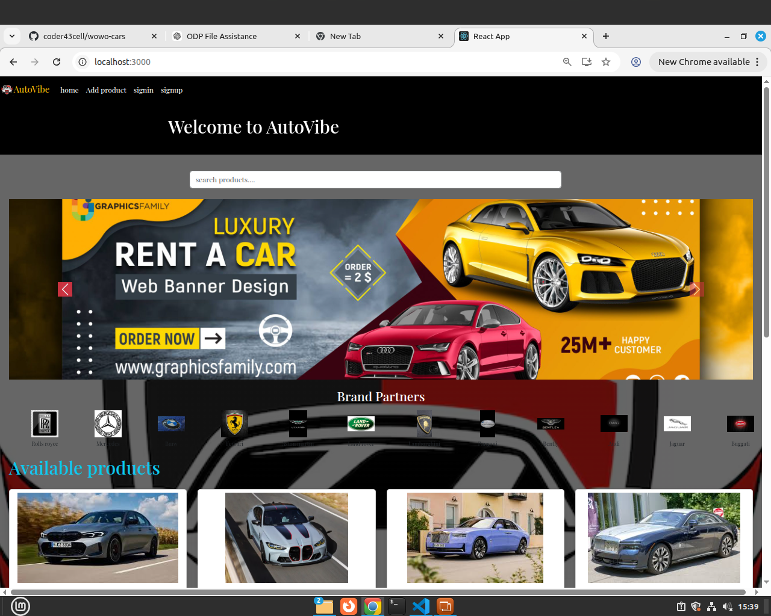
Slide 4: Screenshots

Slide 6
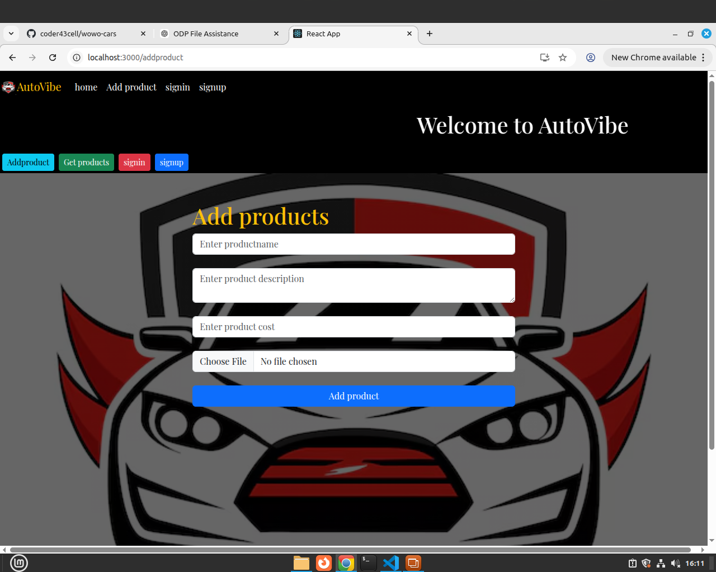
Slide 4: Screenshots

Slide 7
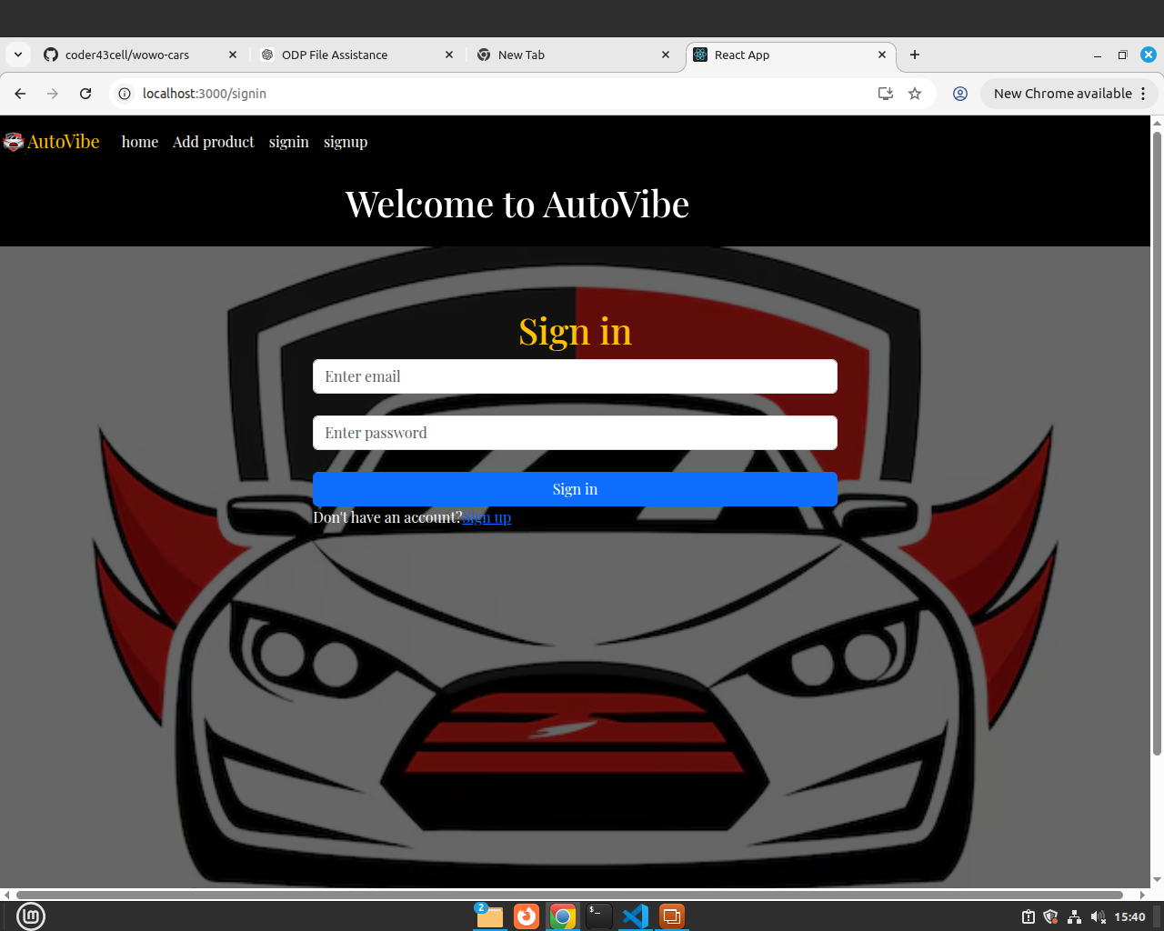
Slide 5: Screenshots

Slide 8
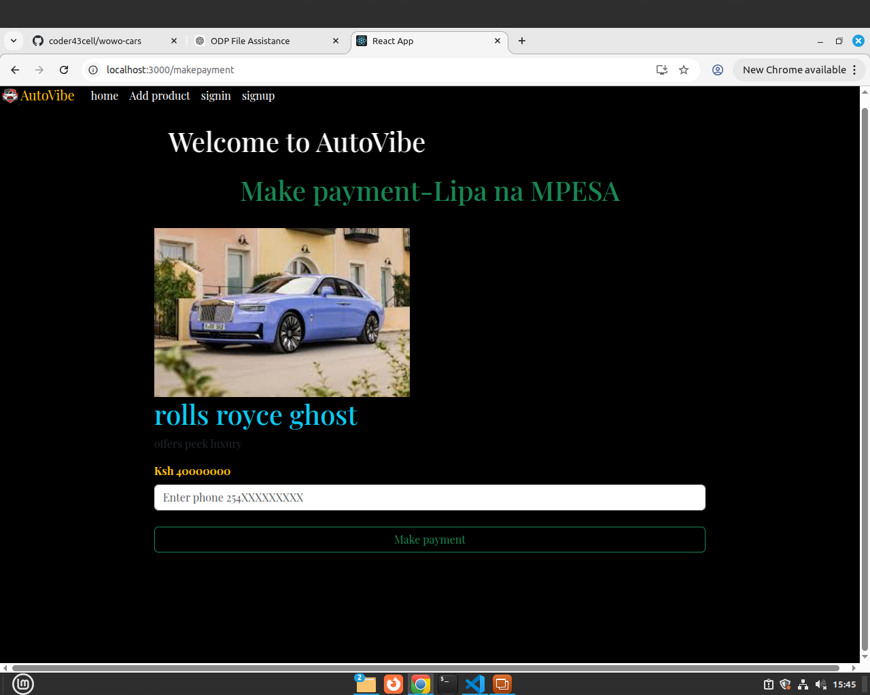
Slide 5: Screenshots

Slide 9
Slide 6: Target Market
AutoVibe targets:
Young professionals
Car enthusiasts
Luxury lifestyle lovers
Business people
Customers looking for premium and trusted vehicles
The platform is designed for people who value comfort, style, performance, and status.

Slide 10

Slide 7: Revenue Model
AutoVibe will make money through:
Featured car advertisements
Premium dealer subscriptions
Vehicle promotion packages
Commission from successful sales
This creates a sustainable business while helping dealers reach more serious buyers.

Slide 11
THANK YOU
“AutoVibe — Drive the Dream.”

