Slide 1

React Native

Slide 2


Hi, I’m Yagnesh Modh
I am a Full-Stack Developer. I design & Build Web/Mobile Application. I also develop Node.JS Web services using NoSQL and GraphQL
LinkedIn: www.linkedin.com/in/ymodh
Twitter: @imyagnesh
Github: https://github.com/coder4affine

Slide 3
Prerequisites
JavaScript, preferably ES6/ES2015
Knowledge of command line
Basic understanding of NPM

Slide 4
What Is React?
React is a declarative, efficient, and flexible JavaScript library for building user interfaces.
React is for Web.

Slide 5
What Is React Native?
React Native lets you build mobile apps.
It is an extension of React.
JavaScript library.
Built for building user interface for Mobile Apps.

Slide 6







Who Uses React Native?
Facebook
Instagram
Pinterest
Skype
Uber
Walmart

Slide 7
Why REACT NATIVE?

Slide 8


1. Cross Platform Compatibility
Android
iOS

Slide 9

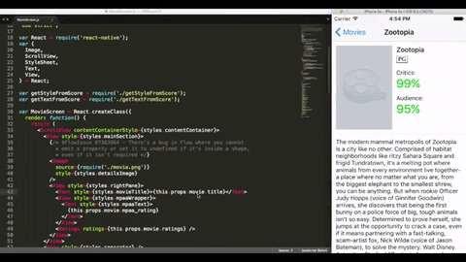
2. Don’t Waste Time On Recompiling
Hot Reloading Feature
[2]

Slide 10
3. Strong Performance for mobile
environment
Uses GPU Instead of CPU
More strength for mobile

Slide 11
4. Modular Architecture
Easy to understand
Easy to test
Development time reduces

Slide 12
Limitations
REACT NATIVE IS STILL YOUNG.
Its improving day by day

Slide 13

How React Native Works?

Slide 14



Native UI Platform
JavaScript Core VM

Slide 15
Your JavaScript
Third-Party JavaScript
React Library
Bridge Bridge
React Library
Your Native Code
Third-Party Native Code
Native SDK

Slide 17
Developer Experience

Slide 18
Developer Experience
User Experience
Developer Experience

Slide 19


Developer Experience
Developer Experience
User Experience
Web Native RN
Web
React Native
Native Mobile
User Experience

Slide 20
What can I do with React Native?
Everything a native app can do

Slide 21
Hello World
Download and install Xcode and Xcode command line tools
Download and install JDK and Android Studio

Slide 22
$ brew install
$ brew install
$ npm
node watchman
install -g
react-native-cli
$ react-native init
$ cd AwesomeProject
AwesomeProject

Slide 23
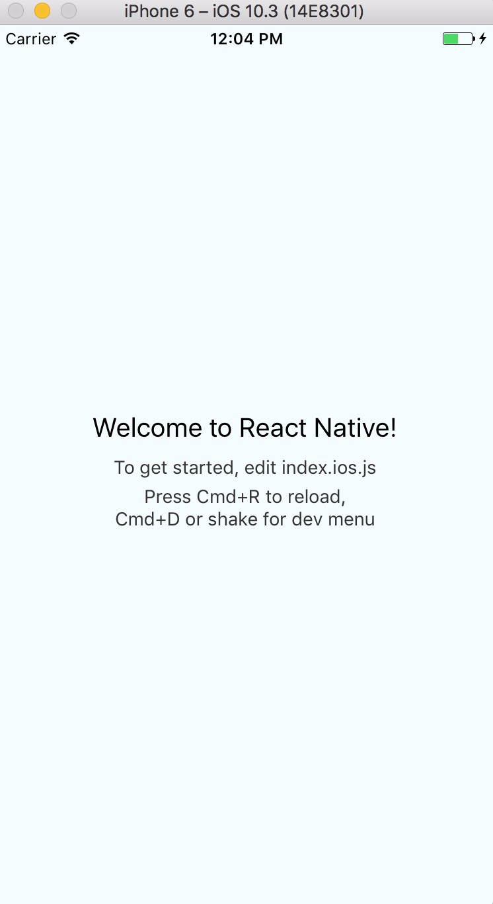
$ react-native
run-ios

Slide 24
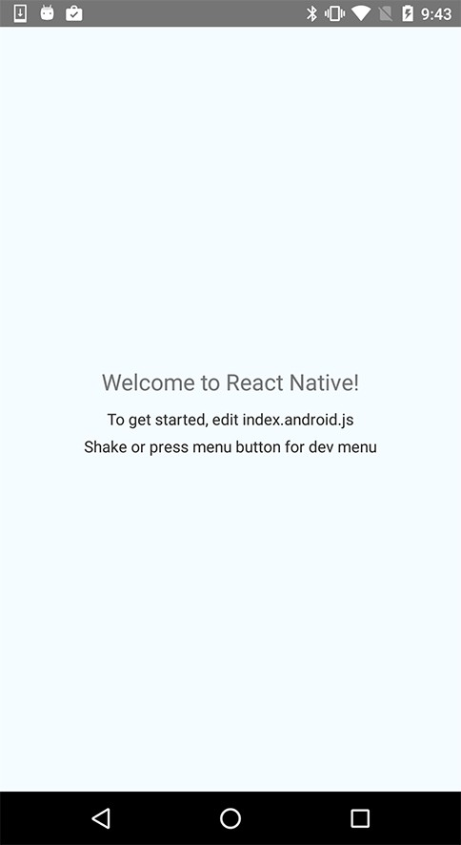
$ react-native
run-android

Slide 25
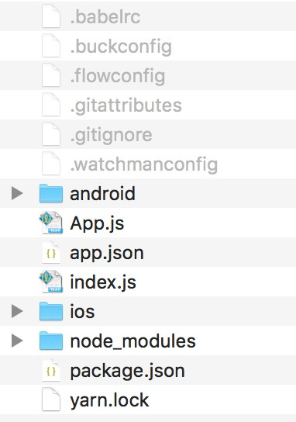
JavaScript ⟶ App.js, index.js
JavaScript Tools ⟶ Babel, Flow Libraries ⟶ Node, yarn Packager/Build ⟶ Buck, Watchman Native ⟶ Android, iOS
Other ⟶ Git

Slide 26
Setup React-Native Project using ESLint/Prettier/Flow

Slide 27
Style Layout With Flexbox

Slide 28
Demo

Slide 29
Questions…..

Slide 30
Thank You

