Slide 1
SEMINAR ON
LIGHT WEIGHT CONCRETE
Presented by-
ADIL IQBAL
REG:-D192001092
ROLL:-DASNCES6
NO:-10001381
COURSE:-PROFESSIONAL PRACTICE
PROGRAMME:-DIPLOMA IN CIVIL ENGINEERING
ACADEMIC SESSION:-2021-2022

Slide 2
CONTENTS
Introduction
Principle of LWC
Advantages
Disadvantages
Application
Properties of LWC
Methodology
Conclusion
Summary

Slide 3
INTRODUCTION:
Light weight concrete is a special concrete which weighs lighter than conventional concrete.
Density of this concrete is considerably low (300 kg/m3 to 1850 kg/m3) when compared to normal concrete (2200kg/m3 to 2600kg/m3).
Three types of LWC
Light weight aggregate concrete
Aerated concrete
No-fines concrete

Slide 4
PRINCIPLE BEHIND LWC
The basic principle behind the making of light weight concrete is by including the air in concrete.
To achieve the above principle practically, there are 3 different ways.
By replacing the conventional aggregates by cellular porous aggregates (Light weight agg. Concrete).
By incorporating the air or gas bubbles in concrete (Aerated concrete).
By omitting the sand from the concrete (No- fines concrete).

Slide 5
ADVANTAGES
Reduce the deal load of the building.
Easy to handle and hence reduces the cost of transportation and handling.
Improves the workability.
Relatively low thermal conductivity
Comparatively more durable
Good resistance to freezing & thawing action when compared to conventional concrete.

Slide 6
DISADVANTAGES
Very sensitive with water content in the mixture.
Difficult to place and finish because of porosity and angularity of the aggregate. In some mixes the cement mortar may separate the aggregate and float towards the surface.
Mixing time is longer than conventional concrete to assure proper mixing
Lightweight Concrete are porous and shows poor resistance.

Slide 7
APPLICATIONS
Since the strength of L.W.C is low, it is used in the construction of roof slabs, small houses with load bearing walls etc.
It is also used in the construction of stairs , windows, garden walls , etc.
In large buildings also, this is used in the construction of partition walls.
These are moulded in the form of slabs and used as thermal insulators inside the building.

Slide 8
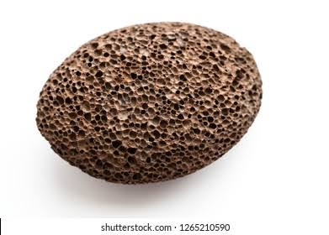
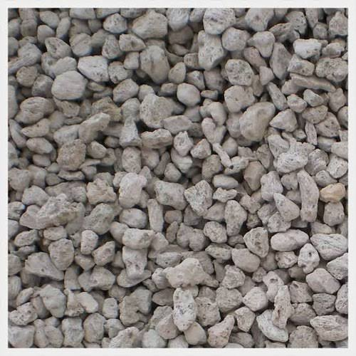
PROPERTIES OF LIGHT WEIGHT AGGREGATES
Pumice and scoria are volcanic rocks having densities between 500kg/m3 to 900kg/m3.
Natural aggregate have good insulating properties but subjected to high absorption and shrinkage.
PUMICE

Slide 9
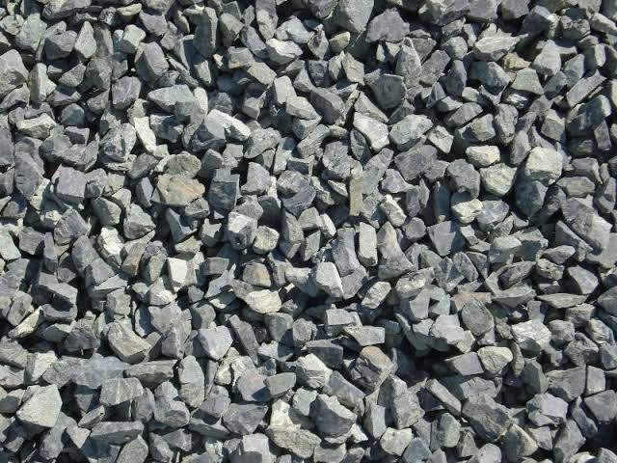
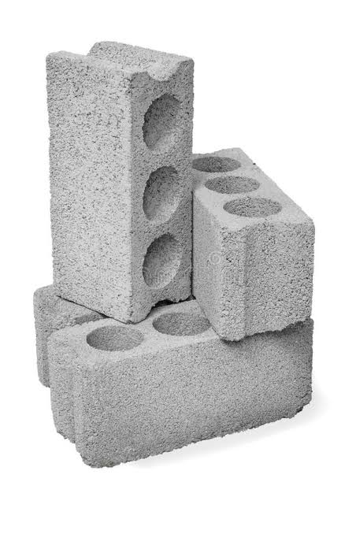
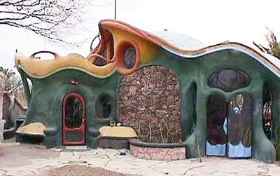

AGGREGATE
BLOCKS

Slide 10
METHODOLOGY
BATCHING
WEIGH BATCHING
MEASUREMENT OF WATER
PREPARATION OF CONCRETE CUBES
COMPACTING
CURING
TESTING

Slide 11
CONCLUSION
Compression strength value is compared to normal concrete and replacement of coarse aggregate by Pumice from different percentages (50%, 60%, 70%).
Maximum value of strength is obtained in 60% replacement by Pumice with coarse aggregate.
Concrete with 60% replacement of Pumice the compressive strength is comparable with normal concrete.
This type of concrete can be utilized in wall panels of non load bearing type for use in precast buildings.

Slide 12
SUMMARY
By using 60% of light weight aggregate as a partial replacement to NCA the compressive strength is promising.
The density of concrete is found to decrease with the increase in percentage replacement of natural aggregate pumice aggregate.
The compressive strength of concrete is found to increase with the decrease in pumice content.
With the addition of mineral admixtures, the compressive, split-tensile and flexural strengths of concrete are increased. Light weight aggregate is no way inferior to natural coarse aggregate and it can be used for construction purpose.

