Slide 1
A Seminar on “PASSIVE SOLAR BUILDING DESIGN”
AN ECONOMICAL FUTURE
Presented by-
VAIRAB MONDAL
REG:-D192001118
ROLL:-DASNCES6
NO:-10001407
COURSE:-PROFESSIONAL PRACTICE
PROGRAMME:-DIPLOMA IN CIVIL ENGINEERING
ACADEMIC SESSION:-2021-2022

Slide 2
CONTENTS
What Is “Passive Solar Building Design” ?
Why Passive ?
Basic Principles of Passive Solar Design
Passive Solar Heating
Passive Solar Cooling
Advantages of Passive Solar Design
Disadvantages of Passive Solar Design
Future Trends

Slide 3
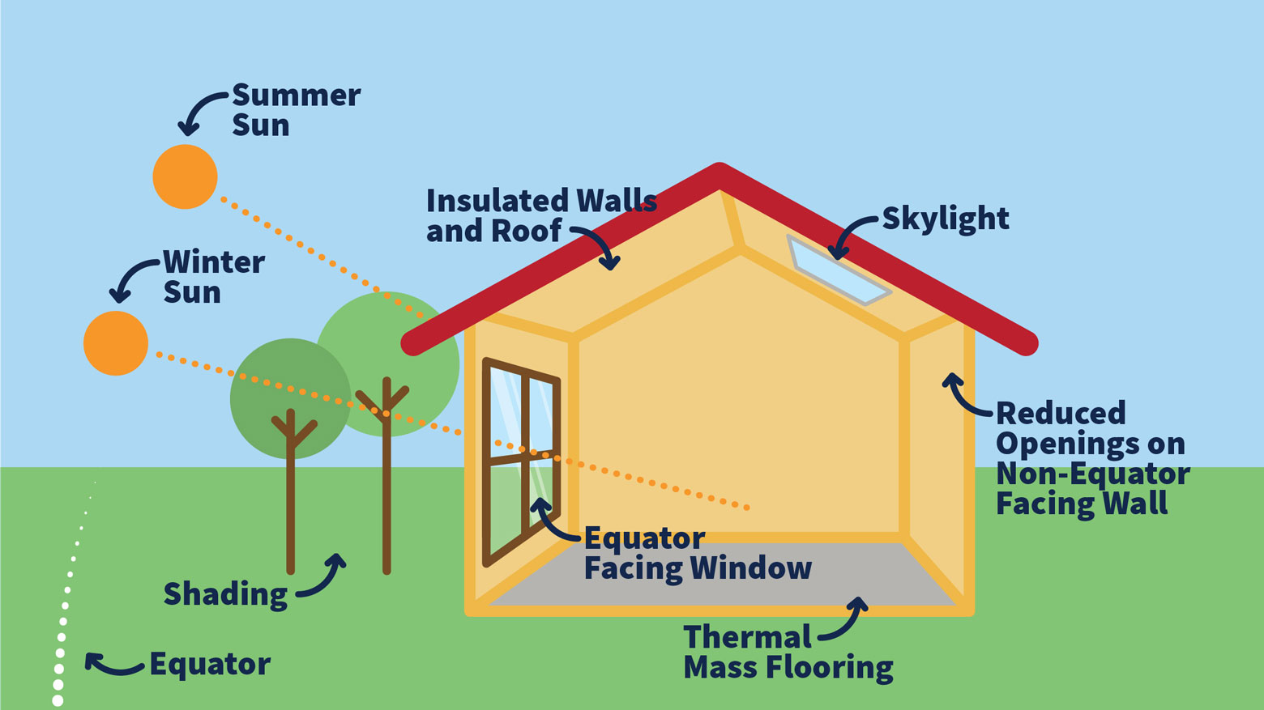
What Is “Passive Solar Design Building”?
“In PASSIVE SOLAR BUILDING DESIGN, windows, walls, and floors are made to collect, store, and distribute ‘SOLAR ENERGY’ in the form of heat in the winter and reject solar heat in the summer by means of conduction, convection and radiation.”

Slide 4
Why Passive?
Passive meets the minimum requirements.
Active produce the green house gases such as CO2.
Active Solar energy is expensive and more equipment are needed for installation.

Slide 5
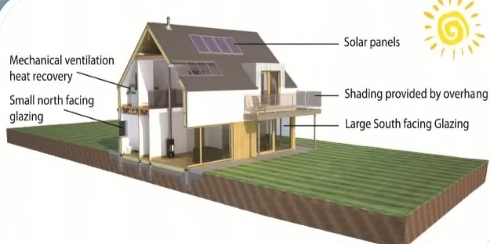
Basic Principles of Passive Solar Design
Generally, passive solar design makes use of the following elements:
Orientation
Over shading
Insulation
Ventilation
Building Layout
Glazing

Slide 6
PASSIVE SOLAR HEATING
Primary elements of passive solar heating are :
Thermal mass to absorb, store, and distribute heat.
South-facing windows are designed to let the sun’s heat in while insulating against the cold.
Open floor plans allow more sun inside.
There are 3 main methods of passive solar heating:
Direct Gain Method
Indirect Gain Method
Isolated Gain Method

Slide 7
PASSIVE SOLAR COOLING
The primary focus of passive cooling is:
Slow heat transfer into the house.
Remove unwanted heat from the building.
Various passive technologies that can be adopted in India are as follows:
Shading System
Ventilation
Thermal Mass
Evaporative Cooling System
Solar Chimney
Wind Towers

Slide 8
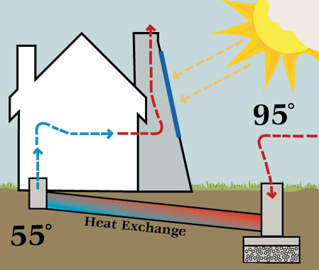
SOLAR CHIMNEY
Improve the ventilation using convection
Stack effect
Black-painted chimney, with a partly glazed surface area towards the top.
During the day, solar energy heats the chimney and the air within it, creating an updraft of air in the chimney.

Slide 9
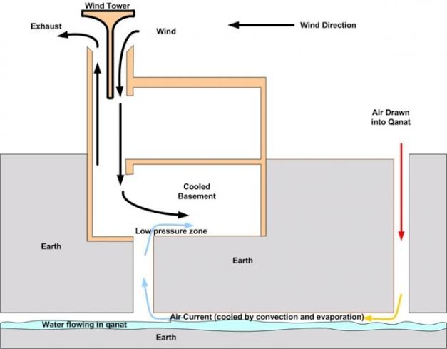
WIND TOWERS
In a wind tower, the hot air enters the tower through the openings in the tower, gets cooled, and thus becomes heavier and sinks down.

Slide 10
Advantages of Passive Solar Design
Eliminate heating and cooling costs
Reduce greenhouse gas emissions
Clean process
Renewable energy resource
Eco-friendly
Cost of installation is lower than active solar energy resources
Unwavering comfort

Slide 11
Disadvantages of Passive Solar Design
Great deal of work for the engineers to arrange this system.
All systems are not same.
Careful construction required.
Improperly designed not work well.
Sunshine not available all day.
Extra heat and the higher temperatures.
Thermal wall loses heat back to the out-of-doors through the glass.

Slide 12
FUTURE TRENDS
The design of passive solar buildings based on the materials are available today and will consistent for next several decades.
Many obstacles due to over exploitation of non-renewable resources may be eradicated by using this energy.

