Slide 1
Structures

Slide 2
Why Use Structures
We have seen earlier how ordinary variables can hold one piece of information and how arrays can hold a number of pieces of information of the same data type.
These two data types can handle a great variety of situations. But quite often we deal with entities that are collection of dissimilar data types.
For example, suppose you want to store data about a book. You might want to store
  its name (a string),
  its price (a float) and
  number of pages in it (an int).
  If data about say 3 such books is to be stored, then we can follow two approaches:
(a) Construct individual arrays, one for storing names, another for storing prices and still another for storing number of pages.
(b) Use a structure variable.

Slide 3
What is a Structure?
Arrays allow to define type of variables that can hold several data items of the same kind.
Similarly structure is another user defined data type available in C that allows to combine data items of different kinds.
Structure is a collection of different types of variables under single name.
It is a convenient tool for handling a group of logically related data items.
– Examples:
• Student name, roll number and marks.

Slide 4
Defining a Structure
To define a structure, you must use the struct statement. The struct statement defines a new data type, with more than one member.
The format of the struct statement is as follows −
– struct is the required keyword.
– tag is the name of the structure.
– member 1, member 2, … are individual member declarations.
struct tag_name {
data _type member 1;
data _type member 2;
:
data _type member m;
};

Slide 5
Contd.
The individual structure elements (logically related data items) are called members.
The individual members can be ordinary variables, pointers, arrays, or other structures.
– The member names within a particular structure must be distinct from one another.
– A member name can be the same as the name of a variable defined outside of the structure.

Slide 6
Defining a structure
A structure definition:
This structure is named account (i.e., the tag is account).
It contains four members: an integer quantity (acct_no), a single character (acct_type), an 80-element character array (name [80]),and a floating-point quantity (balance).
struct account {
int acct_no;
char acct_type;
char name[80];
float balance;
};

Slide 7
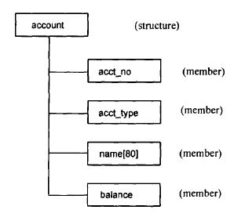
Defining a structure
Note- The above definition has not declared any variables. It simply describes a format called template to represent information.

Slide 8
Declaring structure variable
Once a structure has been defined, the individual structure-type variables can be declared as:
Example:
A new data-type
It declares a1, a2, a3 as variables of type struct account.
Each one these variables has four members as specified by the template.
struct tag_name var_1, var_2, …, var_n;
struct account a1, a2, a3;

Slide 9
A Compact Form
It is possible to combine the declaration of the structure with that of the structure variables:
In this form, “tag” is optional.
struct tag {
member 1;
member 2;
:
member m;
} var_1, var_2,…, var_n;

Slide 10
Equivalent Declarations
struct student {
char name[30];
int roll_number;
int total_marks;
char dob[10];
} a1, a2, a3;
struct {
char name[30];
int roll_number;
int total_marks;
char dob[10];
} a1, a2, a3;

Slide 11
Structure variable Declarations
struct Student { int id; char name[32]; }; struct Student S1,S2,S3; | struct Student { int id; char name[32]; }S1,S2,S3; | struct { int id; char name[32]; }S1,S2,S3;

Slide 12
Important Points
Note- The members of structure themselves are not variables. They do not occupy any memory until they are associated with the structure variables.
When the compiler come across structure variable declaration statement, it reserves memory space for structure variables.

Slide 13
Structure variable Declarations
struct Student {
int id;
char name[32];
}; // until now no memory allocation
struct student S1,S2,S3; /*now memory is reserved for variables*/

Slide 14
Structure Initialization
C language does not permit initialization of individual structure members within the template.
struct Point
{
int x = 0; // COMPILER ERROR: cannot initialize members here
int y = 0; // COMPILER ERROR: cannot initialize members here
};
The initialization must be done only in the declaration of structure variables.
Like primary variables and arrays, structure variables can also be initialized where they are declared. The format used is quite similar to that used to initiate arrays.
struct student
{
char name[20];
int roll;
float marks;
} std1 = { "Pritesh",67,78.3 };

Slide 15
Structure Initialization
struct student
{
char name[20];
int roll;
float marks;
} std1 = { "Pritesh",67,78.3 };
The order of values enclosed in braces must match the order of members in structure definition.

Slide 16
Structure Initialization
Declaring and Initializing Multiple Variables
struct book
{
char name[10] ;
float price ;
int pages ;
} ;
struct book b1 = { "Basic", 130.00, 550 } ;
struct book b2 = { "Physics", 150.80, 800 } ;
There is one-to-one correspondence between the members and their initializing values.

Slide 17
Structure Initialization
Initializing inside main
struct student
{
int mark1;
int mark2;
int mark3;
};
void main()
{
struct student s1 = {89,54,65};
- - - - --
- - - - --
};

Slide 18
Structure Initialization
Partial Initialization
struct student
{
int mark1;
int mark2;
int mark3;
} sub1={67};
Though there are three members of structure, only one is initialized , Then remaining two members are initialized with Zero.
The uninitialized members should be only at the end of the list.
Data Type | Default value if not initialized
integer | 0
float | 0.00
char and string | ‘\0’

Slide 19
Accessing Structure Members
The members of a structure are processed individually, as separate entities.
To access any member of a structure, we use the member access operator ‘.’ or also known as ‘dot operator’
A structure member can be accessed by writing
StructureVariable.member
where StructureVariable refers to the name of a structure-type variable, and member refers to the name of a member within the structure.

Slide 20
Accessing Structure Members
Example:
struct Student
{
int id;
char name[32];
}S1,S2,S3;
S1.id=1234;
S1.name= “C Programming”;
scanf (“%d %s”, &S2.id, S2.name);

Slide 21
Example
struct Point
{
int x, y;
}; // structure template or definition
int main()
{
struct Point p1; // structure variable declaration
p1.x = 20; // Accesing members of point p1
p1.y= 1;
printf ("x = %d, y = %d", p1.x, p1.y);
return 0;
}

Slide 22
Example: Complex number addition
#include <stdio.h>
void main()
{
struct complex
{
float real;
float cmplex;
} a, b, c;
scanf (“%f %f”, &a.real, &a.cmplex);
scanf (“%f %f”, &b.real, &b.cmplex);
c.real = a.real + b.real;
c.cmplex = a.cmplex + b.cmplex;
printf (“\n %f + %f ”, c.real, c.cmplex);
}

Slide 23
Structure within Structure : Nested Structure
Structure written inside another structure is called as nesting of two structures.
Nested Structures are allowed in C Programming Language.
We can write one structure inside another structure as member of another structure.

Slide 24
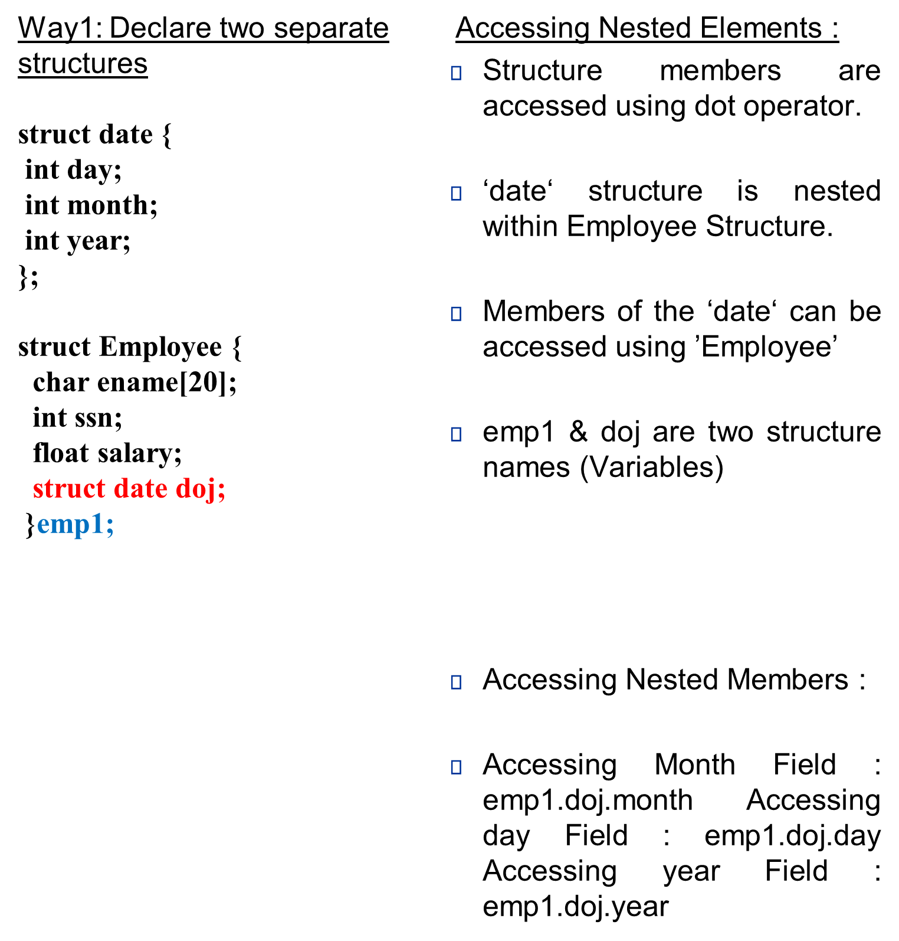
Structure within Structure : Nested Structure

Slide 25
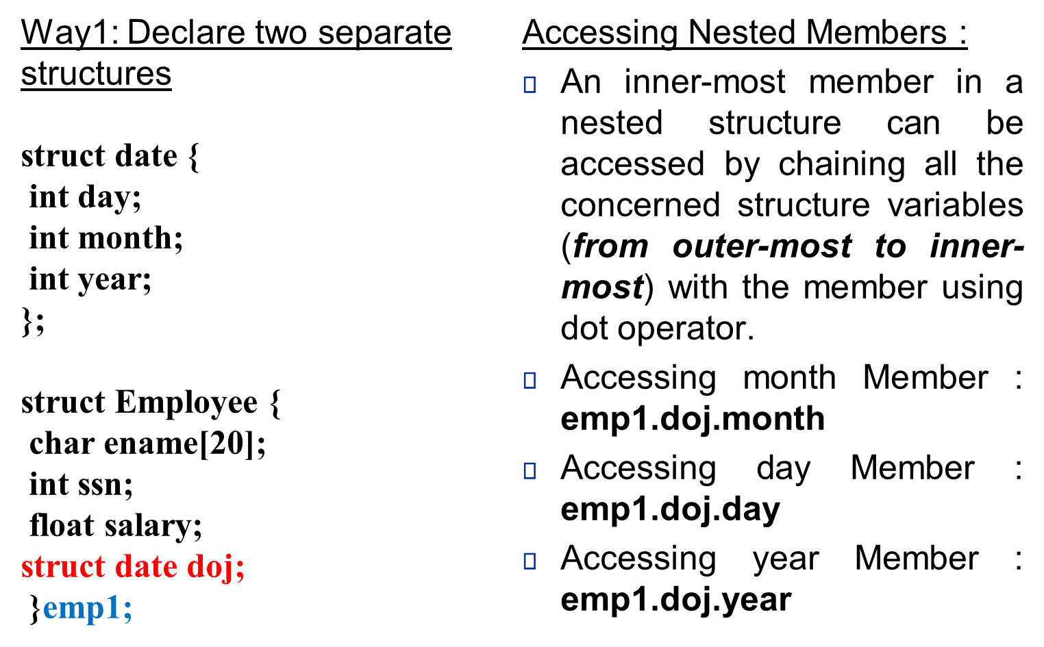
Structure within Structure : Nested Structure

Slide 26
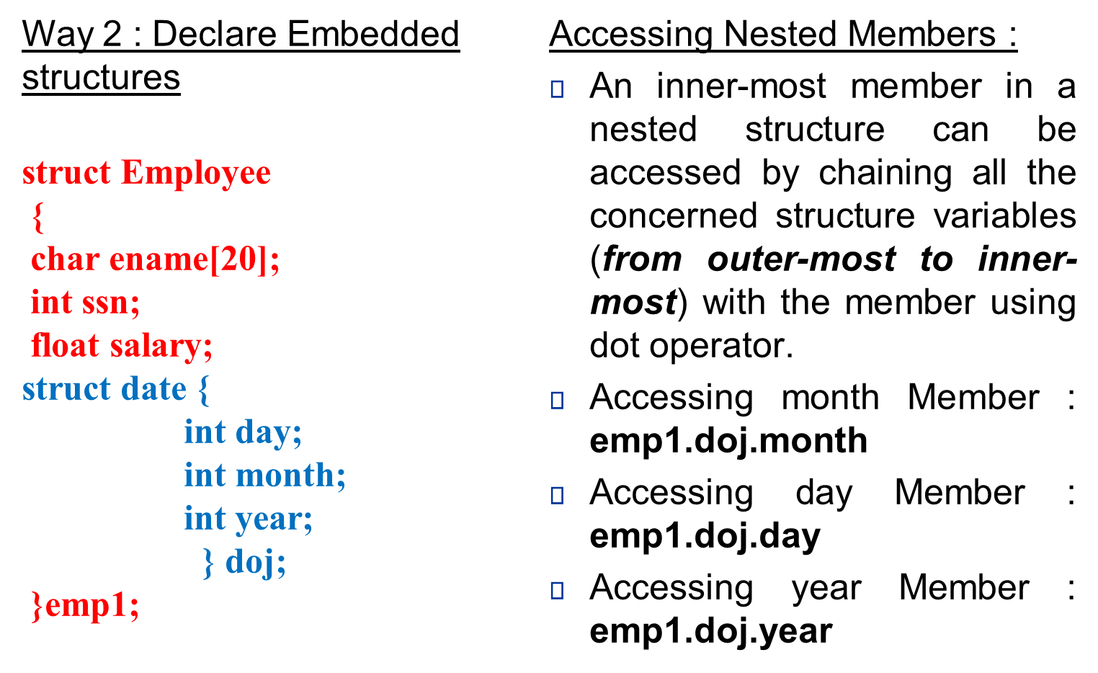
Structure within Structure : Nested Structure

Slide 27
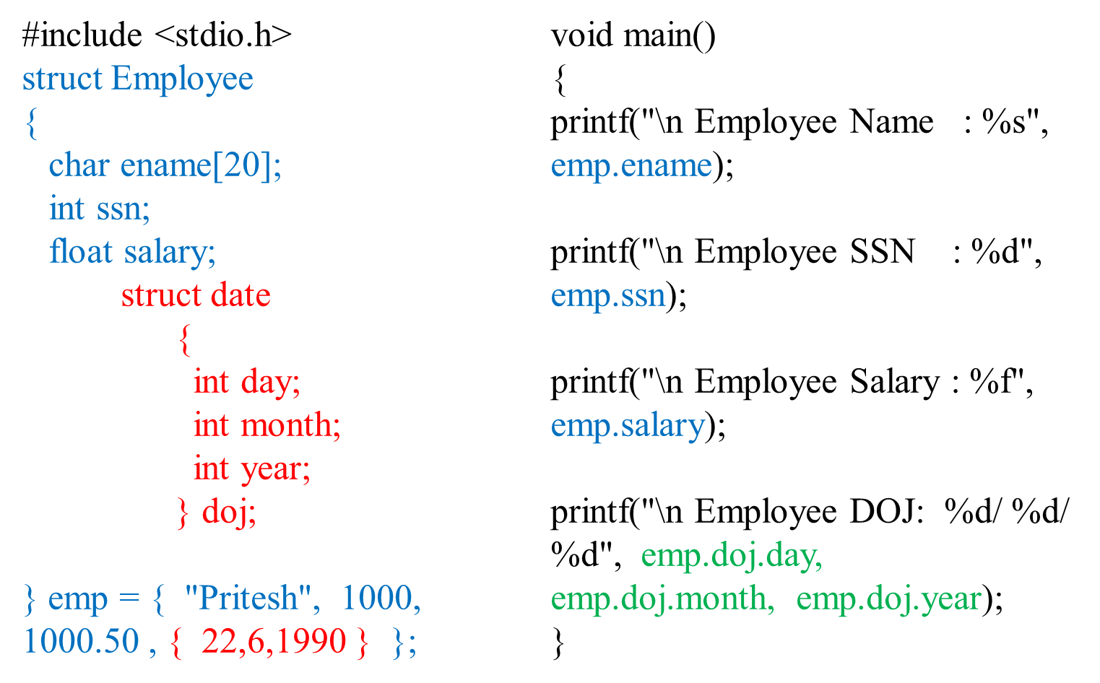
Nested Structure: Example

Slide 28
Arrays of Structures
Structure is used to store the information of one particular object but if we need to store such 100 objects then Array of Structure is used.
Each element of the array represents a structure variable
Once a structure has been defined, we can declare an array of structures.
struct student
{
char name[20];
int roll;
float marks;
};

Slide 29
Arrays of Structures
struct student class[50];
defines an array called class that consists of 50 elements. Each element is of type struct student.
Each element has three members.
– The individual members can be accessed as:
class[0].name
class[0].roll
class[0].marks
………..
class[49].name
class[49].roll
class[49].marks

Slide 30
Example
struct Point
{
int x, y;
};
void main()
{
struct Point arr[10]; // Create an array of structures
arr[0].x = 10; // Access array members
arr[0].y = 20;
printf("%d %d", arr[0].x, arr[0].y);
}

