Slide 1
Parallel Processing
Chris Skane

Slide 2

What is it?
Processing
in parallel

Slide 3
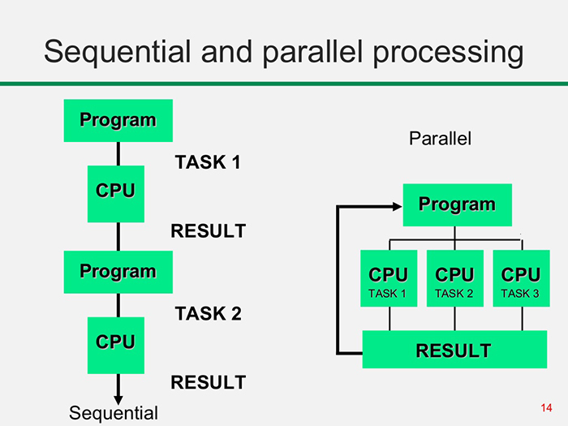

Diagram
http://www.itrelease.com/2017/11/difference-serial-parallel-processing/

Slide 4
How?
GPGPU (General-Purpose GPU)
  OpenCL (Open Computing Language)
  CUDA (Compute Unified Device Architecture)
Hybrid
  OpenMP (Open Multi-processing)
CPU
  Pthreads (POSIX Threads)

Slide 5
Demo/Live code

Slide 6
Collatz conjecture
3n + 1 problem/conjecture
Ulam conjecture (after Stanisław Ulam)
Kakutani's problem (after Shizuo Kakutani)
Thwaites conjecture (after Sir Bryan Thwaites)
Hasse's algorithm (after Helmut Hasse)
Syracuse problem
Hailstone sequence

Slide 7
Collatz conjecture
No matter what value of n, the sequence will always reach 1.
Start with some n > 1
  If n is even, next term = n/2
  If n is odd, next term = 3n + 1
The sequence on numbers will be called a chain

Slide 8
Collatz conjecture demo
Find the longest chain under some maximum integer M
M = 64*2^{n}, n = 0...22
Why 22?
  Max power of 64 without multiple GPU batches

Slide 9
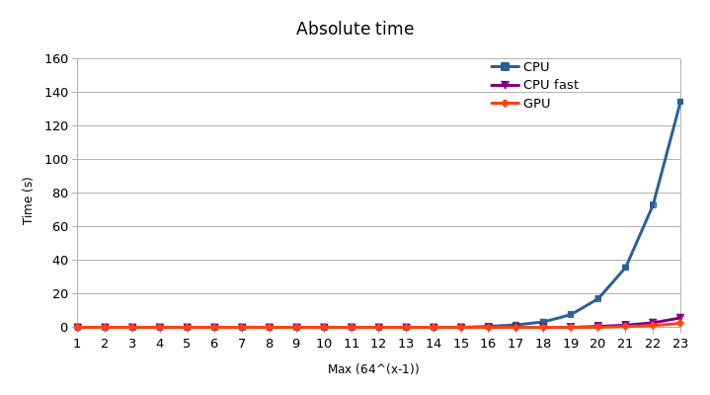
Results 1

Slide 10
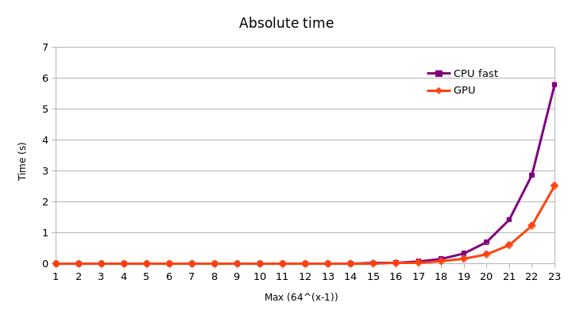
Results 2

Slide 11
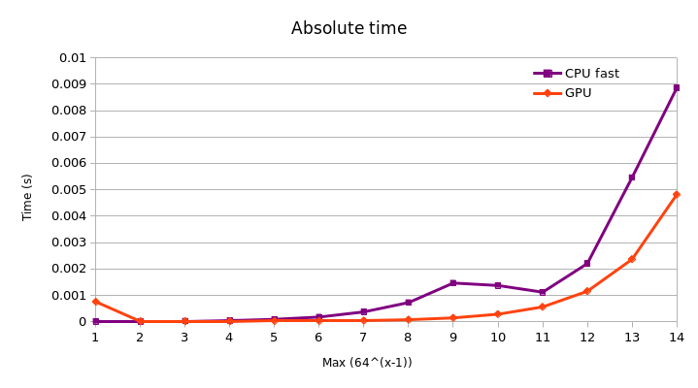
Results 3

Slide 12
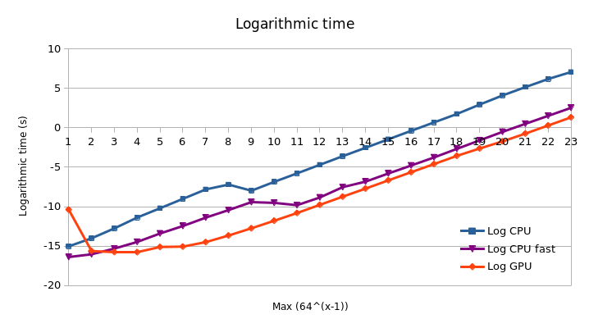
Results 4

Slide 13
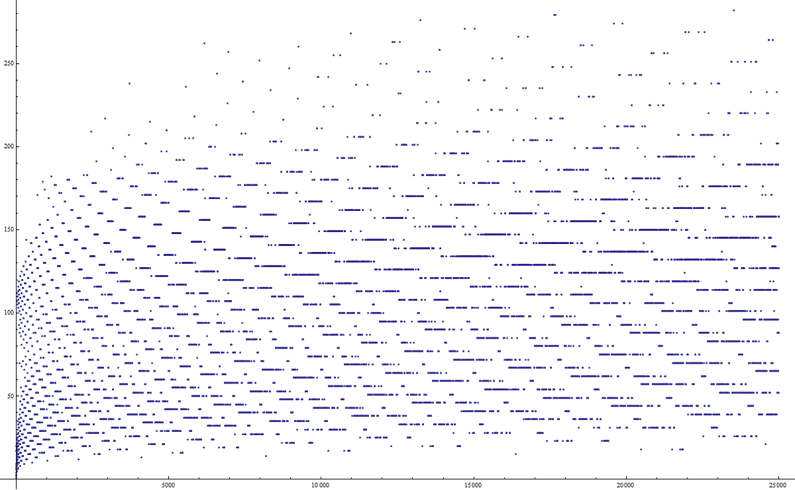
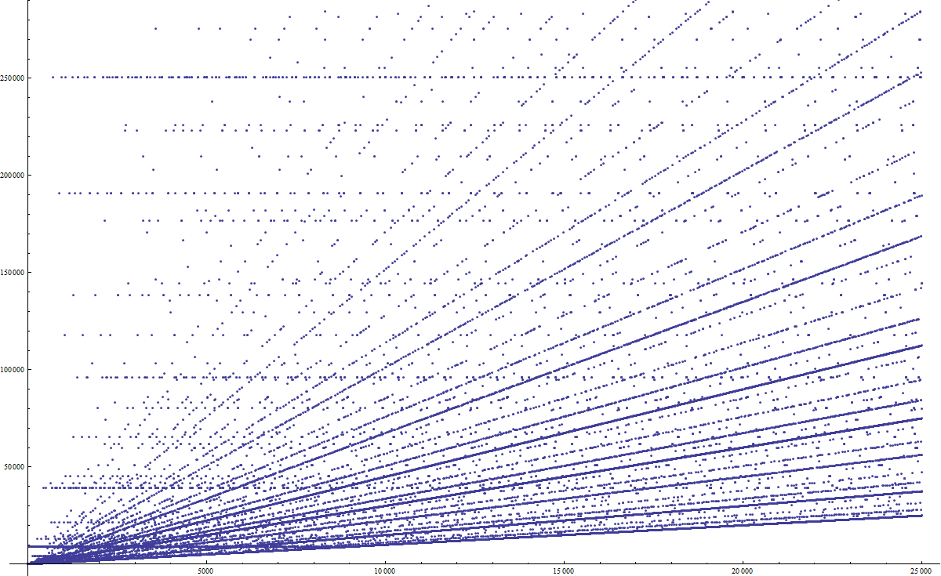
Pictures related to demo
https://www.reddit.com/r/math/comments/28suxb/collatz_conjecture_graphs_and_stuff/

Slide 14
When to use it
The task at hand can be meaningfully divided into sub-tasks
The processes of all tasks are disjoint, i.e they are independent of one another

Slide 15
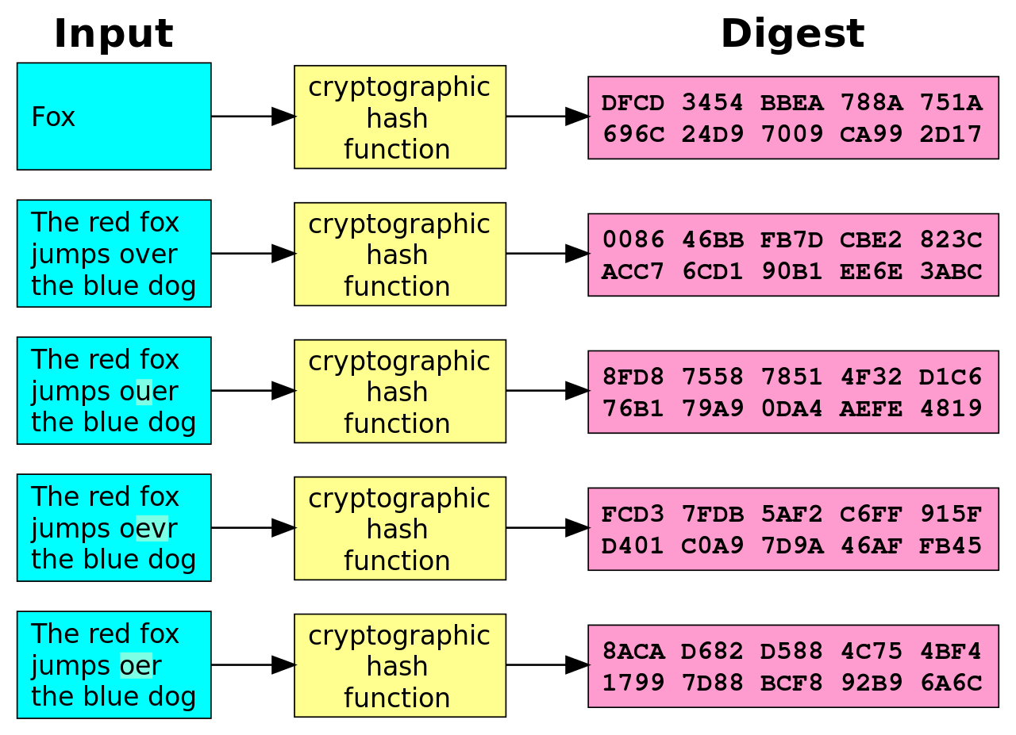
Example 1
Brute-force password hashing

Slide 16
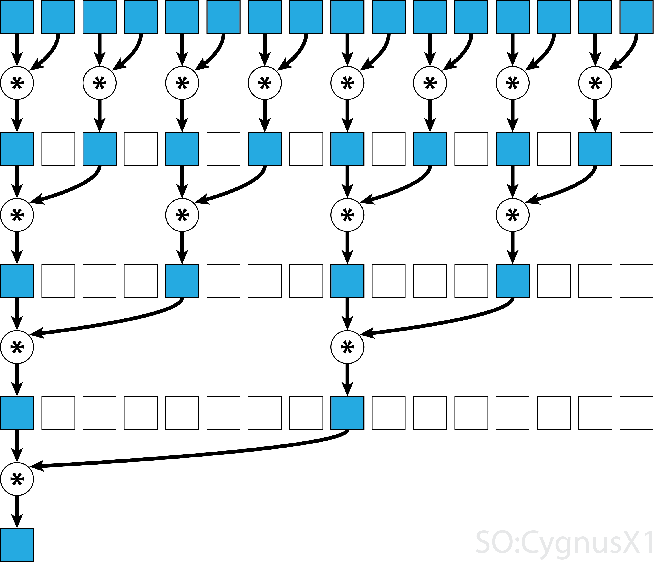
Example 2
Multiply 16 numbers
Extra overhead
Still sequential dependencies

Slide 17
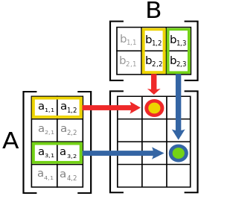
Example 3
Every cell can be calculated independently
Only initial resources shared

