Slide 1
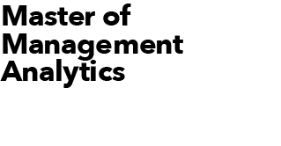
Datathon 2022
Assemble a new hockey team for the NWHL
June 17, 2022 Prepared by Team Lavender
(Ojaswita Kalra, Manas Joshi, Elaheh Dehghan, Jad Krisht)

Slide 2
Problem Statement
Dataset Characteristics
Building a proficient hockey team of five members from analysing all players’ performance in all year round games. Players are to be chosen from the NWHL teams. Three excellent goal scorers and at least two should be excellent passers. In addition, at least two faceoff specialists and one takeaway specialist need to be selected.
Dataset used comprises of events by NWHL teams from Jan 23,2021 to Feb 1,2021 .There are 126 players and 6 teams in total from which 5 need to be selected. There were total 76 goals scored.

Slide 3
Methodology
Player selected for goal ranking and takeaway ranking
For excellent goal scorers, goal proportion to find out the number of shots converted to goals by each player.
Select Faceoff Specialist based on total Faceoff wins and face off losses
Feature Dependence(Using Random Forest Recursive Feature Elimination RF-RFE) based on ranking and Modelling.
On the basis of 'Goals' or 'Net' or 'pass_and_shot_onnet' or 'Takeaway' or 'Puck_Recovery' and excluding 'Missed' or 'Fanned' or 'Game_Misconduct' or 'Unsportsmanlike_conduct' do initial selection of players
For excellent passing expert, pass proportion was calculated to find out the successful passes by each player.
A cumulative ranking algo for each player is used, highest weightage was given to the rankings based on goals scored(40%) followed by passing ranks(30%) followed by the takeaway(15%) and face off(15%) ranks.
Original Data Set
Select takeaway specialist using ranks based on their total takeaways in the matches.
Player not selected for goal ranking and takeaway ranking.

Slide 4
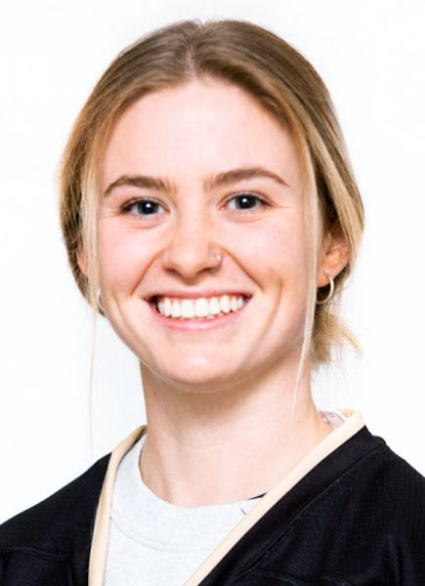
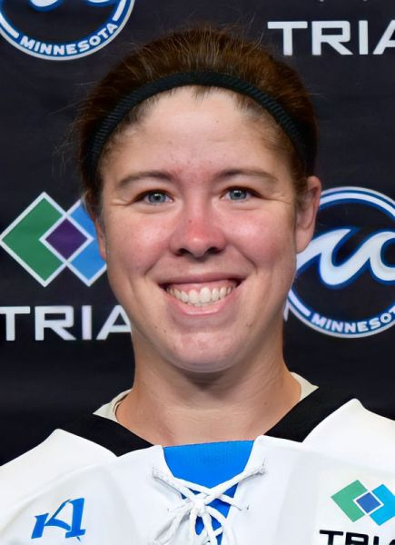
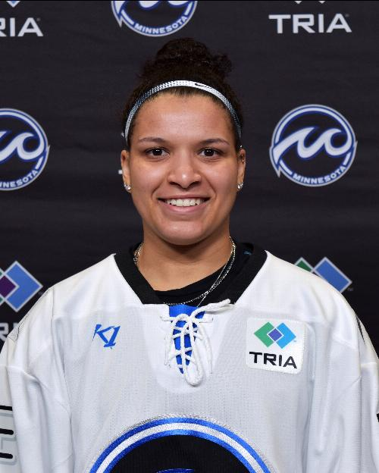
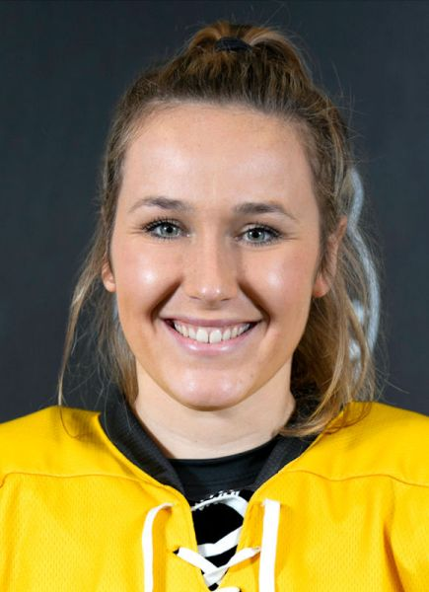
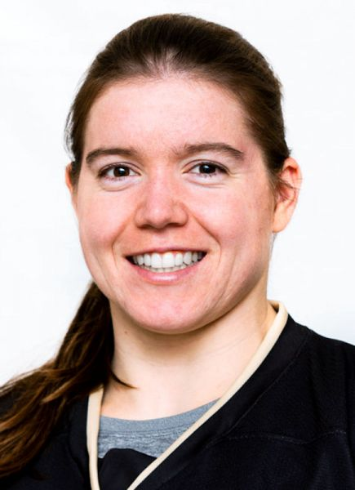



Top Five Players
Amy Curlew
Faceoff and Pass specialist
Meaghan Pezon
Takeaway and Pass specialist
Nina Rodgers
Goal and Takeaway specialist
Mckenna Brand
Play, Faceoff, Takeaway and Goal specialist
Taylor Woods
Excellent Passer, Takeaway and Goal Specialist
Goal | Goal | Goal | Goal | Goal
Passes | Passes | Passes | Passes | Passes
Faceoff Win | Faceoff Win | Faceoff Win | Faceoff Win | Faceoff Win
Takeaway | Takeaway | Takeaway | Takeaway | Takeaway
Toronto Six | Minnesota Whitecaps | Minnesota Whitecaps | Boston Pride | Toronto Six
**Highlighted cells represent good track record of completing passes to goal scorers.

Slide 5
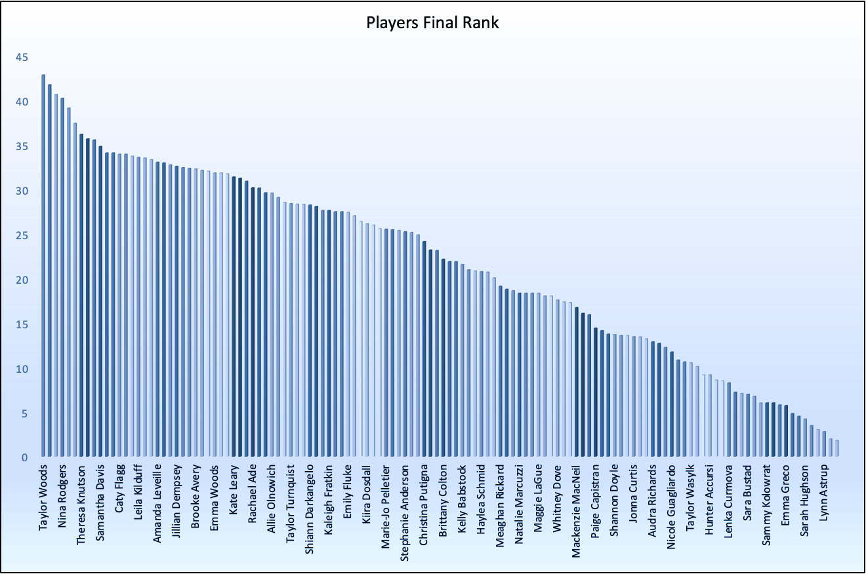
Final Ranking
Top 5 Players
Taylor Woods
Meaghan Pezon
Amy Curlew
Taylor Woods | 42.8
Meaghan Pezon | 41.7
Amy Curlew | 40.6
Nina Rodgers | 40.2
McKenna Brand | 39.1
Nina Rodgers
McKenna Brand
A cumulative ranking algorithm for each player is used in which highest weightage was given to the rankings based on:
Goals scored : 40%
Passing ranks : 30%
Takeaway : 15%
Face off : 15%

Slide 6
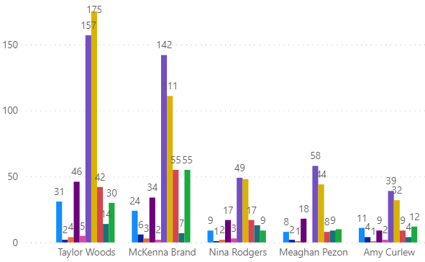
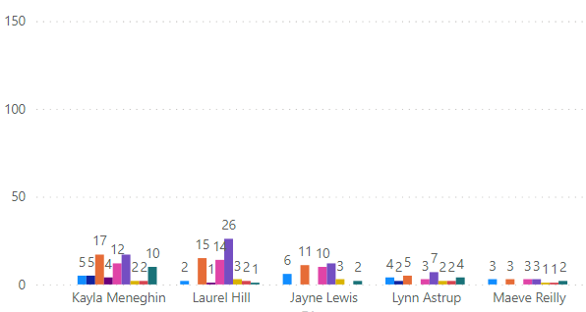
Best vs. Worst Players (Ranking Higher the better)
Comparison of the greatest and worst players in terms of event performance
Highest rank players
Lowest Rank players
Taylor Woods
McKenna Brand
Laura Hill
Kyla Meneghin
Nina Rodgers
Meaghan Pezon
Frequency
Frequency
Amy Curlew
Jayne Lewis
Maeve Reilly
Kayla
Meneghin
Laurel
Hill
Jayne Lewis
Lynn Astrup
Lynn Astrup
Maeve
Reilly
Players
Players

Slide 7
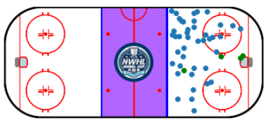
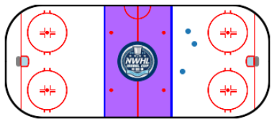
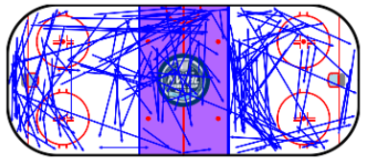
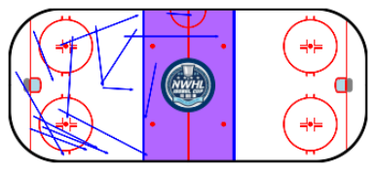
Highest Rank vs Lowest Rank player performance comparison
Taylor Woods (Selected)
Here we do a comparison between the two player Taylor woods (Selected) and Laurel Hills(Not Selected) based on our ranking algorithm.
We can see that the number of goals as well as the number of shots made by Taylor woods is significantly higher than Laurel hills.
The reach of Taylor woods on field in the upper and lower half is significantly higher than Laurel hills.
The ranking algorithm was able to recommend a very good player for selection.
Laurel Hills (Not selected)
Plays, shots (blue dots) and goals (green dots) of Taylor Woods (Selected) on the
rink
Plays, shots (blue dots) and goals (green dots) of Laurel Hill (Not selected) on the rink

Slide 8
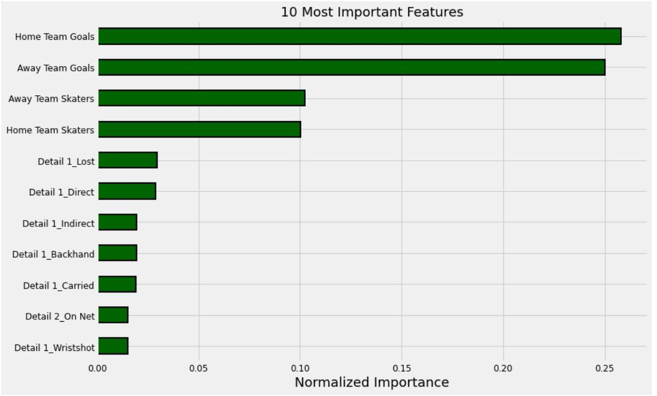
Feature Importances
Top ten most important features that were used for selecting a player.
We used Random forest recursive feature elimination (RF-RFE) to recursively find out the most important features for selection of a particular player.
Using cumulative feature importance we were able to find out that these ten features required for 95% of cumulative importance.

Slide 9
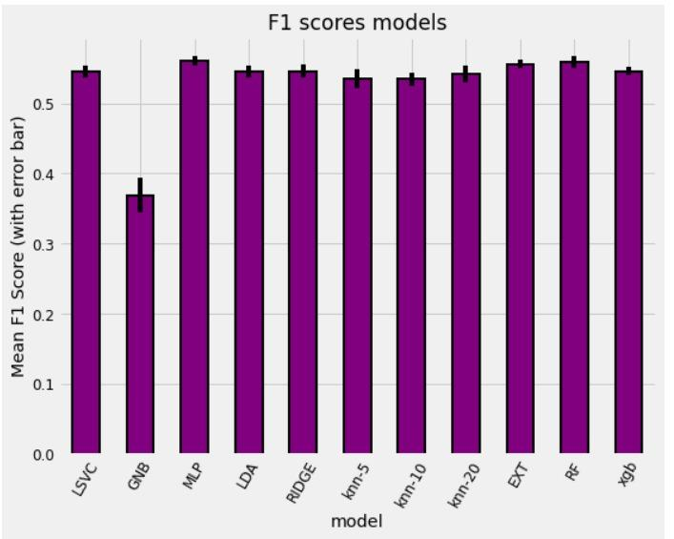
ML Modelling and its business use-case
The ML models were trained on binary labels target label 0/1 on basis of rank>threshold_rank.
The ML models were trained so that:
If we are dealing with an even larger dataset for example dataset from multiple NWHL seasons we can use these models as initial sort to select players on whom we can apply further analytics and select top five.
We got F1 score of about 56% and accuracy of 67% on test dataset (unseen dataset), this can further be improved with DNN.
We set threshold_rank for labelling to be 26.0 since this gave us balanced data distribution

Slide 10
Thank You

Slide 11
Appendix and Citations
F1 score : The F1-score combines the precision and recall of a classifier into a single metric by taking their harmonic mean. It is primarily used to compare the performance of two classifiers.
Random Forest Recursive Feature Elimination (RF-RFE) : This is a popular feature selection algorithm. RF-RFE is popular because it is easy to configure and use and because it is effective at selecting those features (columns) in a training dataset that are more or most relevant in predicting the target variable. (https://arxiv.org/abs/1310.5726) (https://machinelearningmastery.com/rfe-feature-selection-in-python/)
Hockey Rink : A Python library for plotting hockey rinks with Matplotlib.
Github link: https://github.com/coderXcode/MMADatathon2022

