Slide 1
TUBESENSE
SUBMISSION · 4 TRACKS
ENCODE LONDON 2026 · SOLO BUILD
Trains located between stations from ordinary phone rides, and a cited evidence pack. No GPS. Every claim checked. A human signs.
Tobi Ojebiyi · github.com/coderback
Notes:
Opener. Keep it to one breath: Tubesense turns ordinary London Underground rides, recorded on a phone, into a section-by-section noise map, without GPS, and drafts a cited evidence pack that a human approves. Numbers are the repo on 25 Oct 2026.

Slide 2
87 dB
01 · THE PROBLEM
83 dB
Bethnal Green → Mile End, same TfL measurement
85 dB(A)
HSE upper exposure action value, for reference
TfL’s own in-cab LAeq, Liverpool Street → Bethnal Green, Central line eastbound.
92.8 dB
Reported in the press, Jan 2026. Primary source not located
Measured 24 June 2024, released under FOI-1231-2425.
Sources: TfL FOI-1231-2425 · Brixton Buzz, 27 Jan 2026 (secondary)
02
Notes:
Open on TfL’s own number, not the press one. 87 dB is TfL’s in-cab LAeq on Liverpool Street to Bethnal Green, June 2024, FOI-1231-2425. 92.8 is a press report: always say “reported”, never “TfL data”. The 85 dB(A) line is the HSE upper exposure action value, shown for scale only; a section LAeq is not a daily personal exposure. Tubesense is not a safety system or a hearing-loss claim.

Slide 3
TFL: CORRUGATION COMES BACK AFTER GRINDING
02 · WHY IT KEEPS COMING BACK
Dec 2021 – May 2022
Every 6–12 months
16 Jul 2026
Both sections were ground for noise (direction not stated).
TfL says grinding must be repeated, “usually 6 months – a year”.
TfL turned down most of Elly Baker AM’s data requests.
Mayor’s Question 2022/1791
TfL Tube Noise presentation, 6 Dec 2022
Mayor’s Question Time 2026/2156
Schematic, not to scale: corrugation = periodic ripples worn into the rail head
03
Notes:
The main cause is rail corrugation: ripples worn into the rail head. Grinding removes them, but they return; TfL itself says grinding is usually repeated every 6 months to a year. Both our sections were ground Dec 2021 to May 2022. The gap: nobody outside TfL can check whether the noise has come back, because section-level data is not published. Note: Tubesense does not measure corrugation. Our frequency-over-speed test failed (the roar peaks are fixed resonances). The only corrugation evidence we hold is TfL’s own 2018 roughness plots, read by Argon and pending a human check.

Slide 4
ELLY BAKER AM
03 · WHO IT’S FOR
WHAT SHE NEEDS
1
Phone measurements placed between stations, without GPS
Labour transport spokesperson · Deputy Chair, London Assembly Transport Committee
2
A cited pack that says what the record does and does not show
At Mayor’s Question Time on 16 July 2026 she said TfL had turned down most of her requests for noise data, and plans grinding only eight weeks ahead.
3
The precise information requests to make next
Ultimately for those exposed longest: train drivers and their unions (RMT, ASLEF) · MQT 2026/2156
04
Notes:
Named user: Elly Baker AM. This is paraphrased from Mayor’s Question 2026/2156, not a direct quote. Backups if asked: Hina Bokhari AM, Andrew Boff AM, Caroline Russell AM (Transport Committee chair), RMT and ASLEF reps. TfL’s own figures are measured in the cab, so drivers are the people most exposed.

Slide 5
ONE RIDE IN, A SIGNED DRAFT OUT
04 · HOW IT WORKS
01
02
03
04
05
06
RIDE
CLEAN
LOCATE
MEASURE
INVESTIGATE
APPROVE
A phone on a seat: accelerometer, gyro, magnetometer, barometer, audio.
Sync, pauses, a phone on the floor, split runs: flagged from the data.
Curve signatures place the train between stations. No GPS.
1-second A-weighted levels and bands. Raw audio never leaves the laptop.
Gemini 4 Argon reads TfL and Assembly records from MongoDB Atlas.
Code checks every quote and number. A human signs the draft.
Sensing 01–04 runs locally · Agent 05–06: Gemini 4 Argon + MongoDB Atlas
05
Notes:
Six steps. The first four are sensing and run on the laptop: ingest phyphox and Voice Memos, sync with the knock, detect messy inputs, locate the train with the gyro, compute 1-second A-weighted levels. The last two are the agent: Argon reasons over TfL’s own records stored in Atlas, then a deterministic verifier and a human gate everything that goes out.

Slide 6
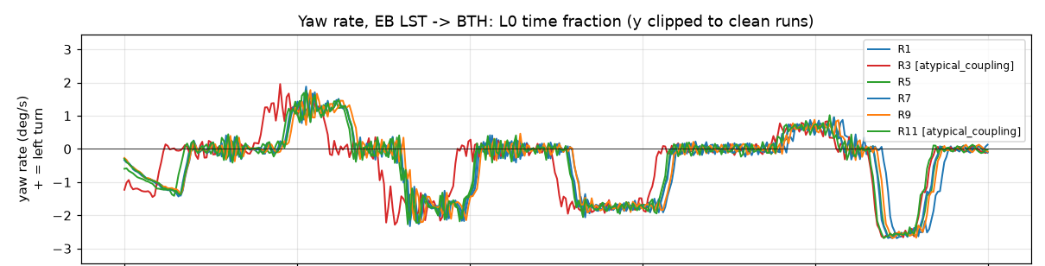
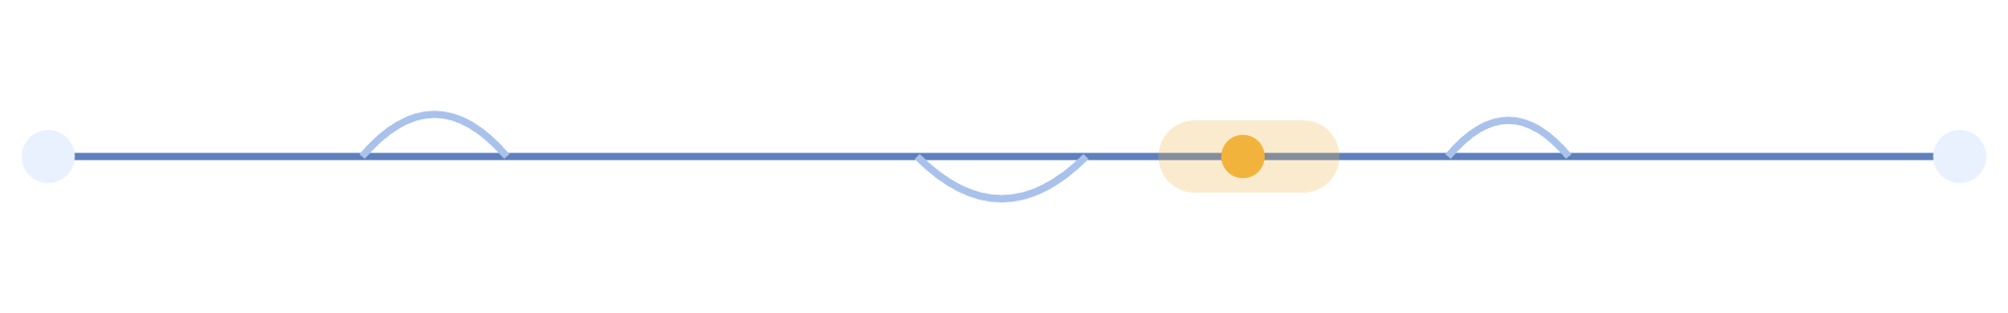
EVERY CURVE IS A FINGERPRINT
05 · FINDING THE TRAIN WITHOUT GPS
REAL DATA, 6 RIDES
Gyro yaw rate along Liverpool St → Bethnal Green. The same curves arrive in the same order on every ride: that repeat is the fingerprint the tracker matches.
r 0.76–0.99
DTW
Gyro wins
Gyro yaw traces of the same section, ride to ride (Central, 23 Oct). Different sections: 0.20.
Matches a new ride to a map of earlier rides in distance, not time, between two stops.
Ablation: the magnetometer adds nothing to positioning (NO-GO as a fingerprint).
Real data: outputs/gonogo/gyro_EB_LST-BTH.png · outputs/FINDINGS.md (a), (b), (e)
06
Notes:
Each curve twists the phone the same way on every ride, so the gyroscope’s yaw rate is the most position-locked signal. Same-section correlation 0.76 to 0.99 against 0.20 for different sections. We match a new ride to a map of earlier rides with dynamic time warping in the distance domain, forcing speed to zero at both stops. The magnetometer was tested and does not help; we did not establish why (train-to-train differences and traction current are candidates). Prior art: Royal Holloway 2019 did station-level ID; we go between stations.

Slide 7
METRES, NOT STATIONS
06 · RESULTS SO FAR
median error
Tubesense
Timetable guess
New rides, frozen maps (pre-registered, 24 Oct, Liverpool St ⇄ Bethnal Green)
1.95 m
96%
8.2 m
Live tracker, held-out rides (23 Oct)
of the time the truth sat inside the tracker’s 90% band on new rides.
2.2 m
11.2 m
Between curves only (the hard part)
11 m
16 m
Error = agreement with curve-edge landmarks matched across rides; there is no GPS truth in a tunnel
07
Notes:
Headline: the pre-registered forward test. Maps frozen on 23 Oct, tracked on brand-new 24 Oct Central line rides: median 1.95 m on Liverpool Street to Bethnal Green against 8.2 m for a timetable guess, with 90% band coverage 0.96 over 6 sections. Live tracker, leave-one-run-out on 23 Oct: 2.2 m vs 11.2 m. Be upfront: between curves, with the gyro hidden, it is barely better than the timetable, 11 vs 16 m. Bars are drawn to scale, 60 px per metre.

Slide 8
WE PUBLISH THE NO-GOS TOO
07 · THE HONEST SCOREBOARD
Question | Verdict | Evidence
Do gyro curve signatures repeat? | GO | r 0.76–0.99 same section vs 0.20 different
Positioning on new rides (pre-registered) | GO | 1.95 m vs 8.2 m timetable, coverage 0.96
Does it transfer to Hammersmith & City? | NO-GO | One usable pair; 52 m vs 47 m timetable
Rank section loudness from phone audio | NO-GO | 10 of 11 trips, +0.54 dB mean; rule needed all 11
Magnetometer as a position fingerprint | NO-GO | No stable platform signature (sd 19 vs 22 µT)
Absolute level, NIOSH app (indicative) | INDICATIVE | 91.9 dB(A) EB, 87.3 WB, whole trip; app valid to ~85
Corrugation wavelength from the roar | NO-GO | Peaks don’t move with speed (9/9); cause untested
24 Oct analysis frozen before the rides (git tag prereg-24oct) · outputs/FINDINGS.md
08
Notes:
This is the Real World and DeepMind judges’ slide: honesty about uncertainty. The 24 Oct plan was written and frozen before the rides. Two GOs, four NO-GOs, one indicative measurement. The loudness NO-GO is close (10 of 11, +0.54 dB) but the rule said every trip, so it is a NO-GO. The NIOSH app is validated only up to about 85 dB(A), so those numbers are indicative. The corrugation method failed: the roar peaks stay at the same frequency as speed changes, so frequency over speed gives no wavelength. Corrugation as the cause stays untested by us.

Slide 9
THE AGENT CAN’T MARK ITS OWN HOMEWORK
08 · THE VERIFICATION LOOP
PROPOSE
SCORE
LOG
ONE SHOT
Argon picks tracker settings from an allow-list, each with a stated hypothesis.
A harness it cannot edit scores each one, with a rule fixed before the session.
Every call is hash-chained and mirrored to MongoDB Atlas.
A single sealed score on rides recorded after it chose.
6 → 1
Sealed test: 1.8 m, the same as the old tracker. The tuning gain didn’t carry over, and the log proves we only got one try.
experiments → accepted
agent/harness.py · outputs_posthoc/attempts.jsonl (attempt 8) · analyst_session.md
09
Notes:
This is the DeepMind track’s verification loop. Argon proposes, a harness it cannot edit scores, the rule was written before the session: every section’s calibration must hold, not just the average. Six experiments, five rejected, including one with lower error that broke calibration on one section. One accepted, submitted and tagged before any 24 Oct ride existed. The one allowed score on 24 Oct rides: 1.8 m, coverage 0.94 vs 0.95 for v1. Say it plainly: it matched, it did not beat.

Slide 10
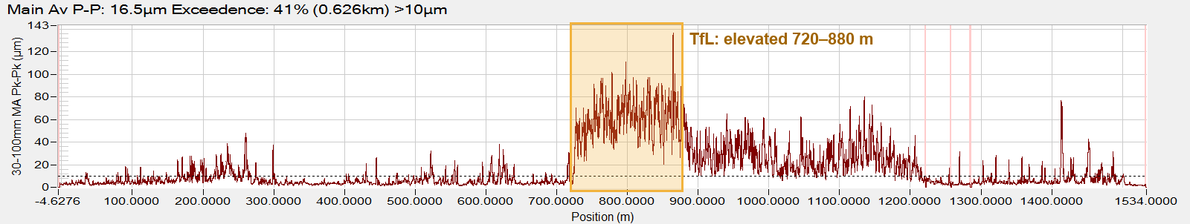
EVERY ARGON JOB HAS A CHECK
09 · MORE REAL WORK FOR ARGON
ASK
READ
RE-DERIVE
COMPARE
Live answers go through the verifier, then an Argon review; flagged claims are withheld.
Reads TfL’s 2018 roughness charts from the PDF; a pixel reader checks every value.
Recomputes our headline numbers with its own code: 65 of 65 match.
Flash vs Argon, 6 runs each: equal on the verifier; Argon cites more of the record.
120/120
chart readings match the pixels
Checks still caught misnamed colours and invented numbers. Pending a human check.
TfL FOI-1730-1819, Jan 2018, Bethnal Green → Mile End EB. Highlight: TfL’s own stated stretch.
agent/ask.py · roughness.py · recheck.py · outputs_posthoc/model_comparison.md
10

Slide 11
TFL’S OWN RECORDS, SEARCHED THREE WAYS
10 · INVESTIGATOR + MONGODB ATLAS
14 PUBLIC DOCUMENTS · 44 CHUNKS
12 / 12
Atlas Search (full-text)
LIVE
test questions where hybrid search ranks the expected document first (our questions, not blind)
Automated Embedding · Voyage 4
LIVE
Vector Search
LIVE
Verifier canary (seeded claim)
Hybrid Search ($rankFusion)
LIVE
“92.8 dB is TfL’s own data” → REJECTED
Stream Processing
LIVE
M10 · MongoDB 8.0 · eu-west-1 · only public text is embedded · investigator: 16 claims verified, 0 dropped
11
Notes:
MongoDB track: all six scored features are live — Atlas Search, Automated Embedding with Voyage 4 (which also counts as Voyage AI), Vector Search, and Hybrid Search via $rankFusion. Stream Processing: a ride (replayed through the tracker now, or live from the phone) streams into ingest_live one row per second; an SP2 processor groups 10 s windows into live_view. The investigator, Gemini 4 Argon with long context, reads the whole corpus plus hybrid-search hits and returns typed claims with verbatim quotes. The verifier checks every quote against the stored source and every number against a quote, our stats or a formula. 25 Oct run: 15 claims, 5 rejected by the verifier and fixed; after independent review, 16 claims, all verified, 0 dropped, 4 information requests.

Slide 12
ONE CLUSTER, TWO PIPELINES
11 · MONGODB ATLAS, END TO END
amber outline = runs in Atlas
LIVE RIDE DATA
A ride
ingest_live
Stream Processing
live_view
Replayed through the tracker now, or live from the phone (phyphox)
One row per second, random trip id, no audio
10 s tumbling windows, SP2 processor
Read by the web app as windows close
INVESTIGATOR RETRIEVAL
Public records
Search + Vector
Hybrid
Gemini 4 Argon
14 TfL / GLA documents, 44 chunks
BM25 full text plus autoEmbed vectors (Voyage 4)
$rankFusion of both rankings
Cited claims, then the deterministic verifier
Also in Atlas: hash-chained logs, claims, approvals, asks, roughness and rechecks · no raw rider data
12

Slide 13
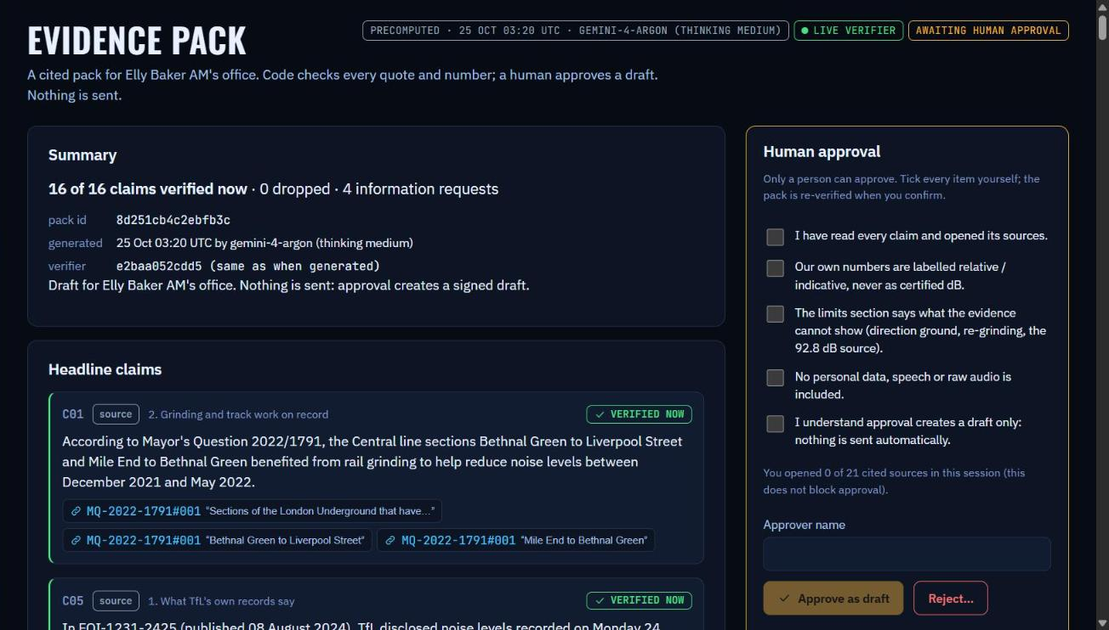

NOTHING IS SENT AUTOMATICALLY
12 · WHERE THE HUMAN APPROVES
RE-VERIFY
The verifier runs again at the moment of approval.
SIGN
SHA-256 over pack, approver, time and verifier version.
RECORD
Written to Atlas approvals; rejections are kept with a reason.
Web app Evidence pack page · agent/approve.py · pack 8d251cb4c2ebfb3c, 16 verified claims
13
Notes:
Agents That Ship: human approval and a clear record. The approval page needs every box, a name, and the claims must still pass the verifier. It writes a signed draft and an approvals record to Atlas. Status: the pack (16 verified claims) is ready; the approval happens live in the demo. Never fake an approval in the demo.

Slide 14
REAL RIDES ARE MESSY. PRIVACY IS NOT OPTIONAL.
13 · MESSY INPUTS, HANDLED RESPONSIBLY
DETECTED FROM THE DATA, NOT HAND-CODED
PRIVACY BY DESIGN
A phone on the floor, from its tilt and vibration
Two app pauses, recovered from phyphox’s event log
A trip split across two files after a wrong stop
Calibrated vs raw magnetometer (it reversed our own notes)
Silent sync taps, so it falls back to matching vibration to sound
Audio is decoded in memory and never written to disk
Only 1-second levels and third-octave bands are kept
Gemini sees public documents and summary statistics only
Raw recordings deleted on 1 Nov 2026
The ICO calls recording conversations “highly intrusive”, so we keep no audio at all.
outputs/qc.json · docs/PRIVACY.md
14
Notes:
The Real World track scores reading messy inputs and responsibility. Every one of these was detected from the data and is listed in qc.json. On privacy: the levels we keep are coarser than the 125 ms third-octave frames that research found make speech almost unintelligible. Say the ICO line out loud in the pitch.

Slide 15
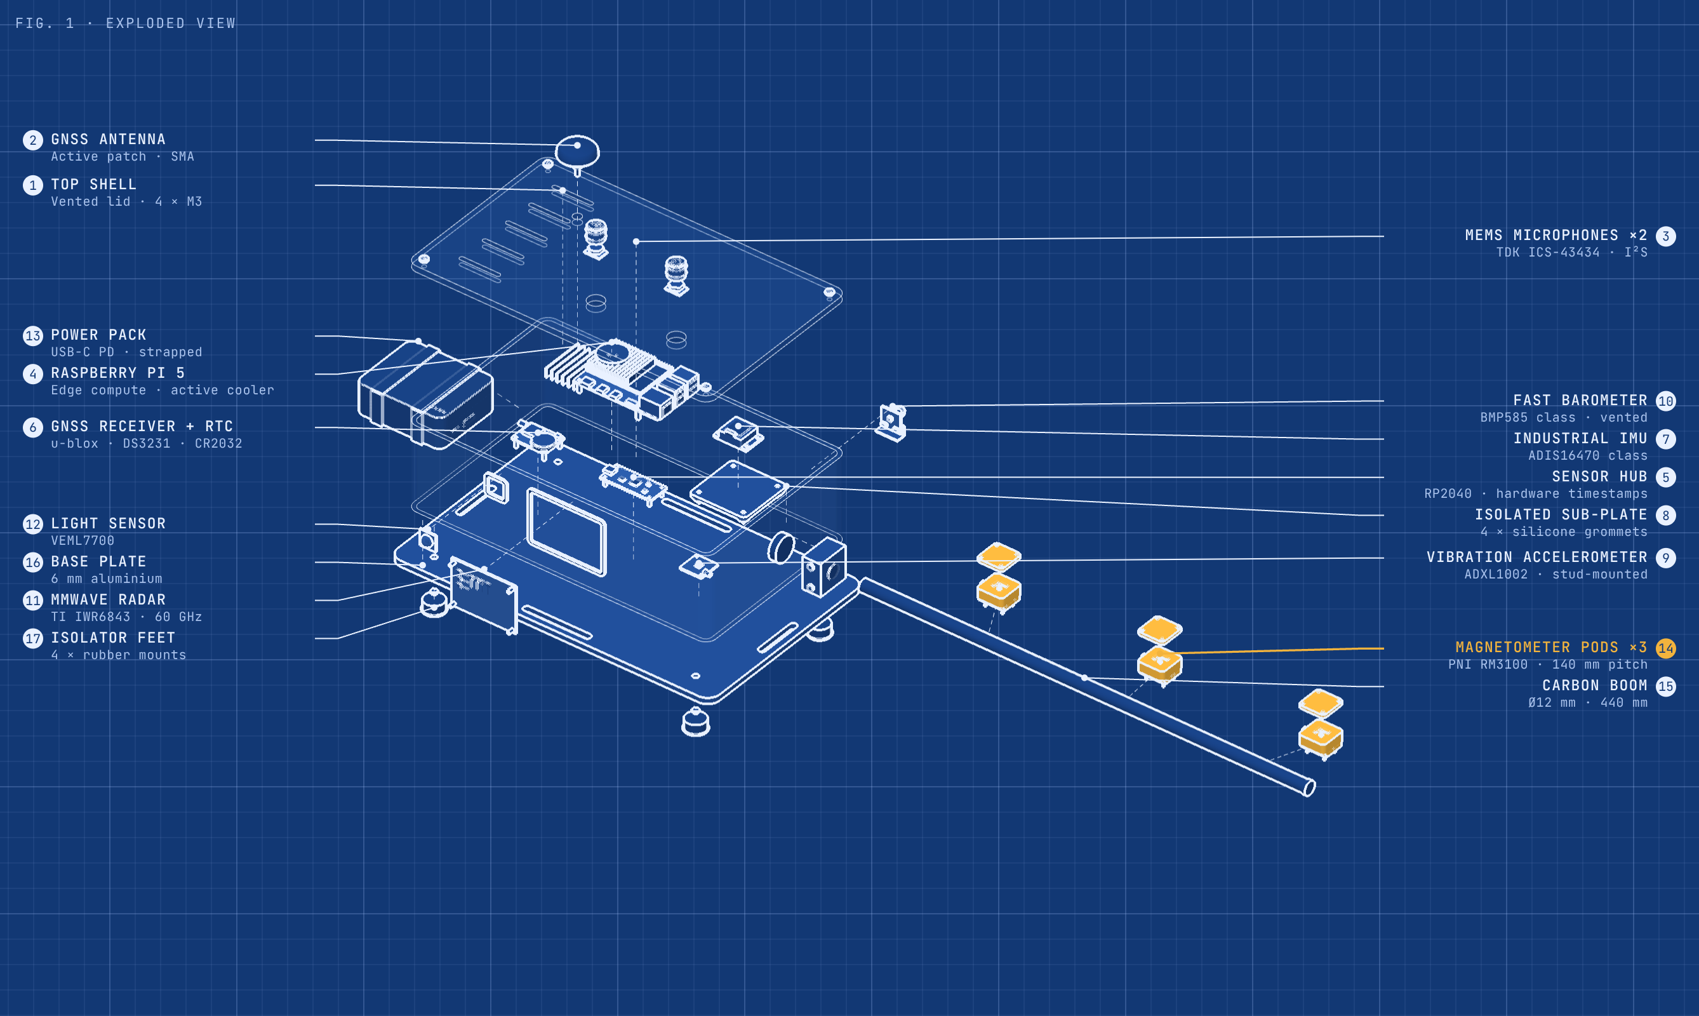
RESEARCH BOX V2
14 · WHERE IT COULD GO
CONCEPT · NOT BUILT
Notes:
A look ahead, clearly labelled as a concept. The phone proved the idea works for positioning; the box is what a purpose-built instrument for the same pipeline could look like. One hardware clock across every sensor, an isolated industrial IMU, two I2S MEMS microphones, a fast barometer, mmWave radar for speed, and three magnetometer pods on a boom. Estimated £700–1,400 using an owned Pi 5.

Slide 16
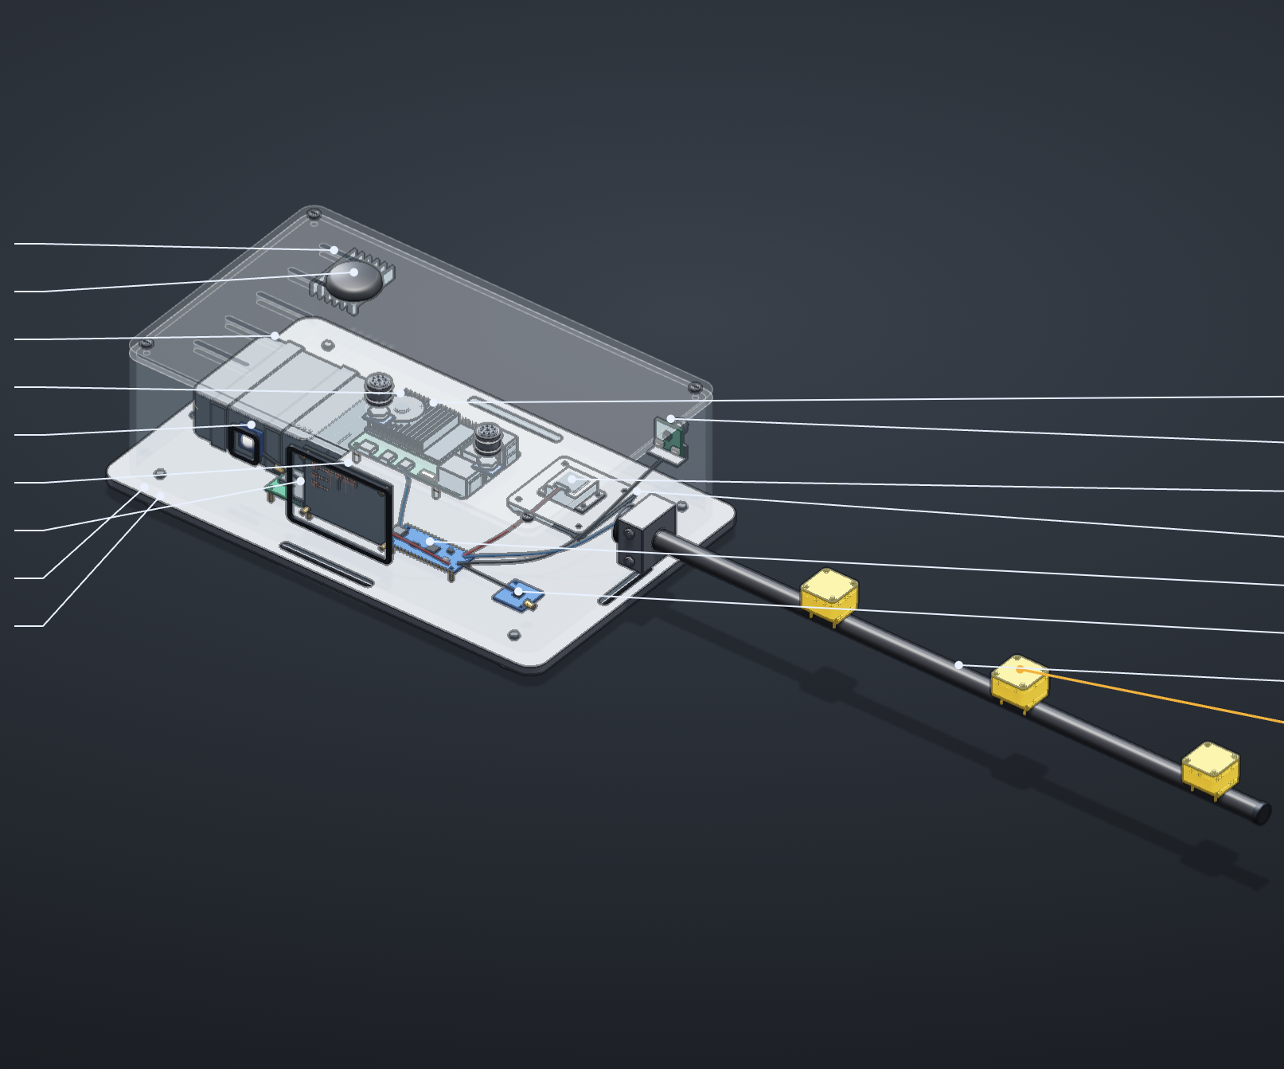
EACH PART TARGETS A LIMIT WE MEASURED
15 · WHY BUILD IT
Signal | Phone today | Research Box v2
Timebase | Two apps, synced by a knock | GNSS PPS + RTC, one hardware clock
Acoustic | Voice Memos limiter, relative only | 2 × I²S MEMS mics, calibratable dB(A)
Magnetic | One sensor beside the battery | 3 × RM3100 array on a boom (to test)
Speed | Inferred from position | Radar Doppler (to test) + sleeper frequency
Inertial | Phone IMU, ~99 Hz | ADIS16470-class IMU, isolated
Pressure | Phone barometer | BMP585-class, tens of Hz, vented
Concept, not built or tested · est. £700–1,400 · hand-carried; fixed mounting only with TfL approval
16
Notes:
Tie each sensor to a limit we hit. Loudness was NO-GO partly because the Voice Memos limiter compresses the differences: calibrated MEMS mics fix that. The magnetometer showed no stable fingerprint, and we did not establish why: a three-pod array is an experiment to test whether it reduces the train-to-train spread (19 vs 22 µT), not a result. Corrugation ground truth has to come from TfL’s own roughness plots (FOI-1730-1819), which Argon has read; a floor-mounted sensor would also hear the car’s own resonances. The block diagram leaves room for a quantum IMU in the same position filter, the kind of sensor RQINS-style navigation trials use. Each part targets a limit we measured. None is tested. This is a concept, not a promise.

Slide 17
BUILT IN A WEEKEND, HONEST ABOUT THE REST
16 · STATUS AND NEXT STEPS
WORKING
IN PROGRESS
NEXT
GPS-free tracker + web app
Messy-input QC
All 6 Atlas features, incl. streams
Analyst harness + hash-chained log
Investigator, Ask Argon, verifier, approval
Signed evidence pack (live in demo)
Live phone sensors via phyphox
Human check of roughness readings
3-minute demo video
More rides, more lines
A calibrated reference meter
Our noise vs TfL roughness plots
Station labels via Gemini Transcribe
Research Box v2 prototype
Every commit dated 23–25 Oct 2026 · github.com/coderback
17
Notes:
Update this slide on the day. Move items from In progress to Working as they land, especially the investigator run and the first signed pack. Argon has read TfL’s 2018 roughness plots (FOI-1730-1819): one rough stretch at about 725–905 m, overlapping TfL’s own 720–880 m statement; pending a human check by eye. Station announcement labelling with gemini-3.5-transcribe is designed but not built.

Slide 18
ORDINARY RIDES.
NO GPS.
TFL’S OWN RECORDS.
EVERY CLAIM CHECKED.
A HUMAN SIGNS.
Raw audio never leaves the laptop.
Tubesense · Tobi Ojebiyi · github.com/coderback
18
Notes:
Close on the five-part line from the demo sheet, then the privacy line. Then open for questions.

