Slide 1
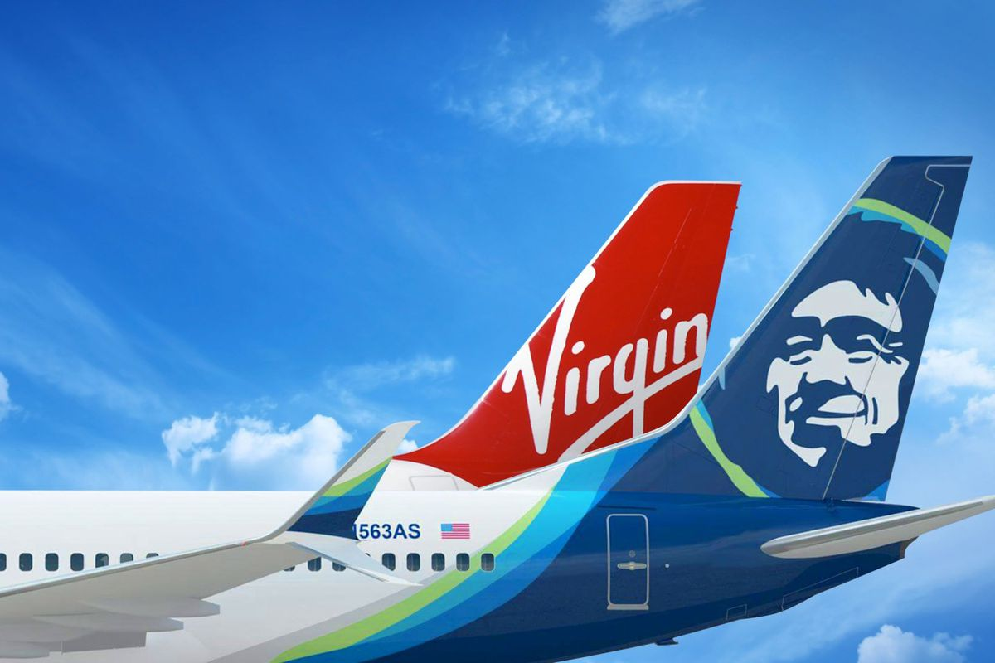
Data Warehousing and Business Intelligence (MIS 636) Individual Accreditation Assignment
Alaska Airlines Acquires Virgin America
April 18, 2018
Bhumika Patoliya CWID: 10432870

Slide 2
Alaska Airlines acquires Virgin America
Headquartered in SeaTac, Washington, Alaska Airlines was founded in 1932.
It is the fifth-largest airline in the United States with a fleet size of 313 and serves 118 destinations with the support of its 11000+ employees.
In 2017, its revenue was US $7.9 billion, operating income was US $1.26 billion and net income was US $1 billion
On April 4, 2016, Alaska Air Group announced it would acquire Virgin America, an airline based out of the San Francisco Bay Area.
The Alaska Air Group purchased Virgin America for $57 per share, a total valuation of $2.6 billion, with additional expenses bringing the cost to approximately $4 billion.
The acquisition was completed on December 14, 2016.

Slide 3
Problem
A merged passenger service system means that most of the customer-facing portions of the company (including flight numbers, website, mobile apps, and airport check-in kiosks) will have a single brand, Alaska Airlines.
Alaska expects to have the Virgin America brand fully retired in 2019.
Data on Alaska’s system was differently structured as compared to Virgin America due to which it became difficult to acquire and manage the data in a timely and simple manner.
Solution to the above problem is to bring their data to a common multidimensional model.
This would enable simpler, uniform and timely access to the databases across all of their application and business operations.

Slide 4
Data Access
After the merger between Alaska Airlines and Virgin America was completed, Alaska Airlines approached an implementation partner who can help them with integrating the data warehouses.
I gained the information necessary for this accreditation from an acquaintance who worked on this data warehouse integration .
This document uses only a subset of the overall data integration project.
This is a representation of the data taken from the acquaintance’s experience in consulting for their client.

Slide 5
High Level Data Model
Bag Status
Bags
Airline Operations
Flights
Stages
Passengers
Airports
Calendar
Booking Agents
Flight
Schedules
Reservations
Reservation
Payments
Legs
Payments
Itinerary
Legs

Slide 6
Airline Reservations Diagram
Passengers
Passenger_ID (PK)
First_Name
Second_Name
Last_Name
Email_Address
Address
Phone_Number
Gender
Other_personal_details
Booking_Agents
Agent_ID (PK)
Agent_name
Agent_details
Reservations Fact
Reservation_ID (PK)
Agent_ID (FK)
Passenger_ID (FK)
Payment_Status_Code (FK)
Origin_Airport (FK)
Destination_Airport (FK)
Date_reservation_made (FK)
Number_of_party
Cancellation_upto_date
Airports
Airport_ID (PK)
Name
Address
Other_Airport_Details
Reservation_Payments
Reservation_ID (PK)
Payment_ID
Flight_Schedules
Flight_number (PK)
Airline_code (FK)
Usual_aircraft_type_code (FK)
Origin_airport_code (FK)
Destination_airport_code (FK)
Departure_date_time
Arrival_date_time
Itinerary_Legs
Reservation_ID (PK)
Leg_ID (FK)
Payments
Payment_ID (PK)
Payment_Status_Code (FK)
Payment Mode
Payment_Date
Payment_amount
Calendar
Day_Date (PK)
Year
Month
Day
Legs
Leg_ID (PK)
Flight_number (FK)
Origin_airport_code (FK)
Destination_airport_code (FK)
Actual_departure_time
Actual_arrival_time

Slide 7
Airline Operation Diagram
Passengers
Passenger_ID (PK)
First_Name
Second_Name
Last_Name
Email_Address
Address
Phone_Number
Gender
Other_personal_details
Airline Operations Fact
Operation_ID (PK)
Arrival_Airport_ID (FK)
Bag_ID (FK)
Bag_Status_Code (FK)
Departure_Airport_ID (FK)
Arrival_Date (FK)
Flight_ID (FK)
Location_ID (FK)
Passenger_ID (FK)
Stage_Code (FK)
Stage_Start_Time (FK)
Stage_End_Time (FK)
Total_Capacity
Capacity_Utilization
Operation_Type
Airports
Airport_ID (PK)
Name
Address
Other_Airport_Details
Bags
Bag_ID (PK)
Insurance
Wight
Type
Checking_Counter
Charges
Bag_Status
Bag_Status_Code (PK)
Bag_Status_Description
Calendar
Day_Date (PK)
Year
Month
Day
Flights
Flight_ID (PK)
Flight_Nr
Arrival_Date
Other_Details
Stages
Stage_Code (PK)
Stage_name
Stage_description

Slide 8
Fact Tables
Two facts tables are introduced in this model mentioned in above slides. The First is used by the airline operations management department and the second is used by the airline reservations department.
Foreign keys have been used as composite primary keys in each facts table.
For example, in the Reservations fact table, agent id and passenger id are used as the composite primary key which provide us the information related to passengers and in the same fact table the number of party is taken as the numerical fact field.
Correspondingly in Airline Operations fact table, flight id and stage code are the composite primary key and total capacity and capacity utilization as the numerical field.
In the reservation schema, Itinerary Legs is used as bridge between the Reservation fact table and the Legs dimension table.

Slide 9
Dimensions in Fact Table
Reservation Fact Table :
The dimensions in this table are as follows:
Agent_ID from Booking_Agents
Passenger_ID from Passengers
Payment_Status_Code from Payments
Origin_Airport from Airports
Destination_Airport from Airports
Date_reservation_made from Payments

Slide 10
Dimensions in Fact Table
Operations Fact Table:
The dimensions in this table are as follows:
Arrival_Airport_ID from Airports
Bag_ID from Bags
Bag_Status_Code from Bag Status
Departure_Airport_ID from Airports
Arrival_Date from Flights
Flight_ID from Flights
Location_ID from Airports
Passenger_ID from Passengers
Stage_Code from Stages
Stage_Start_Time from Stages
Stage_End_Time from Stages

Slide 11
Conformed Dimension
From the high level model mentioned above we gained the knowledge that for the two fact tables, there are three conformed dimensions, namely: Passengers, Airports and Calendar.
Reason for this conformed dimension is because they are common to both the fact tables.
Passengers
Airports
Operations Star Schema
Reservations Star Schema
Calendar

Slide 12
Bridge Table
A bridge table is needed when a numerous connections (many to many) are present while using a star model outline. In this scenario, a journey can be a direct flight or it may have multiple stops.
Many tickets can have multiple legs of the journey and each leg can be 'assigned' to many tickets.
The Itinerary Legs Bridge table has one entity from the parent entity to its subsidiary entity.
However, the relation between Reservation Fact and Itinerary Legs Bridge table and also the one between Leg Details and Itinerary Legs Bridge table are all many to one.
Reservations Fact
Reservation_ID (PK)
Agent_ID (FK)
Passenger_ID (FK)
Payment_Status_Code (FK)
Origin_Airport (FK)
Destination_Airport (FK)
Date_reservation_made (FK)
Number_of_party
Cancellation_upto_date
Legs
Leg_ID (PK)
Flight_number (FK)
Origin_airport_code (FK)
Destination_airport_code (FK)
Actual_departure_time
Actual_arrival_time
Itinerary_Legs
Reservation_ID (PK)
Leg_ID (FK)

Slide 13
Attributes and Keys
Two facts table are introduced and both the table contains a composite primary key.
For instance, Bag ID and Flight ID are the 2 composite primary key in Airline Operations fact table.
Primary key in the dimension table are the foreign keys in the fact tables. There are three conformed dimension:
Passengers
Airports
Calendar

Slide 14
Grain
In our case, individual reservation is the fundamental grain.
Therefore, the fact tables are measured at a certain given point in time, not over a time span.
Each reservation is tied to a flight operation that begins from a particular location and particular date are present under operations fact table.
It also represents the number of party and cancellation up to date for a particular single reservation only.
The operations fact table covers the details of the particular flight operation: its total capacity, utilization, operation type at that particular instance.

