Slide 1
  Hospital-Bed booking
DBMS Project.
Created by - Bhawesh Kumar Pandit (20CS3021),
Dhanu Pratap Jakhar (20CS3026),
Manish Wahale (20CS3070).

Slide 2
Project Overview:
MediX is a covid bed booking website where hospitals can enroll how many available beds are there for the patient. Patient can accordingly choose the hospital and book the bed in that hospital.
Here the website have 3 login portals:
1) Admin login - Where new hospital needs to make an ID on this website to become the user of this website.
2) Hospital Login - Where the hospital can display number of available beds in their hospital.
3) User Login - Where people can log-in and book the bed as per their requirement.

Slide 3
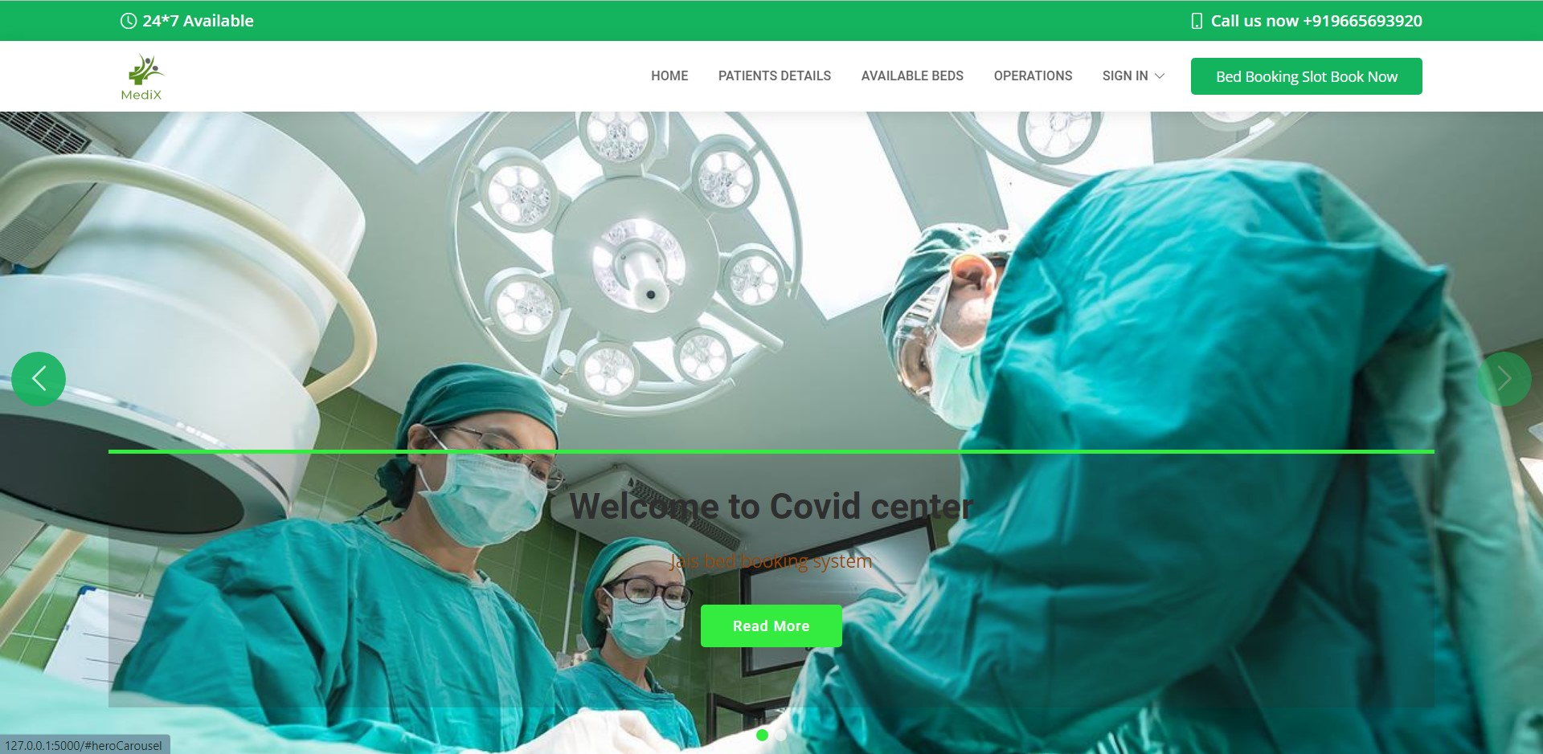

Slide 4
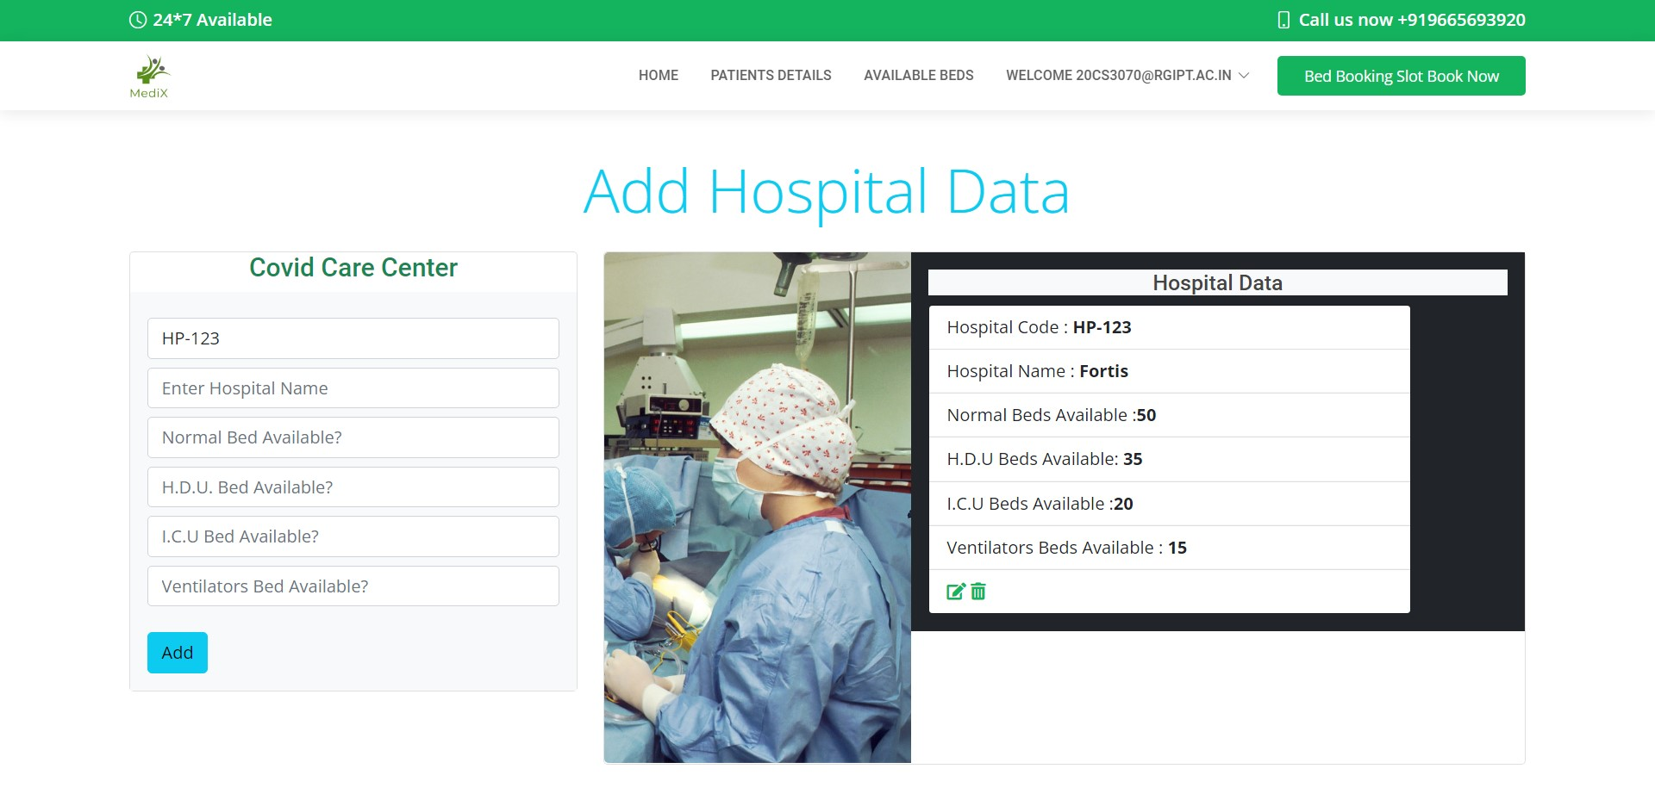

Slide 5
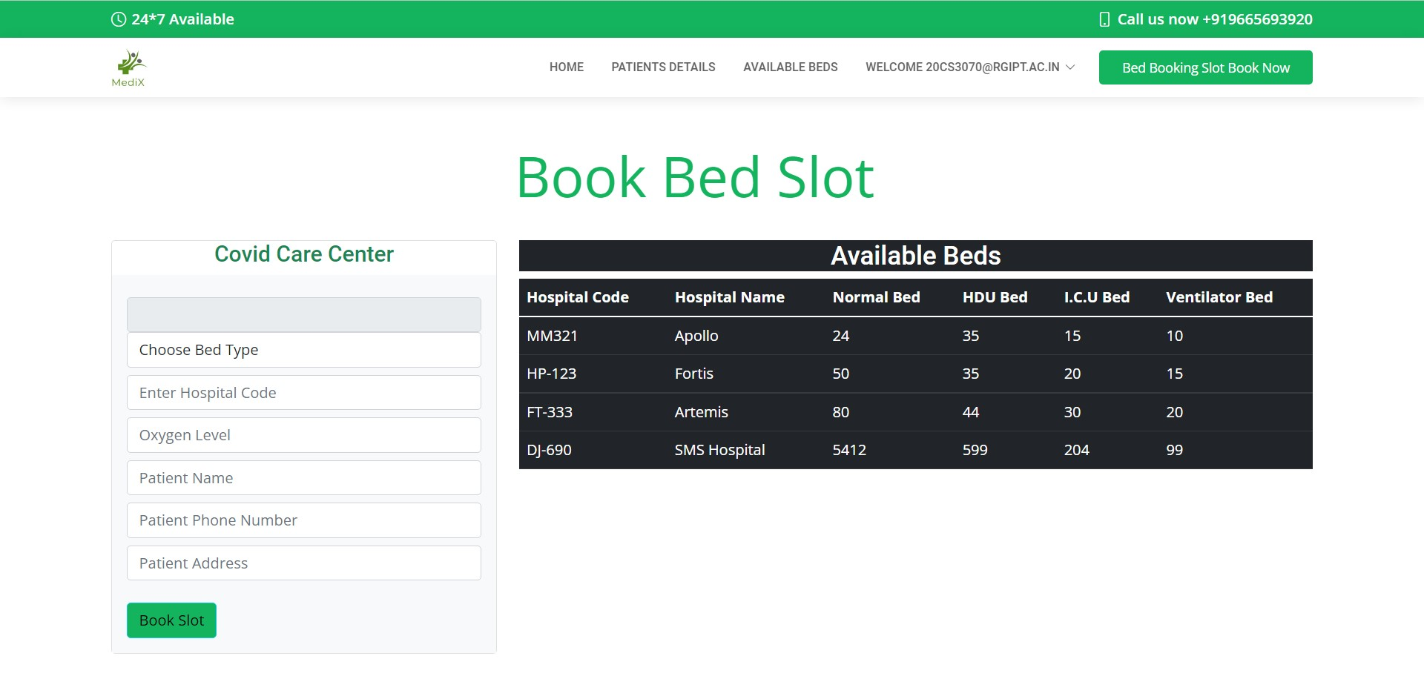

Slide 6
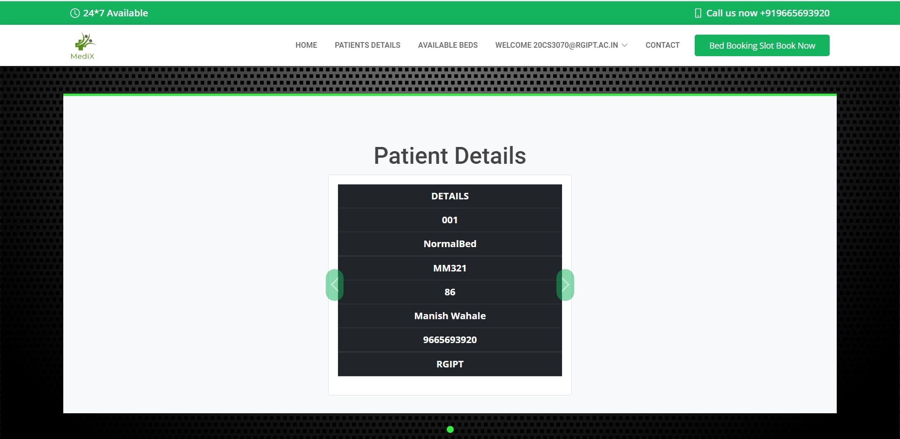

Slide 7
Technology used in our project
Database management:
1)PHP.
2)MySQL.
Backend:
1)Flask
2)SQL-Alchemy
Frontend:
1)HTML
2)CSS
3)Javascript

Slide 8
Other Technology used in our project:
1) flask_login - Used for login purposes.
2) flask_mail - Used for mailing purposes.
3)werkzeug.security - for encryption of password.

Slide 9
Future plan:
Make a relation where hospital can also see the number of patients and their details they need to cure in their respective hospitals. And accordingly after the cure the available beds will be updated accordingly.

Slide 10
Thank you.

