Slide 1

JSS ACADEMY OF TECHNICAL EDUCATION DEPARTMENT OF INFORMATION SCIENCE
“Native language to English translator using Image Processing”
ARJUN RAJA Y(1JS15IS010)
ASHIKA NB(1JS15IS012)
CHAITRA KULKARNI(1JS15IS019)
ADITYA ABHISHEK(1JS14IS001)
PROJECT GUIDE : MRS. SUDHA P R

Slide 2
MOTIVATION
Conversion of official documents into English (FIR’s, Taxable bills of companies/ political parties) to prevent corruption
A means to recognize and date historical scriptures that hasn’t been translated into English yet
Redefine peer to peer learning for rural kids who do not have a means of having a teacher at all times through smartphones
Dynamically convert sign-boards written in kannada

Slide 3
INTRODUCTION
Human presence at every nook and corner is impossible and hence the sign boards are put up to make it easier for people to follow directions regarding their area of work.
These instructions are put up in the native language so as to make it easier to understand. But these can only be understood by someone familiar with the native language and someone who can read.
This can be solved if there were some means to read it or translate it into another language to help the visually impaired and those unfamiliar with the language.

Slide 4
LITERATURE SURVEY
Paper Name & Year | Details | Method | Author | Dataset
Review of Automatic Handwritten Kannada Character Recognition Technique Using Neural Network-2017 | International Journal of Engineering Development And Research | Pre-Processing technique is presented for extracting Handwritten characters. Back Propagation Neural Network, Form Processing, Histogram of Gradients, Kannada Script | Mukesh Kumar Dr. Jeeetendra Sheethlani | 57 Character dataset
Unrestricted Kannada Online Handwritten Akshara Recognition using SDTW | Kannada Database of Medical Intelligence and Language Engineering (MILE) Lab, IISc | Statistical Dynamic Time Warping (SDTW) | Rituraj Kunwar, Mohan P., Shashikiran K, A. G. Ramakrishnan | The dataset used has handwriting of 69 people from four different locations
Recognition of Handwritten Kannada Numerals | 9th International conference on Information Technology | Quadratic classifier based scheme for the recognition | N.Sharma U.Pal F.Kumura | 64 dimensional and 100 dimensional features for a comparative study on the recognition accuracy

Slide 5
TOOLS USED
Python - Python 3.6.7 is now the latest maintenance release of Python 3.6 and supersedes 3.6.0. Get 3.6.7 here. Python 3.7, a newer feature release, is now also available.
Libraries:
scikit image - scikit-image is an open-source image processing library for the Python programming language. It includes algorithms for segmentation, geometric transformations, color space manipulation, analysis, filtering, morphology, feature detection, and more.
Numpy - NumPy is the fundamental package for scientific computing with Python.

Slide 6
OpenCV - OpenCV (Open Source Computer Vision Library) is released under a BSD license and hence it’s free for both academic and commercial use
Django - Django is a high-level Python Web framework that encourages rapid development and clean, pragmatic design.
Scipy - SciPy is a free and open-source Python library used for scientific computing and technical computing.
Keras - Keras is a high-level neural networks API, written in Python and capable of running on top of TensorFlow, CNTK, or Theano.
Matplotlib - Matplotlib is a Python 2D plotting library which produces publication quality figures in a variety of hardcopy formats and interactive environments across platforms.

Slide 7
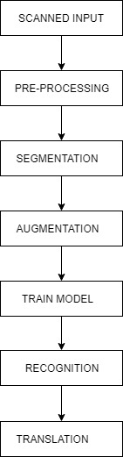
APPROACH FOR KANNADA OCR

Slide 8
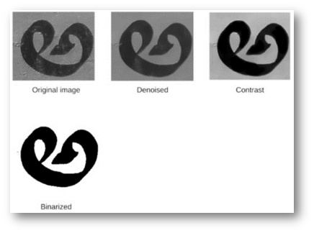
PRE-PROCESSING
The image is preprocessed using different image processing algorithms like Inverting image.
Gray Scale Conversion and image thinning, contrast normalization and binarization are the steps that are carried out in this stage.

Slide 9
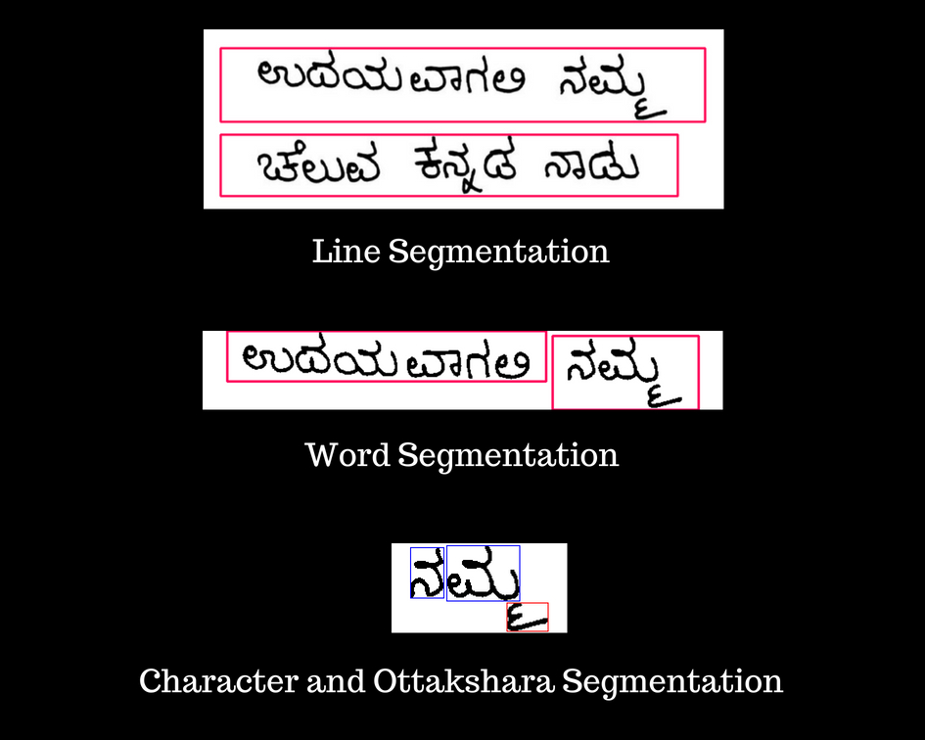
SEGMENTATION
Segmentation is the process of partitioning the preprocessed image into multiple segments. These segments are later used in the recognition process. Line segmentation is the process of segmenting the text document into lines. Later word segmentation and character segmentation is carried out.
The following steps should be done.
Divide the text into rows
Divide the rows into words
Divide the word into letters

Slide 10
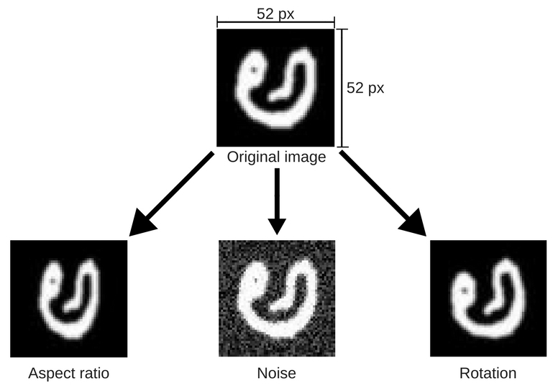
AUGMENTATION
The augmentation steps considered were
Aspect ratio
Rotation
Smoothening
Padding
Noise
Resizing

Slide 11
TRAIN MODEL
.
Convolutional neural network (CNN) was used in image recognition and processing that is specifically designed to process pixel data.
The layers of a CNN consist of an input layer, an output layer and a hidden layer that includes multiple convolutional layers, pooling layers, fully connected layers and normalization layers.
Max pooling, a sample-based discretization process, down-samples an input representation reducing its dimensionality and allowing for assumptions to be made about features contained in the sub-regions binned.
Local Response Normalization layer is added to implement lateral inhibition.

Slide 12
RECOGNITION AND TRANSLATION
Our model outputs a stream of Unicode and a function called un_to_kannada compares it with Unicode dictionary and gives the ANSI output which is displayed to the user.
Once the word is correctly recognized the word is compared to the dictionary of kannada words with english meanings
After the comparison the corresponding English meaning is displayed to the user

Slide 13
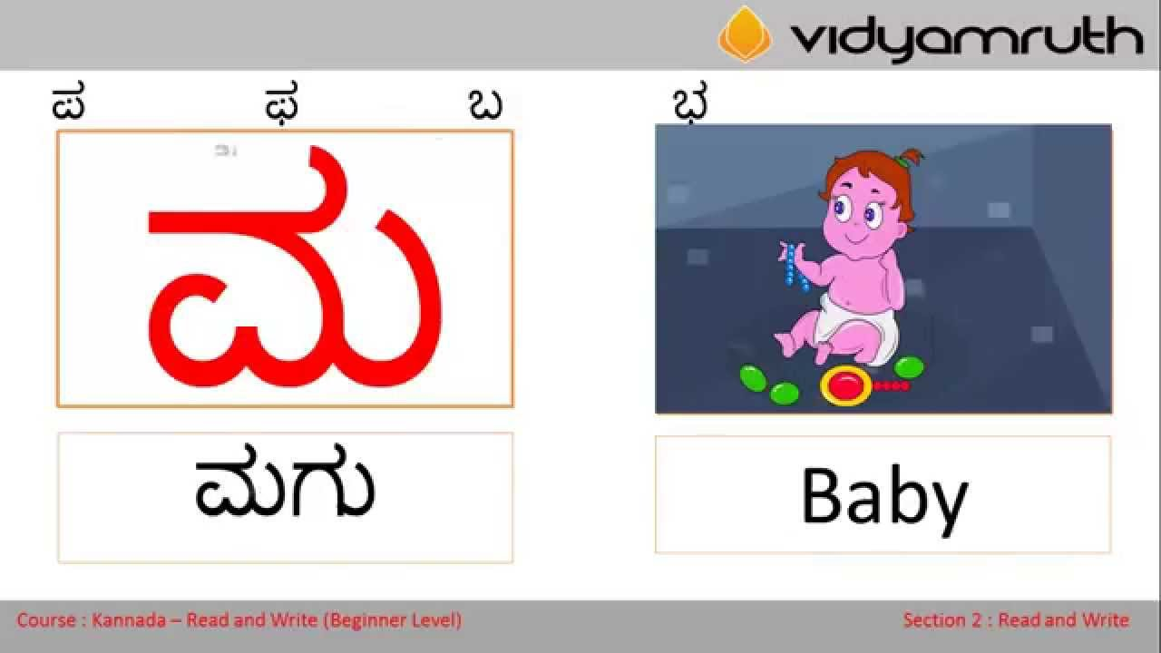
APPLICATIONS
Provides a means of visual output of correct English word/sentence for a given Kannada scripture

Slide 14
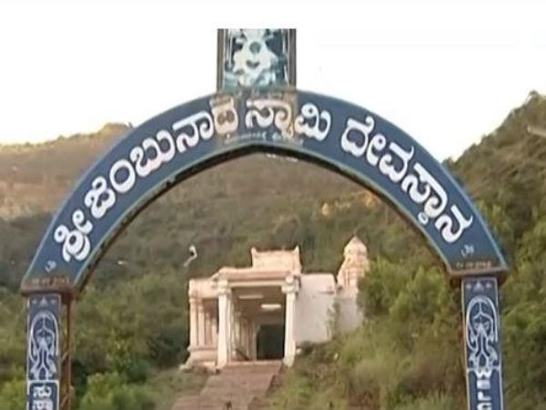
Helps those who are not native to this language, understand the language and have an easy access to translation

Slide 15
CONCLUSION
Communication in this fast pace world has become as necessary as shelter is for survival.
Language barrier only makes it worse and since there so many language in the world, 28 official only in India it makes it hard for even a multilingual person to manage
This application will help people who do not know Kannada have an easy access to the language without having to go around asking people which will again put them in a loop of language barrier
This application will also help people learn kannada by learning one word at a time
Once invested with time and money to acquire the necessary huge dataset, this application can be used to recognize any kannada word from any kannada script

Slide 16


