Slide 1

QGenomix
A quantum-classical framework to find lean South Asians at high risk of type 2 diabetes
Presented by
Guided by
Aritro Chowdhury
Suyash Gupta
Dr. Husanbir Singh Pannu
Assistant Professor, CSED
Thapar Institute of Engineering and Technology, Patiala
Rishabh Sharma
Akshat Ahuja
Anshh Pasriccha
Notes:
Introduce the team and our guide. One sentence on the project: we want to find South Asians who look healthy and slim but carry a high inherited risk of type 2 diabetes.

Slide 2
India's diabetes crisis
101 million
Indians live with diabetes
136 million
more have prediabetes
Source: ICMR-INDIAB, The Lancet Diabetes & Endocrinology, June 2023; The Tribune, 10 June 2023
Notes:
The ICMR-INDIAB study tested over 113,000 people. It found 101 million Indians with diabetes and 136 million more with prediabetes. More than one Indian adult in four either has the disease or is on the way to it.

Slide 3
A quarter of the world's diabetes
212 million
of the world's 828 million adults with diabetes live in India
Source: NCD Risk Factor Collaboration, The Lancet, November 2024; ThePrint, 14 November 2024
Notes:
A Lancet study pooled over a thousand population studies. It counted 828 million adults with diabetes in 2022, more than a quarter of them in India. The count differs from ICMR's because the studies use different age ranges and blood tests, but the message is the same.

Slide 4
Much of it is hidden
43%
62%
of Indian adults with diabetes do not know they have it
of Indians with diabetes are not on medication
Source: IDF Diabetes Atlas, 2025; ThePrint, 14 November 2024
Notes:
Nearly half of the people with diabetes in India do not know it, and most are not treated. A disease that stays hidden does its damage in silence.

Slide 5
Normal weight does not mean low risk
The BMI that carries the same diabetes risk as BMI 30 in White people
Source: Caleyachetty et al., The Lancet Diabetes & Endocrinology, 2021
Notes:
This is the first punch line. In a study of 1.47 million people, a South Asian at BMI 23.9 had the same diabetes risk as a White person at BMI 30. Most charts call 23.9 normal. The same risk in a White person is called obese.

Slide 6
Normal weight, yet far more diabetes
Source: Gujral et al., Diabetes Research and Clinical Practice, 2018
Notes:
Compare people of normal weight directly. In Chennai, 23.5 percent of normal-weight men have diabetes; in the United States, 6 percent. For women it is 13.6 against 2.8. That is four to five times as much diabetes in people who look just as healthy.

Slide 7


Screening cannot see these people
BMI rule
IDRS questionnaire
Never flags a lean person
Four questions, no genes
Source: IDRS: Mohan et al., Journal of the Association of Physicians of India, 2005
Notes:
Two tools decide who gets tested. A BMI rule cannot flag a lean person. The IDRS asks about age, waist, activity and family history, so a young, slim person scores low by design. These are exactly the people we just saw.

Slide 8
The missing risk is inherited
8.2 years
earlier diagnosis, at a BMI 3 points lower, in people with high genetic risk on two mechanisms
Source: Hodgson et al., Nature Medicine, 2025
Notes:
Among British South Asians, people with high genetic risk on both insulin deficiency and lipodystrophy were diagnosed 8.2 years earlier at a lower BMI. They look healthy on every measure used in screening today. And only 2 percent of the people in the largest genetic study were South Asian.

Slide 9
Prevention works, if people are found
28%
less progression to diabetes with lifestyle change
But only people who know they are at risk can act.
Source: Indian Diabetes Prevention Programme, Ramachandran et al., Diabetologia, 2006
Notes:
This is why the problem is worth solving. Lifestyle change lowered progression to diabetes by about 28 percent in Indian adults. The hard part is finding the right people early.

Slide 10
Three questions
1
How much does genetics add to screening, above all for lean people?
2
Do diabetes mechanisms interact, or do they only add up?
3
Can a consumer DNA file give a reliable report?
Notes:
The problem comes down to three questions, and the rest of the talk answers them in turn.

Slide 11
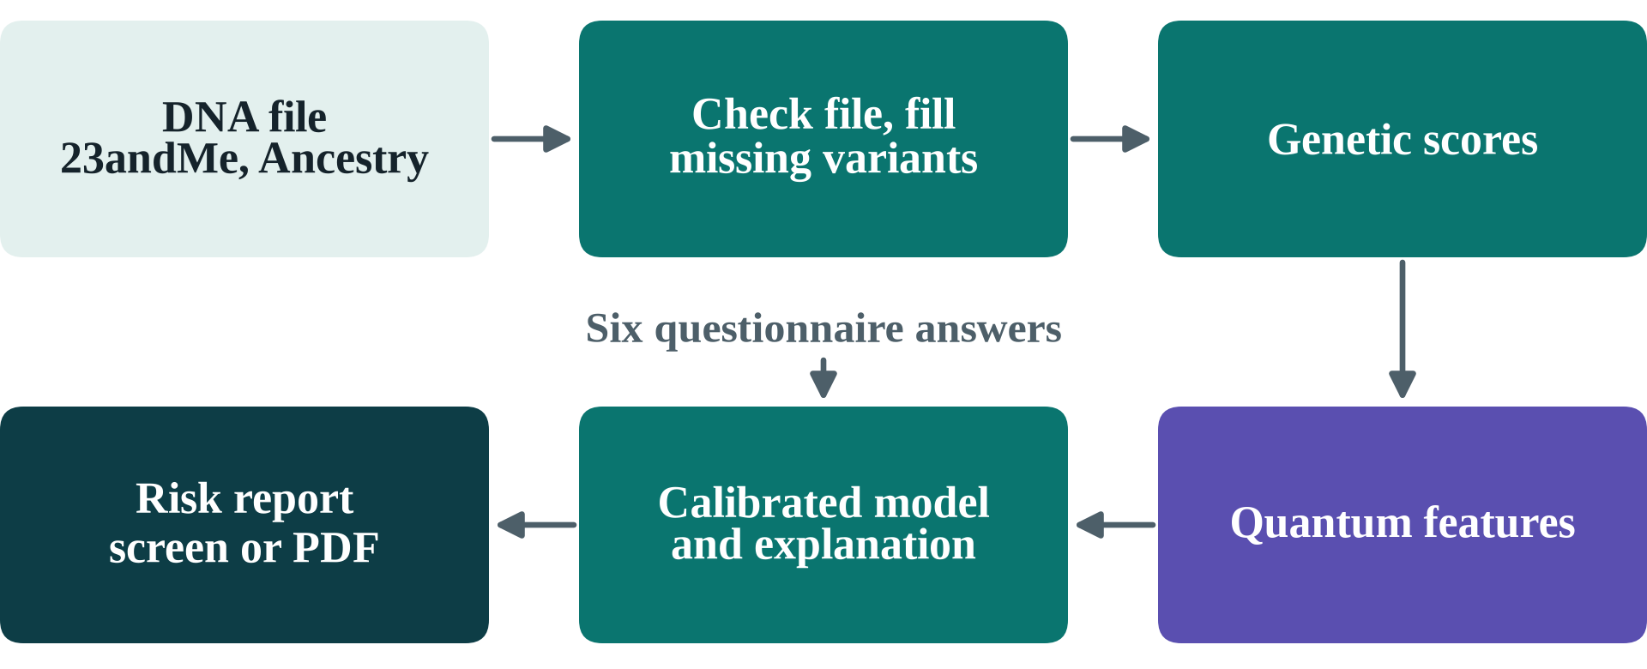
One DNA file, six answers, one report
Notes:
QGenomix turns a 23andMe or AncestryDNA file and six questionnaire answers into a risk report that a person can read. This slide is the destination; the next slides show how we got there.

Slide 12


Real genomes, known truth
2,504
1.34 M
10,000
real genomes from 1000 Genomes
variants in the D-PRISM risk score
synthetic South Asians with a known truth
Notes:
Genotypes and risk weights are real. Disease outcomes are simulated on synthetic South Asians built from real haplotypes, with ten planted gene pairs, so that every discovery can be checked against a known truth. This is also the main limit of the work, which is why we test it so hard later.

Slide 13
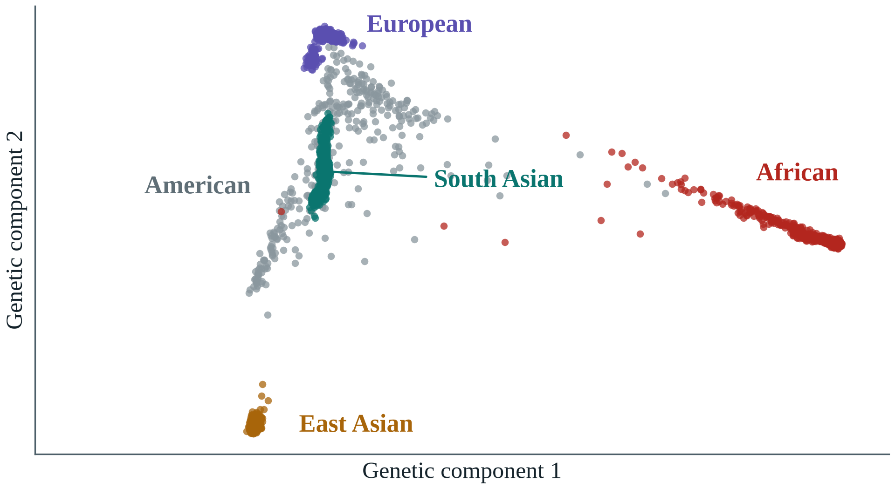
2,504 real genomes, five ancestries
Notes:
Each dot is a person. This is the well-known shape of human genetic variation, so the data was read correctly. South Asians, in teal, are the group we study.

Slide 14
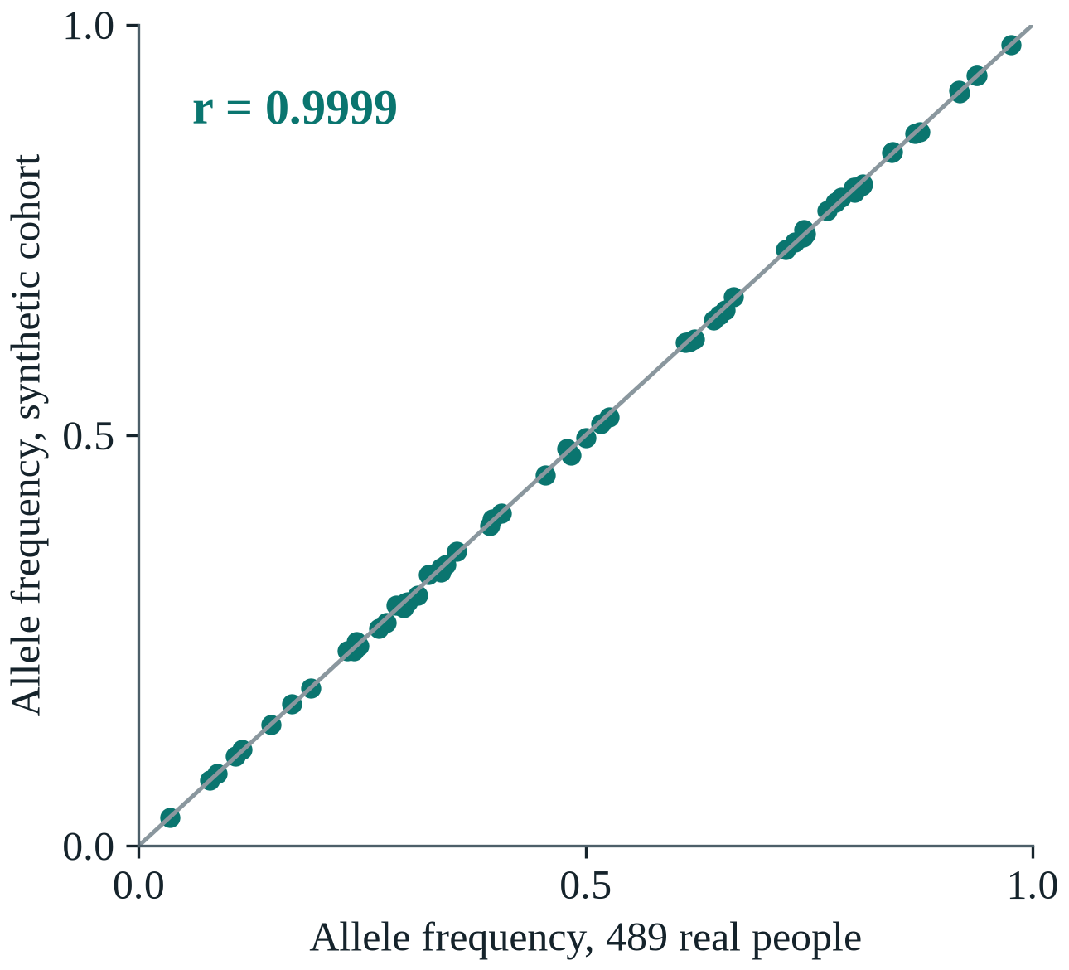
Synthetic people match real people
r = 0.9999
between real and synthetic allele frequencies
Notes:
Each dot is one of the 62 mechanism SNPs. Its frequency in 489 real South Asians and in 10,000 synthetic people is the same, with a correlation of 0.9999.

Slide 15
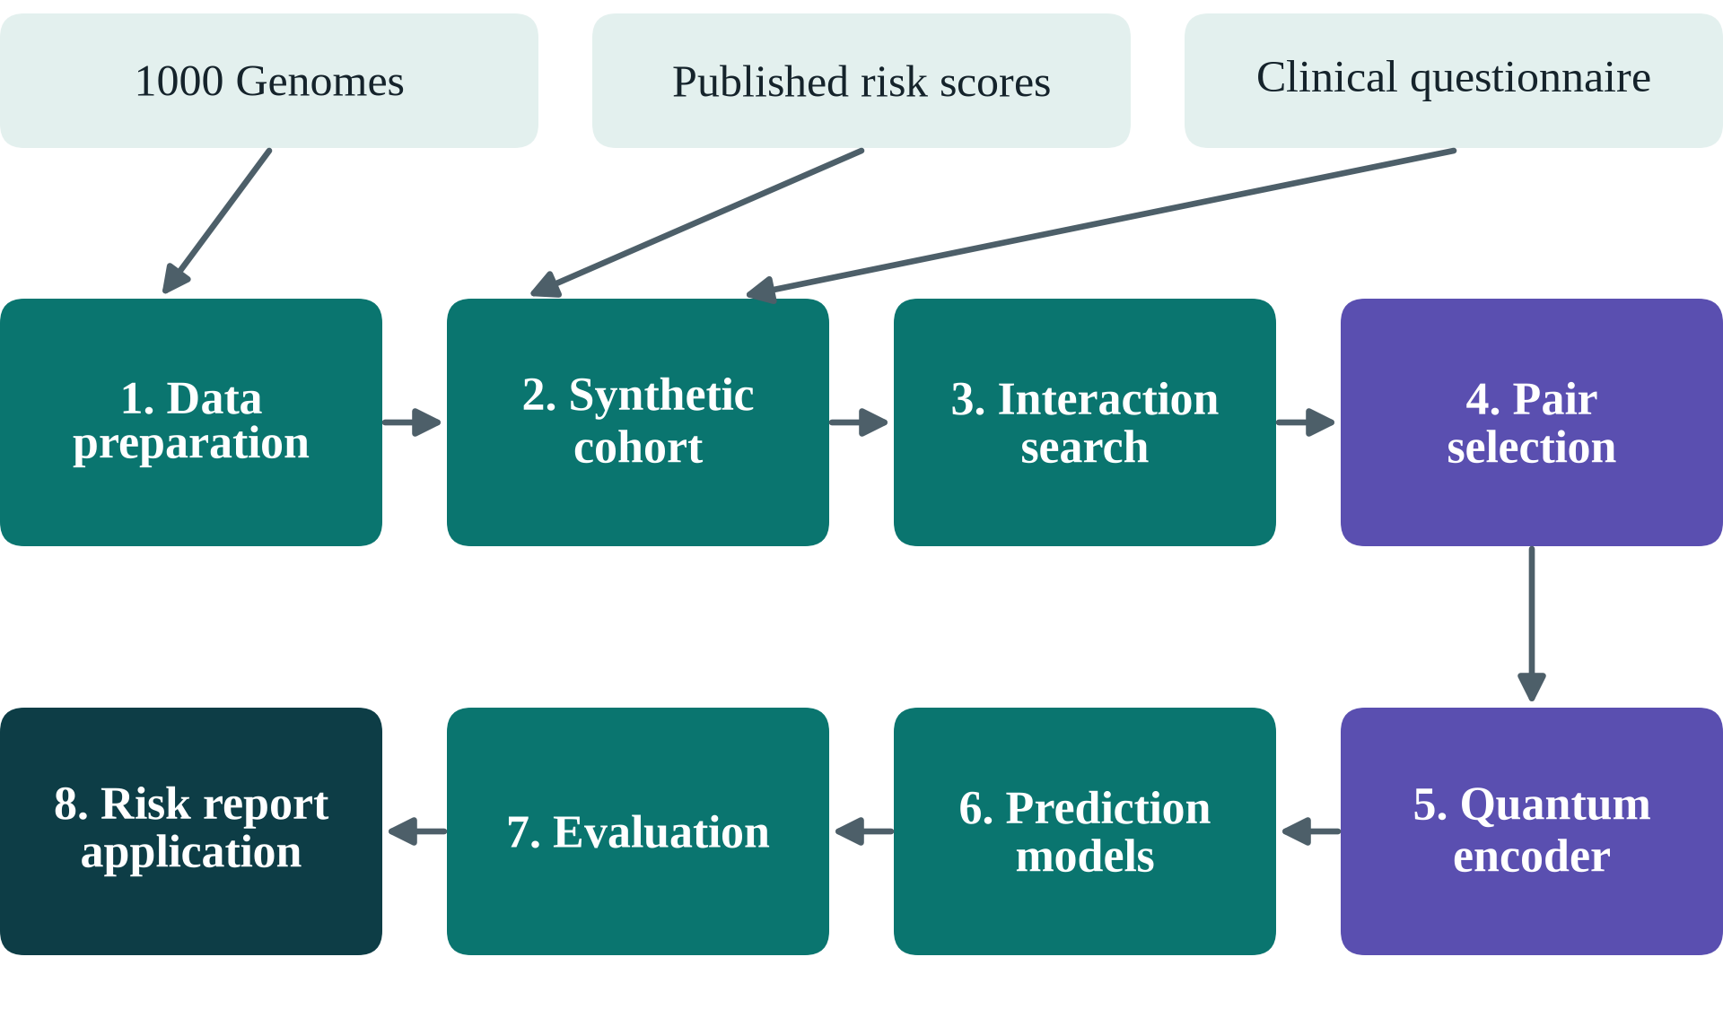
Eight stages, two of them quantum
Notes:
Walk the pipeline quickly. The two purple stages are where quantum computing enters. Everything else is classical.

Slide 16


Why quantum computing?
Gene pairs
Pair selection
Entanglement links two variants, so a qubit can see interaction
48 of 200 pairs: 10⁴⁷ choices, a native QUBO for QAOA
Every quantum part faces a classical control.
Notes:
Quantum is used where the problem has a quantum shape. Our question is gene-gene interaction, and entanglement is exactly the operation that makes two qubits depend on each other. Choosing 48 of 200 pairs has about 10 to the 47 possible answers, and as a QUBO it is the native problem of QAOA and quantum annealers. The circuits are 8 and 12 qubits, sized for today's hardware. And because quantum claims are easy to overstate, every quantum part faces a classical control.

Slide 17
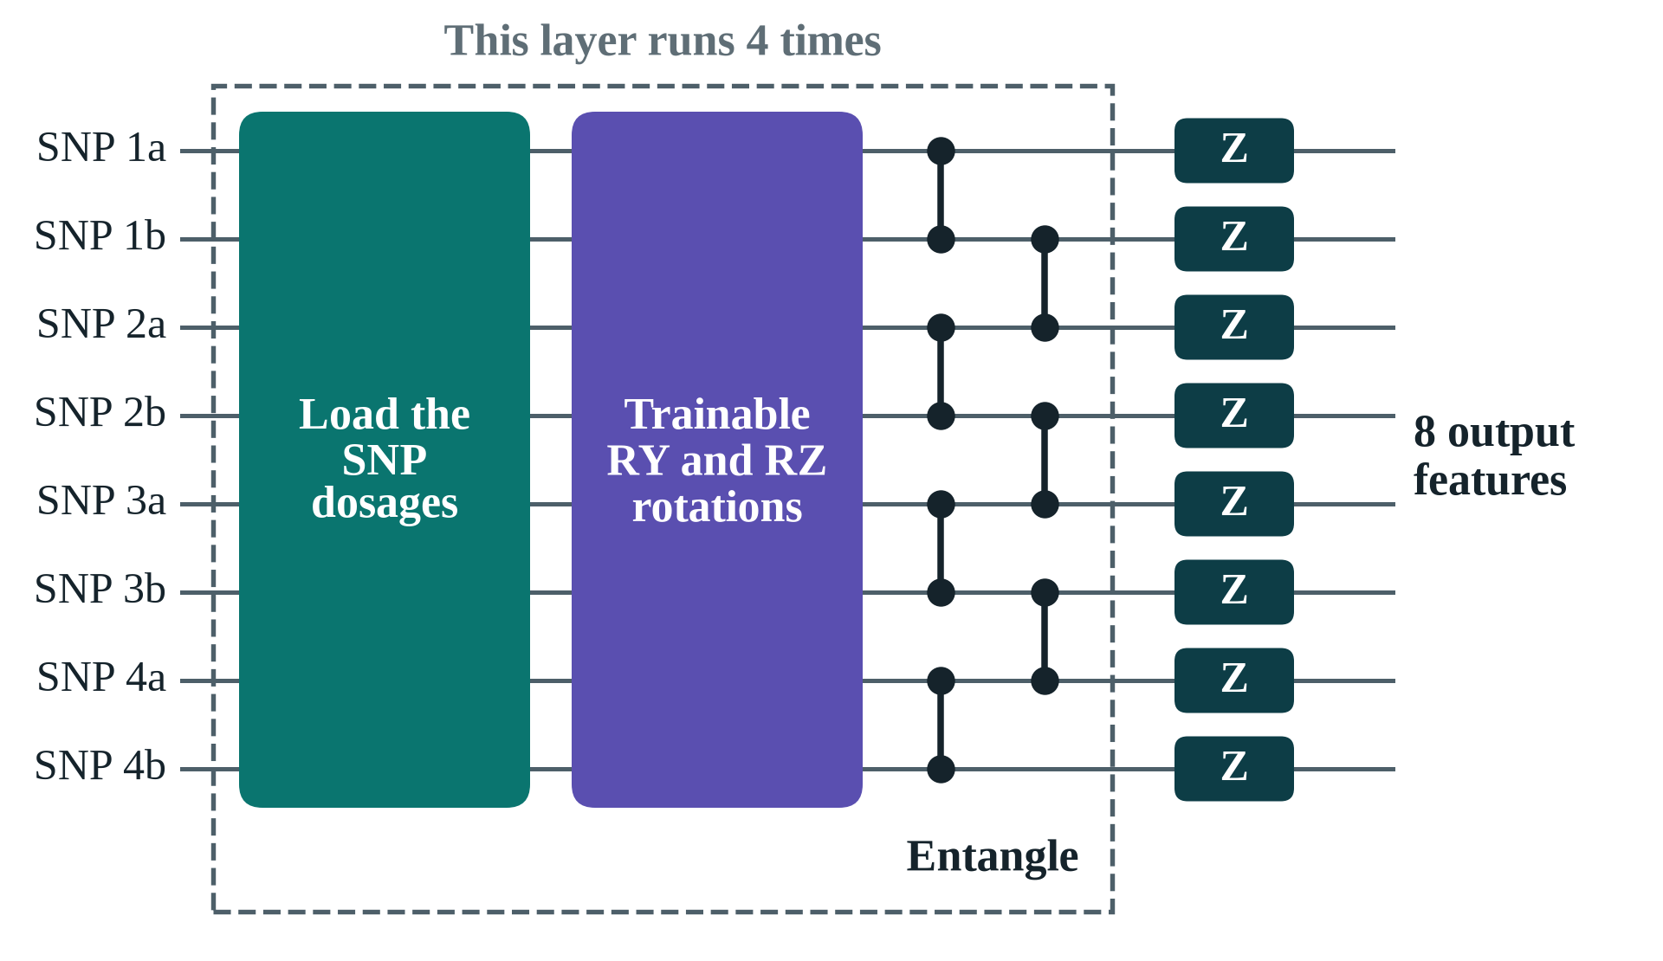
The quantum pair encoder
Notes:
Each circuit carries four SNP pairs on eight qubits. It loads the dosages, applies trainable rotations and entangles the qubits, four times over. Twelve circuits give 96 features. Without the CZ gates a qubit sees only its own SNP, which is the control we test.

Slide 18
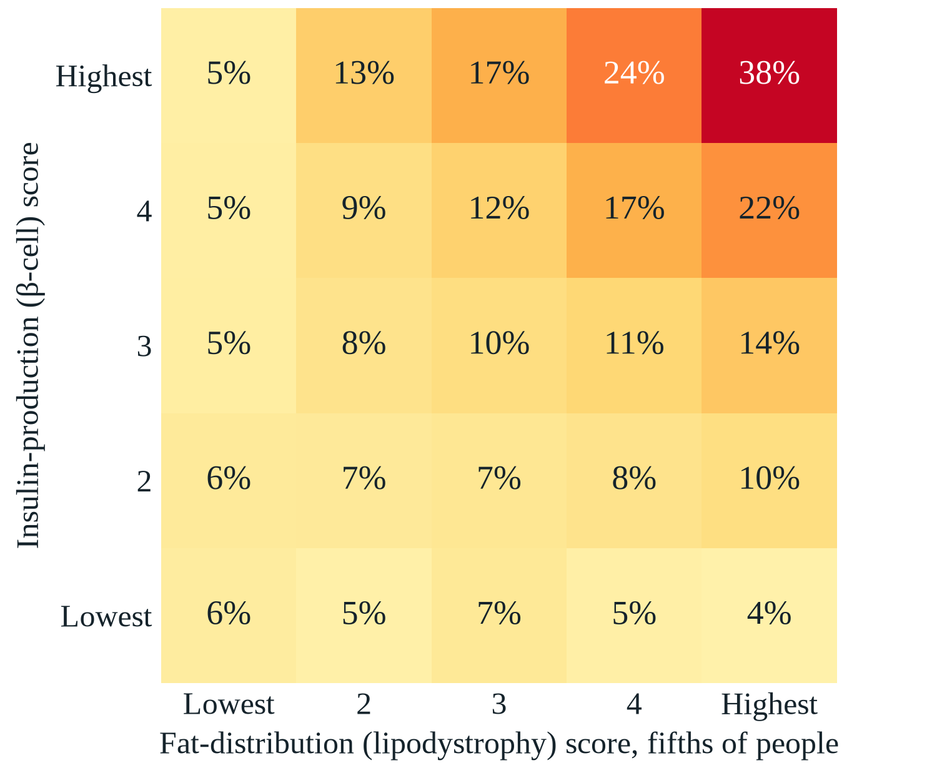
Two mechanisms, dangerous together
38%
develop diabetes when both scores are in the top fifth
About 5% when the insulin score is lowest
Notes:
In the simulated cohort, risk stays near 5 percent along the bottom row and climbs to 38 percent in the top corner. People high on both have a 37 percent case rate at a lower BMI. This is the lean pattern from the start of the talk.

Slide 19
Genetics lifts screening accuracy
AUC: 0.5 is a coin toss, 1 is perfect
Notes:
Each step adds information. All clinical factors reach 0.812; adding the genetic scores lifts this to 0.874, significant in every seed. The stacked hybrid reaches 0.877 but its margin is not significant.

Slide 20
Genetics nearly doubles lean cases caught
Lean diabetes cases caught when the top 20% by risk are screened
Notes:
This is the main result. A BMI rule catches no lean cases, the IDRS 30%, all clinical factors 35%, and with genetics 58%. Genetics helps most for exactly the people screening misses.

Slide 21
The search finds planted gene pairs
Share of 10 planted pairs in the top 10, as the interaction grows stronger
Notes:
Ten pairs are planted, so a search can be marked exactly. Across the mechanism settings the score test finds 70 to 84 percent at strength 0.2, against 40 to 48 percent for PLINK's BOOST. With more people it finds them all: 78 percent at 10,000 people and 100 percent at 40,000.

Slide 22
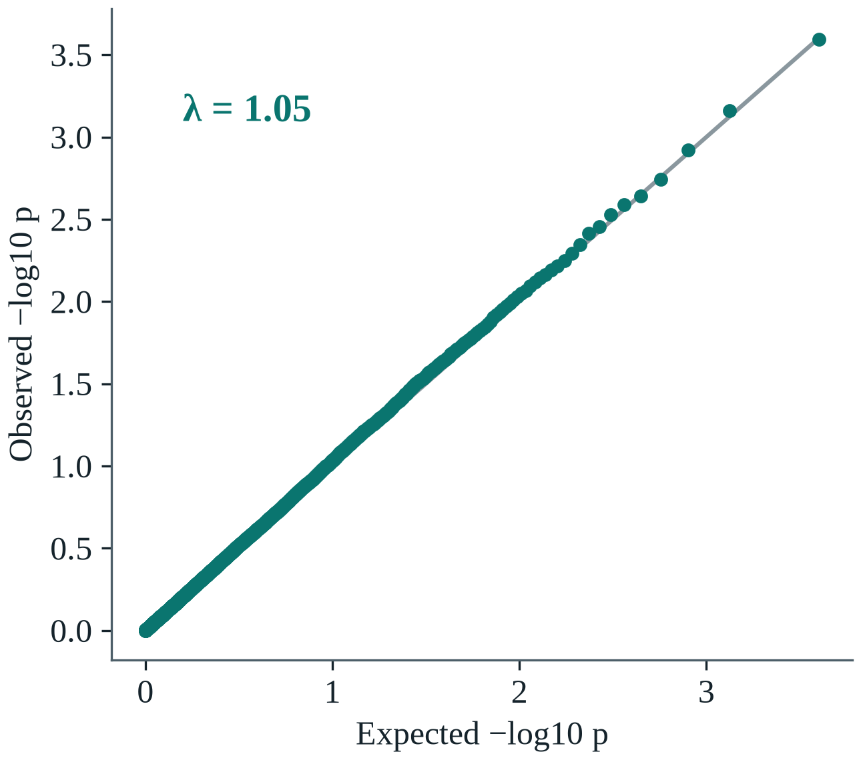
It does not invent interactions
18 of 20
runs with no true interaction report nothing
Notes:
We repeated the search twenty times with no planted interaction. The p-values follow chance almost exactly and 18 of the 20 runs report nothing.

Slide 23
Selection cuts redundant pairs
Redundant pairs among the 48 chosen
Notes:
Nearby variants repeat the same signal. Top-K wastes 22 of its 48 places on these shadows. The QUBO and mRMR both cover 62 SNPs with about 16 shadows; the QUBO reaches the best objective in 61% of runs and mRMR in 39%, so it is only slightly better than mRMR.

Slide 24
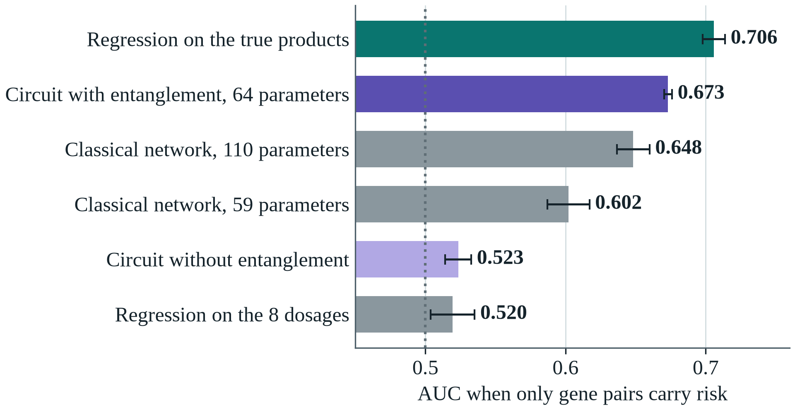
Entanglement lets the circuit see interaction
Notes:
To test what entanglement does, we built an outcome from four gene pairs only, so no single SNP carries risk. Without entanglement the circuit stays at chance, 0.523, like plain regression. With the CZ gates it reaches 0.673, most of the way to the 0.706 of a model told the answer, and with 64 parameters it beats classical networks of 59 and 110 parameters. The networks were not tuned for this, so the claim is that entanglement detects interaction, not that quantum beats classical.

Slide 25
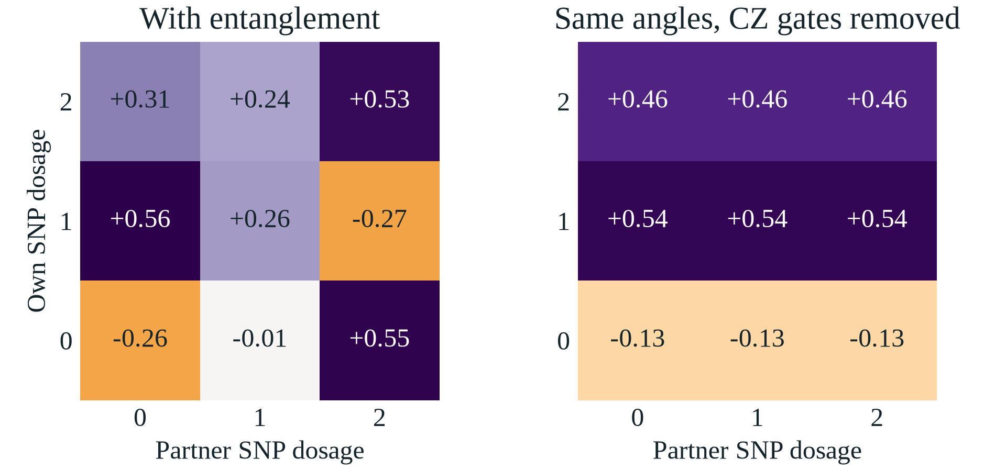
Without entanglement, a qubit is blind
Notes:
This is the mechanism. With entanglement the qubit's output changes with its partner SNP; remove the CZ gates and keep the same angles, and every row is flat. Across the circuit 42 percent of a qubit's output comes from its partner, against exactly zero without entanglement.

Slide 26
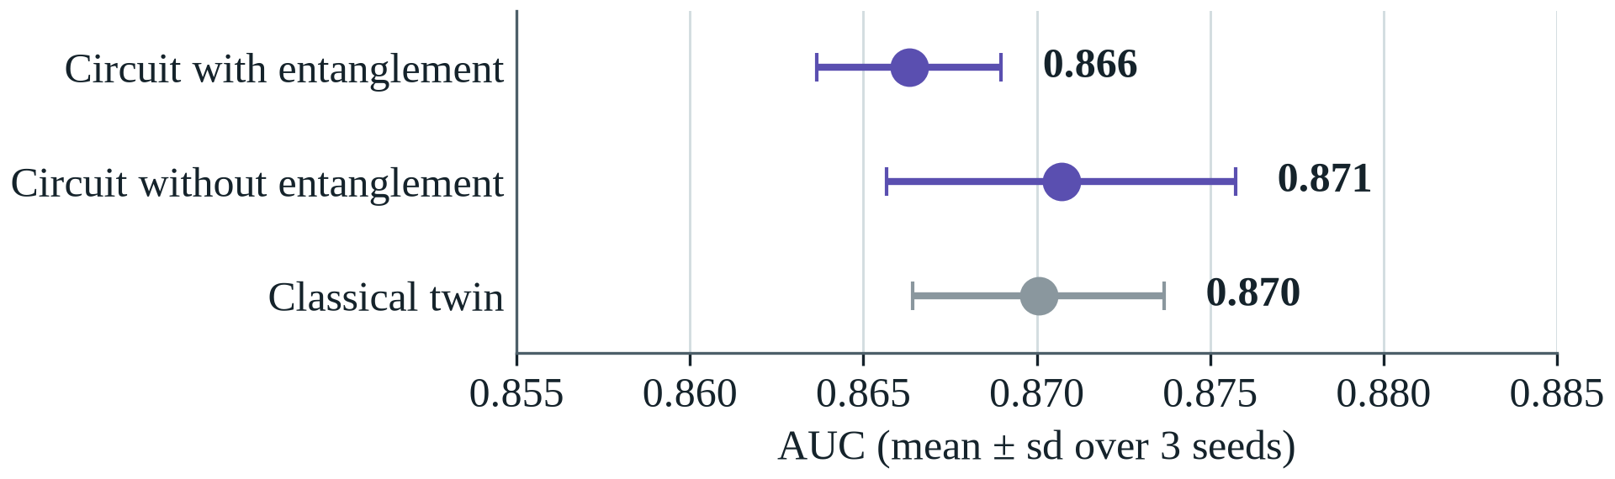
On realistic data, all encoders tie
Notes:
On the realistic cohort, interaction is a small part of risk and the additive scores carry most of the signal, so all three encoders tie: 0.866 with entanglement, 0.871 without, 0.870 for a classical network. Entanglement helps exactly when there is interaction to find.

Slide 27
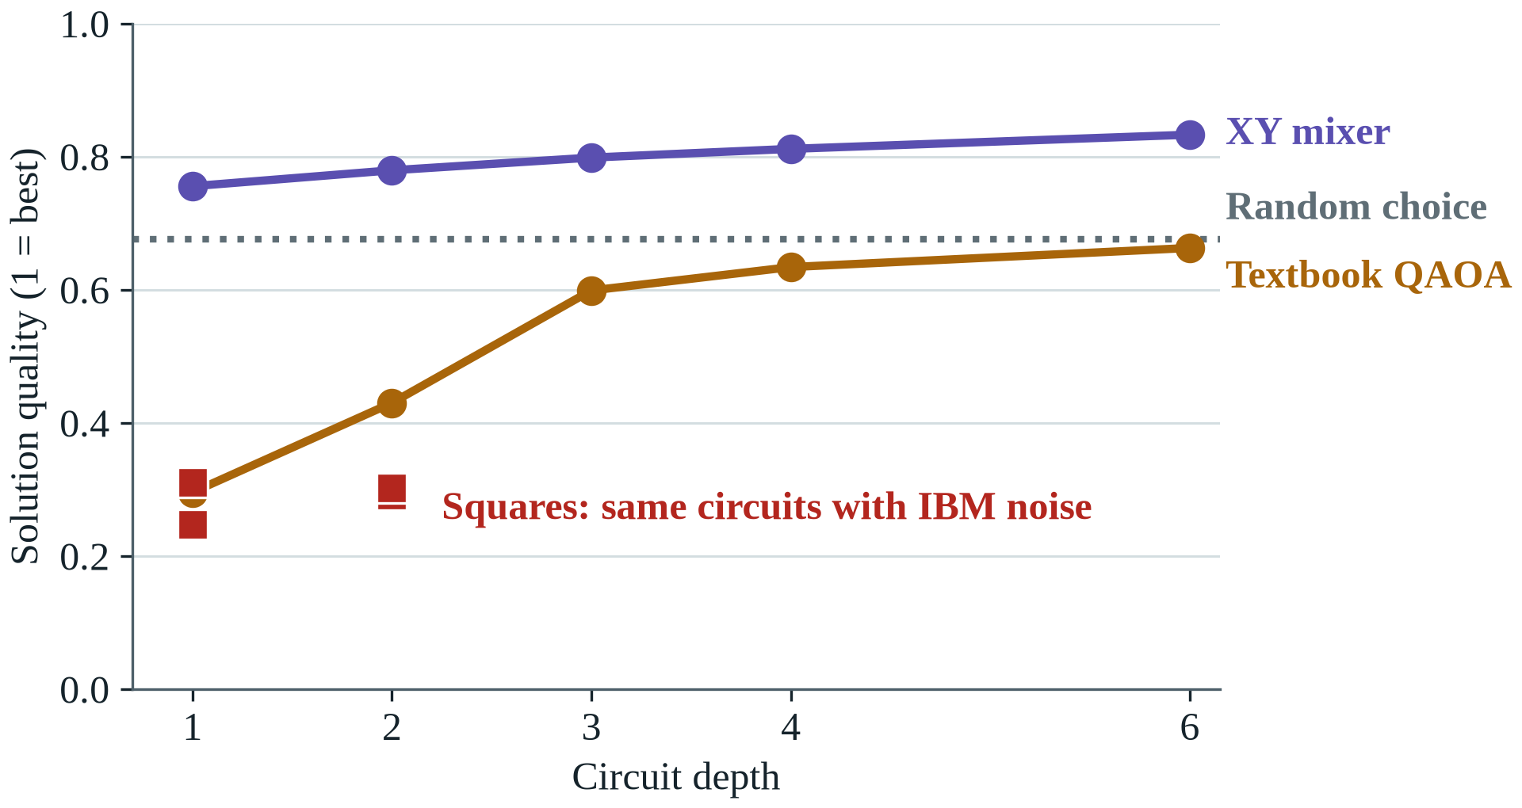
A better mixer, until noise arrives
Notes:
On an ideal simulator our XY mixer beats textbook QAOA at every depth and beats a random valid choice. On a noise model of the IBM Kingston processor both fall to about 0.3.

Slide 28
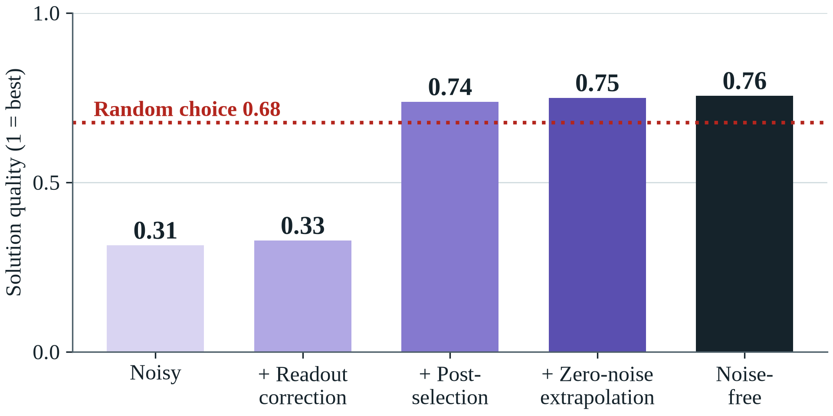
Error mitigation wins most of it back
Notes:
Three inexpensive techniques take the XY circuit from 0.31 to 0.75, against 0.76 with no noise. Post-selection does most of the work, because this circuit conserves the number of selected pairs.

Slide 29
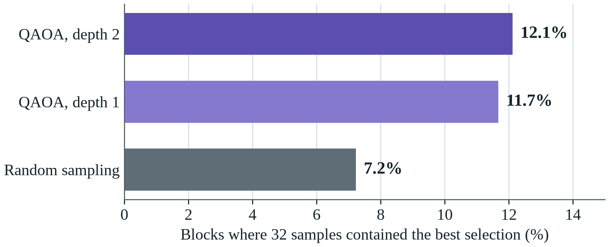
12-qubit QAOA makes the real selection
4 of 6 runs match or beat simulated annealing
Notes:
QAOA can now make the selection the pipeline uses, 48 of 200 pairs, by solving it 12 pairs at a time, a hardware-sized circuit. With the same 32 samples per block, QAOA finds the best answer about 1.7 times as often as random sampling. The whole search matches or beats simulated annealing in 4 of 6 runs; random sampling never does. No speed-up is claimed: these circuits are small enough to simulate exactly.

Slide 30
It holds on real genomes
AUC of the clinical + genetic model on real 1000 Genomes people
Notes:
Trained on synthetic South Asians and tested on real genomes, with simulated outcomes. It is best in South Asians and weakest in Africans, the expected loss far from the training ancestry.

Slide 31
It holds across South Asia
AUC gained from genetics in each group
Notes:
Genetics improves on clinical factors in every population and in both sexes. Predicted risks run about 11 percent high on real genomes, equally in every group, so local recalibration is the remedy.

Slide 32
It survives 13 simulator settings
13 of 13
13 of 13
settings where genetics beats clinical factors
settings where it catches more lean cases than the IDRS
Notes:
Because outcomes are simulated, we changed one assumption at a time. The AUC gain ranges from 0.039 to 0.072 and is positive in every setting, even with no mechanism interaction at all. Interaction discovery is less forgiving and depends on the true effect size, which we report as a limit.

Slide 33
Partial DNA files stay reliable
Truly high-risk people still flagged, by the share of variants in the file
Notes:
Consumer chips hold about 45 percent of the variants. Filling the gaps with the average keeps only 54% of high-risk people flagged. Our LD imputation keeps 80% and cuts the percentile error from 13 to 6 points.

Slide 34
The what-ifs match the truth
Drop in diabetes risk from each change
Notes:
The simulator knows the true effect of each change, so the app can be checked directly. Its estimates are close and on the cautious side.

Slide 35
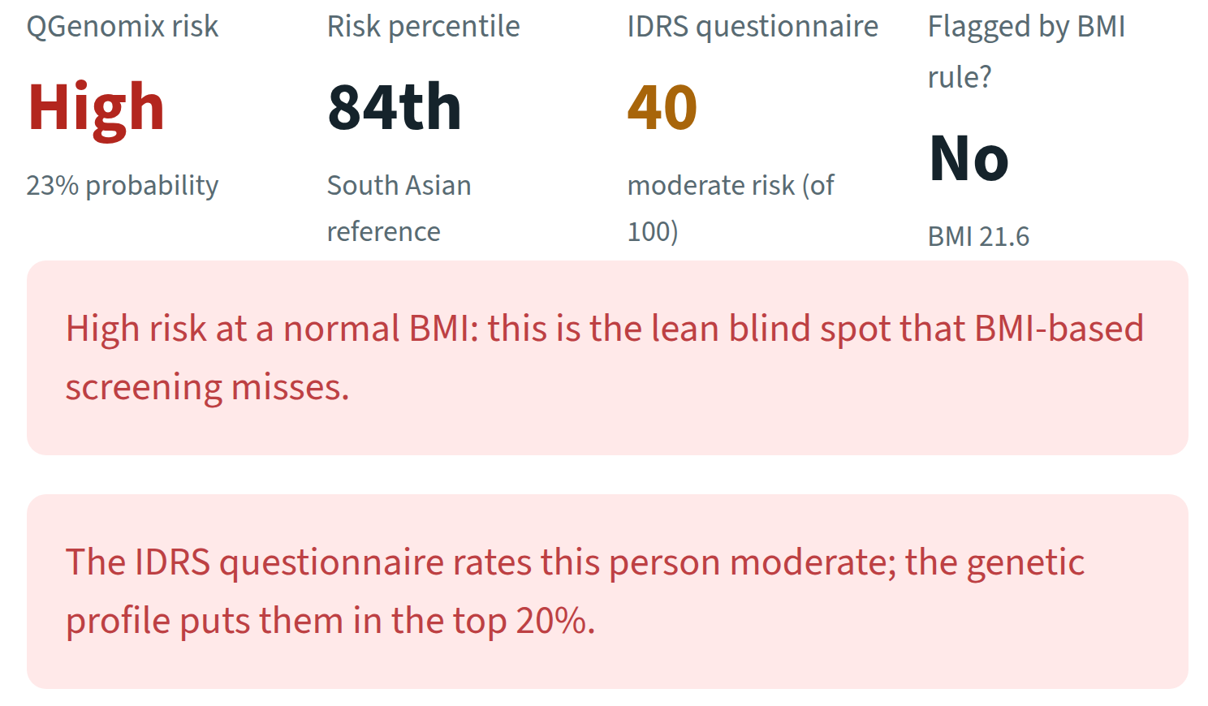
A lean woman, flagged high risk
Notes:
A synthetic demo person: 34 years old, BMI 21.6. QGenomix rates her high risk at the 84th percentile. The IDRS says moderate and the BMI rule says nothing. The report says so in plain words.

Slide 36
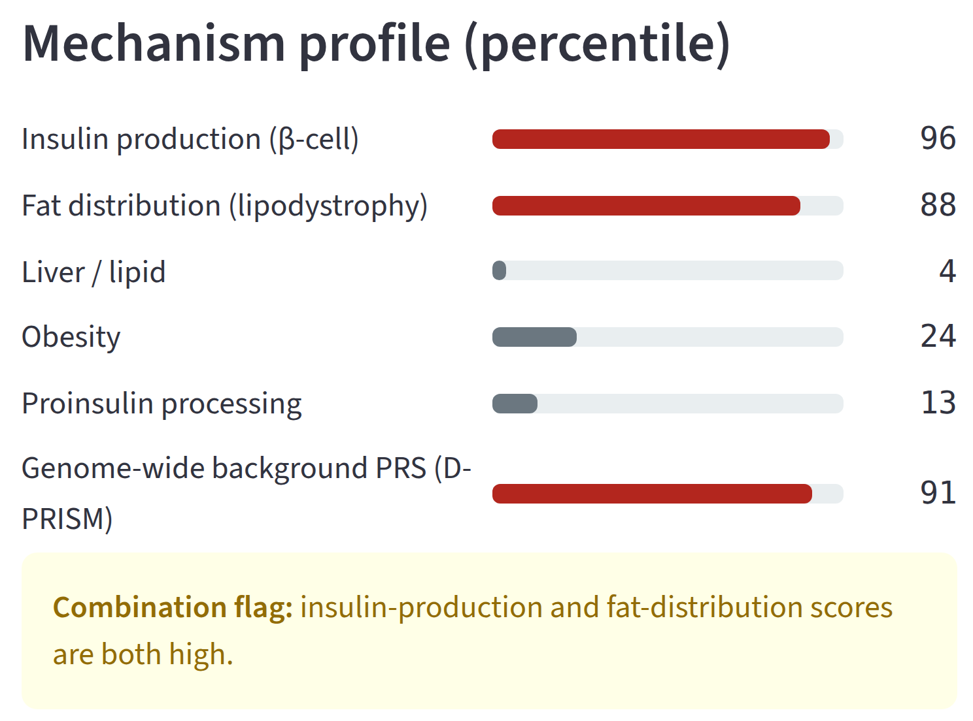
Her genes show why
Notes:
Her insulin-production and fat-distribution scores are high and her obesity score is low. This is the genetic pattern behind lean diabetes.

Slide 37
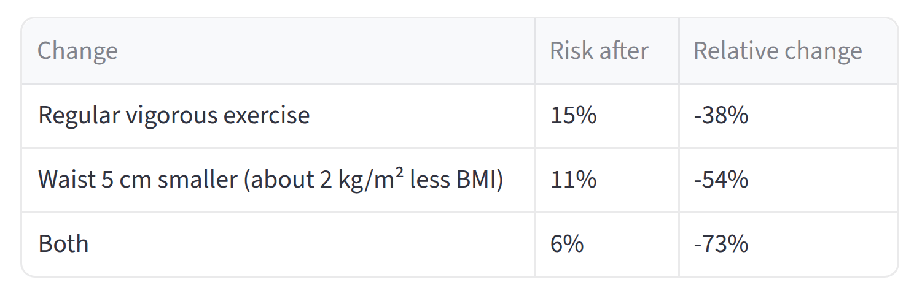
What she can change
Notes:
With genes, age and family history fixed, exercise and a smaller waist take her risk from 23 percent to 6 percent. The same report downloads as a PDF. Live demo here if time allows.

Slide 38




Built to be checked
41
17
automated tests on every push
experiments
17
1
predictors compared
command to run it anywhere
Notes:
Everything can be checked. Tests run on every push, re-runs match bit for bit, and docker compose up runs the whole application.

Slide 39

Live demonstration
A lean woman's risk report, step by step
make app
The same report from the API, as JSON and PDF
make api
Quantum experiments E14 and E15, rerun live
make quantum
QAOA with error mitigation on IBM's noise model
make rehearse-ibm
All 41 automated tests
make test
Notes:
Run the demonstration in this order. Open the dashboard on the lean demo woman and walk through her report, mechanism profile and what-ifs, then download the PDF. Show the same report from the API. Rerun the two quantum experiments, about five minutes, and the IBM noise-model rehearsal. Finish with the tests. No internet is needed.

Slide 40


What comes next
Run on a real IBM quantum computer
A public online demo
Validation on Indian patients
More ancestries, a larger panel
Notes:
The IBM run is scripted and rehearsed. The Docker image is ready for a public demo. Most important scientifically is validation on real Indian patients, because our outcomes are simulated.

Slide 41
What we found
Genetics nearly doubles lean cases caught: 30% to 58%
The search finds 70–84% of planted gene pairs
Entanglement captures interaction; QAOA matches annealing
A tested app turns a DNA file into a clear report
Notes:
Four things to remember, one from each part of the talk. On quantum: the parts do what they are there for, with no speed-up claimed. The main limit is that outcomes are simulated.

Slide 42
Thank you
Questions and feedback are welcome
Team
Guide
Aritro Chowdhury
Suyash Gupta
Dr. Husanbir Singh Pannu
Assistant Professor, CSED
Rishabh Sharma
Akshat Ahuja
Anshh Pasriccha
Notes:
Thank our guide and invite questions.

