Slide 1


QGenomix
CAPSTONE PROJECT CPG 218 · MENTOR EVALUATION
Quantum-assisted genetic screening for early-onset type 2 diabetes in lean South Asians
TEAM
MENTOR
Aritro Chowdhury · 102303452
Suyash Gupta · 102303017
Rishabh Sharma · 102303286
Akshat Ahuja · 102315073
Anshh Pasriccha · 102303455
Dr. Husanbir Singh Pannu
Assistant Professor, CSED
Computer Science and Engineering Department
Thapar Institute of Engineering and Technology
Patiala · October 2026
Notes:
Introduce the team and the mentor. One sentence on the project: QGenomix asks how much genetics adds to India's diabetes screening for lean South Asians, and tests honestly whether quantum computing helps find interacting genes. Today: the problem, what we built since the mid-semester review, the results, the working application, and the plan for the final panel.

Slide 2


Lean South Asians slip through screening
101 M
A BMI rule misses them
South Asians develop type 2 diabetes younger and at a lower body weight than Europeans, so BMI-based screening misses lean people at risk.
adults with diabetes in India
136 M
The IDRS cannot see genes
adults with prediabetes
India's screening questionnaire scores age, waist, activity and family history, so a young, slim person scores low even with high inherited risk.
Source: ICMR-INDIAB-17 national survey (Lancet Diabetes Endocrinol., 2023)
Notes:
India has about 101 million adults with diabetes. South Asians get it younger and thinner, so the two screening tools in use both have a blind spot: a BMI rule never flags a lean person, and the IDRS questionnaire has no way to see genetic risk in someone young and slim. That lean, high-risk group is our target.

Slide 3
What QGenomix sets out to answer
1
2
How much does genetics add to India's screening questionnaire, especially for lean people?
Do insulin-production (β-cell) and fat-distribution (lipodystrophy) variants interact, and can quantum optimisation help find them?
Polygenic and mechanism scores on real genomes (E1, E8)
Score test, QUBO, QAOA and a quantum encoder (E2–E7b)
Every quantum component has a classical control: simulated annealing for QAOA, and the same circuit without entanglement plus a classical network of similar size for the quantum encoder.
Notes:
Two questions drive everything. The first is clinical: what does genetics add to the IDRS, and does it help the lean people current screening misses? The second is scientific and technical: do two diabetes mechanisms interact, and does quantum optimisation help find the interacting pairs? Because quantum claims are easy to overstate, every quantum step has a matched classical control.

Slide 4


Progress since the mid-semester review
Added beyond the plan
QAOA with error mitigation
Clinical factors and the IDRS
Real-genome, fairness and robustness tests
LD imputation for consumer DNA files
App with PDF report, REST API and Docker
*Built and measured, then replaced: the score test with QUBO selection found 73% of planted pairs, SHAP ranking 33%.
Notes:
At mid-semester only the data pipeline was complete. All six approved objectives are now done; the SHAP refinement loop was built and measured, but the score test with QUBO selection found far more of the planted pairs, so it replaced the loop and SHAP is now used for per-person explanations. On the right is what we added beyond the plan.

Slide 5


Real genomes, simulated outcomes
1000 Genomes
Published scores
Synthetic cohort
2,504 real genomes
84 million variants
489 South Asians: 978 haplotypes
D-PRISM South Asian PRS: 1.34 M variants
5 mechanism scores, 62 SNPs
1,263 cross-mechanism SNP pairs
10,000 South Asians as haplotype mosaics
Simulated T2D, 11% prevalence
10 planted gene pairs: known truth
Why simulate the outcomes? A known ground truth lets every discovery claim be checked. The synthetic cohort matches real South Asian allele frequencies (r = 0.9999), and models are re-tested on the real genomes.
Notes:
Genotypes are real: all 2,504 people in 1000 Genomes, including 489 South Asians. Risk weights are published: the D-PRISM score trained for South Asians and five mechanism scores. To score discovery exactly we simulate outcomes on 10,000 synthetic South Asians assembled from real haplotypes, with ten planted gene pairs that we know are true.

Slide 6
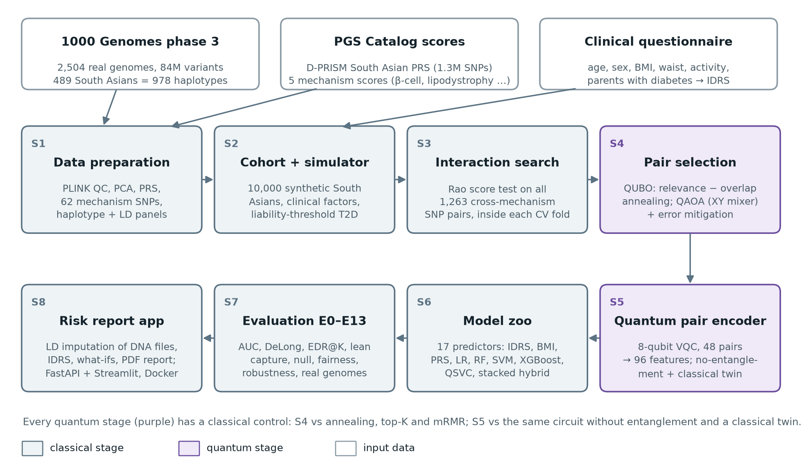
Eight stages, two of them quantum
Notes:
Walk the pipeline: data preparation, cohort and simulator, interaction search, pair selection (QUBO with annealing and QAOA), the quantum encoder, the model zoo of 17 predictors, the evaluation (15 experiments), and the risk-report application. The purple stages are quantum; each has a classical control.

Slide 7

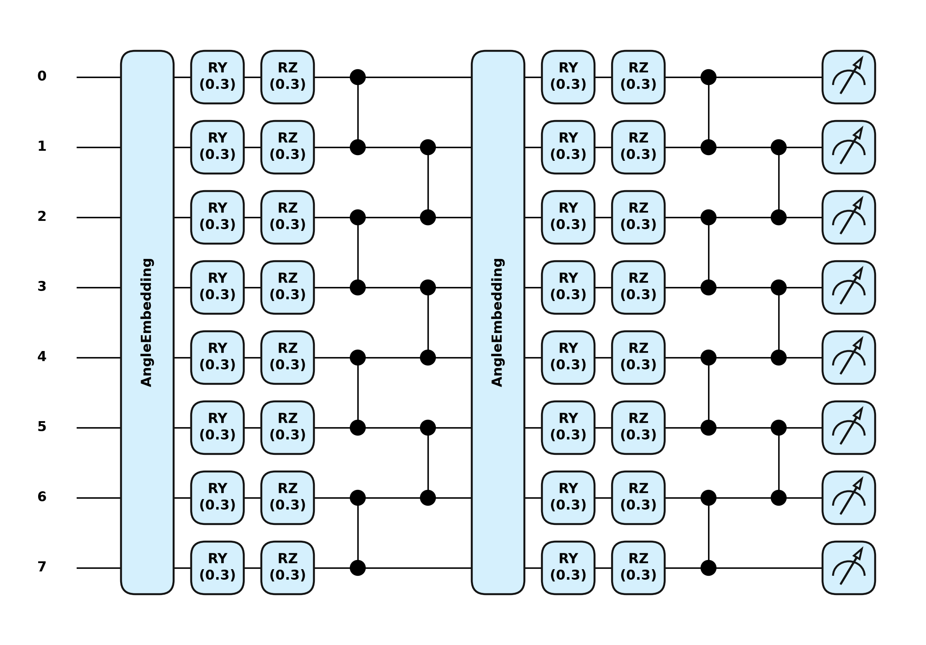

Where the quantum computing comes in
QUBO pair selection
Pick 48 non-redundant pairs from the 200 strongest: reward relevance, penalise pairs that share a SNP. Solved by simulated annealing.
QAOA
The same selection on a quantum circuit: a constraint-preserving XY mixer started from a Dicke state, tested on the IBM Kingston noise model with error mitigation.
Variational pair encoder
8 qubits, 4 layers, 64 shared angles: 12 circuits turn the 48 pairs into 96 features for the model.
The pair encoder, two of its four layers: data rotations, trainable RY/RZ, a chain of CZ gates
Notes:
Quantum computing appears in two places. Choosing a non-redundant set of gene pairs is a QUBO, which we solve classically and with QAOA; our QAOA uses an XY mixer that only explores valid selections. The selected pairs are then encoded by an 8-qubit variational circuit whose entanglement lets a feature depend on both SNPs of a pair.

Slide 8
Genetics adds to clinical screening
+0.063
AUC from genetics on top of all clinical factors
DeLong p ≤ 4×10⁻⁶ in every seed
0.866–0.871
AUC of the quantum variants: no significant gain over classical
Notes:
The IDRS alone reaches 0.761; clinical factors 0.812. Adding the PRS and mechanism scores lifts this to 0.874, significant in every seed. The stacked hybrid is best at 0.877 but not significantly better than the additive model, and the quantum variants do not beat their classical counterparts.

Slide 9
Genes find the lean cases screening misses
30% → 58%
of lean diabetes cases (BMI < 23) caught in the top 20% of risk: IDRS questionnaire → with genetics
A BMI rule catches none of them by construction.
Notes:
This is the main clinical result. Among lean people who develop diabetes, the BMI rule flags none, the IDRS 30%, a clinical model 35%. Adding genetics raises this to 58%. Genetics helps most for exactly the people current screening misses.

Slide 10
The search finds the planted gene pairs
70–84%
of planted pairs in the top 10 at 10,000 people; PLINK BOOST finds 40–48%
18 of 20
runs with no true interaction report nothing (λ = 1.05)
62 vs 49
distinct SNPs covered by QUBO vs top-K, with 26% fewer redundant pairs
Notes:
With 10,000 people the score test puts 70 to 84 percent of the planted pairs in its top ten, against 40 to 48 percent for PLINK's BOOST, and the curve shows how discovery grows with cohort size. With no true interaction it stays quiet: 18 of 20 null runs report nothing. QUBO selection covers more distinct SNPs and wastes fewer slots on redundant shadow pairs than plain top-K.

Slide 11
Quantum results, measured honestly
Entanglement adds nothing: 0.866 with it, 0.871 without, 0.870 for a classical twin.
On an ideal simulator the XY mixer beats textbook QAOA (0.76 vs 0.30 at depth 1).
Hardware noise drops both to about 0.3; mitigation brings the XY circuit back to 0.75 (noise-free 0.76, random choice 0.68).
No speed-up is claimed: an 8-qubit circuit can be simulated exactly.
Notes:
We report the quantum results as they are. The encoder performs the same with and without entanglement. QAOA with our XY mixer clearly beats the textbook form on an ideal simulator, but realistic IBM noise destroys both. Error mitigation recovers most of it: readout correction, post-selection on the conserved pair count, and zero-noise extrapolation take the XY circuit from 0.31 to 0.75, close to the noise-free 0.76. The penalty form reaches only 0.69, the level of a random valid choice.

Slide 12
Fair across groups, robust to assumptions
13 / 13
simulator settings where genetics beats clinical factors
13 / 13
settings where it catches more lean cases than the IDRS
AUC gain in every South Asian population: +0.05 to +0.08. Risk runs about 11% high on real genomes, equally in every group, so local recalibration fixes it.
Notes:
Two checks of trust. Fairness: on the real South Asian genomes, genetics improves on clinical factors in every population and in men and women. Robustness: because outcomes are simulated, we changed one assumption at a time in 13 settings; genetics wins in all of them.

Slide 13
Consumer DNA files: filling the gaps
At 45% coverage, typical of a 23andMe file
13 → 6
points of error in the risk percentile
54% → 80%
of truly high-risk people still flagged high
0.95 → 0.98
correlation with the full-genome PRS
Each missing variant is predicted from its best-correlated measured neighbour in 489 South Asian genomes; about one second per genome.
Notes:
Consumer chips measure about half the variants of the risk score. Filling the gaps with the average pulls everyone to the middle and hides high-risk people. Our LD imputation predicts each missing variant from its best-correlated measured neighbour; at typical coverage it halves the error and keeps most high-risk people flagged.

Slide 14
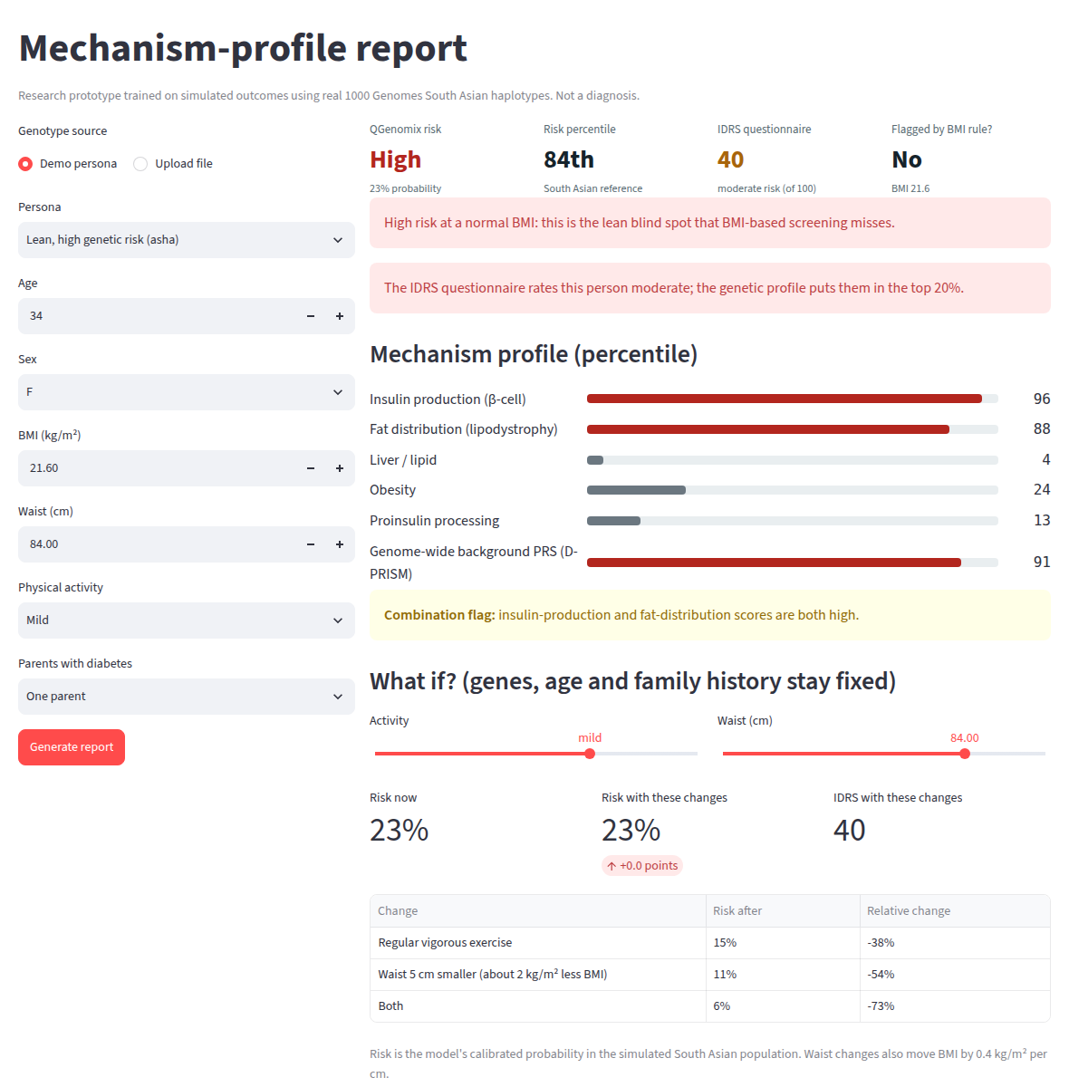
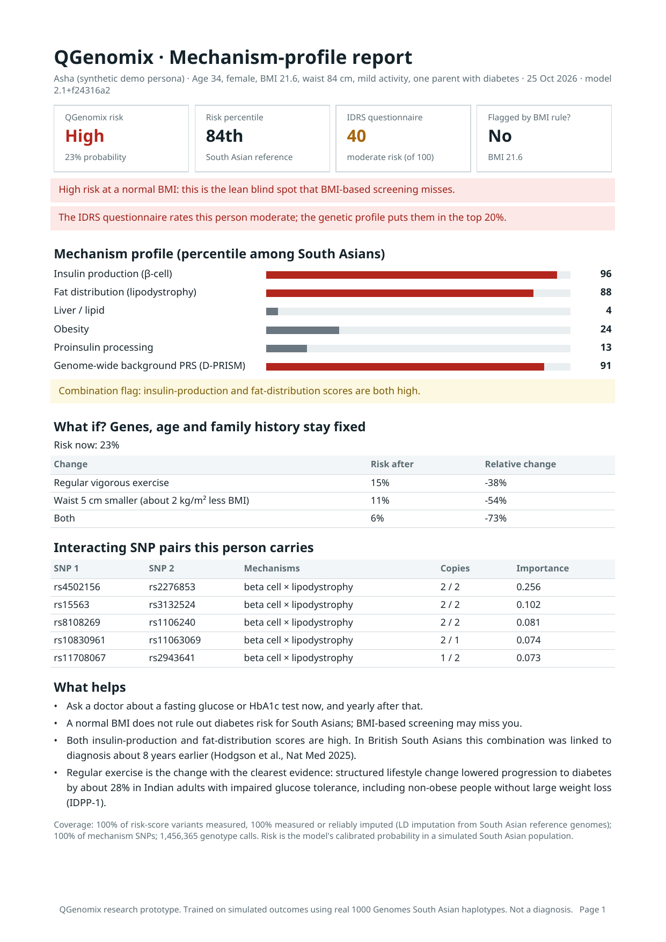
The working application
Reads 23andMe and AncestryDNA files
Fills in missing variants (LD imputation)
Risk tier, percentile, IDRS and screening flags
Mechanism profile and SHAP-ranked gene pairs
Live lifestyle what-ifs
PDF report, REST API and Docker image
Dashboard report for a synthetic demo persona
The one-page PDF
Notes:
This is the product. A user uploads a 23andMe or AncestryDNA file and answers six questions. The app imputes missing variants, shows the risk with its percentile and the IDRS, flags people the BMI rule or the IDRS would miss, explains which mechanisms and gene pairs drive the risk, and lets them try lifestyle changes. The same report downloads as a PDF, and everything runs from one Docker image. Live demo: make app.

Slide 15






Built to be checked
38
15
17
automated tests, run on every push with GitHub Actions
experiments, from data checks to robustness
predictors compared on identical data splits
41
Bit for bit
1 command
Python modules, 4,053 lines
re-runs reproduce the stored results
docker compose up runs the app anywhere
Notes:
Everything can be checked. Tests cover the maths, the equivalence of our simulators with PennyLane and Qiskit, the pipeline end to end, and the app. One configuration file drives every result, re-runs match bit for bit, and the whole application runs with one Docker command.

Slide 16

Next: the final panel on 9 November
1
2
3
28–31 Oct
1–5 Nov
6–9 Nov
IBM quantum hardware run, public online demo, updated figures and report
Final report, paper draft, slides and a three-minute demo video
Test run on a clean machine and a timed rehearsal
Kept for the panel: real IBM quantum run
Kept for the panel: public online demo
Script ready and rehearsed on the Kingston noise model; one batched job uses about 2 of the 10 free QPU minutes.
Docker image built and tested; deploy it to a free host under a team account and share the link.
Notes:
Two features are deliberately kept for the final panel because each needs an account in our own name: the run on a real IBM quantum computer, which is scripted and rehearsed, and a public online demo from the Docker image. The rest of the time goes to the final report, a paper draft, slides, a demo video and rehearsal.

Slide 17
Thank you
Questions and feedback are welcome
Genetics nearly doubles the lean diabetes cases caught (30% → 58%), in every population and every setting tested.
The interaction search finds 70–84% of planted pairs and stays quiet when there are none.
Quantum methods, measured against classical controls: no advantage yet, and mitigation recovers most of the noise.
A working, tested application turns a consumer DNA file into an explained report.
Aritro Chowdhury · Suyash Gupta · Rishabh Sharma · Akshat Ahuja · Anshh Pasriccha
Mentor: Dr. Husanbir Singh Pannu, Assistant Professor, CSED, Thapar Institute of Engineering and Technology, Patiala
Notes:
Close with the four takeaways and invite questions. Ask the mentor which emphasis to give the final panel: the clinical result, the quantum study, or the application.

