Slide 1

QGenomix
A quantum-classical framework to find lean South Asians at high risk of type 2 diabetes
Presented by
Guided by
Aritro Chowdhury
Suyash Gupta
Dr. Husanbir Singh Pannu
Assistant Professor, CSED
Thapar Institute of Engineering and Technology, Patiala
Rishabh Sharma
Akshat Ahuja
Anshh Pasriccha
Notes:
Introduce the team and our guide. One sentence on the project: we want to find South Asians who look healthy and slim but carry a high inherited risk of type 2 diabetes.

Slide 2
India's diabetes crisis
101 million
Indians live with diabetes; 136 million more have prediabetes
1 in 4
of the world's 828 million adults with diabetes live in India
43%
of Indian adults with diabetes do not know they have it
Sources: ICMR-INDIAB, The Lancet Diabetes & Endocrinology, June 2023, and The Tribune, 10 June 2023; NCD-RisC, The Lancet, November 2024, and ThePrint, 14 November 2024; IDF Diabetes Atlas, 2025
Notes:
The ICMR-INDIAB study tested over 113,000 people: 101 million Indians have diabetes and 136 million more have prediabetes. A Lancet study counted 828 million adults with diabetes in the world in 2022, more than a quarter of them in India, and 62 percent of those were not on medication. The International Diabetes Federation says 43 percent of Indian adults with diabetes do not know it. The counts differ because the studies use different age ranges and blood tests, but the message is the same.

Slide 3
Normal weight does not mean low risk
The BMI that carries the same diabetes risk as BMI 30 in White people
Source: Caleyachetty et al., The Lancet Diabetes & Endocrinology, 2021
Notes:
This is the first punch line. In a study of 1.47 million people, a South Asian at BMI 23.9 had the same diabetes risk as a White person at BMI 30. Most charts call 23.9 normal. The same risk in a White person is called obese. Comparing people of normal weight directly tells the same story: in Chennai 23.5 percent of normal-weight men have diabetes, against 6 percent in the United States.

Slide 4


Screening cannot see these people
BMI rule
IDRS questionnaire
Never flags a lean person
Four questions, no genes
Source: IDRS: Mohan et al., Journal of the Association of Physicians of India, 2005
Notes:
Two tools decide who gets tested. A BMI rule cannot flag a lean person. The IDRS asks about age, waist, activity and family history, so a young, slim person scores low by design. These are exactly the people we just saw.

Slide 5
The missing risk is inherited
8.2 years
earlier diagnosis, at a BMI 3 points lower, in people with high genetic risk on two mechanisms
Source: Hodgson et al., Nature Medicine, 2025
Notes:
Among British South Asians, people with high genetic risk on both insulin deficiency and lipodystrophy were diagnosed 8.2 years earlier at a lower BMI. They look healthy on every measure used in screening today. And only 2 percent of the people in the largest genetic study were South Asian.

Slide 6
Prevention works, if people are found
28%
less progression to diabetes with lifestyle change
But only people who know they are at risk can act.
Source: Indian Diabetes Prevention Programme, Ramachandran et al., Diabetologia, 2006
Notes:
This is why the problem is worth solving. Lifestyle change lowered progression to diabetes by about 28 percent in Indian adults. The hard part is finding the right people early.

Slide 7
Three questions
1
How much does genetics add to screening, above all for lean people?
2
Do diabetes mechanisms interact, or do they only add up?
3
Can a consumer DNA file give a reliable report?
Notes:
The problem comes down to three questions, and the rest of the talk answers them in turn.

Slide 8
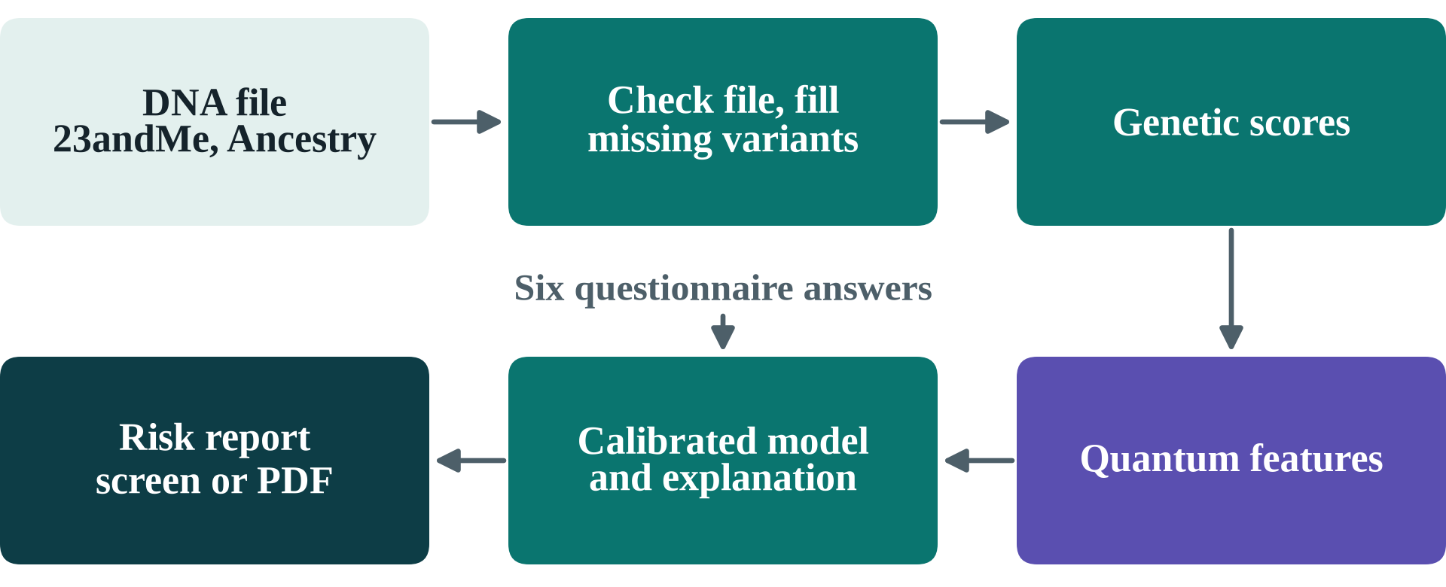
One DNA file, six answers, one report
Notes:
QGenomix turns a 23andMe or AncestryDNA file and six questionnaire answers into a risk report that a person can read. This slide is the destination; the next slides show how we got there.

Slide 9


Real genomes, known truth
2,504
1.34 M
10,000
real genomes from 1000 Genomes
variants in the D-PRISM risk score
synthetic South Asians with a known truth
Synthetic people match real ones: allele frequencies r = 0.9999
Notes:
Genotypes and risk weights are real: all 2,504 people of 1000 Genomes, whose genetic map has the well-known shape of human variation. Disease outcomes are simulated on synthetic South Asians built from real haplotypes, with ten planted gene pairs, so every discovery can be checked against a known truth. The synthetic people have the same allele frequencies as the 489 real South Asians, with a correlation of 0.9999. Simulation is also the main limit of the work, which is why we test it so hard later.

Slide 10
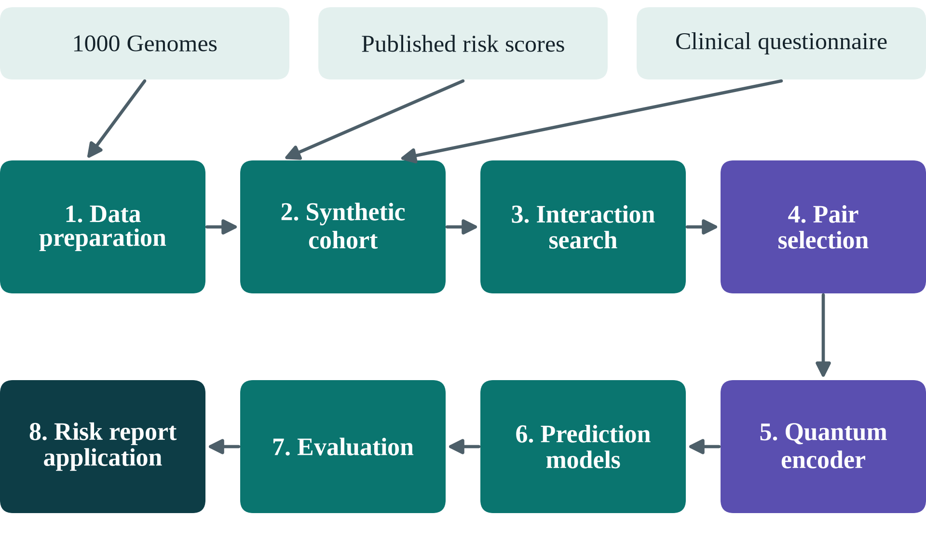
Eight stages, two of them quantum
Notes:
Walk the pipeline quickly. The two purple stages are where quantum computing enters. Everything else is classical.

Slide 11


Why quantum computing?
Gene pairs
Pair selection
Entanglement links two variants, so a qubit can see interaction
48 of 200 pairs: 10⁴⁷ choices, a native QUBO for QAOA
Every quantum part faces a classical control.
Notes:
Quantum is used where the problem has a quantum shape. Our question is gene-gene interaction, and entanglement is exactly the operation that makes two qubits depend on each other. Choosing 48 of 200 pairs has about 10 to the 47 possible answers, and as a QUBO it is the native problem of QAOA and quantum annealers. The circuits are 8 and 12 qubits, sized for today's hardware. And because quantum claims are easy to overstate, every quantum part faces a classical control.

Slide 12
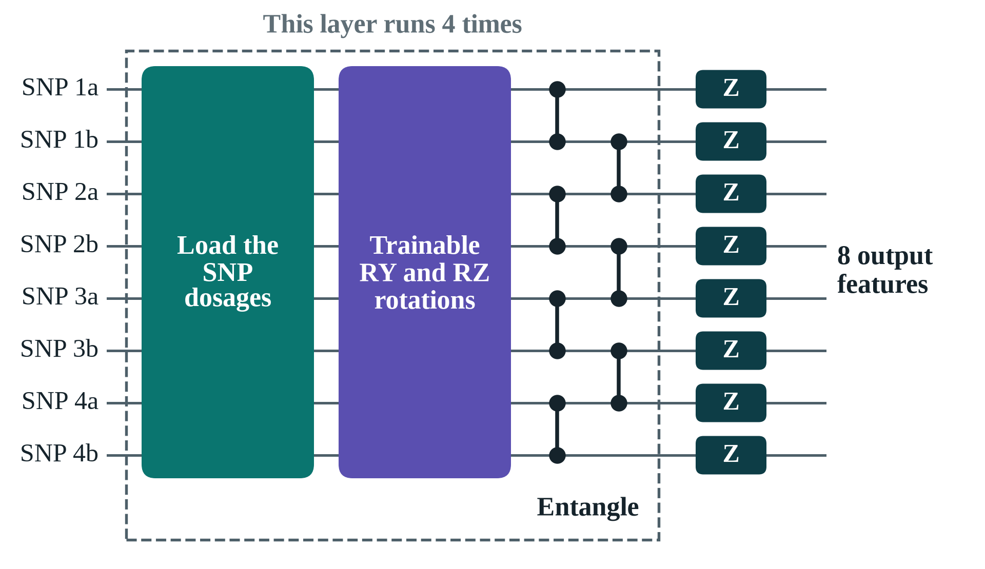
The quantum pair encoder
Notes:
Each circuit carries four SNP pairs on eight qubits. It loads the dosages, applies trainable rotations and entangles the qubits, four times over. Twelve circuits give 96 features. Without the CZ gates a qubit sees only its own SNP, which is the control we test.

Slide 13
Genetics lifts screening accuracy
AUC: 0.5 is a coin toss, 1 is perfect
Notes:
Each step adds information. All clinical factors reach 0.812; adding the genetic scores lifts this to 0.874, significant in every seed. The stacked hybrid reaches 0.877 but its margin is not significant.

Slide 14
Genetics nearly doubles lean cases caught
Lean diabetes cases caught when the top 20% by risk are screened
Notes:
This is the main result. A BMI rule catches no lean cases, the IDRS 30%, all clinical factors 35%, and with genetics 58%. Genetics helps most for exactly the people screening misses.

Slide 15
The search finds planted gene pairs
Share of 10 planted pairs in the top 10, as the interaction grows stronger
Notes:
Ten pairs are planted, so a search can be marked exactly. Across the mechanism settings the score test finds 70 to 84 percent at strength 0.2, against 40 to 48 percent for PLINK's BOOST. With more people it finds them all: 78 percent at 10,000 people and 100 percent at 40,000. It does not invent pairs either: in 20 runs with no planted interaction, 18 reported nothing. The QUBO then picks 48 pairs without redundant shadows, covering 62 distinct SNPs instead of 49 for a plain top-48 list.

Slide 16
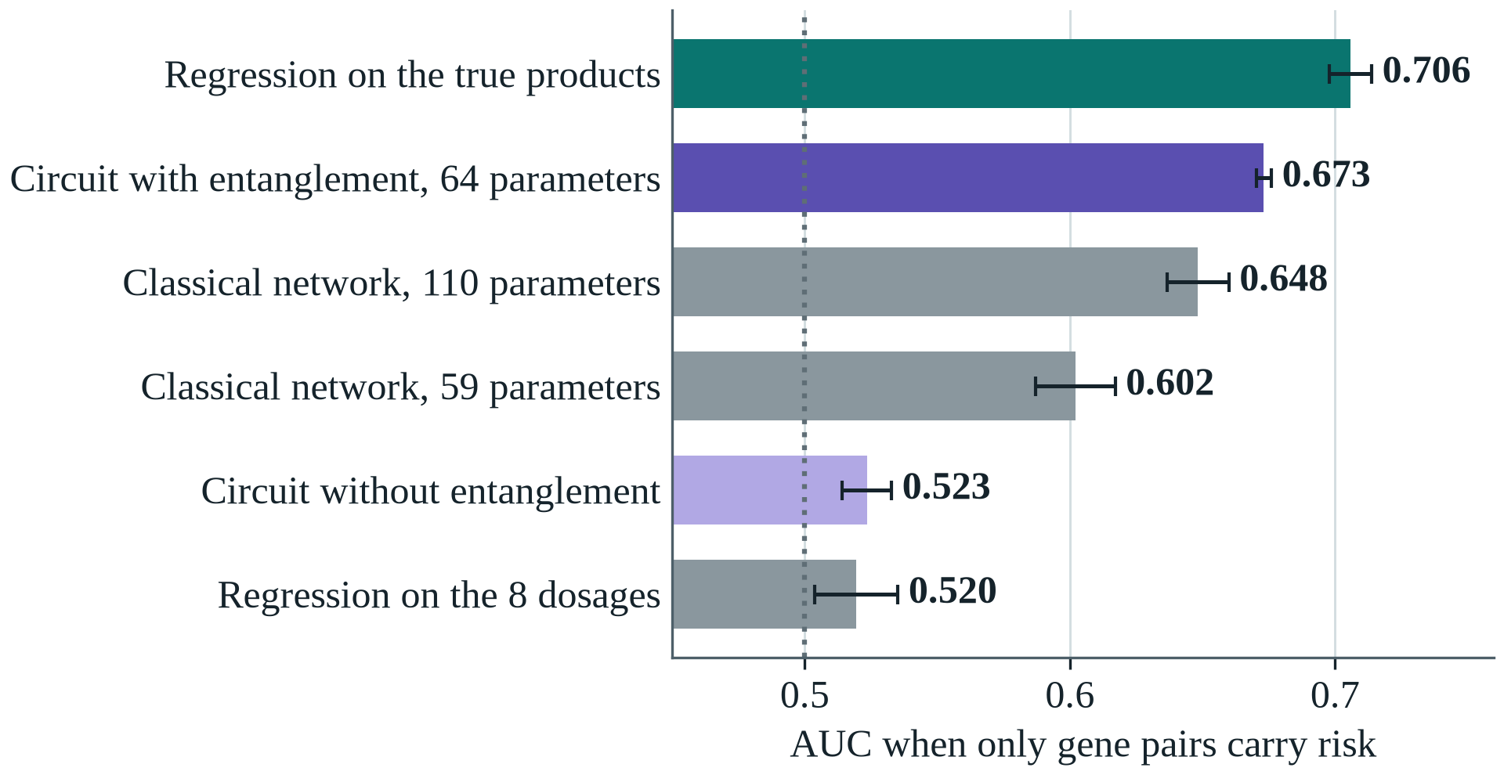
Entanglement lets the circuit see interaction
Notes:
To test what entanglement does, we built an outcome from four gene pairs only, so no single SNP carries risk. Without entanglement the circuit stays at chance, 0.523, like plain regression. With the CZ gates it reaches 0.673, most of the way to the 0.706 of a model told the answer, and with 64 parameters it beats classical networks of 59 and 110 parameters. The networks were not tuned for this, so the claim is that entanglement detects interaction, not that quantum beats classical.

Slide 17
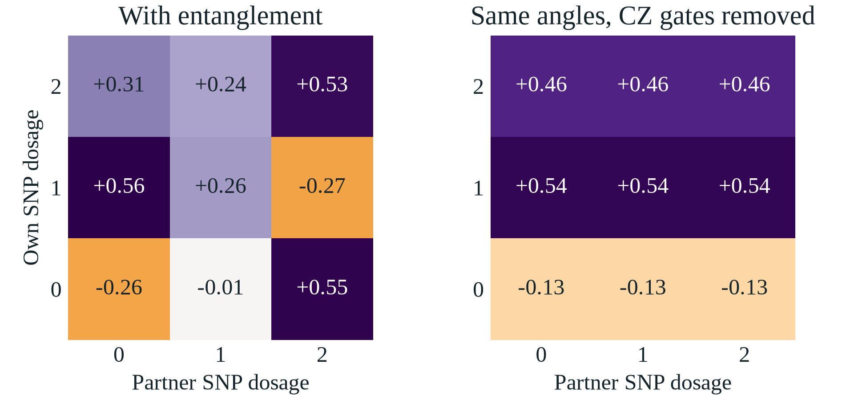
Without entanglement, a qubit is blind
Notes:
This is the mechanism. With entanglement the qubit's output changes with its partner SNP; remove the CZ gates and keep the same angles, and every row is flat. Across the circuit 42 percent of a qubit's output comes from its partner, against exactly zero without entanglement.

Slide 18
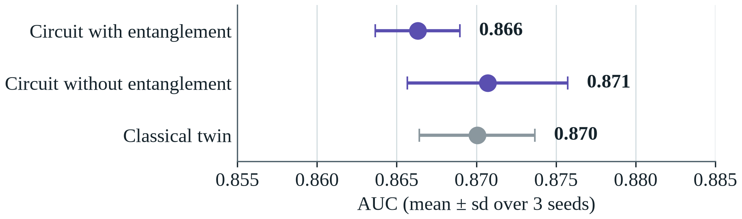
On realistic data, all encoders tie
Notes:
On the realistic cohort, interaction is a small part of risk and the additive scores carry most of the signal, so all three encoders tie: 0.866 with entanglement, 0.871 without, 0.870 for a classical network. Entanglement helps exactly when there is interaction to find.

Slide 19
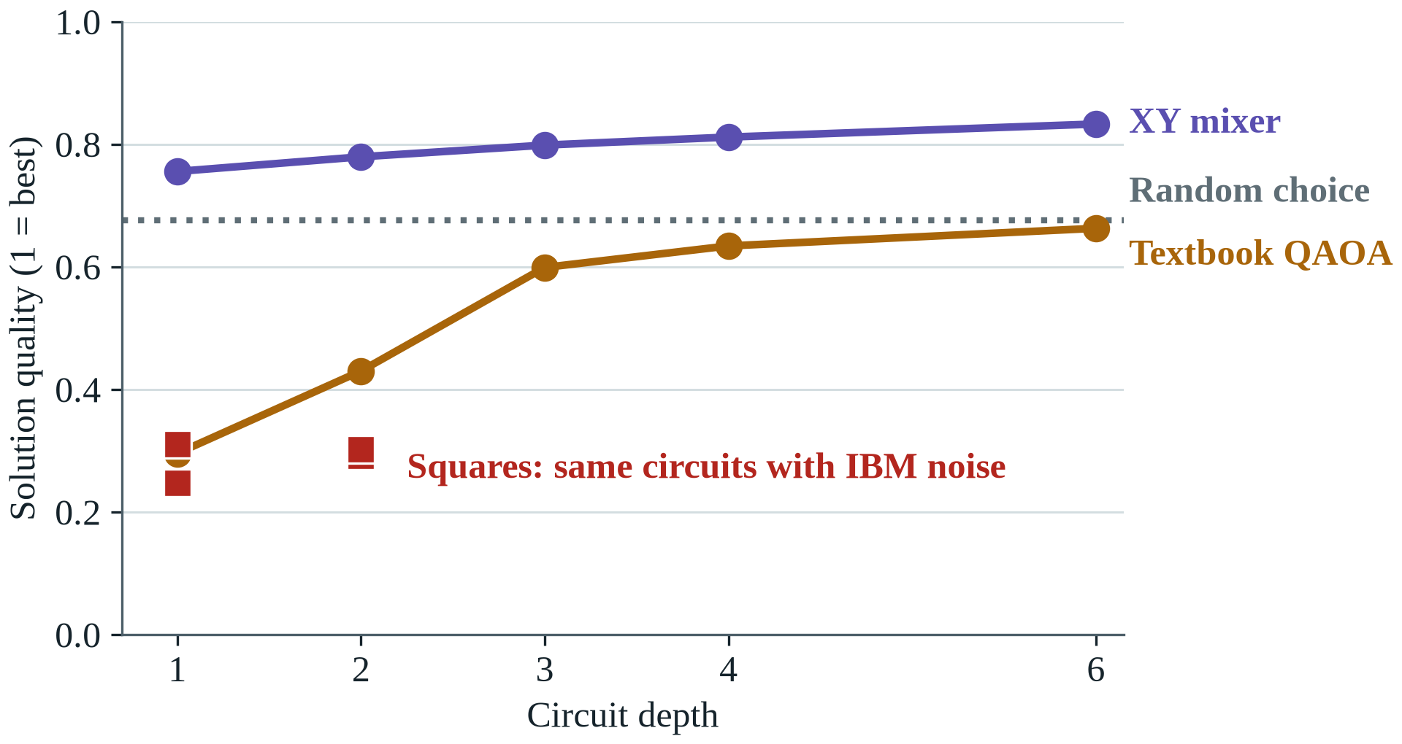
A better mixer, until noise arrives
Notes:
On an ideal simulator our XY mixer beats textbook QAOA at every depth and beats a random valid choice. On a noise model of the IBM Kingston processor both fall to about 0.3.

Slide 20
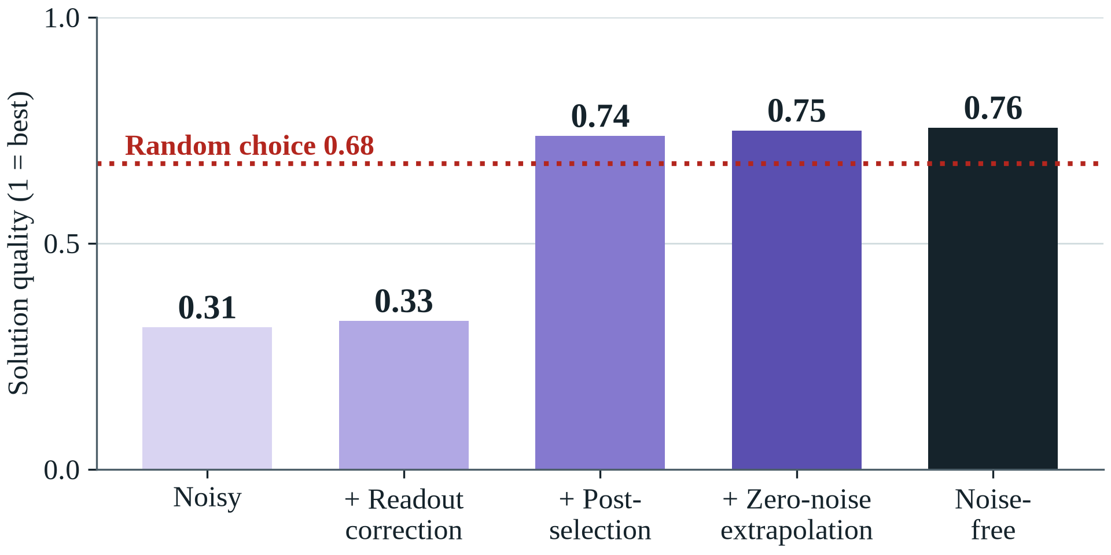
Error mitigation wins most of it back
Notes:
Three inexpensive techniques take the XY circuit from 0.31 to 0.75, against 0.76 with no noise. Post-selection does most of the work, because this circuit conserves the number of selected pairs.

Slide 21
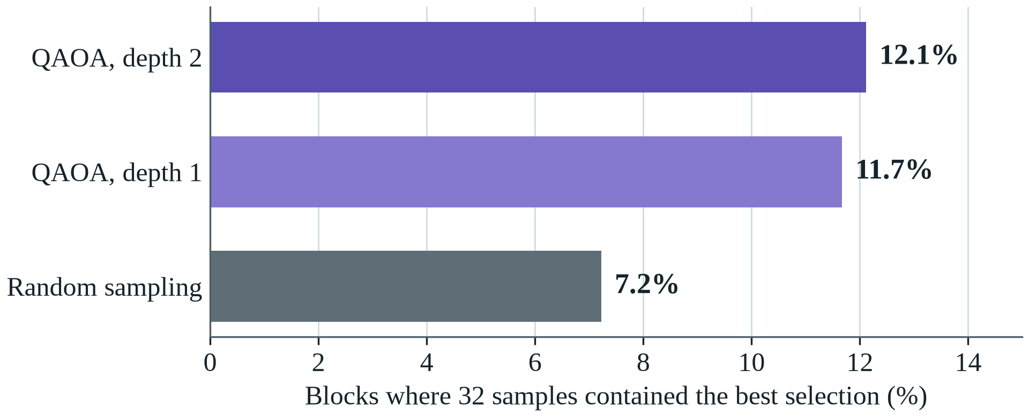
12-qubit QAOA makes the real selection
4 of 6 runs match or beat simulated annealing
Notes:
QAOA can now make the selection the pipeline uses, 48 of 200 pairs, by solving it 12 pairs at a time, a hardware-sized circuit. With the same 32 samples per block, QAOA finds the best answer about 1.7 times as often as random sampling. The whole search matches or beats simulated annealing in 4 of 6 runs; random sampling never does. No speed-up is claimed: these circuits are small enough to simulate exactly.

Slide 22
It holds on real genomes
0.88
5 of 5
AUC on the real genomes of South Asians
South Asian populations where genetics helps, and in both sexes
Notes:
Trained on synthetic South Asians and tested on the real genomes of 1000 Genomes, with simulated outcomes, the model reaches 0.88 in South Asians and 0.79 in Africans, the expected loss far from the training ancestry. Within South Asia, genetics improves on clinical factors in every population and in both sexes. Predicted risks run about 11 percent high on real genomes, equally in every group, so local recalibration is the remedy.

Slide 23
It survives 13 simulator settings
13 of 13
13 of 13
settings where genetics beats clinical factors
settings where it catches more lean cases than the IDRS
Notes:
Because outcomes are simulated, we changed one assumption at a time. The AUC gain ranges from 0.039 to 0.072 and is positive in every setting, even with no mechanism interaction at all. Interaction discovery is less forgiving and depends on the true effect size, which we report as a limit.

Slide 24
Partial DNA files stay reliable
Truly high-risk people still flagged, by the share of variants in the file
Notes:
Consumer chips hold about 45 percent of the variants. Filling the gaps with the average keeps only 54% of high-risk people flagged. Our LD imputation keeps 80% and cuts the percentile error from 13 to 6 points.

Slide 25
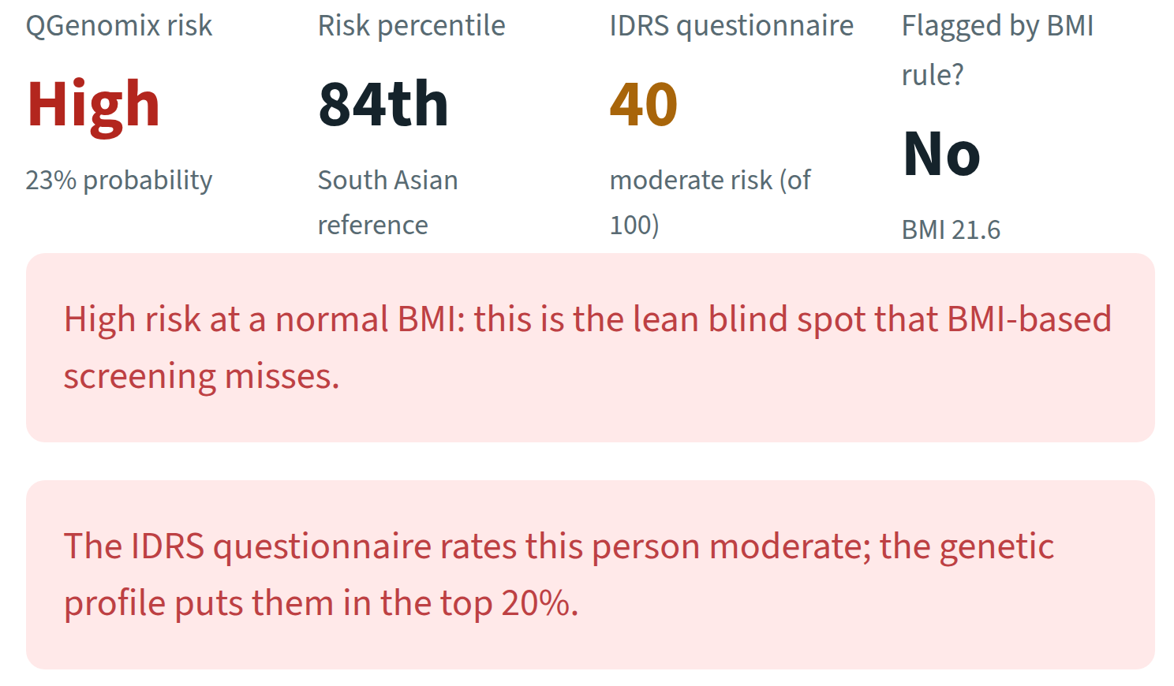
A lean woman, flagged high risk
Notes:
A synthetic demo person: 34 years old, BMI 21.6. QGenomix rates her high risk at the 84th percentile. The IDRS says moderate and the BMI rule says nothing. The report says so in plain words, and shows why: her insulin-production and fat-distribution scores sit at the 96th and 88th percentiles while her obesity score sits at the 24th, the genetic pattern behind lean diabetes.

Slide 26
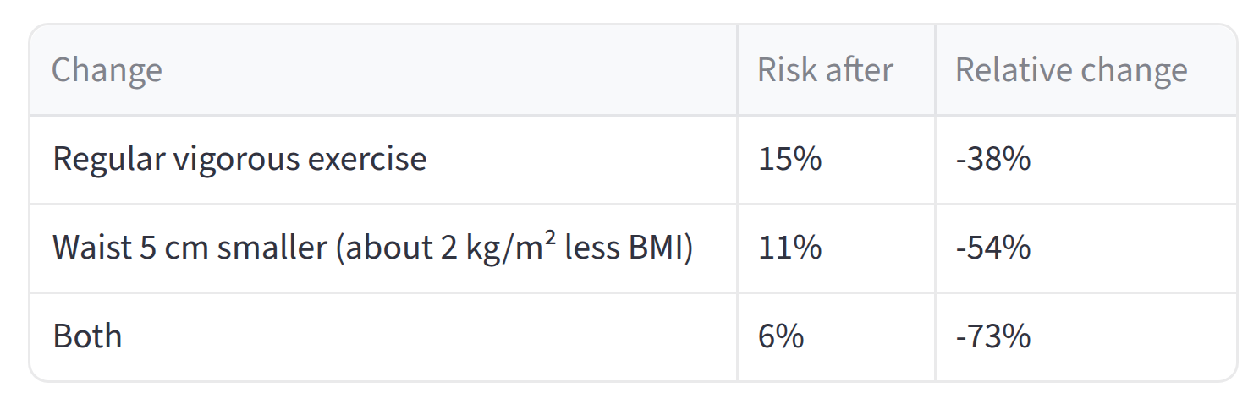
What she can change
Notes:
With genes, age and family history fixed, exercise and a smaller waist take her risk from 23 percent to 6 percent. These estimates were checked against the simulator's true effects: a waist 5 cm smaller lowers risk by 28 percent in the app and 28 in truth, exercise by 32 against 40. The same report downloads as a PDF.

Slide 27




Built to be checked
41
17
automated tests on every push
experiments
17
1
predictors compared
command to run it anywhere
Notes:
Everything can be checked. Tests run on every push, re-runs match bit for bit, and docker compose up runs the whole application.

Slide 28



What comes next
Run on a real IBM quantum computer
A public online demo
Validation on Indian patients
More ancestries, a larger panel
Notes:
The IBM run is scripted and rehearsed. The Docker image is ready for a public demo. Most important scientifically is validation on real Indian patients, because our outcomes are simulated.

Slide 29
What we found
Genetics nearly doubles lean cases caught: 30% to 58%
The search finds 70–84% of planted gene pairs
Entanglement captures interaction; QAOA matches annealing
A tested app turns a DNA file into a clear report
Notes:
Four things to remember, one from each part of the talk. On quantum: the parts do what they are there for, with no speed-up claimed. The main limit is that outcomes are simulated.

Slide 30
Thank you
Questions and feedback are welcome
Team
Guide
Aritro Chowdhury
Suyash Gupta
Dr. Husanbir Singh Pannu
Assistant Professor, CSED
Rishabh Sharma
Akshat Ahuja
Anshh Pasriccha
Notes:
Thank our guide and invite questions.

