Slide 1
SuperNanny
ICT Project Simon, Ismail, Ibish, Anna

Slide 2
Contents
What has been achieved
Demonstration
Challenges
Improvement for the next time

Slide 3
What has been achieved
A fully functional power monitoring system where
An environment monitoring system where you can receive the configuration from the cloud and monitor CO2, TVOC, Temperature and Humidity. Everything works but the CO2 Sensor is drifting after several hours.

Slide 4
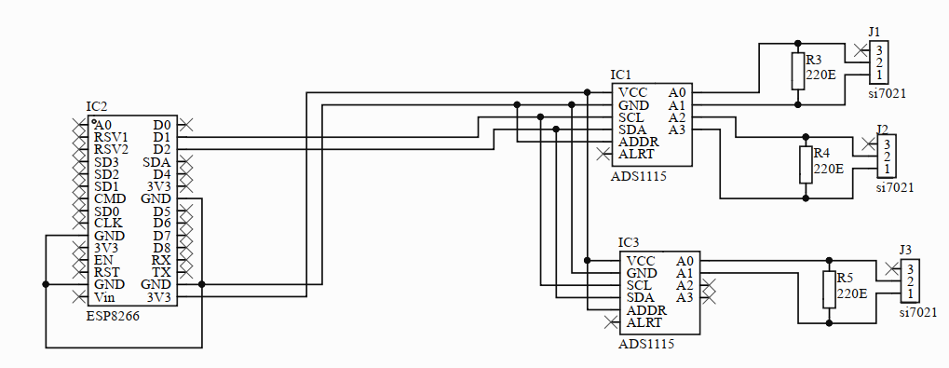
Power measurement

Slide 5
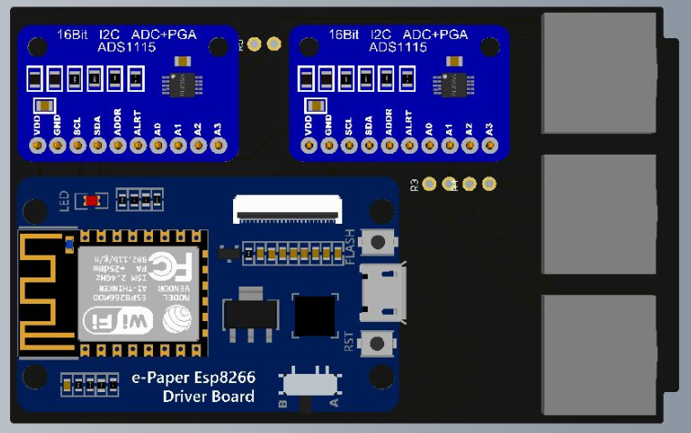
Power measurement

Slide 6
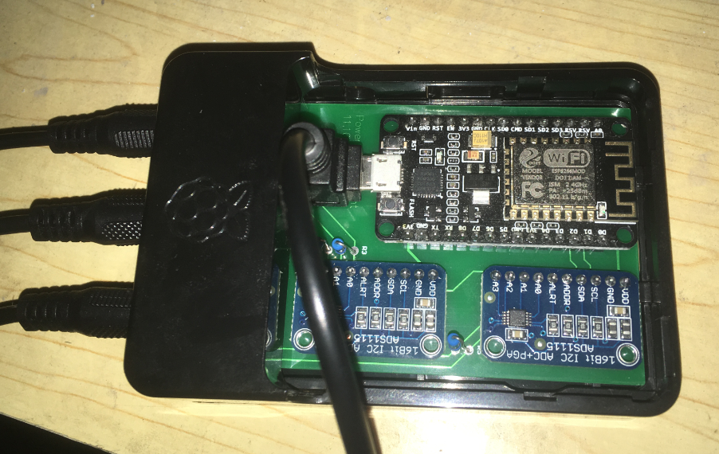
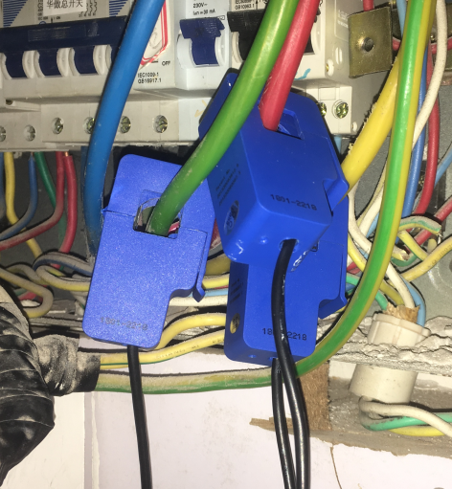
Power measurement

Slide 7
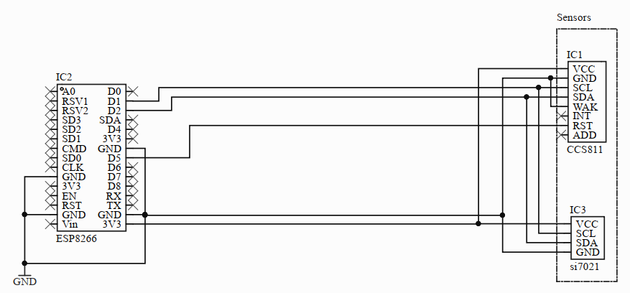
Environment measurement

Slide 8
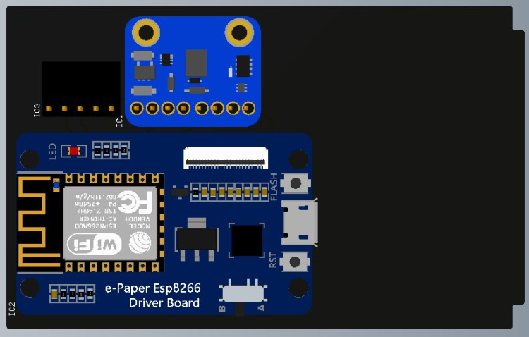
Environment measurement

Slide 9
Demonstration
Power measurement in Chronograpf
https://chronograf01.monitor.agora-space.com/sources/1/dashboards/20?lower=now%28%29%20-%205m

Slide 10
Challenges
Sensor
Network
Communication
Environment and equipment
Communication with configuration API and Arduino

Slide 11
Improve for the next time
Better communication with the project owner, say him more clearly what we want and need and get the information out from him what he wants from as.
Take an other sensor, that hasn’t the problem with the drifting

Slide 12
Questions
?

