Slide 1
SuperNanny
ICT Project Simon, Ismail, Ibish, Anna

Slide 2
Contents
What has been achieved
Demonstration
Challenges
Improvement for the next time

Slide 3
What has been achieved
A fully functional power monitoring system where you can receive the data from the cloud
An environment monitoring system where you also can receive the data from the cloud. It is fully functional, but the sensor standards don’t met. And because of this we haven’t done a device, it would not be worthwhile.

Slide 4
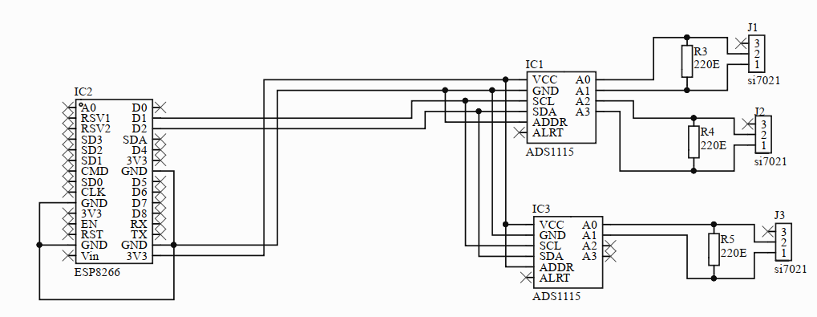
Power measurement

Slide 5
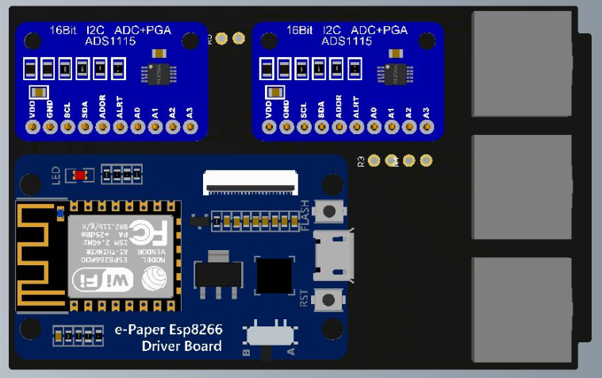
Power measurement

Slide 6
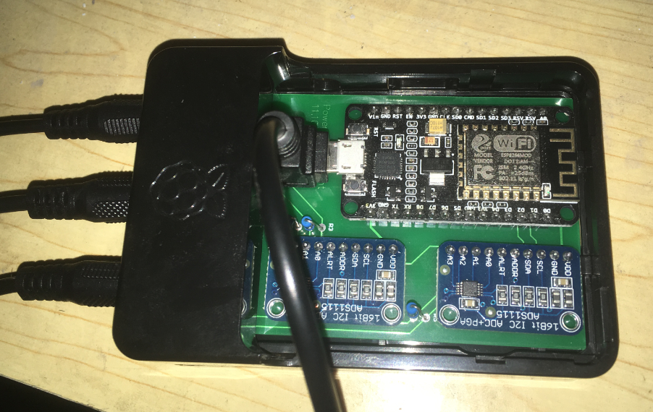
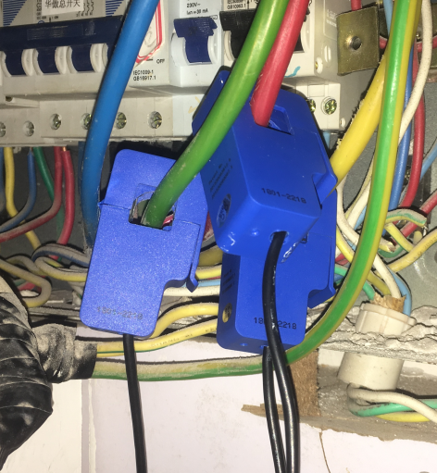
Power measurement

Slide 7
Demonstration
Power measurement in Chronograpf
https://chronograf01.monitor.agora-space.com/sources/1/dashboards/20?lower=now%28%29%20-%205m

Slide 8
Challenges
Sensor
Communication
Environment and equipment

Slide 9
Improve for the next time
Better communication with the project owner, say him more clearly what we want and need and get the information out from him what he wants from as.
Take an other sensor, that hasn’t the problem with the drifting

Slide 10
Questions
?

