Slide 1

Session 1
29 September 2018

Slide 2
CoderDojo Session
Dojo updates
Warm Up
Outline the Tasks/Challenges for the Session
Brainstorm
Get Coding
Show your Work

Slide 3
What are we?
Free, volunteer-led, community-based, programming club.
We ARE NOT a classroom
We ARE explorers of technology

Slide 4
Who are we?
Eugene
Greg, Eugene, Emer, Sherree, Josh, Peter
You Guys!

Slide 5
Our Dojo Mottos
One rule, be cool
Ask 3 then me
If you made it, you can play it
Parents, pitch in

Slide 6
One Rule, Be Cool
CoderDojo is a fun place to be, but it’s only fun because our attendees are so cool.
To be cool, you need to:
Be positive be kind
Be friendly (bullying or excluding others is not cool)
Help each other
Chat about ideas (but not too loudly ☺)

Slide 7
Ask 3 then me
If you have a problem then you should:
Ask yourself; “is there something else I could try?”
Ask a team member, you are all working together!
Ask another Ninja, everyone is very friendly!
Ask Google
Then ask a mentor

Slide 8
If you made it, you can play it!

Slide 9
Parents, pitch in!
Always looking for volunteers

Slide 10
Other small rules….
No open drink containers
Watch the wires!

Slide 11
Wifi
KPRC Training – kprc2000

Slide 12
Warm Up
5-10 mins

Slide 13
Get Into Teams
5 mins

Slide 14
This Week Session Challenges
Scratch
HTML / CSS
Make something that moves!
Make a game with something that moves!
Make it better!
Create a small web page
Add a image or a video
Have fun with it!

Slide 15
HTML / CSS cheat sheet
<HTML>...</HTML> Define HTML document
<HEAD>...</HEAD> Define HTML document header
<BODY>...</BODY> Define the body of the HTML document
<TITLE>...</TITLE> Define a title for the web page. It is placed in the <HEAD> of the document.
<LINK REF=”*.css” REL=”stylesheet”> Defines a link to the CSS stylesheet
<P>...</P> Define a paragraph for the web page. It is placed in the <BODY> of the page.
<H1>...</H1> Defines a heading within the <BODY> of the document. <H2>...</H2> is a smaller size heading. Increasing the number makes the heading size smaller. There a 6 heading sizes.

Slide 16
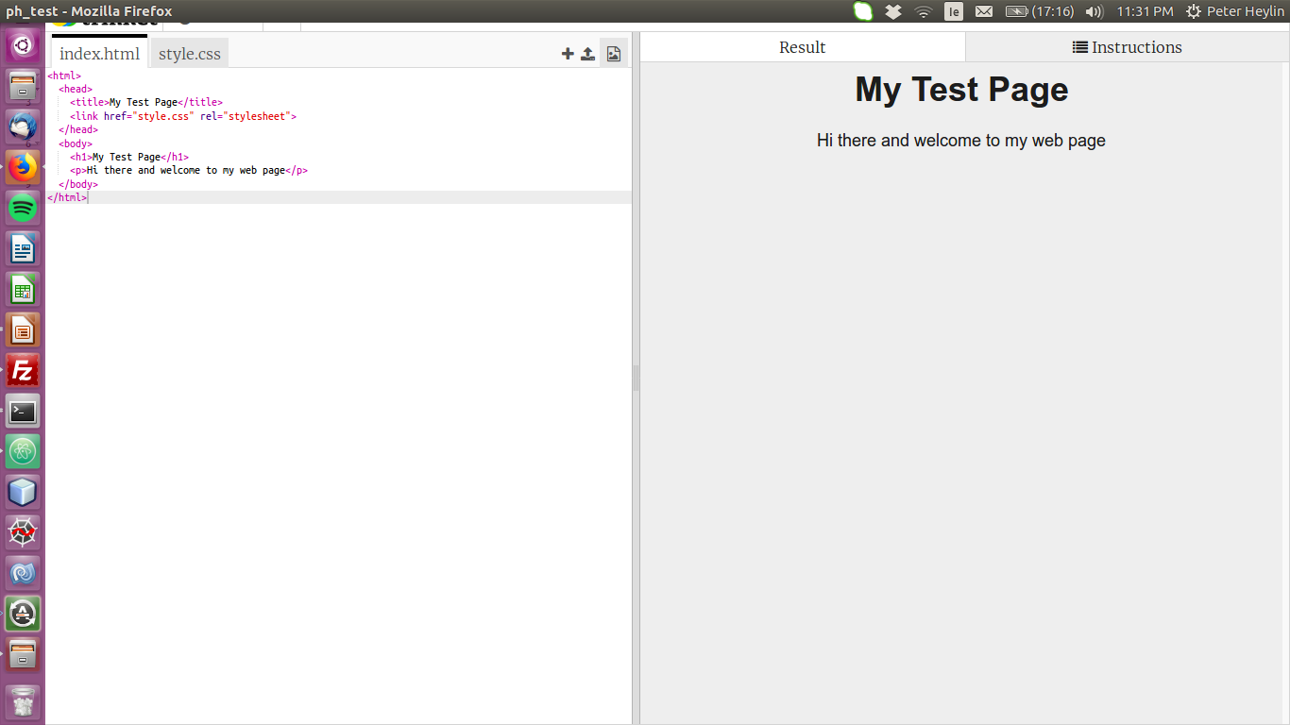
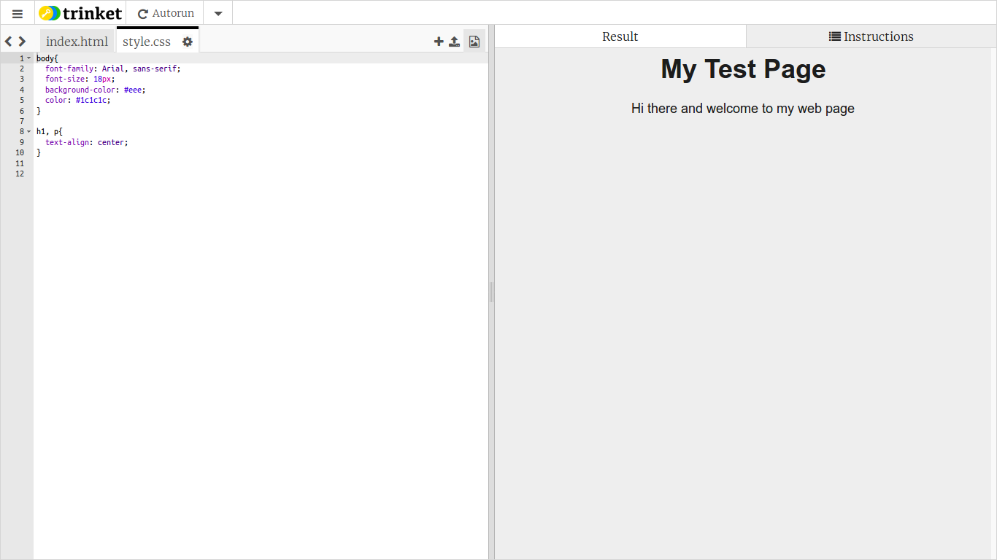
HTML / CSS example – trinket.io

Slide 17
Brainstorm
5-10 mins

Slide 18
Get Coding
45-60 mins

Slide 19
Showtime

