Slide 1

Session 6
10 November 2018

Slide 2
CoderDojo Session
Dojo updates
Motto Recap
Warm Up
Outline the Tasks/Challenges for the Session
Brainstorm
Get Coding
Show your Work

Slide 3
Dojo updates
Join Scratch Online
Save your work, build a collection
Share your interests
Animation: Alice3, Muvizu, Pencil2D
Games: Scratch
Blogs/Websites: HTML, CSS, Javascript
Apps: AppInventor
Our Dojo has a website – coderdojokells.com (Would HTML / CSS ninjas like to help us make it better?)

Slide 4
Our Dojo Mottos
One rule, be cool
Ask 3 then me
If you made it, you can play it
Parents, pitch in

Slide 5
Other small rules….
No open drink containers
Watch the wires!
Phones silent & put away
Stay in the room. bathroom? – let a mentor know

Slide 6
Wifi
KPRC Training – kprc2000

Slide 7
Warm Up
5-10 mins

Slide 8
Get Into Teams
5 mins

Slide 9
This Week Session Challenges (Scratch)
The script provided is using conditions which allows the program to decide which action to take. Copy the code and run it.
Is it working?
Can you fix it?
Can you make it better?

Slide 10
This Week Session Challenges (HTML)
HTML / CSS:
1. Can you embed a Scratch project in a web page?
2. Create a web page to showcase any Scratch projects you might have saved. How might you lay it out?

Slide 11
Brainstorm
5-10 mins

Slide 12
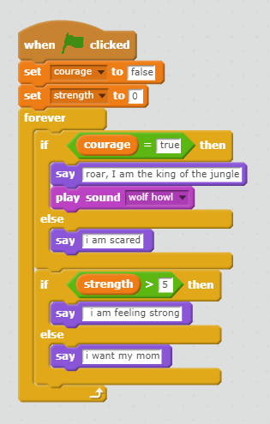
Get Coding
45-60 mins

Slide 13
Showtime

Slide 14
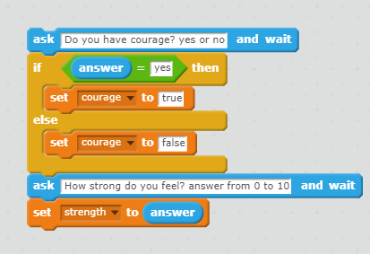
Some additional help

