Slide 1

Session 8
24 November 2018

Slide 2
CoderDojo Session
Dojo updates
Motto Recap
Warm Up
Outline the Tasks/Challenges for the Session
Brainstorm
Get Coding
Show your Work

Slide 3
Dojo updates
Join Scratch Online
Save your work, build a collection
Share your interests
Animation: Alice3, Muvizu, Pencil2D
Games: Scratch
Blogs/Websites: HTML, CSS, Javascript
Apps: AppInventor
Our Dojo has a website – coderdojokells.com (Would HTML / CSS ninjas like to help us make it better?)

Slide 4
Our Dojo Mottos
One rule, be cool
Ask 3 then me
If you made it, you can play it
(please do not play games you have not made)
Parents, pitch in

Slide 5
Other small rules….
No open drink containers
Watch the wires!
Phones silent & put away
Stay in the room. bathroom? – let a mentor know

Slide 6
Wifi
KPRC Training – kprc2000

Slide 7
Warm Up
5-10 mins

Slide 8
Get Into Teams
5 mins

Slide 9
This Week Session Challenges (Scratch)
The task is to create a game that allows a player to guess the number to win prizes. The fewer guesses taken, the more prizes the player can win. If player takes too many guesses, they lose the game.
To create this game, you will need variables and conditional statements as well as picking a random number (hint: remember last week's ball game)

Slide 10
This Week Session Challenges (Scratch)
Step 1:
- Download this image & upload to a new Scratch project: http://share.coderdojokells.com/ninja-challenges/santa.png or
http://bit.ly/cdk-Santa
Step 2:
- Select the Gift sprite from the Scratch library and copy the code provided.
Step 3:
- Add code to generate a random winning number, reset scoreboard, accept the player's guess, check the player's guess is correct, and tell player if they win or lose.

Slide 11
Brainstorm
5-10 mins

Slide 12
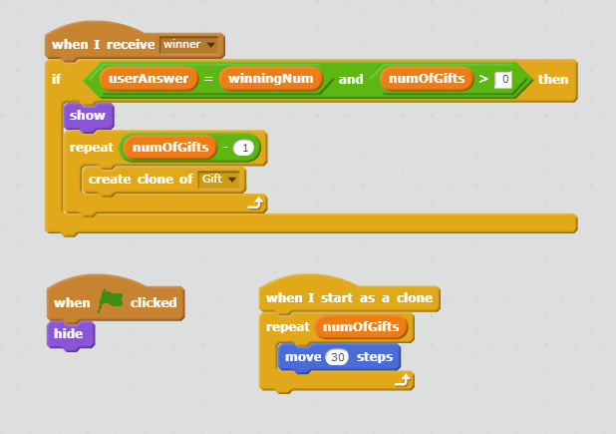
Get Coding
45-60 mins

Slide 13
Showtime

Slide 14
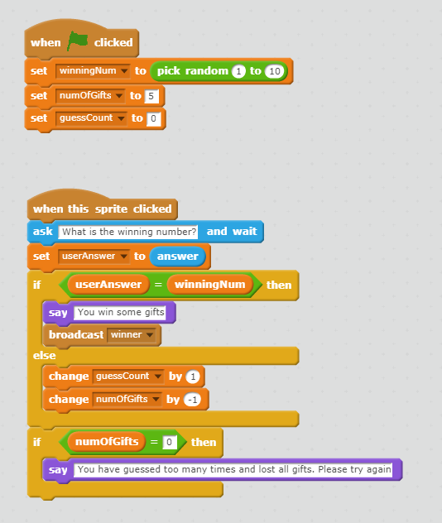
One Possible Solution

Slide 15


Happy Christmas

