Slide 1

Challenges
2019

Slide 2

This Week Session Challenges (Scratch)
The problem we have is we do not know who might be listening to us.
Your mission should you choose to accept it is to create an encoding program where what we say is converted into our secret language.

Slide 3
This Week Session Challenges (Scratch)
Step 1:
Copy the code provided, but wait! I think this code is broken. Can you find what is wrong with it and fix it?
Step 2:
Get creative and see if you can make it better.

Slide 4
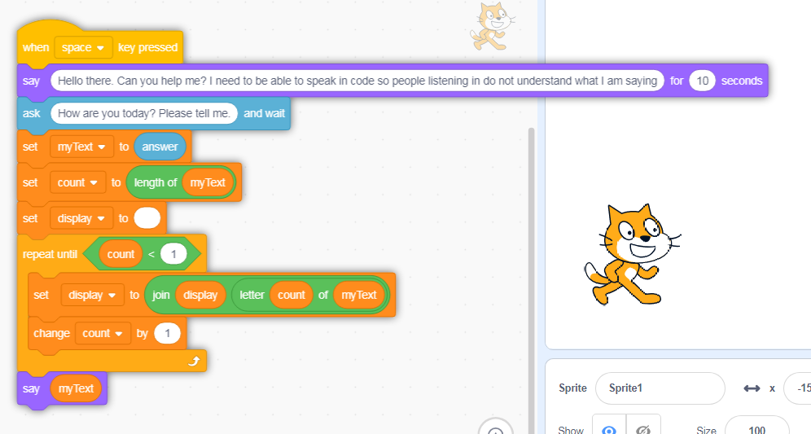
Get Coding
45-60 mins

Slide 5
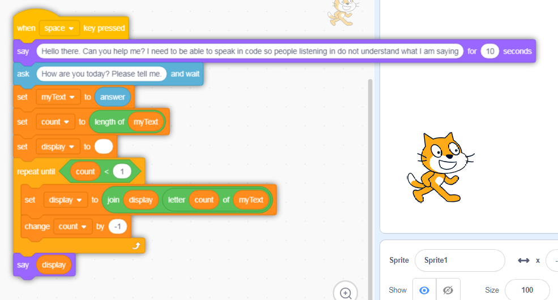
Solution

Slide 6
Animation / Storytelling
Create an animation in Scratch that includes the following:
St. Patrick character / sprite (your own image – be creative!)
At least 3 backdrops
Animate your character with both movement and speech (display speech bubble on screen or add sound)
Bonus: Make it tell a story

Slide 7
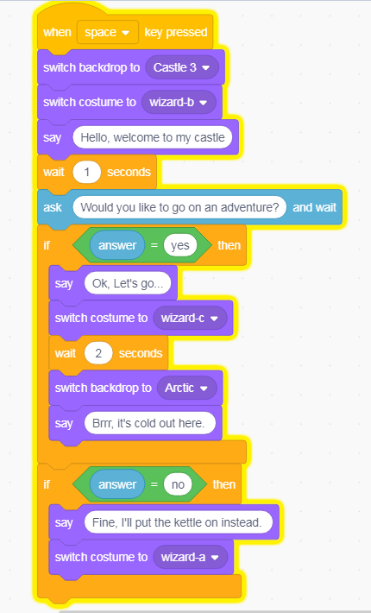
Animation / Storytelling
The code here is a short example in case you need help getting started:

Slide 8
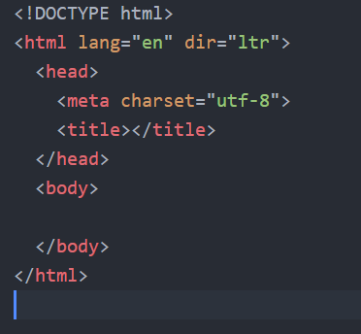
HTML
Create a web page about St Patrick,
include:
A heading (note: this is different from title)
At least two images
A paragraph of text or a bulleted list
Bonus: add CSS styling if you can
The code here will help get you started.

