Slide 1

Challenges
16 March 2019

Slide 2
Animation / Storytelling
Create an animation in Scratch that includes the following:
St. Patrick character / sprite (your own image – be creative!)
At least 3 backdrops
Animate your character with both movement and speech (display speech bubble on screen or add sound)
Bonus: Make it tell a story

Slide 3
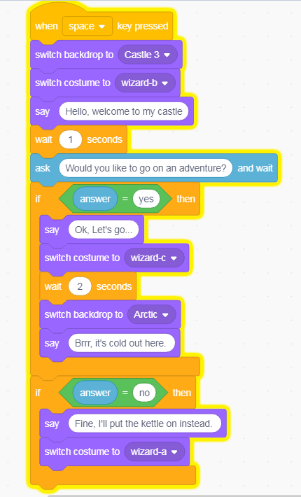
Animation / Storytelling
The code here is a short example in case you need help getting started:

Slide 4
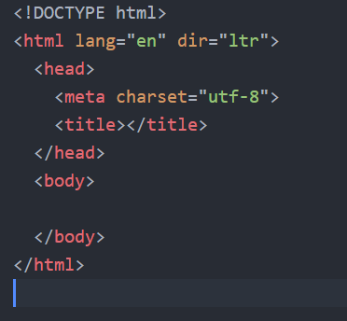
HTML
Create a web page about St Patrick,
include:
A heading (note: this is different from title)
At least two images
A paragraph of text or a bulleted list
Bonus: add CSS styling if you can
The code here will help get you started.

