Slide 1

Challenges
30 March 2019

Slide 2
Animation / Storytelling
Create an animation in Scratch that includes the following:
The theme is Meath or Mother – create an animation about something to do with Meath or something for Mother’s day
At least 3 backdrops
Make your character move
Add second character
Bonus: Make it tell a story

Slide 3
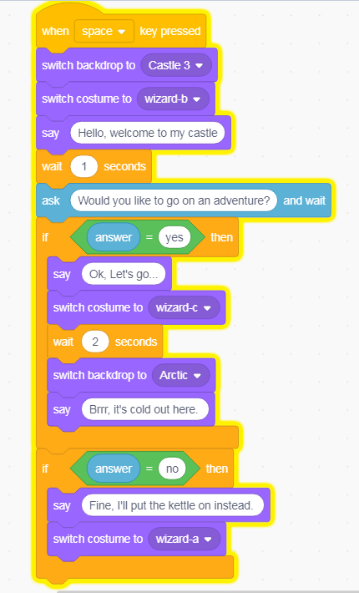
Animation / Storytelling
The code here is a short example in case you need help getting started:

Slide 4
HTML
Create a web page to show off or promote Meath or Ireland:
A heading (note: this is different from title)
At least two images
Add some text using paragraph or a list
Add at least one other type of media (sound / video)
Bonus: add CSS styling if you can – we’ve provided a small sample to help you
The code here will help get you started.
We added sample sound and video to this page in case you can’t find any others: http://share.coderdojokells.com/ninja-challenges/

Slide 5
