Slide 1

Scratch Day
11 May 2019

Slide 2
CoderDojo Session
Dojo updates
Motto Recap
Warm Up
Outline the Tasks/Challenges for the Session
Brainstorm
Get Coding
Show your Work

Slide 3
Some Dojo Reminders
Join Scratch Online
Save your work, build a collection
Share your interests
Animation: Alice3, Muvizu, Pencil2D
Games: Scratch
Blogs/Websites: HTML, CSS, Javascript
Apps: AppInventor
Our Dojo has a website – coderdojokells.com (Would HTML / CSS ninjas like to help us make it better?)

Slide 4
Our Dojo Mottos
One rule, be cool
Ask 3 then me
If you made it, you can play it.
(please do not play games you have not made)

Slide 5
Other small rules….
No open drink containers
Watch the wires!
Phones silent & put away
Stay in the room. bathroom? – let a mentor know

Slide 6
Wifi
KPRC Training – kprc2000

Slide 7
Warm Up
5-10 mins

Slide 8
Get Into Teams
5 mins

Slide 9

This Week Session Challenges (Scratch)
The problem we have is we do not know who might be listening to us.
Your mission should you choose to accept it is to create an encoding program where what we say is converted into our secret language.

Slide 10
This Week Session Challenges (Scratch)
Step 1:
Copy the code provided, but wait! I think this code is broken. Can you find what is wrong with it and fix it?
Step 2:
Get creative and see if you can make it better.

Slide 11
Brainstorm
5-10 mins

Slide 12
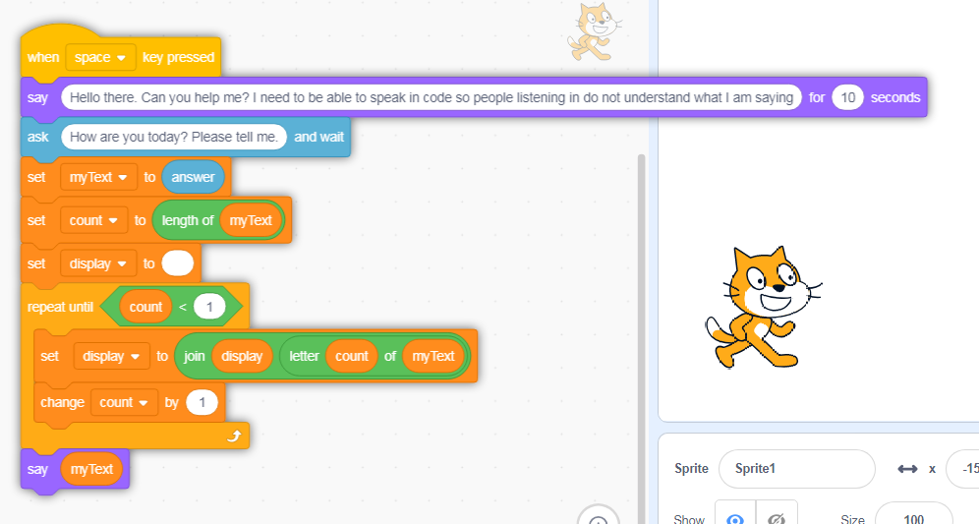
Get Coding
45-60 mins

Slide 13
Showtime

Slide 14
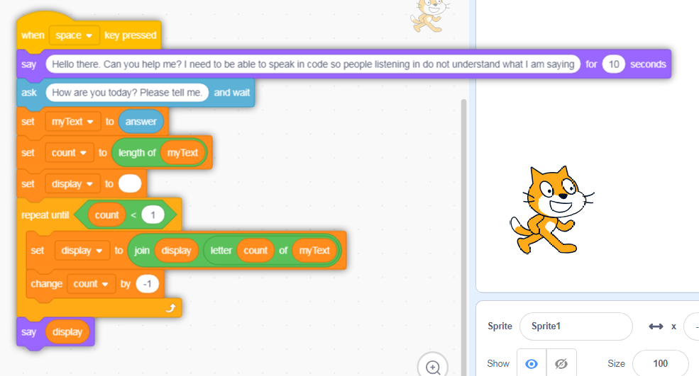
Solution

Slide 15


Happy Christmas

