Slide 1
Kells
Session 4
5 May 2018

Slide 2
CoderDojo Session
Dojo updates
Motto Recap
Warm Up
Outline the Tasks/Challenges for the Session
Brainstorm
Get Coding
Show your Work

Slide 3

Dojo updates
New Website!
http://kellscoderdojo.heylinhosting.com/
Reference Materials
Join Scratch Online
Explore your interests

Slide 4
Our Dojo Mottos
One rule, be cool
Ask 3 then me
If you made it, you can play it
Parents, pitch in

Slide 5
Other small rules….
No open drink containers
Watch the wires!

Slide 6
Wifi
KPRC Training – kprc2000

Slide 7
Warm Up
5-10 mins

Slide 8
Get Into Teams
5 mins

Slide 9
This Week Session Challenges
Scratchers:
Make a “scroller” game
We need:
Backgrounds (that scroll…)
A player character (something you control)
An item (you collect) or bad guy (you avoid)
A score variable

Slide 10
Brainstorm
5-10 mins

Slide 11
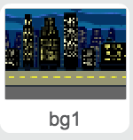
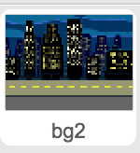
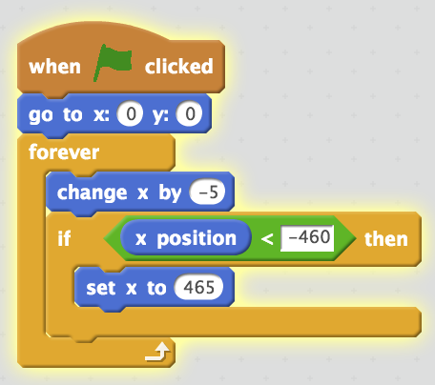
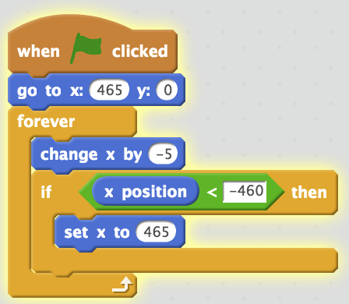
Get Coding
45-60 mins

Slide 12
Showtime

