Slide 1

Session 8
24 November 2018

Slide 2
CoderDojo Session
Dojo updates
Motto Recap
Warm Up
Outline the Tasks/Challenges for the Session
Brainstorm
Get Coding
Show your Work

Slide 3
Dojo updates
Join Scratch Online
Save your work, build a collection
Share your interests
Animation: Alice3, Muvizu, Pencil2D
Games: Scratch
Blogs/Websites: HTML, CSS, Javascript
Apps: AppInventor
Our Dojo has a website – coderdojokells.com (Would HTML / CSS ninjas like to help us make it better?)

Slide 4
Our Dojo Mottos
One rule, be cool
Ask 3 then me
If you made it, you can play it
Parents, pitch in

Slide 5
Other small rules….
No open drink containers
Watch the wires!
Phones silent & put away
Stay in the room. bathroom? – let a mentor know

Slide 6
Wifi
KPRC Training – kprc2000

Slide 7
Warm Up
5-10 mins

Slide 8
Get Into Teams
5 mins

Slide 9
This Week Session Challenges (Scratch)
The task is to create a game that allows a player to hit a ball. Each time the player hits the ball, they score a point.
The knowledge required to complete this game is a combination of variables and conditional statements which you saw in the last two sessions.

Slide 10
This Week Session Challenges (Scratch)
Step 1:
- Download this image & upload to a new Scratch project: http://share.coderdojokells.com/ninja-challenges/crosshairs_small.png
Step 2:
- Select the Ball sprite from the Scratch library and copy the code provided.
Step 3:
- Add code to accept a new player's name, reset scoreboard, and allow control of crosshairs / target (left/right/up/down).

Slide 11
Brainstorm
5-10 mins

Slide 12
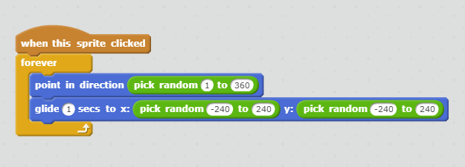
Get Coding
45-60 mins

Slide 13
Showtime

Slide 14
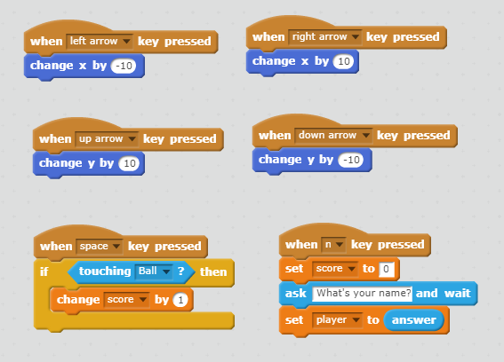
One Possible Solution

