Slide 1


Session 4
27 October 2018

Slide 2
CoderDojo Session
Dojo updates
Motto Recap
Warm Up
Outline the Tasks/Challenges for the Session
Brainstorm
Get Coding
Show your Work

Slide 3
Dojo updates
Join Scratch Online
Save your work, build a collection
Share your interests
Animation: Alice3, Muvizu, Pencil2D
Games: Scratch
Blogs/Websites: HTML, CSS, Javascript
Apps: AppInventor
Our Dojo has a website – coderdojokells.com (Would HTML / CSS ninjas like to help us make it better?)

Slide 4
Our Dojo Mottos
One rule, be cool
Ask 3 then me
If you made it, you can play it
Parents, pitch in

Slide 5
Other small rules….
No open drink containers
Watch the wires!
Phones silent & put away
Stay in the room. bathroom? – let a mentor know

Slide 6
Wifi
KPRC Training – kprc2000

Slide 7
Warm Up
5-10 mins

Slide 8
Get Into Teams
5 mins

Slide 9
This Week Session Challenges
Scratchers:
Halloween Theme
- Make a Halloween game
- Choose either platform or scroller (scrolling background)
Advanced:
- Would you like to try using an image other than what is in the Scratch sprite library?

Slide 10
This Week Session Challenges
HTML / CSS:
1. Create a spooky image gallery
2. Explore how you want to lay it out.
3. What more can you do with it?

Slide 11
Brainstorm
5-10 mins

Slide 12
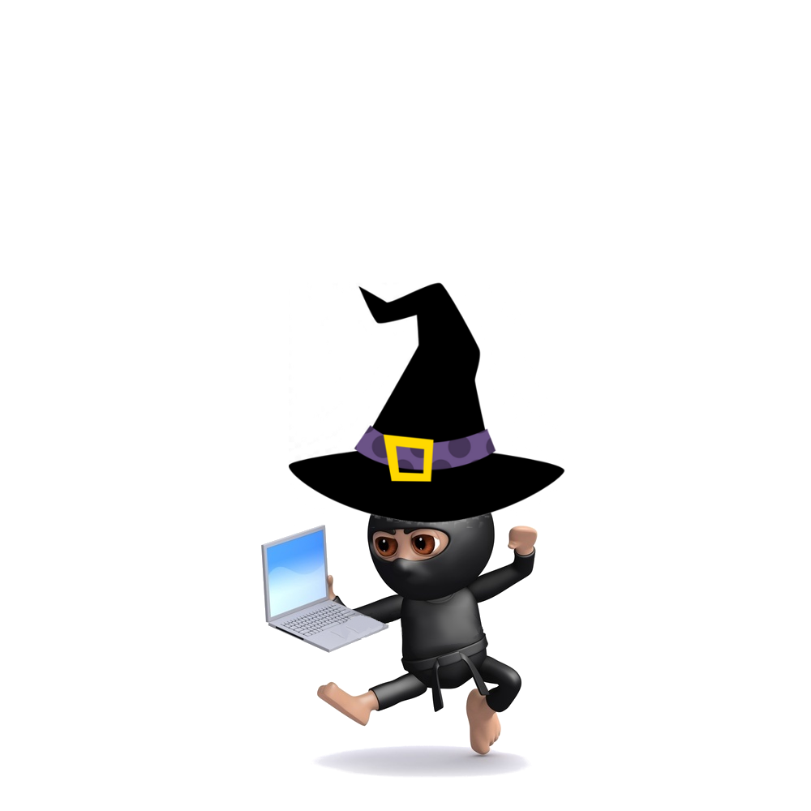
Get Coding
45-60 mins

Slide 13
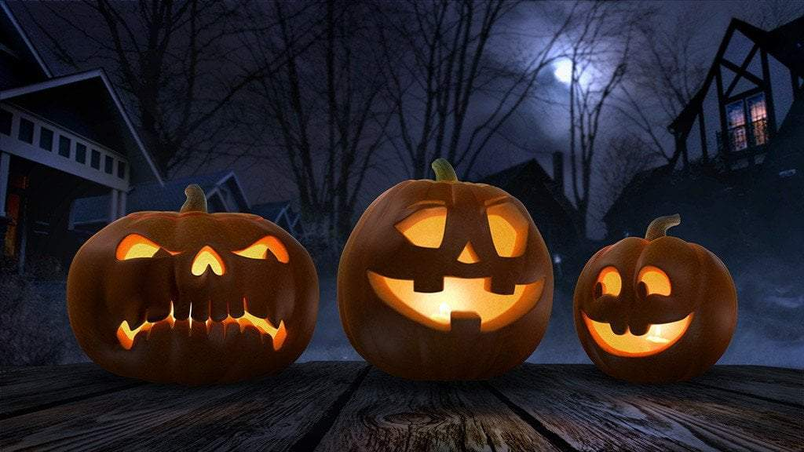
Showtime

