Slide 1

Session 5
03 November 2018

Slide 2
CoderDojo Session
Dojo updates
Motto Recap
Warm Up
Outline the Tasks/Challenges for the Session
Brainstorm
Get Coding
Show your Work

Slide 3
Dojo updates
Join Scratch Online
Save your work, build a collection
Share your interests
Animation: Alice3, Muvizu, Pencil2D
Games: Scratch
Blogs/Websites: HTML, CSS, Javascript
Apps: AppInventor
Our Dojo has a website – coderdojokells.com (Would HTML / CSS ninjas like to help us make it better?)

Slide 4
Our Dojo Mottos
One rule, be cool
Ask 3 then me
If you made it, you can play it
Parents, pitch in

Slide 5
Other small rules….
No open drink containers
Watch the wires!
Phones silent & put away
Stay in the room. bathroom? – let a mentor know

Slide 6
Wifi
KPRC Training – kprc2000

Slide 7
Warm Up
5-10 mins

Slide 8
Get Into Teams
5 mins

Slide 9
This Week Session Challenges (Scratch)
Background:
Moving a character towards a desired object. Example shows a cat trying to get a trophy, but you can be creative and select your own character and desired object.

Slide 10
This Week Session Challenges (Scratch)
Copy the code on screen to your own Scratch project.
Run it – is it working? If not, can you find what is wrong?
Can you make this better?

Slide 11
This Week Session Challenges (HTML)
HTML / CSS:
1. Can you embed a Scratch project in a web page?
2. Create a web page to showcase any Scratch projects you might have saved. How might you lay it out?

Slide 12
Brainstorm
5-10 mins

Slide 13
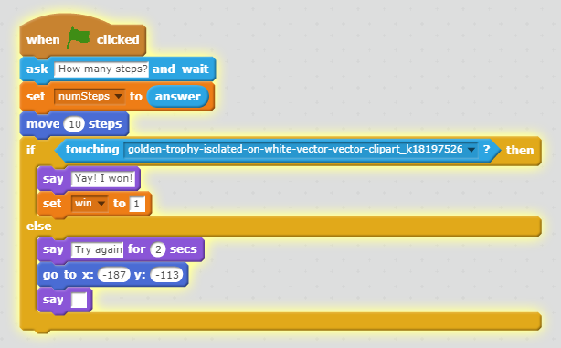
Get Coding
45-60 mins

Slide 14
Showtime

