Slide 1

Challenges
23 March 2019

Slide 2
Animation / Storytelling
Create an animation in Scratch that includes the following:
The theme is Meath – create an animation about something to do with Meath
At least 3 backdrops
Make your character move
Add second character
Bonus: Make it tell a story

Slide 3
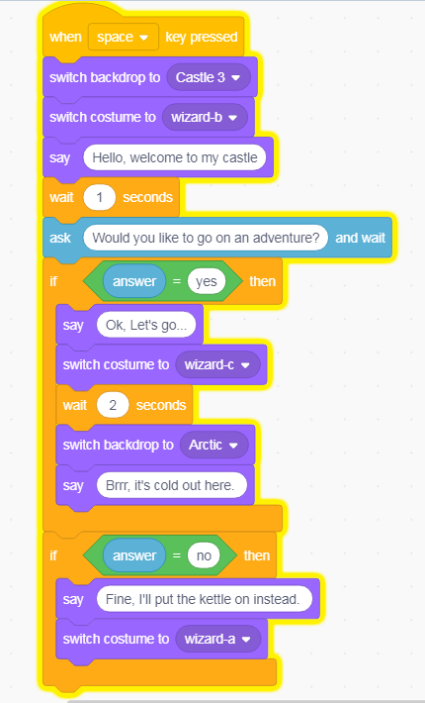
Animation / Storytelling
The code here is a short example in case you need help getting started:

Slide 4
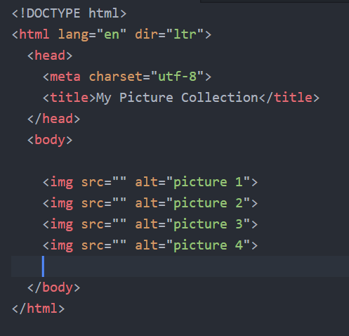
HTML
Create a web page to show off a collection of pictures:
A heading (note: this is different from title)
At least six images
Add some text under each image to describe what it is
Bonus: add CSS styling if you can
The code here will help get you started.

