Slide 1

Ticket Booking App Project
Archana, Durga, Carrie, Hooi,

Slide 2



Ticket Booking App Project
Task 1: App Wireframes
Task 2: Implement your Wireframes using HTML & CSS
Task 3: Task Form Inputs Validation

Slide 3
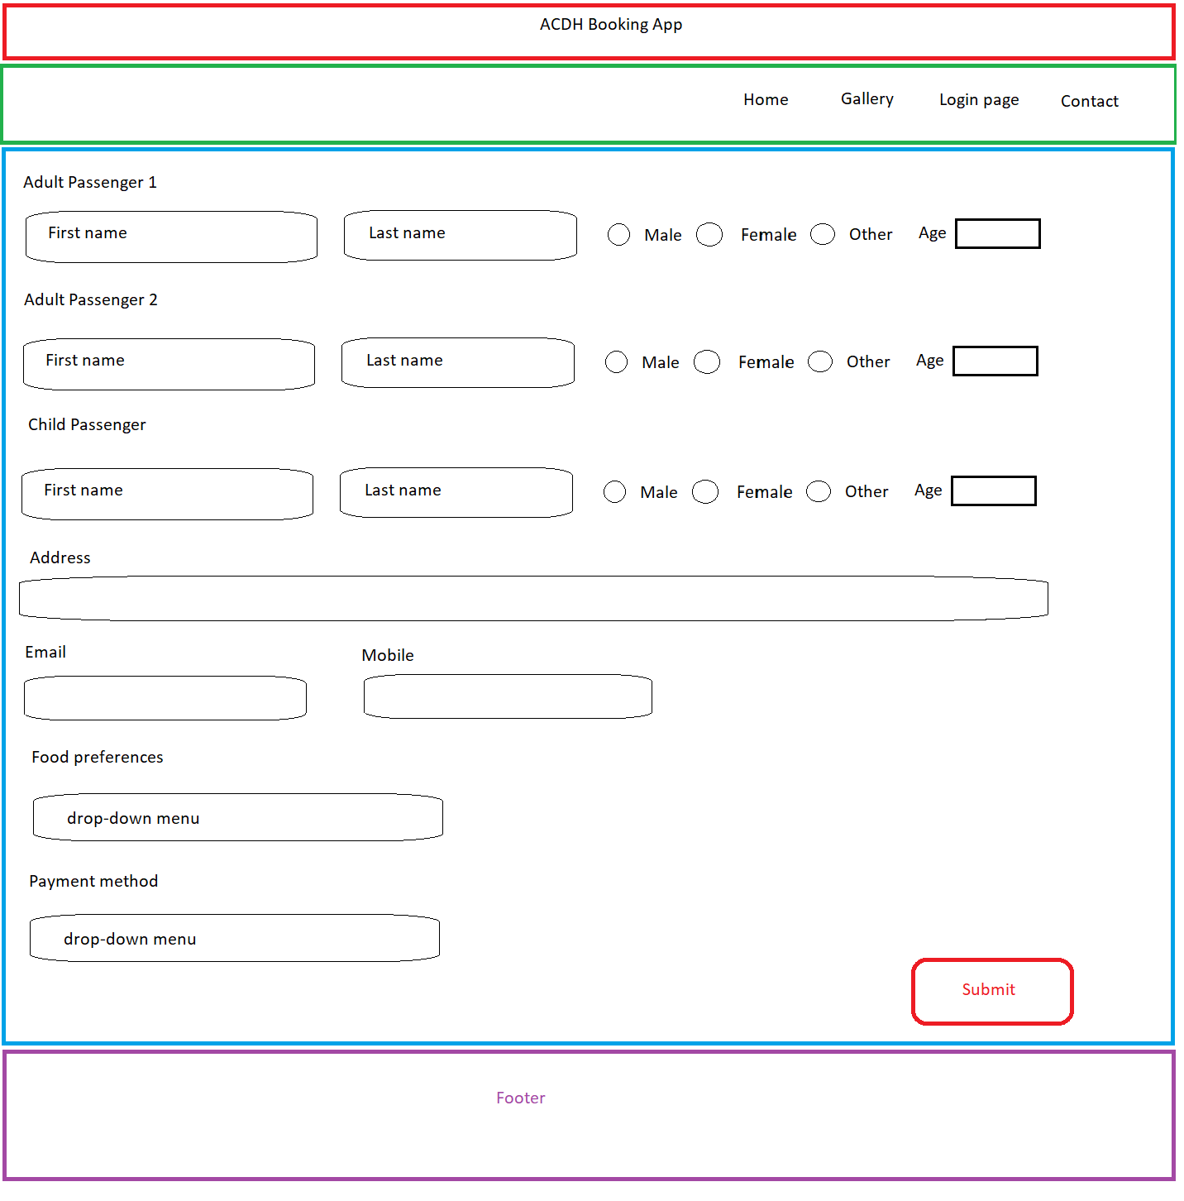
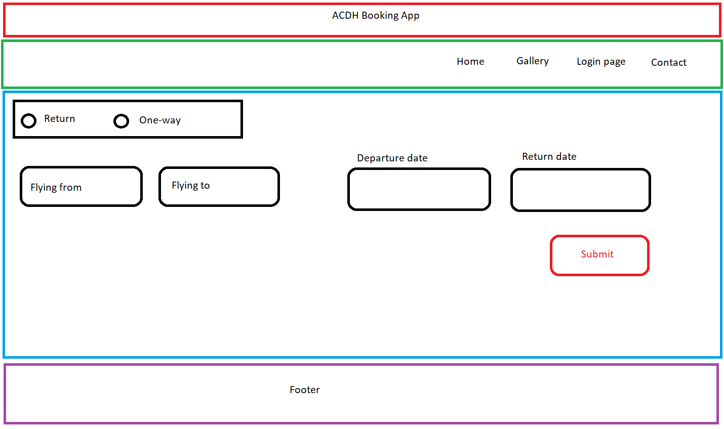
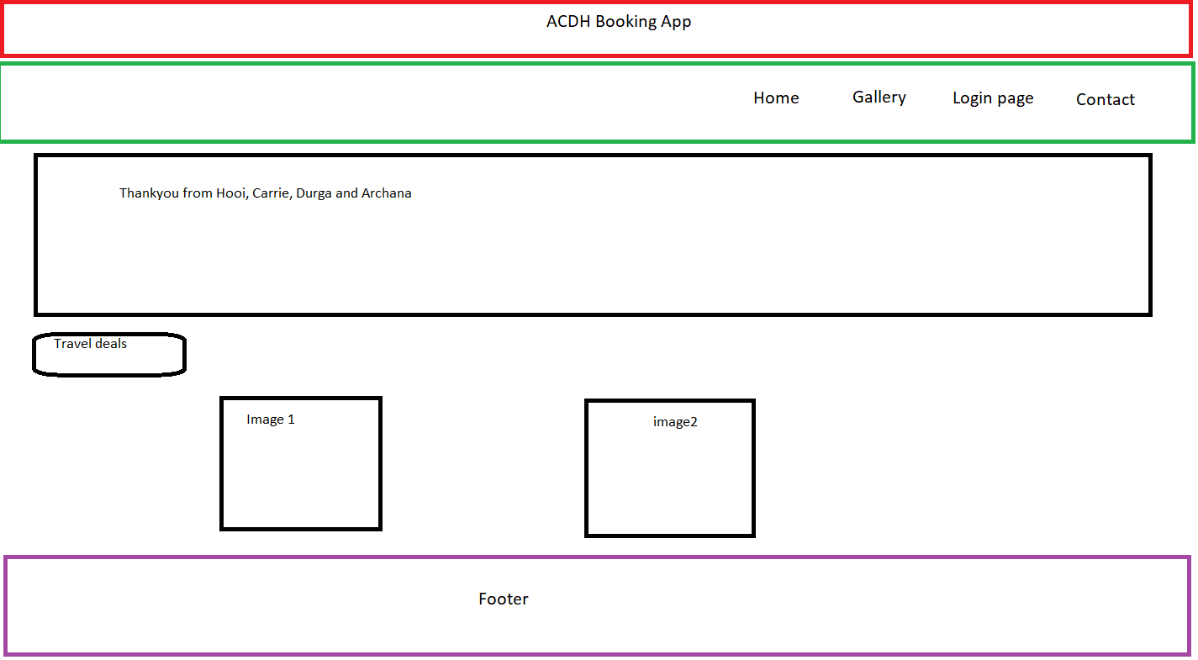
Task 1: App Wireframes

Slide 4
Task 2: Implement Wireframes using HTML & CSS
CSS
To display grid
display: grid;
To split the grid area for HTML elements
.home {grid-area: Home;}
.gallery {grid-area: TravelDeals;}
.login {grid-area: Login;}
.contact {grid-area: Contact;}
grid-template-areas:
'Home TravelDeals Login Contact’;
To generate space around element’s content and space around elements
padding: 6px;
margin: 100px 1px 2px 3px;
HTML
Class name for all the <div> tags to apply CSS styles
<div class="grid3">
<div class="triptype">
We used Anchor tag<a> to link the pages
<div class="grid2">
<div class="home">
<a href="index.html">Home</a>
</div>
To animate the text
@keyframes blinking{
0%{ color: red; }
47%{ color: #000; }
62%{ color: transparent; }
97%{ color:transparent; }
100%{ color: #000; } }

Slide 5
Task 3: Form Inputs Validation

Slide 6

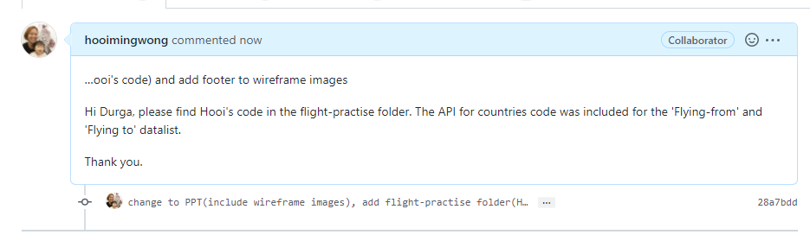
Workflow / Teamwork

Slide 7
Thank you
Archana, Durga, Carrie, Hooi,

