Slide 1
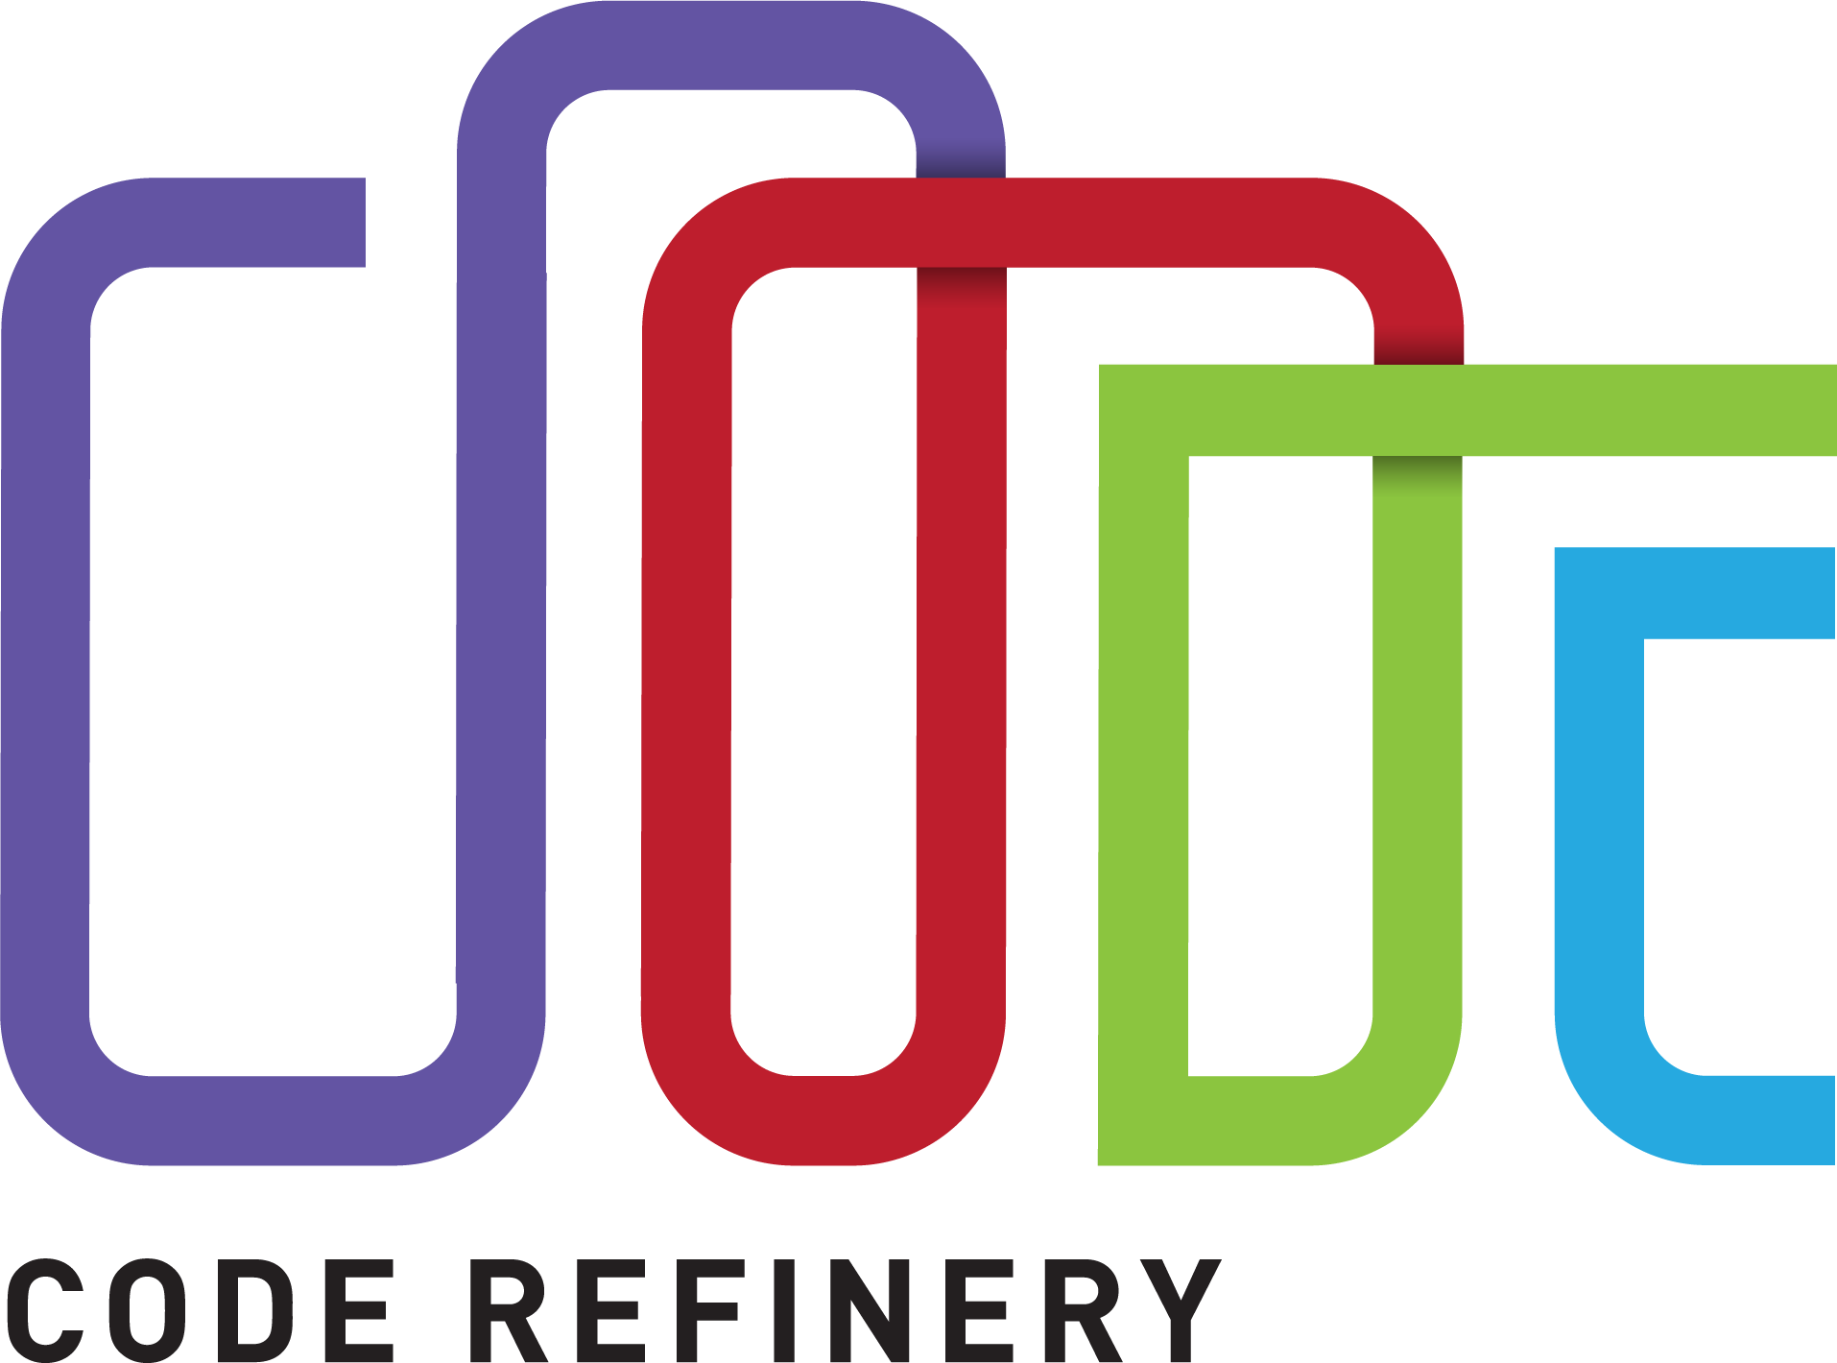
https://coderefinery.org/
We train you in FAIR research software development
[version: Aug 2024]

Slide 2
What is CodeRefinery?
A hub for FAIR research software practices
A project since 2016, currently funded by NeIC
Training network
Reaching about 500 learners/year
Reusable lesson materials
Community
Relation to Research Software Engineering
We teach topics which are helpful for researchers and essential for RSEs.
Nordic RSE colleagues hang out and discuss on the CodeRefinery community chat

Slide 3
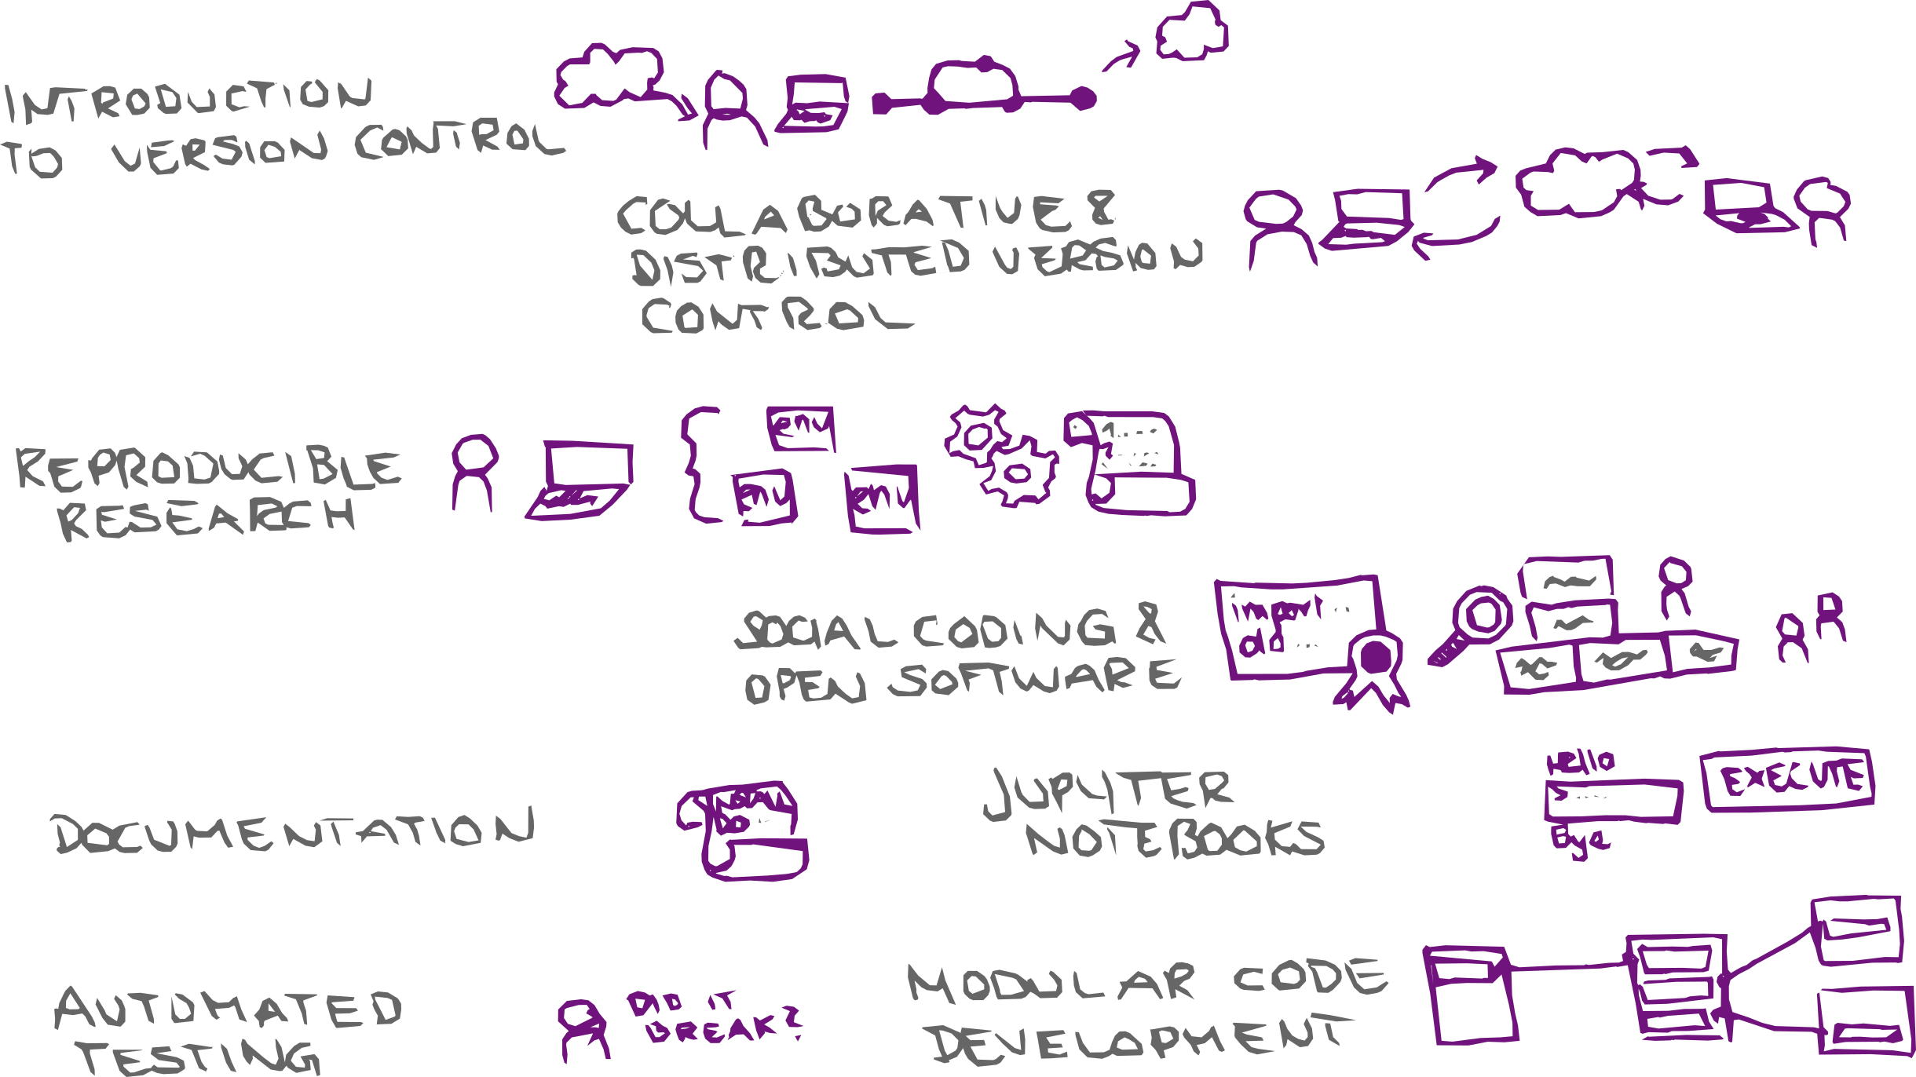
Available lesson material
All lessons are open source (CC-BY) and recordings are available

Slide 4
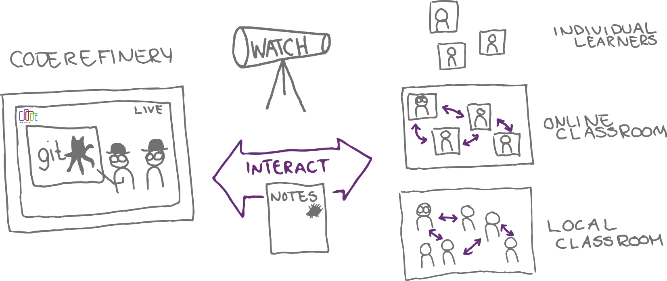
How YOU can participate
Join our next workshop
Tell others about it
Provide a local classroom or join as observer
Use our material and give feedback

Slide 5
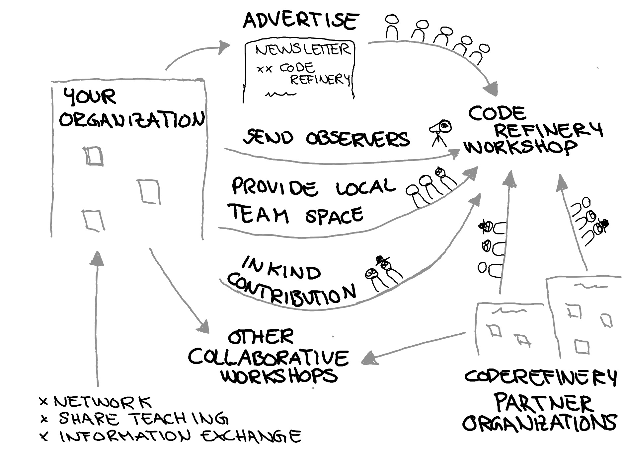
How your organization can participate
Join our next workshop
Tell your students and researchers about it
Provide a local classroom or join as observer
Use our material and give feedback

Slide 6
Join and/or stay up to date
Chat with us: https://coderefinery.zulipchat.com (community!)
Become a CodeRefinery ambassador
Onboarding manual
Blog
Newsletter and chat digest
X/Twitter
Mastodon
Support e-mail: support@coderefinery.org

