Slide 1
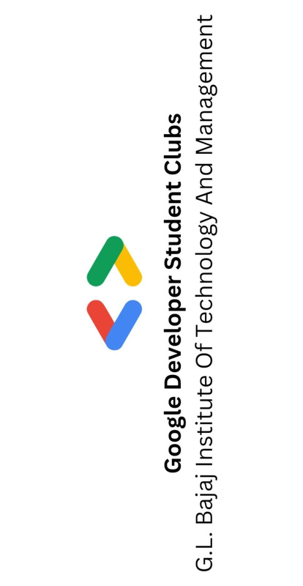



DEV-ON
College Name: G.L. Bajaj Institute of Technology and Management
Team Name: Jujutsu
Team Leader Name: Shivang Singh
Team Members Name: Akshat Gupta, Akhil Singh
Theme: Open innovation

Slide 2
Problem Statement
In today's fast-paced world, Non-technical skilled workers such as housekeepers, maids, electricians, plumbers, massagers etc often lack a centralized platform to showcase their expertise and connect with potential clients, also consumers often struggle to connect with trustworthy service providers at affordable rates. There is a need for a platform that facilitates the seamless connection between skilled non-technical workers seeking freelancing opportunities and consumers looking for reliable services.

Slide 3
Solution
The proposed solution is to develop a comprehensive online platform, named GigConnect, that acts as a bridge between skilled non-technical workers and consumers.
GigConnect will feature user-friendly interfaces for both workers and consumers, allowing workers to showcase their skills, availability, and pricing, while consumers can easily browse and book services based on their needs.
GigConnect aims to revolutionize the non-technical services sector by providing a centralized, accessible, and reliable platform that benefits both workers and consumers, ultimately contributing to the growth of the gig economy and enhancing the overall experience of service hiring.
Transparent pricing models will be implemented to promote fairness and affordability, with a feedback system to foster accountability and build trust within the GigConnect community.

Slide 4
Working & Techstack
Working Model
User Registration
Profile Creation
Verification Process
Service Booking
Secure Transactions
Feedback and Ratings
Real-time Communication
Techstack
Frontend
HTML, CSS, Bootstrap
Javascript, React
Backend
DBMS, PHP, Authentication: JWT (JSON Web Tokens)
Payment Gateway
Razorpay

Slide 5
Uniqueness of your idea
Dedicated to Non-Technical Services
Affordable & Transparent Pricing Models
Ease in finding for both worker and consumer
Freelancing opportunity for Gigs
Platform which connects local workers with consumers

Slide 6
MarketPlace & Impact
Market Place
Buyers (Consumers):
Consumers use the GigConnect platform to find and hire non-technical service providers for tasks such as housekeeping, maid services, electrical work, plumber work, massager etc.
Sellers (Service Providers):
Skilled workers in non-technical fields create profiles on GigConnect, showcasing their skills, availability, and pricing. They offer their services to consumers seeking assistance.
GigConnect
Consumers
Workers
Impact
Empowering Non-Technical Workers
Flexible Work Opportunities for workers
Streamlined Service Booking
Building Trust and Credibility
Enhancing Local Economies

