Slide 1

INDEX
BHARGAVA VADLAMANI
KEERTHI NAREDLA

Slide 2

What is Indexing?

Slide 3

INDEX

Slide 4


Slide 5
STANDARD MODEL
Randomly search on a single machine for
Ex: What are the best c++ books? =>Terms: best, c++, books
Final Result:
Best: x1,x2,x3,x4...........
C++:y1,y2,y3,y4..........
Books: z1,z2,z3,z4,z5...........
How much time you can expect to get this result??
SEEK TIME
TRANSFER TIME

Slide 6
INDEXING
BLOCKED-SORT BASED
SINGLE-PASS-IN MEMORY
DISTRIBUTED INDEXING
DYNAMIC INDEXING

Slide 7
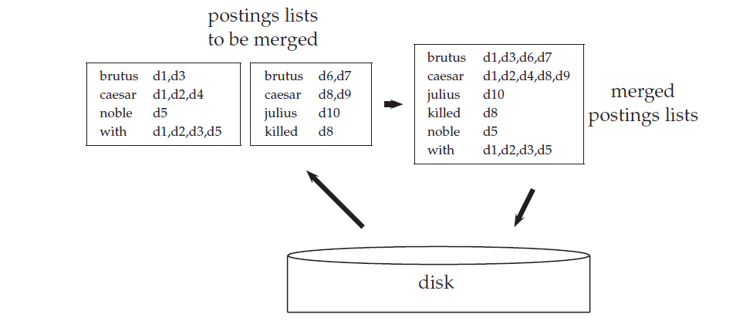
BLOCK-SORT BASED INDEXING
Better than basic model
SEQUENTIAL ACCESS
Still expensive: O(TlogT)
Sorting => logT

Slide 8
SINGLE-PASS IN MEMORY INDEXING
For each block
Tem1: {doc1,doc2,…...}
Term2:{doc2,doc3,…..}
WRITTEN TO
DISK
DICTIONARY
POSTING LIST
No sorting of terms
No collecting term-doc pairs
Faster
Memory efficient
Compression can also be done
It takes o(t)

Slide 9
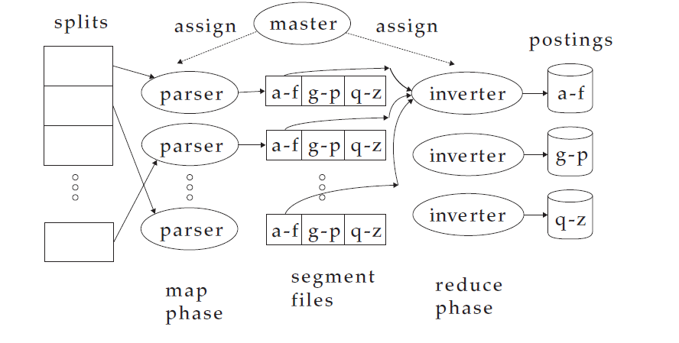
DISTRIBUTED INDEXING
MAP REDUCE
Large collection not possible on a single machine
Divide work into chunks
Distribute among several clusters
Merge results => Distributed index.
Flexibility & Durability

Slide 10
DYNAMIC INDEXING
Collection of data keeps on changing....
MAIN INDEX
AUXILARY INDEX
SEARCH
Time complexity : O(T^2/n)
Logarithmic merge => O(log2(T/n)

Slide 11
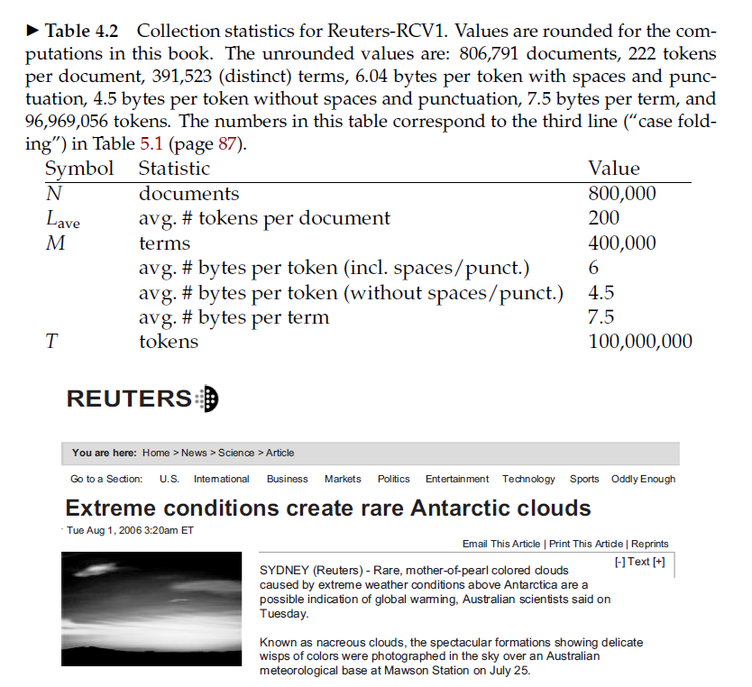
REUTERS
100 MILLION TOKENS
TERMID +DOCID => 0,8 GB OF STORAGE
How do we handle this?

Slide 12
Solution ? INDEX COMPRESSION

Slide 13
Why ?
Saves Disk Space
Increased use of caching
Faster transfer of Data
Lesser time even with compression algorithms time cumulated

Slide 14
Methods
Lossless:
Entirety of the information is preserved.
Lossy Compression:
Better compression ratios
Discards some information
Example : Stemming , Case folding etc.
Used when the information “lost” is unlikely to be queried.

Slide 15
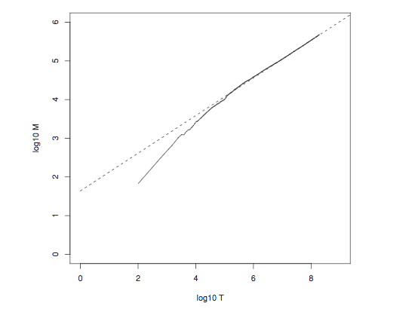

HEAPS LAW
Provides a mathematical relationship between Dictionary words and total number of tokens
$M=kT^{b},\log\left(M\right)=logK+blogT$
(30 <= k <= 100) and b = 0.5
logM = 0.49*logT+1.64 (reuters-RCV1)

Slide 16
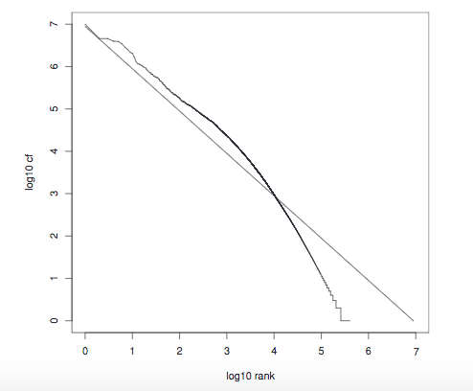

ZIPF'S LAW
Provides a relationship between distribution of terms between across documents as ,
$cf_{i}∝\frac{1}{i}$
$cf_{i} =ci^{k}→logcf_{i}=logc+klogi (k=−1)$

Slide 17
DICTIONARY COMPRESSION
Need for dictionary compression:
Although , dictionary is small, compression is required to increase high query throughput.
Support for extensive search in limited hardware.
Fast startup time, query time and lower space.

Slide 18
TYPES OF DICT COMPRESSION
Simplest Form : Store lexicographically sorted values in a fixed Array
Size = M *(20 + 4+ 4) = 11.2MB
Advantages:
Simple
Use only a large array to store values
Fixed size values
Disadvantages:
Cannot handle super long words
Space wastage with fixed length characters.

Slide 19
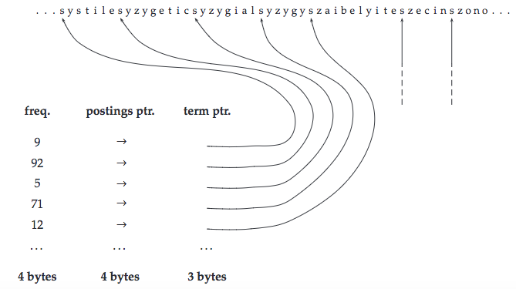
Single String Approach
The entire dictionary is stored as a single string and pointers are created for demarcation of words.
400,000*(4+4+3+8) = 7.6MB

Slide 20
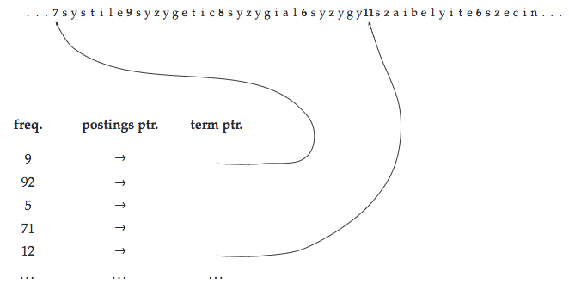
Blocked Storage
We can further compress the dictionary by grouping terms in the string into blocks of size k and keeping a term pointer only for the first term of each block
Increasing the size of k gives better compression but tradeoff is term lookup
400,000*(4+4+1+8) = 6.8MB

Slide 21
Variable byte codes
Variable bit uses an Integral number of bytes to encode a gap.
The last 7 bits of a byte are ’payload’ and encode part of the gap.
The first bit of the byte is a continuation bit(Set to 1 for the last byte of the encoded gap and 0 otherwise)
To decode a variable byte , we read a sequence of bytes with continuation bit 0 terminated by a byte with continuation bit 1.
We then extract and concatenate the 7-bit parts.

Slide 22


$Gamma$byte codes
Variable bit uses an adaptive number of bytes to encode a gap.
We can use bit level codes such as unary codes
For 2 pow n gaps , we can use n bits for encoding
A gamma code is used length and offset where offset is the unary codes.

Slide 23
QUESTIONS??

