Slide 1
ILS-Z534 Search Final Project
Yelp Dataset Challenge 2017
Under supervision of Prof. Xiaozhong Liu
Bhargavi Chalasani
Sowmya Ravi
Priyanka Cherukuri
Bhargava Vadlamani
INDIANA UNIVERSITY BLOOMINGTON

Slide 2
Task 1
Recommend business to users
Task 2
Understanding Features of a Business from review text
Roles and Responsibilities
Sowmya Ravi: CF Item-based top N recommendation, ALS evaluation.
Priyanka Cherukuri: EDA for Task 1. CF based recommendation algorithm analysis. Final report documentation.
Bhargava Vadlamani: ALS evaluation. Scaling MF code to Spark.
Bhargavi Chalasani: Matrix Factorization and Task 2 algorithm, evaluation.

Slide 3








Toolset

Slide 4
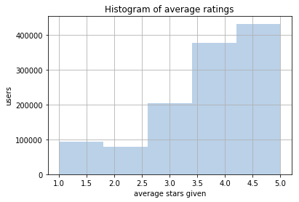
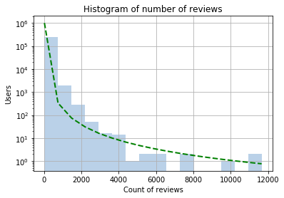
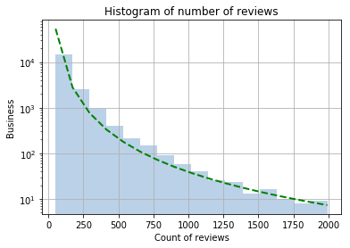
Task 1: EDA
Yelp Dataset: https://www.yelp.com/dataset/challenge
156639 Businesses Histograms:
1183362 Users 1. Users vs average stars given.
4736897 Reviews 2. Users vs review count.
3. Businesses vs review count.

Slide 5
Task 1: Item based top N recommendations
Algorithm
The algorithm is based on the idea that a user is more likely to avail businesses that are similar or related to businesses that he has already availed.
For each business, k most similar businesses
For each user C is union of the k most similar businesses for each business j ϵ U excluding the businesses which already exist in set U.
Then, for each business c ϵ C, the similarity of that business to the set U is computed as the sum of similarities of all businesses in set U and c
The set C finally contains a list of businesses sorted in decreasing order with respect to similarity and first N businesses are selected as the top N recommended set.

Slide 6
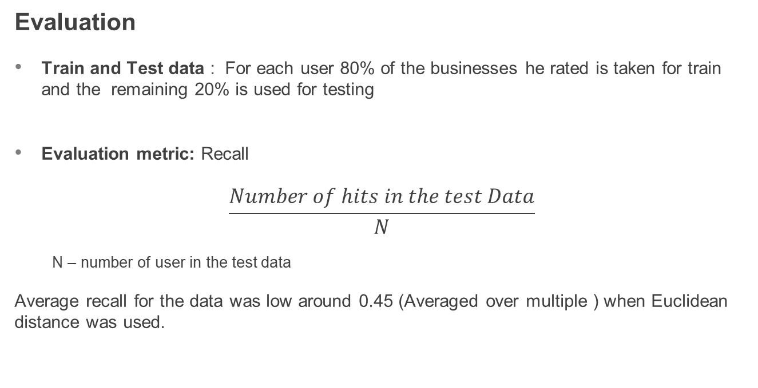
Task 1: Item based top N recommendations
Evaluation
Train and Test data : For each user 80% of the businesses he rated is taken for train and the remaining 20% is used for testing
Evaluation metric: Recall
$$\frac{Number of hits in the test Data}{N}$$
N – number of user in the test data
Average recall for the data was low around 0.45 (Averaged over multiple ) when Euclidean distance was used.

Slide 7
Task 1: Item based top N recommendations
Experiments

Slide 8
Challenges
K Nearest neighbors is very computation heavy and takes a lot of time to train
Unable to use the complete data set because of computations involved
High dimensionality of the business features. PCA took a toll on the hit rate.

Slide 9
Collaborative filtering based recommendation approach
ALS Recommendation algorithm to recommend businesses to user.
ALS Algorithm is trained over the relationship userID-businessID-Start rating.
The algorithm takes the matrix factorization approach to find the top K nearest vectors to the given vector according to the following cost function.
Through ALS, we estimate the matrix of the possible recommendations through a matrix factorization approach

Slide 10

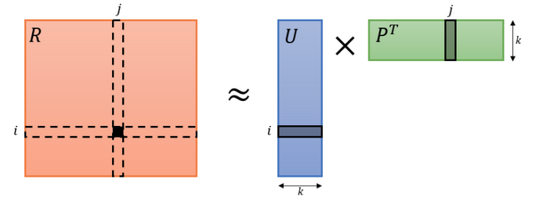

Alternating Least Squares Recommender Model
The algorithm is best suitable in collaborative filtering approach over a set sparse vectors. Apart from the similarity the original value is also taken into consideration and
Penalties imposed over the model to prevent overfitting.

Slide 11
ALS Implementation over Yelp Dataset
The algorithm was directly implemented from the Spark dataset and applied over the reviews dataset.(Explicit features selected)
Given the high complexity and huge volume of data, the code is run on Google cloud instance.
The following results were observed on a 4 Core 4 worker 15GB individual RAM VM Instance.
Evaluation Time: 97 seconds
RMSE over Testing Data : 5.43 (Min and Max values being -80,67 respectively.

Slide 12
Understanding features of a business from review text
TASK 2

Slide 13
Previous Proposal
“Predicting the busy hours of a business from review text”
Challenges:
Low Data availability
Algorithm to build the model
A strong evaluation metric

Slide 14
Task 2: Method Design
Restricted data points to location Las Vegas.
Obtained business with top 100 most common tags.
Used gensim python library for LDA.
Obtained 50 topics from all the available reviews.
Methods for prediction:
Consider all reviews of business to get topics.
Get topics per review of a business and get the top 3 most frequent among all the reviews.

Slide 15
Evaluation
Comparing the topics obtained to the categories of the business.
Cannot be considered as multi-label classification since similar(but not the same) business categories are grouped together.
Evaluated the results by considering the top 3 topics predicted from LDA
Considering the major topics among all reviews gave better results that concatenating all the reviews of a business.
Method 1 : 33.2 %
Method 2 : 51.37%

Slide 16
Challenges
Difficulty mapping the category names to the manually named topics.
Had to generalize the category names for evaluation. For cases like: car dealership, car rental, auto service.
Other latent topics of the business like service, location, ambience were captured which cannot be evaluated.

Slide 17
Future work
Can be extended to capture other features of the businesses. Use case: Can be used to capture missing information like takeout available? Is kid-friendly? Has happy hours?
Cannot be evaluated similarly as data for these inherent features might be missing.

Slide 18
Questions ?
Thank you !

