Slide 1


Slide 2
Virtual and Augmented Reality in Runtime
Private beta for .NET released November 15
Private beta for iOS released November 29
Private beta for Android - coming soon
Email ArcGISRuntimeARVRBeta@esri.com to request access
VR/AR

Slide 3
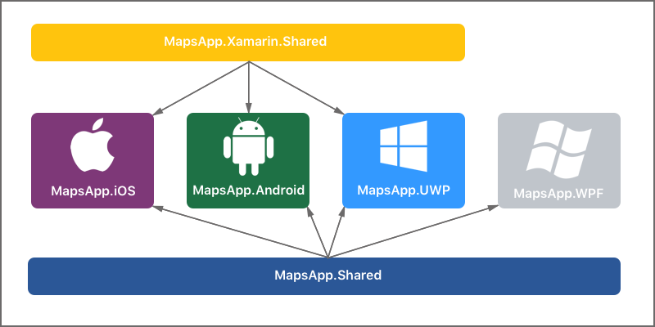
Maps App - 4 apps in 1

Slide 4
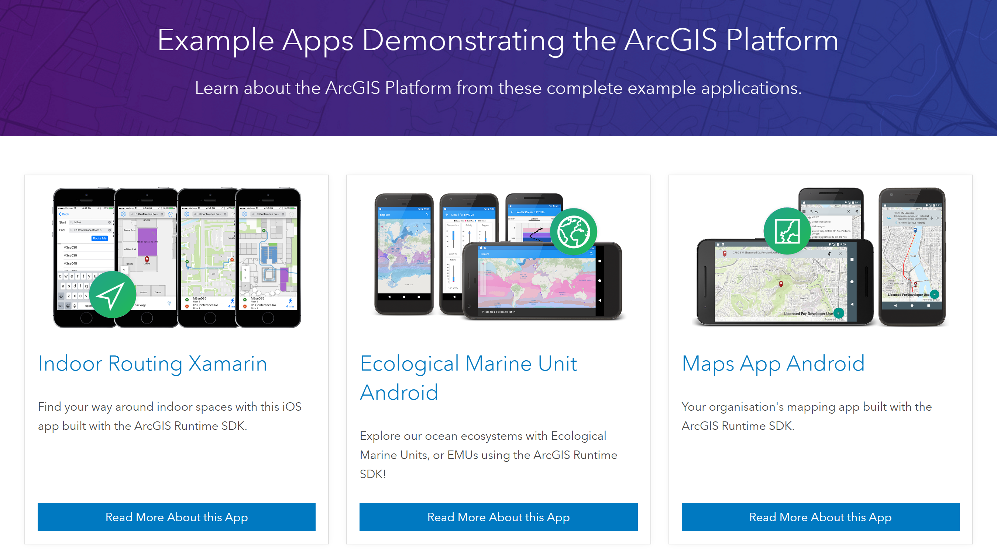
Runtime Example Apps
https://developers.arcgis.com/example-apps/
Notes:
To view the released example apps, go to the developers.arcgis.com site and click on the Example Apps link in the middle of the top banner. This will take you to the Example Apps homepage. Each app on this page is extensively documented and will contain a link to the GitHub repository with the code. All these apps are released with an Apache 2.0 license.

