Slide 1
TRUSTFORGE
A comprehensive solution to protect your trust

Slide 2
What are dark patterns? and Why do we need a solution?
Though Dark Patterns are hidden in plain sight, yet they are hard to avoid which is frustrating for the users and also puts their privacy, security and data at risk.
The identification and elimination of these dark patterns is required to ensure a trustworthy and transparent online shopping experience.

Slide 3
PROJECT DESCRIPTION
TrustForge involves the development of:
A user-friendly browser, called Om, using an inbuilt extension for the implementation of detection of dark patterns.
Om has an inbuilt extension that detects and eliminates dark patterns on e-commerce websites.
BERT and NLP models are employed for efficient dark pattern recognition.
Encryption techniques have also been integrated within the browser to safeguard user data.

Slide 4
Why a browser
We implemented our solutions by making a new browser. This is to increase adaptability and improve ease of access.
01
You can use our browser to browse any website, and you would not have to separately plug in the extension everytime.
02
Just to increase scalability and eliminate coerced choice to user, we also have implemented the solutions as an extension which is adaptable to any browser.
03

Slide 5
Dark patterns tackled
We are ensuring user privacy by encrypting user data (stored as cookies) so that third party platforms cannot target users by using their own data against them.
Our browser (via the inbuilt extension) is automatically detecting dark patterns like subscription trickery, misdirection, urgency, social proof, and scarcity, and gives you a prompt warning you about the same.

Slide 6
User privacy: by encrypting data
Encryption techniques have been used to safeguard user data and maintain user privacy.
User data usually gets stored as cookies on websites, and third party websites use these cookies to their use, by specific targeting users based on their prior interests, and browser history.
TrustForge eliminates this entire cycle by encrypting the user data stores as cookies so that any third party cannot manipulate this data to their use.

Slide 7
Identification and prompting
The identification of dark patterns will be done automatically by the browser using the inbuilt extension.
Web scraping will be done to get the contents of the website you are visiting.
ML model (BERT) for the detection of Dark Patterns keywords has been deployed and integrated with the extension.
Hence the dark patterns will be identified.
Upon identification of a dark pattern, the user will get a prompt, warning them about Dark Patterns being used on the website they are visiting.

Slide 8
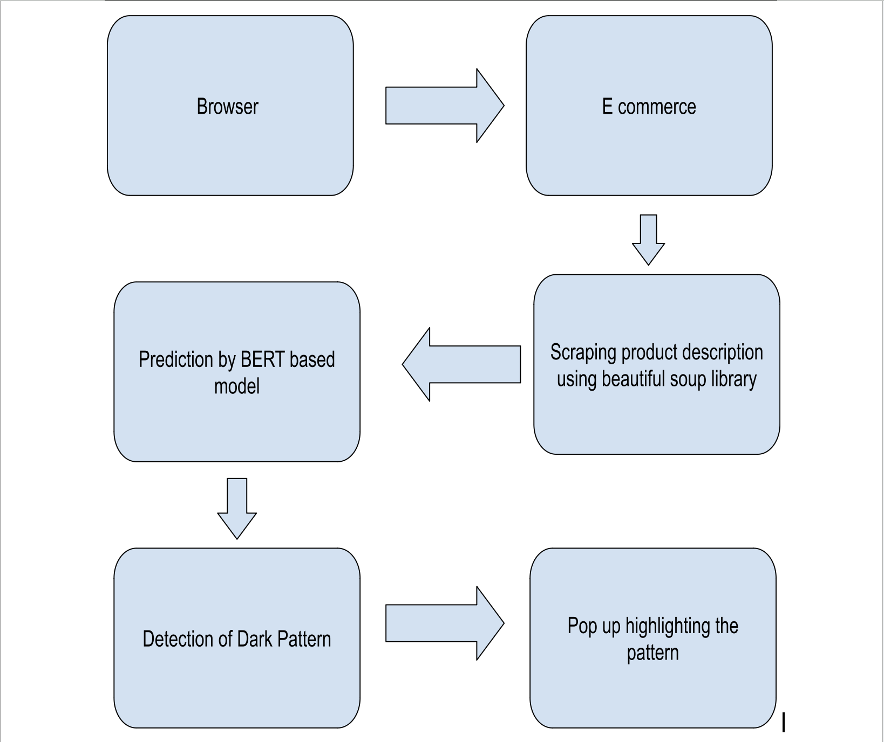

Slide 9

User experience
TrustForge provides users with the easiest way to beat dark patterns. It has a user friendly interface, and is extremely easy and intuitive.
The user has to simply use the TrustForge browser.
Users do not need to plug in any extension, hence a hassle free browsing experience is ensured.
Users gain an added advantage of their data being secure, which has a two way benefit: not only users are being ensured privacy, but also their data cannot be used to specific-target the user.

Slide 10
Future proofing and scalability
Because we have made a browser for the implementation of the solutions, our project is highly adaptable.
User can visit all sites with this browser, and would not have to worry about plugging in the extension.
No matter how e-commerce changes over the years, a browser as a solution will always be able to provide efficient support.
Also, just as an alternative solution, we also are providing the extension separetly.

Slide 11
Thank you

