Slide 1
TI-CNN: Convolutional Neural Networks for Fake News Detection
Group Members:
Ayush Singh- 2018A7PS0274P
Harshita Gupta-2018A2PS0147P
Himanshu Pandey- 2018A7PS0196P
Naman Goenka- 2018A7PS0398P

Slide 2
Problem Statement
Fake News Detection is modelled as a supervised binary classification problem. Feature set (X^{T}_{i},X^{I}_{i}) of i^{th} data point constitutes of text and image features respectively, which further are divided into latent and explicit features, derived by text and image information associated with the article. Hence, fake news task is to learn a model T:(X^{T}_{i},X^{I}_{i})→y; where y describe predicted binary label of article.
1 - Fake; 0 - Real is the label mapping used in our implementation

Slide 3
Research Paper Implemented
Title - TI-CNN: Convolutional Neural Networks for Fake News Detection
Link - https://arxiv.org/pdf/1806.00749v1.pdf
Dataset Link- https://drive.google.com/open?id=0B3e3qZpPtccsMFo5bk9Ib3VCc2c

Slide 4
Solution proposed in the paper

Slide 5
Text branch
Text features is divided into 2 categories-
Textual Explicit Features- These features are based on the statistics of the text. These are the length of the news, the number of sentences, question marks, exclamations and capital letters, average number of words in a sentence, exclusive words, negations,First-person pronoun,Second-person pronoun. There are 31 such attributes We represent these statistics as a vector of fixed size.This vector is then passed through a fully connected layer to form explicit features.
Textual Latent Features- These features are based on the news text itself.First we convert each word in the text into a k-dimensional word embedding.The maximum length of news is fixed to a value ‘n’. News articles with less than n words are padded to make their length as n.Then we use a CNN(convolutional neural network) to extract latent features from the vector representation of news article.

Slide 6
2. Image Branch
Image features into 2 categories-
Image Explicit Features- These features are based on the properties of the image.There are 3 such features, resolution of image(height and width), number of faces in the image .We represent these statistics as a vector of fixed size.This vector is then passed through a fully connected layer to form explicit features.
Image Latent Features- These features are based on the image itself.First we convert each image to a fixed size of 50 x 50. The vector of size 50 x 50 x 3 is thus passed through a CNN(convolutional neural network) to extract latent features from the vector representation of image.

Slide 7
Experimental Setup Proposed in Research Paper
The train-test-validation split of the data - 8:1:1 on a dataset size of 20015 data points
For the textual latent sub branch, the embedding dimension of the word2vec is set to 100.
The filter size in the convolutional neural network is (3, 3). There are 10 filters in all.
Two dropouts are adopted to improve the model’s generalization ability.
For the textual explicit sub branch, there is a dense layer with 128 neurons and then a batch normalization layer.
The outputs of textual explicit sub branch and textual latent feature sub branch are added.
For the visual latent sub branch, all the images are reshaped as size (50 × 50).
Convolutional layers are added followed by a ReLU activation layer.A max-pooling is connected to each convolutional layer to reduce the probability to be over-fitting.
For the visual explicit sub branch, the input of the explicit features is connected to the dense layer with 128 neurons. And then a batch normalization and activation layer are added.
The outputs of explicit and implicit feature sub branches are added.
The outputs of text and image branch are then concatenated. A dense layer with sigmoid activation is added which gives the labels of the news.

Slide 8
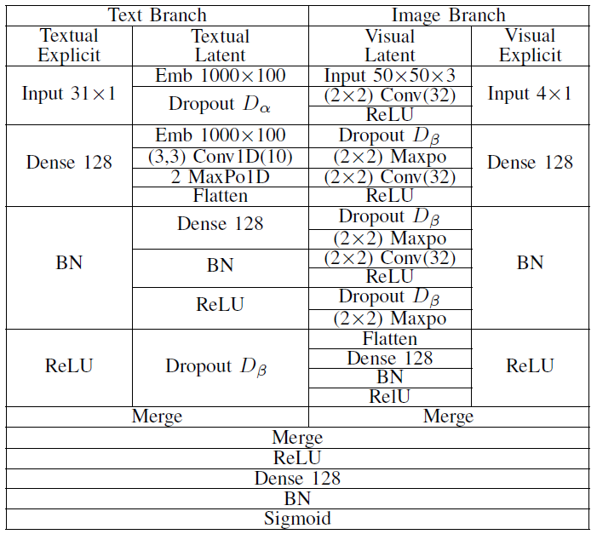
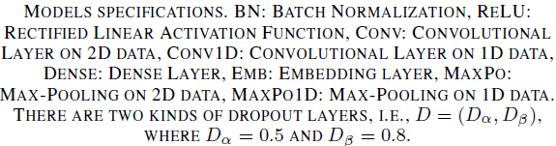
Architecture Proposed in Research Paper

Slide 9
Baseline Methods in paper
With image information only, the model cannot identify the fake news well indicating that image information is insufficient to identify the fake news.
Apart from CNN other techniques of text classification is also used. RNN(Recurrent neural networks), are a class of neural networks that allow previous outputs to be used as inputs while having hidden states. Unlike feedforward neural networks, RNNs can use their internal state (memory) to process sequences of inputs. This makes them applicable to tasks such as text classification or speech recognition.
The two methods used are:
LSTM (Long-Short Term Memory)
RNNs works better for short sentences. When we deal with a long article, there is a long term dependency problem.Therefore, vanilla RNNs are not recommended, instead LSTM is used which is a type of RNNs that can solve this long term dependency problem. Also, the same cell is applied to all the words so that the weights are shared across the words in the sentence.
GRU (Gated Recurrent Unit)
GRU can also be considered as a variation on the LSTM because both are designed similarly and, in some cases, produce equally excellent results.GRU aims to solve the vanishing gradient problem which comes with a standard recurrent neural network.

Slide 10
Our Idea and Solution

Slide 11
Preprocessing
Several columns such as country, language, uuid, id, publication_date, author name etc, are dropped off because either they don’t tell any meaningful information about target attribute or are almost unique for an entry.
Data points having non empty title and text are only kept, accounting to 20015 data points.
Target attribute is encoded via Label Encoder.
Keras inbuilt tokenizer is fitted upon 100 dimensional GLOVE embeddings, and text and title are transformed to sequences of indexes of words in GLOVE vocabulary.

Slide 12
Continued...
Text and title sequences are post padded with 0 value to 1000 (from paper) and 93 length respectively.
Glove embedding matrix is constructed and saved for future use.
Using requests library, a script was written to fetch images urls mentioned in ‘main_img_url ‘ column using custom headers which was robust against 404 error, connection error etc.
A blob of 400 * 400 was used to resize the image with scaling factor 1.2 for feeding it into the model.
A Pre Trained model was used to count faces in the extracted image.
Using OpenCV, we read the image and get its resolution too.
Furthermore, some images which were having more than or less than 3 channels were converted to 3-channel(RGB) format.
Finally, we were able to finally extract 7272 out of 20015 data points. Rest of the data points were discarded mainly due to broken image links in the dataset.

Slide 13
Our Baseline Methods
With image information only, the model cannot identify the fake news well indicating that image information is insufficient to identify the fake news.
Apart from CNN other techniques of text classification is also used. RNN(Recurrent neural networks), are a class of neural networks that allow previous outputs to be used as inputs while having hidden states. Unlike feedforward neural networks, RNNs can use their internal state (memory) to process sequences of inputs. This makes them applicable to tasks such as text classification or speech recognition.
The three methods used are:
LSTM (Long-Short Term Memory)
We made a text branch and content branch with embedding of 400x100 and applied bidirectional LSTM.
Merging both the branches with two dense layers and two dropout layers to improve the model’s generalization ability and a sigmoid activation in the last layer for news prediction.
For hyperparameter(no. of LSTM hidden neurons in both text and title branch, dense layer hidden neurons and dropout values) tuning Bayesian Optimization is used for 3 rounds with Adam Optimizer.
GRU (Gated Recurrent Unit)
Similarly Bidirectional-GRUs are also used as they are a variation on the LSTM because both are designed similarly and, in some cases, produce equally excellent results.

Slide 14
CNN-text-1000
This model makes use of only the textual latent and textual explicit branch of the TICNN-TITLE-1000 model (i.e. only the text content of the news article) to predict the whether the news article is fake or not.The dataset used has 20015 data points. An 8:1:1 training-test-validation split is used for obtaining the results

Slide 15
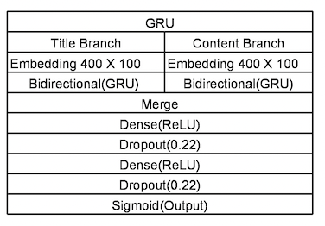
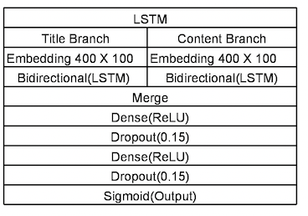
Baseline Models’ Diagrams
GRU-400 Architecture
LSTM-400 Architecture

Slide 16
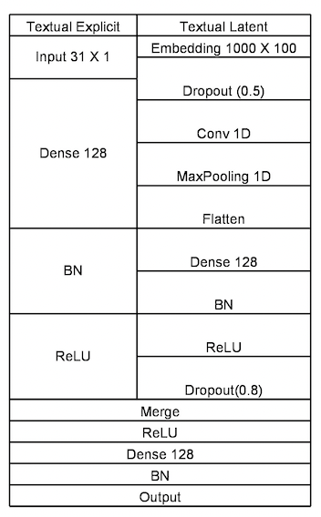
CNN-Text-1000 Architecture

Slide 17
Our Proposed Architecture
To further enhance the accuracy of the model, we have implemented a 5 branch architecture (as compared to 4 branch architecture proposed in the paper). Furthermore, we have made modifications in the structure of branches proposed in the paper which have contributed significantly in improving the accuracy of the model. The major differences between our proposed TICNN-TITLE-1000 model and the model proposed in the paper are as follows-
We have introduced a new branch to the originally proposed model architecture.This branch is used to extract latent features from ‘title’ of the news article.The title of the article is represented as a vector of shape 93 x 1 using glove100 embedding.
We have used glove100 embedding in place of originally proposed word2vec embedding.This has further contributed to increasing the accuracy of the model
We have also made some changes in textual latent branch of the model.These changes include using one embedding layer in the branch in place of originally proposed two layers and changing the hyperparameters of the pooling and convolution layers.

Slide 18
Model Architecture of TICNN-TITLE-1000
Text branch
Text features is divided into 3 categories-
Textual Explicit Features- These features are based on the statistics of the text. These are the length of the news, the number of sentences, question marks, exclamations and capital letters, average number of words in a sentence, exclusive words, negations,First-person pronoun,Second-person pronoun. There are 31 such attributes We represent these statistics as a vector of fixed size.This vector is then passed through a fully connected layer to form explicit features.

Slide 19
Textual Latent Features- These features are based on the news text itself.First we convert each word in the text into a 100-dimensional word embedding using GloVe.The maximum length of news is fixed to a value 1000. News articles with less than 1000 words are padded to make their length as 1000.Then we use a CNN(convolutional neural network) to extract latent features from the vector representation of news article.
Title Latent Features- These features are based on the news title.First we convert each word in the text into a 100-dimensional word embedding using GloVe.The maximum length of title is fixed to a value 93. News articles with less than 93 words are padded to make their length as 93.Then we use a CNN(convolutional neural network) to extract latent features from the vector representation of news article.

Slide 20
2. Image Branch
Image features into 2 categories-
Image Explicit Features- These features are based on the properties of the image.There are 3 such features, resolution of image(height and width), number of faces in the image .We represent these statistics as a vector of fixed size.This vector is then passed through a fully connected layer to form explicit features.
Image Latent Features- These features are based on the image itself.First we convert each image to a fixed size of 50 x 50. The vector of size 50 x 50 x 3 is thus passed through a CNN(convolutional neural network) to extract latent features from the vector representation of image.

Slide 21
3. Combining branches
The outputs of textual explicit sub branch,textual latent feature sub branch and title latent feature sub-branch are added to create a single vector of size 128 x 1
The outputs of image explicit and implicit feature sub branches are added.
The outputs of textual and image branch are then concatenated. A neural network with sigmoid activation is added which gives the labels of the news.

Slide 22
Experimental Setup for TICNN-TITLE-1000
The train-test-validation split of the data - 6:2:2 on a dataset size of 7272 data points
For the textual latent sub branch, the embedding dimension of the GloVe is set to 100.
The input length of news article is fixed to 1000 words.Articles shorter than this are post padded with zeros and those larger than this are post truncated.
The filter size in the convolutional neural network is 3. There are 10 filters in all.
Two dropouts are adopted to improve the model’s generalization ability.
For the textual explicit sub branch, there is a dense layer with 128 neurons and then a batch normalization layer.
For the title latent sub branch, the embedding dimension of the GloVe is set to 100.
The input length of news article is fixed to 93 words.Titles shorter than this are post padded with zeros and those larger than this are post truncated.
The filter size in the convolutional neural network is 3. There are 10 filters in all.
Two dropouts are adopted to improve the model’s generalization ability.
The outputs of textual explicit sub branch,textual latent feature sub branch and title latent feature sub-branch are added.

Slide 23
For the visual latent sub branch, all the images are reshaped as size (50 × 50).
Convolutional layers are added followed by a ReLU activation layer.A max-pooling is connected to each convolutional layer to reduce the probability to be over-fitting.
For the visual explicit sub branch, the input of the explicit features is connected to the dense layer with 128 neurons. And then a batch normalization and activation layer are added.
The outputs of explicit and implicit feature sub branches are added.
The outputs of text and image branch are then concatenated. A dense layer with 128 neurons, batch normalisation layer, ReLU activation layer and sigmoid activation layer is added which gives the labels of the news.

Slide 24
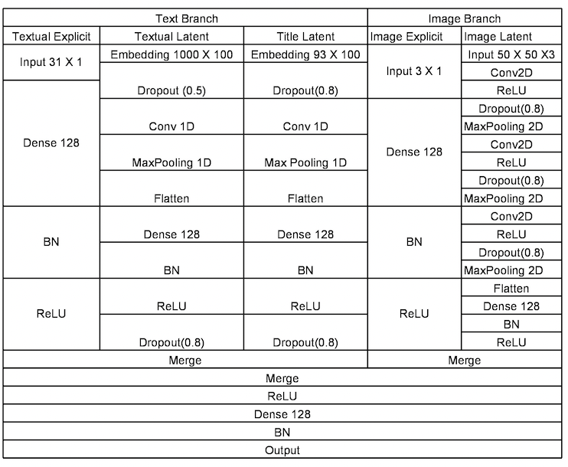
Model architecture of TICNN-TITLE-1000 Proposed by our group

Slide 25
Demo

Slide 26
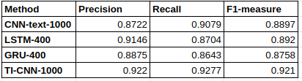
Results from the paper
GRU and LSTM with text information are inefficient with very long sequences, and the model with 1000 input length performs worse. Hence, input length 400 is taken as the baseline method. (Those news text less than the assigned word length are post-padded with zero and those, more than the assigned word length are post truncated.) With text and image information, TI-CNN outperforms all the baseline methods significantly.
THE EXPERIMENTAL RESULTS ON MANY BASELINE METHODS-

Slide 27
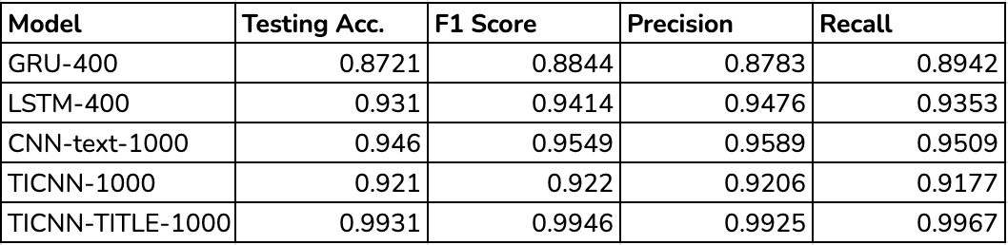
Our results
As evident from the results reported below, our changes have improved the model accuracy significantly.Our model TICNN-TITLE-1000 outperforms the state-of-the-art model proposed in the paper by a large margin.

Slide 28
Conclusion
Text-Image CNN (TICNN) introduced provides efficient robust technique for multimodal fake news detection with capability of requiring less training time than recurrent network counterparts and being able to concentrate on only important parts of data.
A novel TI-CNN-TITLE-1000 model is also presented which helps in better modelling of article’s title role as indicative component of an article. This approach was found to perform better than TI-CNN-1000 model on our preprocessed dataset.

Slide 29
Future Scope
Developing defense mechanism against such high fake news dissemination remains a crucial research opportunity for the future.
Multilingual research, application of image captioning methods, weight sharing methodology of siamese networks applied to TICNN can be explored in future.

Slide 30
Thank You!
Any Questions?

