Slide 1
TI-CNN: Convolutional Neural Networks for Fake News Detection
Group Members:
Ayush Singh- 2018A7PS0274P
Harshita Gupta-2018A2PS0147P
Himanshu Pandey- 2018A7PS0196P
Naman Goenka- 2018A7PS0398P

Slide 2
Introduction
A model named as TI-CNN (Text and Image information based Convolutional Neural Network) is proposed in this paper.
With the development of social networks, fake news for various commercial and political purposes has been appearing in large numbers and gotten widespread in the online world.
It is very difficult to identify fake news because of the fact that it is written by humans, and they strategically use words that can be difficult to differentiate from words used in legitimate news sources.
There are some common ways through which fake news can be identified such as Cartoons in articles, altered low resolution images and irrelevant images.
With a thorough investigation of a fake news data, lots of useful explicit features are identified from both the text words and images used in the fake news such as number of words, exclamation marks for text and image resolution for images. Besides the explicit features, there also exist some hidden patterns in the words and images used in fake news, which can be captured with a set of features extracted via the multiple convolutional layers in our model

Slide 3
Introduction
The simpler models used traditionally are not able to handle higher order features very well.
We use convolutional neural networks to identify the latent features which are not captured by the explicit features such as number of faces.
We utilise the model to combine the explicit and latent features of text and image information into a unified feature space, and then use the learned features to identify the fake news.
The approach is summarised as follows:
We collect a dataset and do in-depth analysis on the text using multiple perspectives.
Image information is proved to be effective features in identifying the fake news.
A combined model is proposed to analyze the text and image information using the convolutional neural networks.

Slide 4
Related Work
Deception detection is a hot topic in the past few years. Deception information includes scientific fraud, fake news, false tweets etc. Fake news detection is a subtopic in this area. The deception detection problem can be seen from two aspects: 1) linguistic approach. 2) network approach.
1. Linguistic approaches
This approach involves the use of natural language processing techniques to solve the problem. Example, Bing Liu analyzed fake reviews on Amazon of past years based on the sentiment analysis, lexical, content similarity, style similarity and semantic inconsistency to identify the fake reviews. The methods based on word analysis is not enough to identify deception. Many researchers focus on some deeper language structures, such as the syntax tree. In this case, the sentences are represented as a parse tree to describe syntax structure, for example noun and verb phrases, which are in turn rewritten by their syntactic constituent parts.

Slide 5
Continued..
2. Network-based approaches
Another way to identify the deception is to analyze the network structure and behaviors, which are important complementary features. In the natural language processing (NLP) area, deep learning models are used to train a model that can represent words as vectors.Convolutional neural networks (CNN) utilize filters to capture the local structures of the image, which performs very well on computer vision tasks. Researchers also find that CNN is effective on many NLP tasks such as semantic parsing, sentence modeling.

Slide 6
Problem Modelling
Given a set of n news articles containing text and image information, we want to represent this information as a set of test-image tuples S={(S^{T}_{i},S^{I}_{i})} where i ranges from 1 to n.The goal of this problem is to build a model to infer whether the news is real or fake based on these test-image tuples. The label set is represented as Y = {[1, 0], [0, 1]}, where [1, 0] denotes real news while [0, 1] represents the fake news. Based on the news articles, e.g., (S^{T}_{i} , S^{I}_{i}) ∈ S, a set of features (including both explicit and latent features) represented as A^{T}_{i} and A^{I}_{i} respectively. The objective of the fake news detection problem is to build a model f : {A^{T}_{i} , A^{I}_{i}}^{n}_{i} ∈ A → Y to infer the potential labels of the news articles in S.

Slide 7
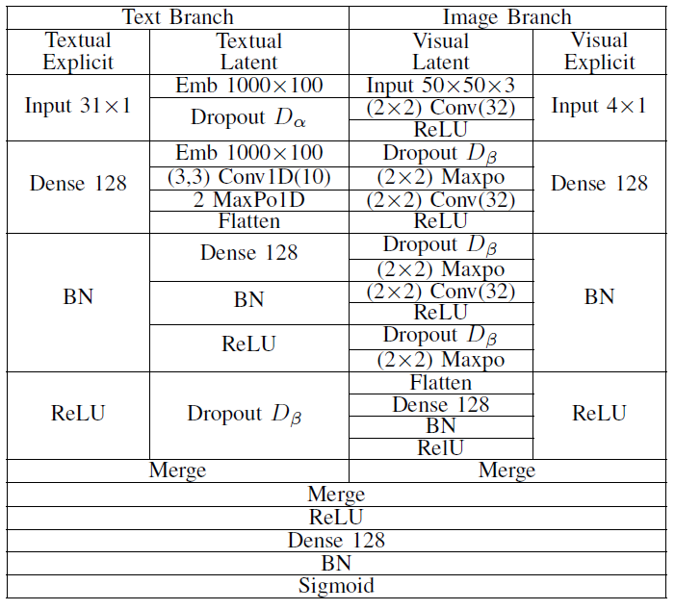
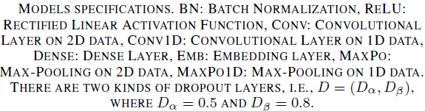
Model Architecture

Slide 8
Proposed Model Architecture
Text branch
We divide the text features in two categories-
Textual Explicit Features- These features are based on the statistics of the text such as number of words in news article,number of sentences,number of exclamations and so on.We represent these statistics as a vector of fixed size.This vector is then passed through a fully connected layer to form explicit features.
Textual Latent Features- These features are based on the news text itself.First we convert each word in the text into a k-dimensional word embedding.The maximum length of news is fixed to a value ‘n’.News articles with less than n words are padded to make their length as n.Then we use a CNN(convolutional neural network) to extract latent features from the vector representation of news article.

Slide 9
2. Image Branch
We divide the image features in two categories-
Image Explicit Features- These features are based on the properties of the image such as resolution of image, number of faces in the image and so on.We represent these statistics as a vector of fixed size.This vector is then passed through a fully connected layer to form explicit features.
Image Latent Features- These features are based on the image itself.First we convert each image to a fixed size of 50 x 50.The vector of size 50 x 50 x 3 is thus passed through a CNN(convolutional neural network) to extract latent features from the vector representation of image.

Slide 10
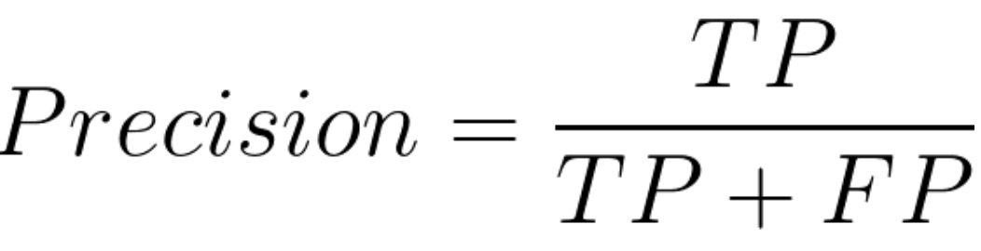
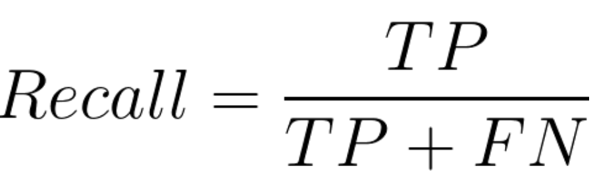
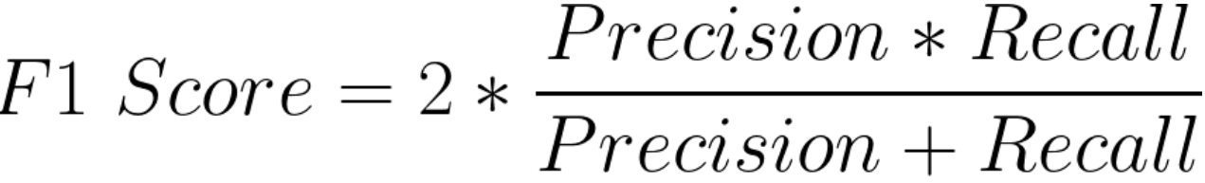
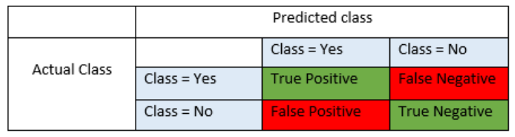
Evaluation Metrics
To evaluate the performance of the model the following metrics will be used-

Slide 11
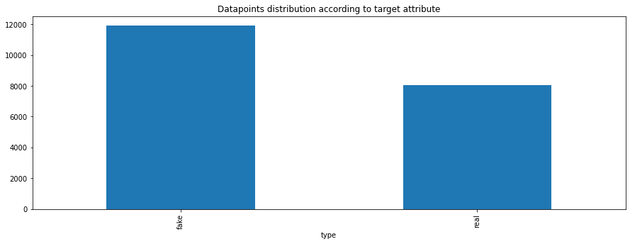
TI-CNN Dataset
Contains 20,015 data points with total 52 attributes.
Balanced w.r.t to binary ‘type’ target attribute, with approx 60% fake news.
Input attributes used for analysis include text, title, 31 explicit textual features, image, number of faces in the image and resolution of the image.
Fake data points are individually extracted from various sources and whereas real news is fetched from reputed news houses.

Slide 12
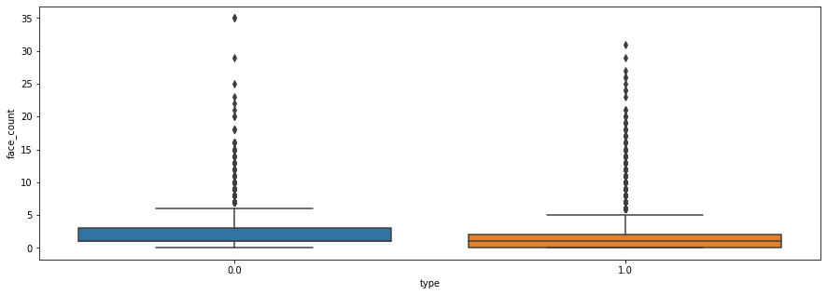
Our Results validating hypothesis mentioned in paper
Images corresponding to real news has more faces count in general.
(Encoding :- 1 Fake ; 0 Real)
In all plots, variance in fake news is more than real news, as authors write real news in constraints imposed by the press unlike that of fake news.

Slide 13
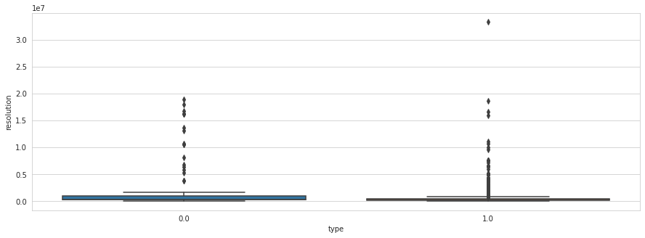
Images corresponding to real news has better resolution in general.
(Encoding :- 1 Fake ; 0 Real)

Slide 14
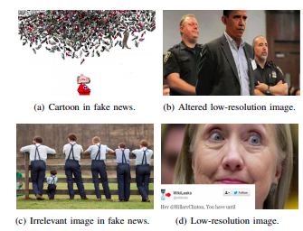
Logic Behind Images in Fake News Detection

Slide 15
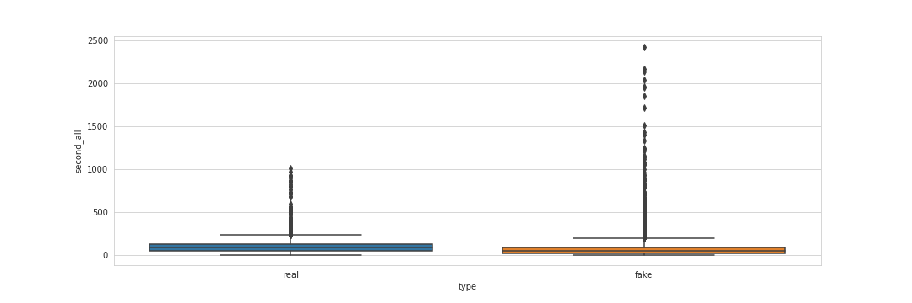
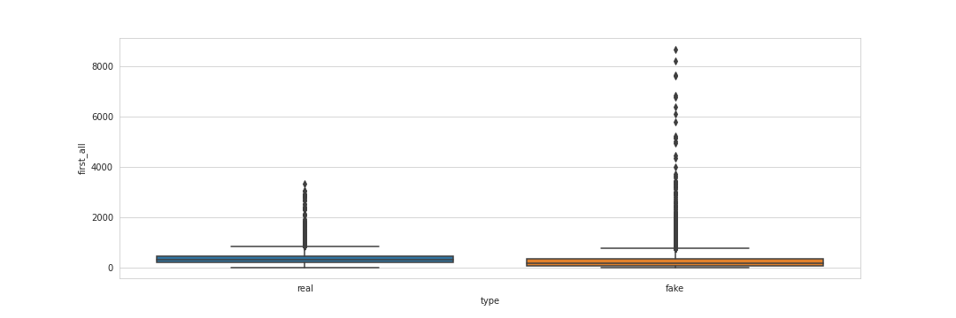
Real News has more first person and second person words than fake news.

Slide 16
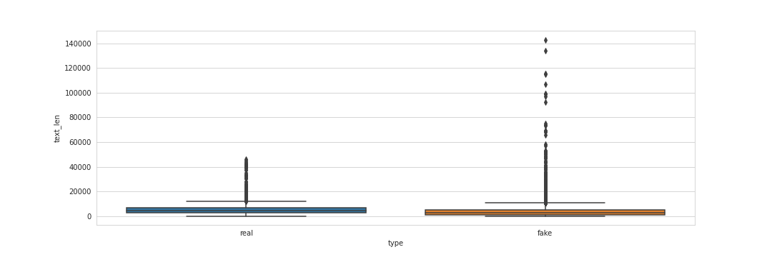
Real News has more words on average than fake news.
The reason can be that the editor of real news must write the article under certain rules of the press. These rules include the length, word selection, no grammatical errors, etc. It indicates that most of the real news are written in a more standard and consistent way. However, most of the people who write fake news don’t have to follow these rules.

Slide 17
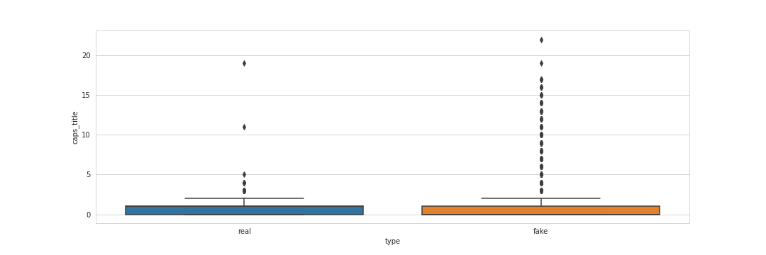
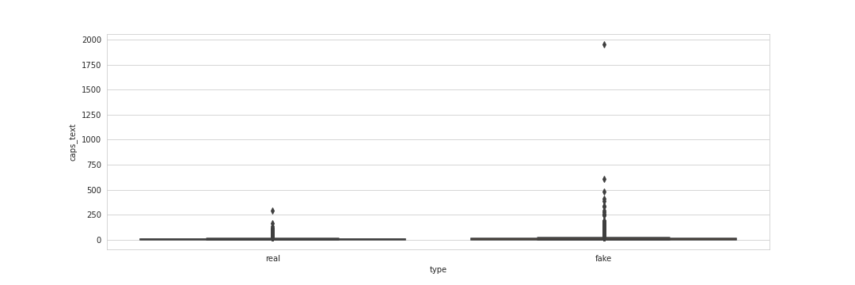
Fake News has more capitalization in both title and text for attracting readers’ attention while the real news contains less capital letters, which is written in a standard format.

Slide 18
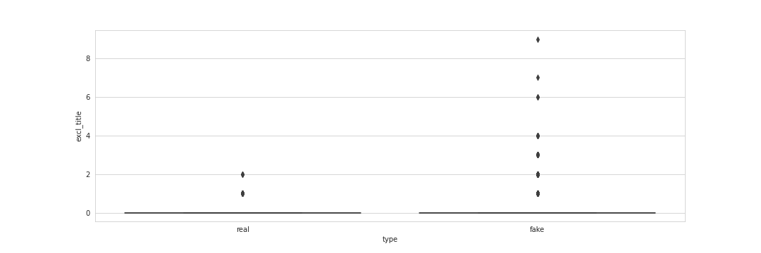
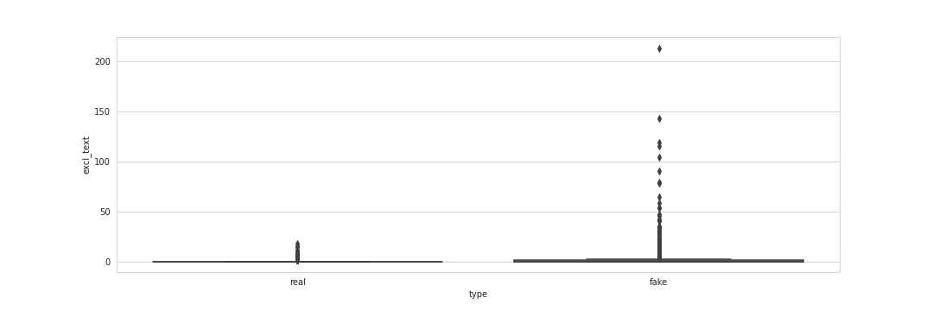
Although exclamation marks are very less in dataset, but fake news has more exclamations explaining that authors are trying to have an impulsive effect on readers.

Slide 19
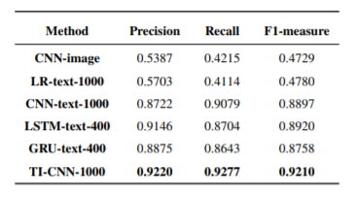
Results from paper

Slide 20
Implementation
Data Analysis- April 5 to April 11
Data Preprocessing- April 5 to April 11
Text Branch Implementation- April 12 to April 18
Image Branch Implementation- April 12 to April 18
Complete model implementation via merging both the branches.-April 19 to April 25
Obtaining results and error analysis- April 19 to April 25
Post processing(if required) and improvement- April 19 to April 25

Slide 21
Data Preprocessing (Completed)
Several columns such as country, language, uuid, id, publication_date, author name etc, are dropped off because either they don’t tell any meaningful information about target attribute or are almost unique for an entry.
Data points having non empty title and text are only kept, accounting to 20015 data points.
Target attribute is encoded via Label Encoder.
Keras inbuilt tokenizer is fitted upon 100 dimensional GLOVE embeddings, and text and title are transformed to sequences of indexes of words in GLOVE vocabulary.

Slide 22
Continued..
Text and title sequences are post padded with 0 value to 1000 (from paper) and 93 length respectively.
Glove embedding matrix is constructed and saved for future use.
Using requests library, a script was written to fetch images urls mentioned in ‘main_img_url ‘ column using custom headers which was robust against 404 error, connection error etc.
A blob of 400 * 400 was used to resize the image with scaling factor 1.2 for feeding it into the model.
A Pre Trained model was used to count faces in the extracted image.
Using OpenCV, we read the image and get its resolution too.
Finally, we were able to finally extract 7272 out of 20015 data points. Rest of the data points were discarded mainly due to broken image links in the dataset.

Slide 23
Final Words..
Implementing architecture (TI-CNN-1000) explained in the paper, on preprocessed the dataset obtained.
Our results will be limited in comparison to actual paper as we managed to obtain 7272 / 20015 data points with text and images attributes due to broken image links in the dataset.
Objective :- Verification of best hyperparameters to the model mentioned in the paper. Carry out qualitative and quantitative error analysis.
Ambitious Objective :- We will try experimenting with other approaches such as CNN+LSTM network, parallel networks, etc.

Slide 24
References
[1] Yang, Yang, Lei Zheng, Jiawei Zhang, Qingcai Cui, Zhoujun Li, and Philip S. Yu. "TI-CNN: Convolutional neural networks for fake news detection." arXiv preprint arXiv:1806.00749 (2018).
[2] Pennington, Jeffrey, Richard Socher, and Christopher D. Manning. "Glove: Global vectors for word representation." In Proceedings of the 2014 conference on empirical methods in natural language processing (EMNLP), pp. 1532-1543. 2014.
[3]Bradski, Gary, and Adrian Kaehler. Learning OpenCV: Computer vision with the OpenCV library. " O'Reilly Media, Inc.", 2008.
Dataset Link- https://drive.google.com/open?id=0B3e3qZpPtccsMFo5bk9Ib3VCc2c

