Slide 1
INTRODUCTION TO DEEP LEARNING
Fulfilled as part of workshop on Machine Learning and Artificial Intelligence at Raghu Engineering College, February 2019

Slide 2
Agenda
History of Deep Learning
Why the hype now?
The power of Deep Learning
Algorithm at the heart of Deep Learning
Code

Slide 3
Why Now?
Big Data
Hardware
Software

Slide 4
Deep Learning in the earlier years
Frank Rosenblatt at the Cornell University, investigated "Perceptrons“
inspired from the neuron in our brain
coined the term "connectionism" to draw parallels between the human brain and artificial intelligence

Slide 5
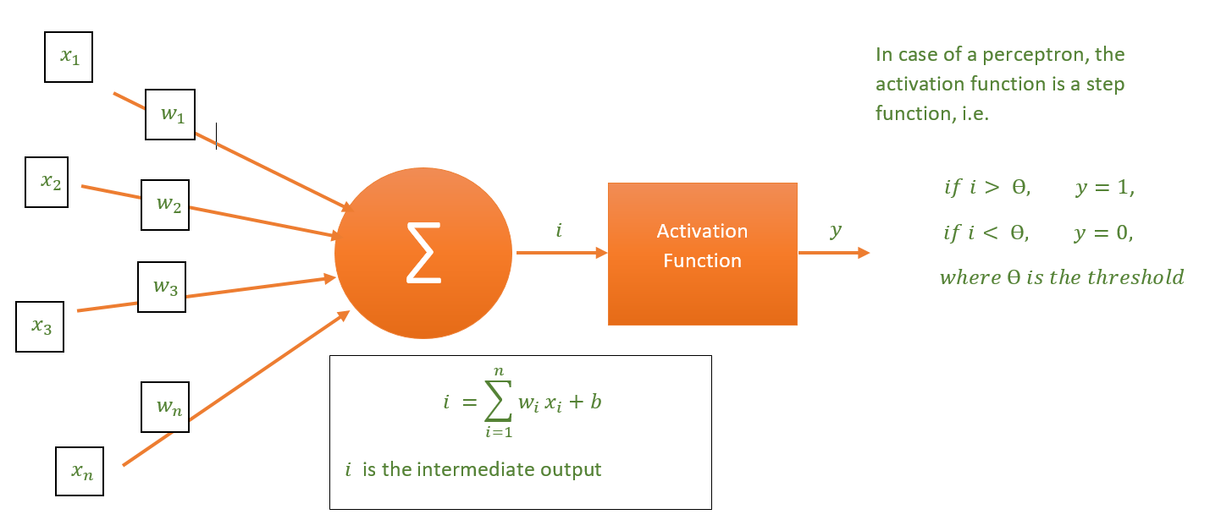
Perceptrons
Basic building block of Neural Networks

Slide 6
GATE Functions using Perceptrons
Perceptrons cannot model more complex functions

Slide 7
Neural Network Architecture

Slide 8
Activation Function
Introduces Non-linearities
Allows modeling of complex functions
Should be differentiable

Slide 9
Types of Activation Functions
Sigmoid
Tanh
ReLu
Leaky-ReLu

Slide 10
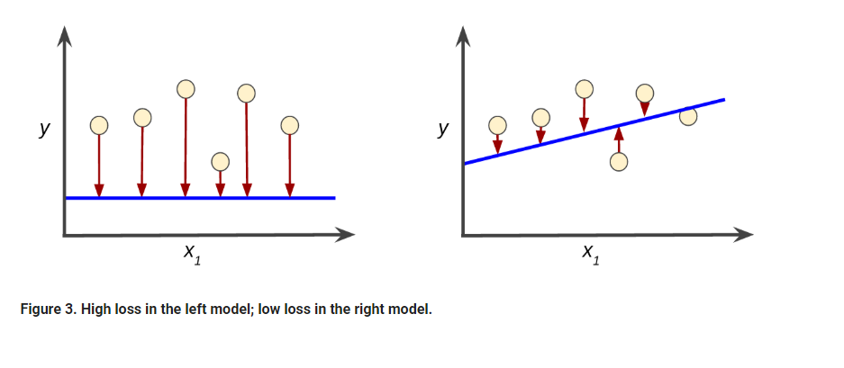
Loss Function

Slide 11
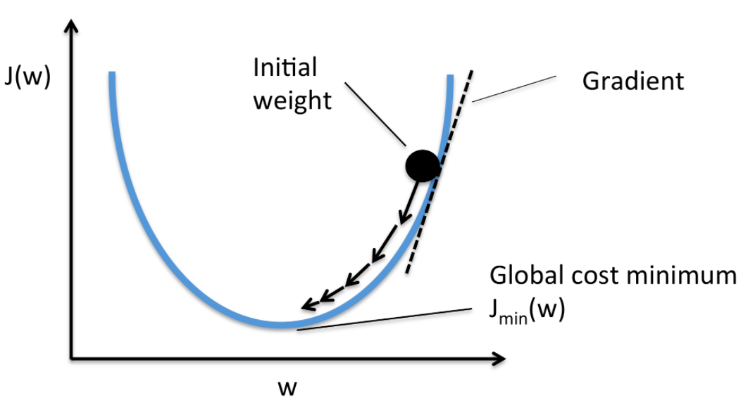
Gradient Descent

Slide 12
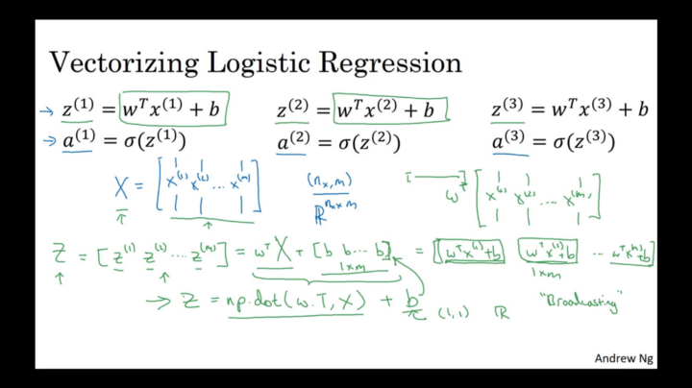
Forward Propagation

Slide 13
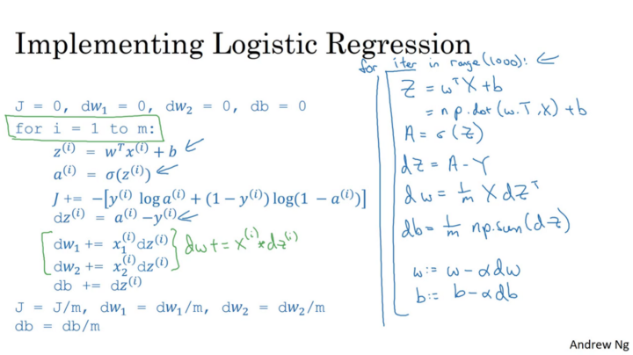
Backpropagation

Slide 14
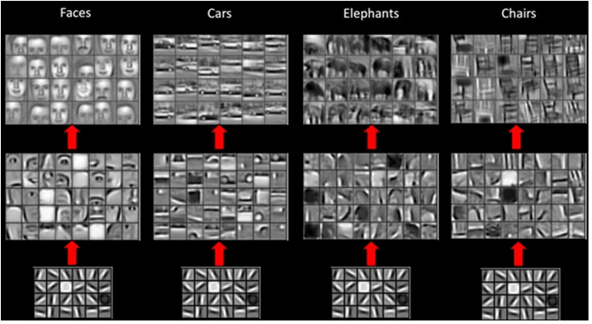
Representation Learning

Slide 15
http://colah.github.io/posts/2014-03-NN-Manifolds-Topology/

Slide 16
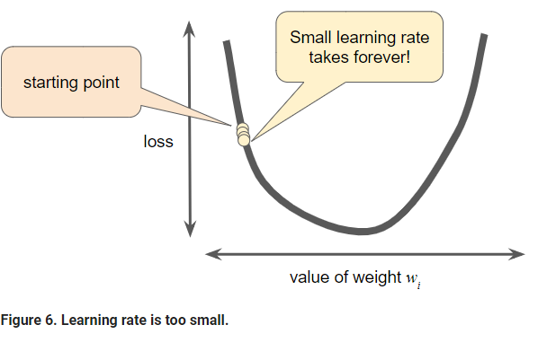
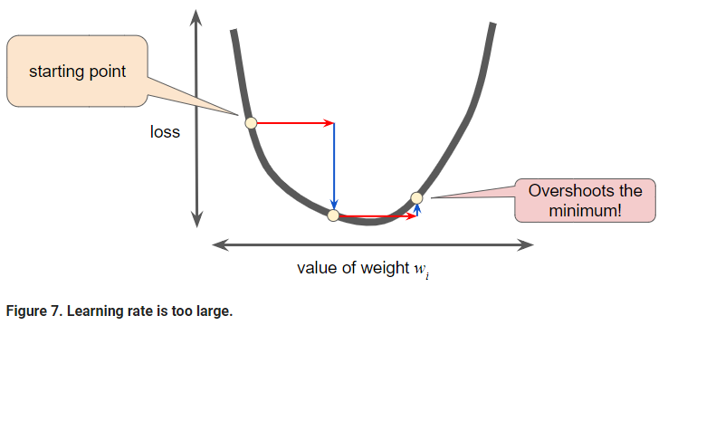
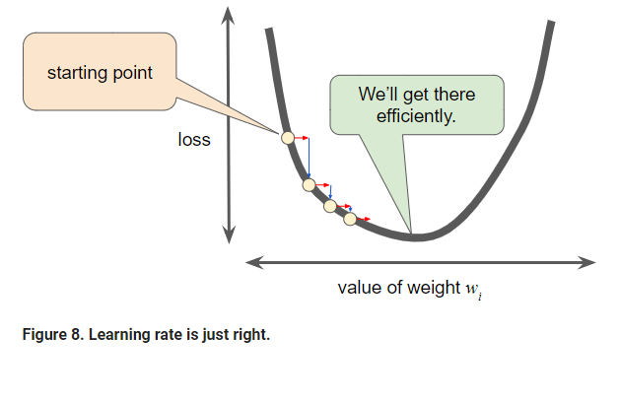
Learning Rate

Slide 17
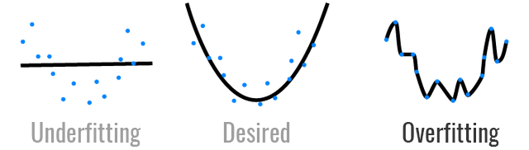
Underfitting and Overfitting
Detection - Validation loss vs training loss

Slide 18
Bias vs Variance (Equation)
The bias is an error from erroneous assumptions in the learning algorithm. High bias can cause an algorithm to miss the relevant relations between features and target outputs (underfitting).
The variance is an error from sensitivity to small fluctuations in the training set. High variance can cause an algorithm to model the random noise in the training data, rather than the intended outputs (overfitting).

Slide 19
Underfitting
Training loss is very high
Model is not complex enough – Introduce higher order functions
Model is not converging – check the code
Bias is high

Slide 20
Overfitting
Training loss << Validation loss
Dataset might be narrow – gather more data
Model might be too complex – make it simple
Variance is high
Data Augmentation and Noise
Early Stopping
Regularization
Dropout

Slide 21
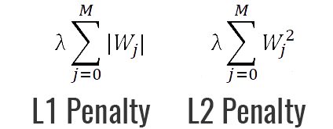
Regularization
Add penalty to loss function

Slide 22
Dropout
Randomly remove some nodes (Intuitively same as Regularization)

Slide 23
Thank You
tanya2911dixit@gmail.com

