Slide 1
Introduction to Machine Learning
Fulfilled as part of workshop on Machine Learning and Artificial Intelligence at Raghu Engineering College, February 2019

Slide 2
Artificial Intelligence
A broader term

Slide 3
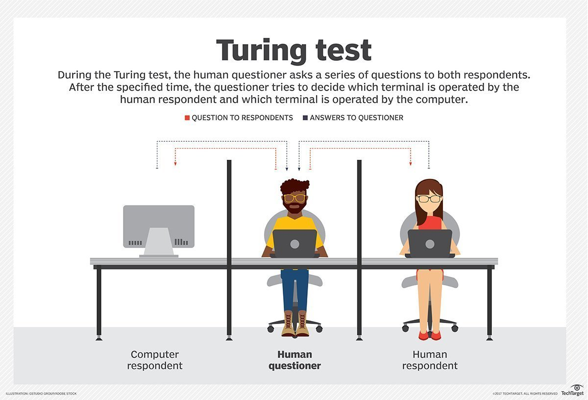
History of Artificial Intelligence
AI has been around since 1900s
Popularized by Alan Turing

Slide 4
The Chinese Room Argument
just because a program can manipulate syntax and give a correct output, doesn't mean it has a semantic content
essential for intelligence
The question is then, what is intelligence?

Slide 5
Types of Intelligence
Narrow AI
General AI
Strong AI

Slide 6
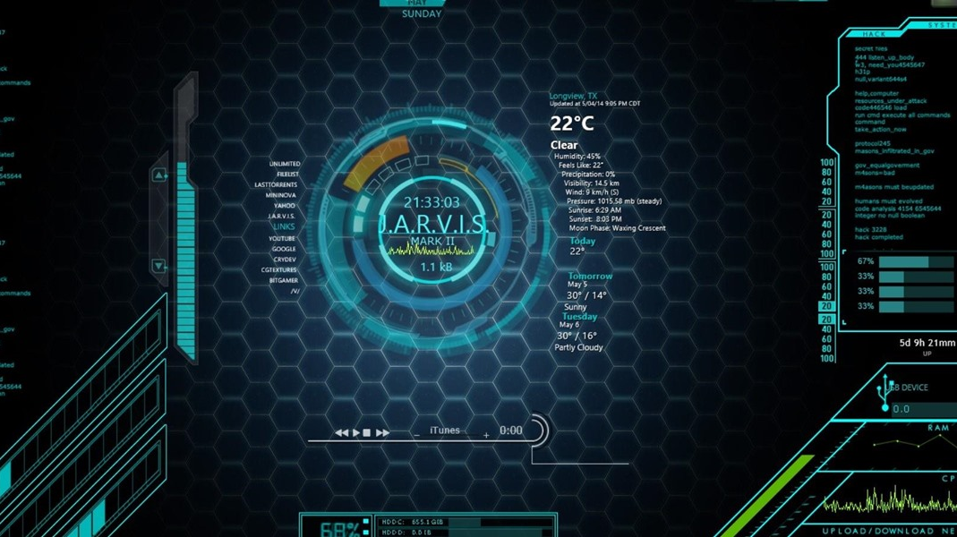

Slide 7
What can JARVIS do?
Ask questions
Acquire New Information
Reason
Make decisions – but has a limit

Slide 8
The Singularity
Ray Kurzweil, the Director of Engineering at Google claims that by 2045, we would have reached Strong AI
Might be a self-fulfilling prophecy
Food for thought – Will the positives of AI outweigh the negatives?

Slide 9

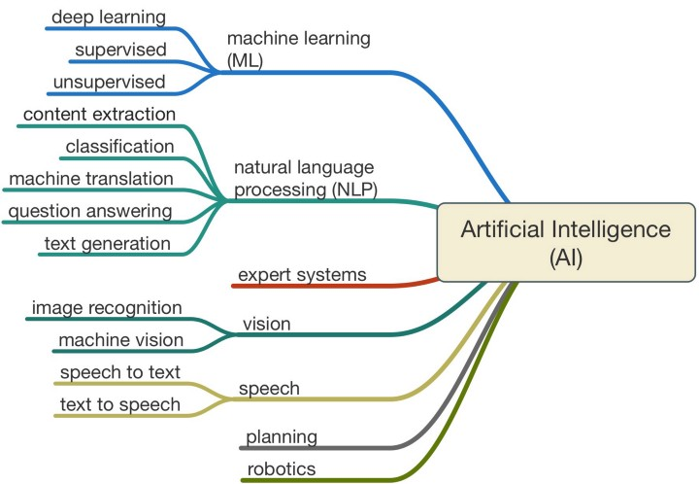

Slide 10
Why Machine Learning?
Early intelligent models Are rule based
Need lots of domain knowledge (deep knowledge)
Difficult and time consuming without domain knowledge
Slight change of logic might need a rewrite of the whole system
Not everyone can create impactful applications

Slide 11
Examples of earlier models
Expert Systems
In agriculture and medicine (RESEARCH PAPER)
Feature Engineering by Hand
Require in-depth domain knowledge

Slide 12
Types of Machine Learning
Supervised
Unsupervised
Semi-supervised or Reinforcement Learning

Slide 13
Common ML Algorithms (Disc vs Gen)
Linear Regression
Logistic Regression
Decision Tree
SVM
Naive Bayes
kNN
K-Means
Random Forest
Dimensionality Reduction Algorithms
Gradient Boosting algorithms
GBM
XGBoost
LightGBM
CatBoost

Slide 14
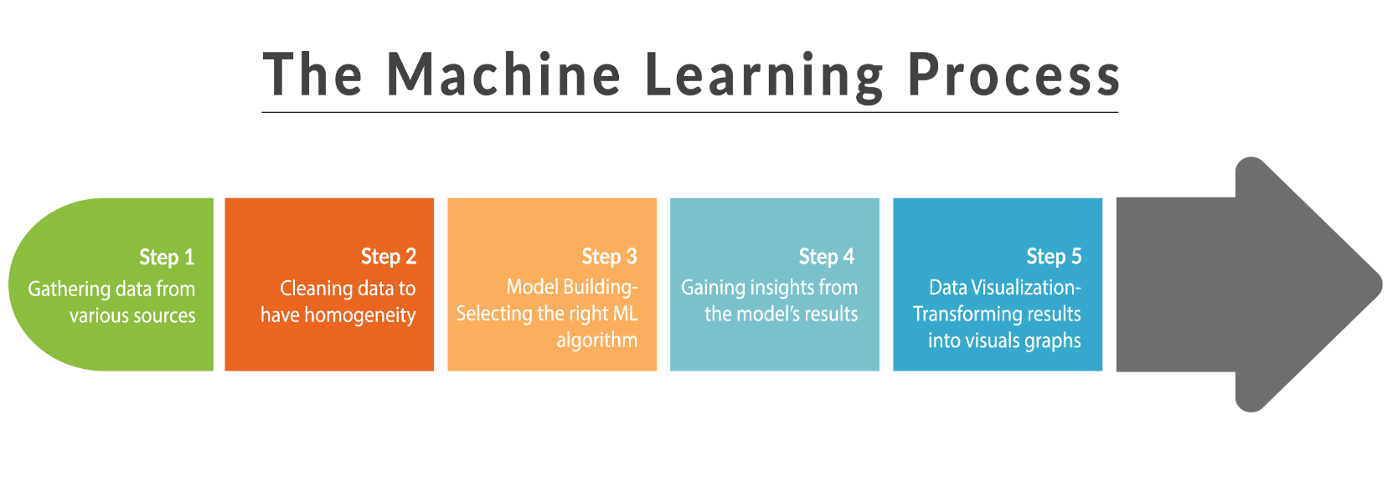
Understanding the ML Process – Know the Problem

Slide 15
The ML Process
First is knowing the problem
Knowing and analyzing your data
How do I pose my question as a ML problem?
Feature extraction –see which features are relevant
Inspecting the data for outliers
Visualize the data

Slide 16
How to select the right ML Algorithm?
https://hackernoon.com/choosing-the-right-machine-learning-algorithm-68126944ce1f
Input Data/ Output Data
Interpretability
Complexity
Response Time
On the go learning

Slide 17

Applications of ML

Slide 18
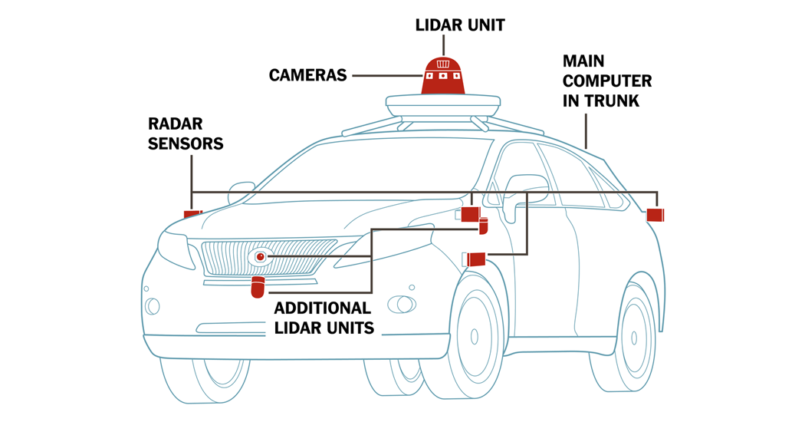
Tesla – Driverless Cars

Slide 19
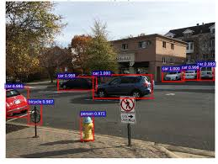
Object Detection and Object Tracking
Uses CNN based models

Slide 20


Baidu – Voice Search
Neural Voice Cloning with a Few Samples
https://arxiv.org/pdf/1802.06006.pdf

Slide 21
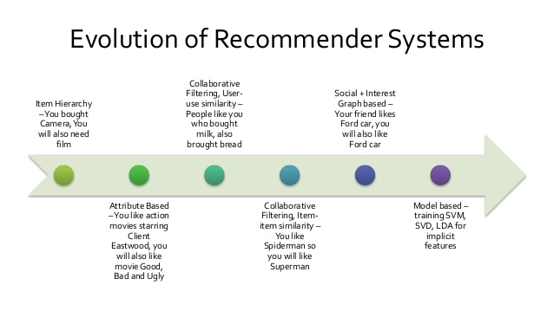
Amazon &Netflix – recommender systems

Slide 22

More Applications…
Email/Spam Filtering
Video Surveillance
Housing Prices Prediction
Stock Price Detection
Detecting Diseases
Chatbots

Slide 23
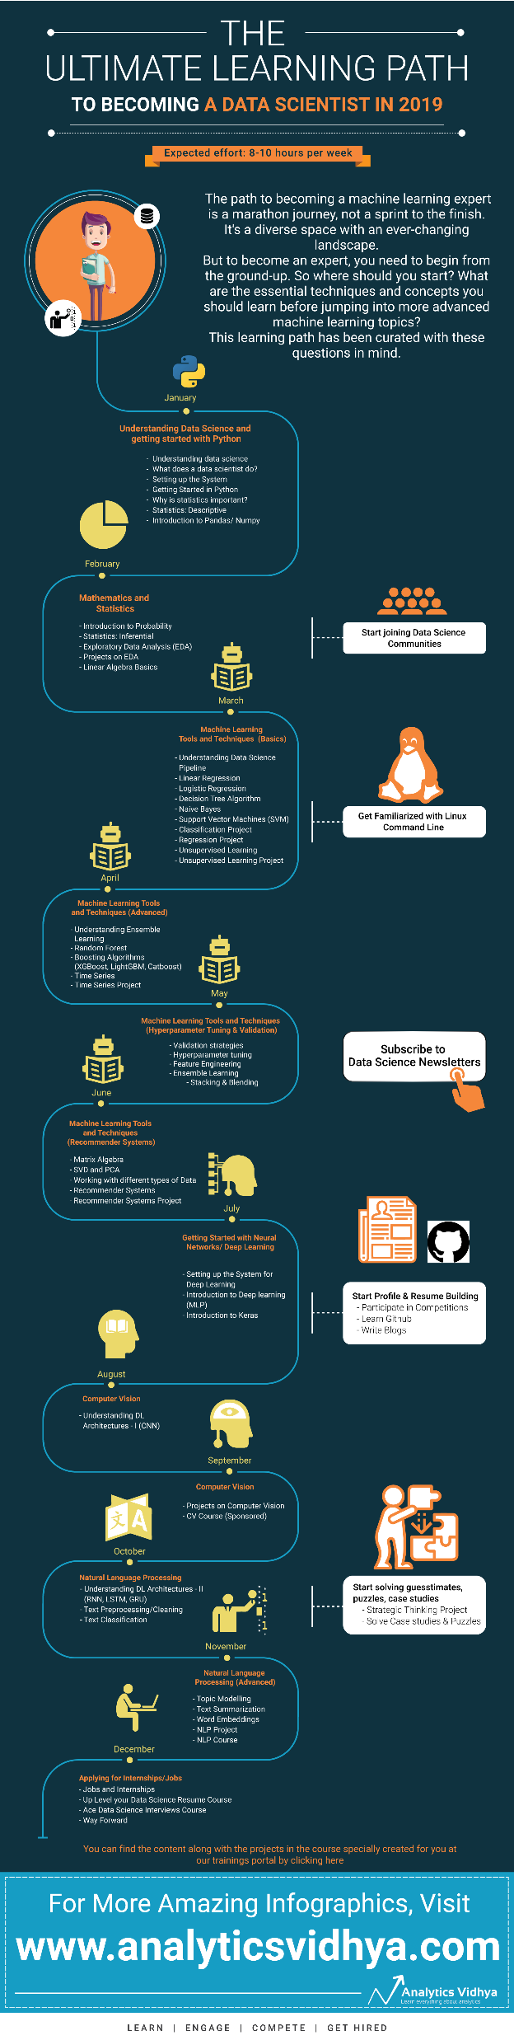
Roadmap

Slide 24
Thank You
tanya2911dixit@gmail.com

Slide 25
Extra Resources

Slide 26
Analytical Solution
https://eli.thegreenplace.net/2014/derivation-of-the-normal-equation-for-linear-regression/

Slide 27
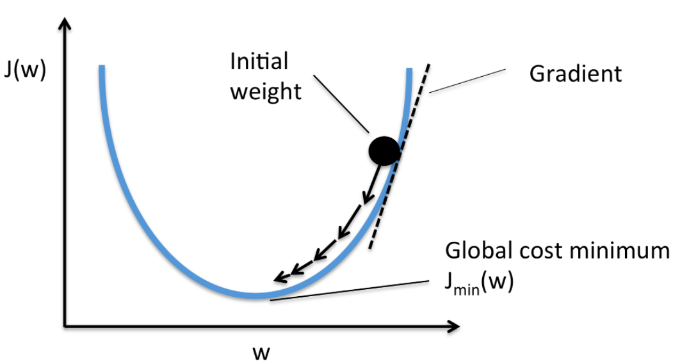
Gradient Descent

Slide 28
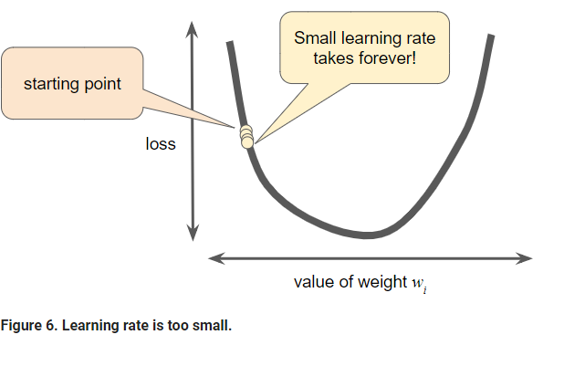
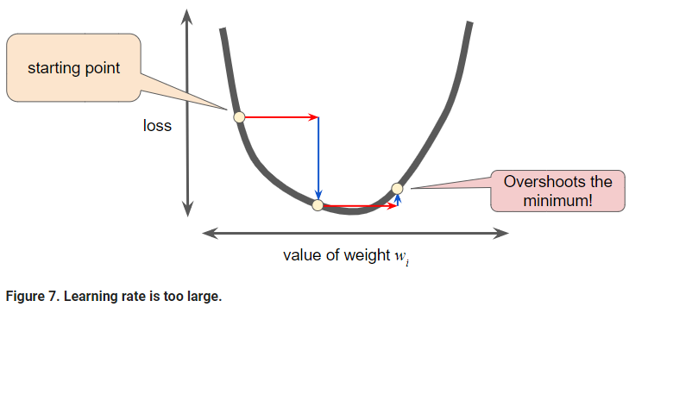
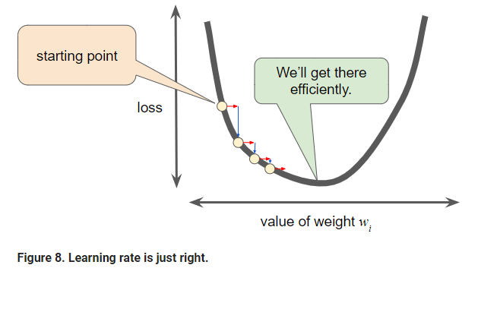
Learning Rate

Slide 29
Logistic Regression

