Slide 1
Tensorflow
Fulfilled as part of workshop on Machine Learning and Artificial Intelligence at Raghu Engineering College, February 2019

Slide 2
What is Tensorflow?
An open source Machine Learning framework by Google
Rather than thinking about neurons, think about Tensors
Computational graph – data moves through the graph and computation is happening at the nodes

Slide 3
Main features
Tensor
Computational Graph/Dataflow graph
Operation
Delayed Evaluation
Session

Slide 4
Workflow of running a program in TF
Build a computational graph, this can be any mathematical operation TensorFlow supports.
Initialize variables, to compile the variables defined previously
Create session, this is where the magic starts!
Run graph in session, the compiled graph is passed to the session, which starts its execution.
Close session, shutdown the session.

Slide 5
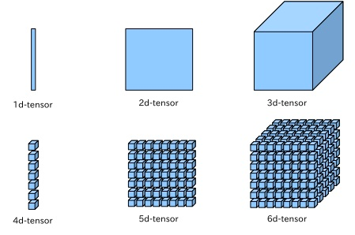
Tensor

Slide 6

Why Tensors?
Tensors favor parallelization – faster operations
Scalable to large datasets
Containers for i/p and o/p

Slide 7
Classes in TF
tf.Tensor
Represents one of the outputs of an Operation.
tf.Operation
Represents a graph node that performs computation on tensors.
tf.Session
A class for running Tensorflow operations
tf.Optimizer
tf.Variable
tf.Graph

Slide 8
tf.Graph Components
Graph Structure (Edges and Nodes)
Graph Collections (Metadata) – like GLOBAL_VARIABLES, LOCAL_VARIABLES, TRAINABLE_VARIABLES, SUMMARIES (tf.GraphKeys)

Slide 9
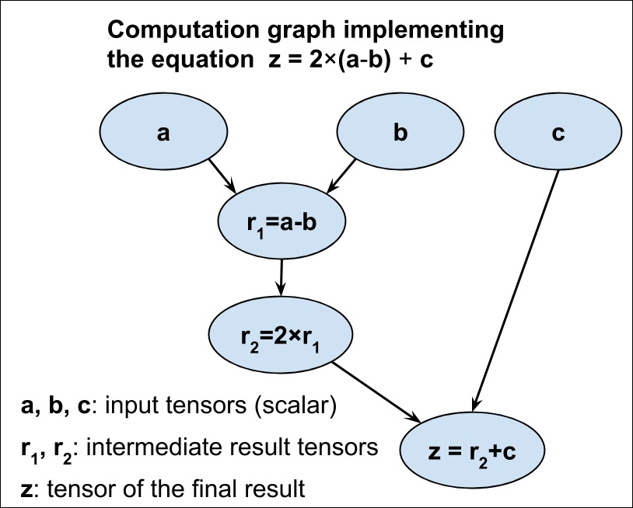
tf.Graph

Slide 10
Constructing a tf Graph
tf.constant(5) -> creates a single tf.Operation that produces the value 5, adds it to the default graph and returns a tf.Tensor that represents the value of the constant
tf.matmul(x,y) -> creates a single tf.Operation that multiplies the values of tf.Tensor objects, adds it to default graph and returns a tf.Tensor
tf.Variable -> adds a tf.Operation that stores a writable tensor value that persists between tf.Session calls

Slide 11
Session
A Session object encapsulates the environment in which Operation objects are executed and Tensor objects are evaluated
It is thread-safe, meaning multiple threads can run the same session which helps in asynchronous parallel execution
A graph is like a blueprint and a session is like a construction site
We only evaluate while running in a session, nowhere else

Slide 12
Feed Dict & Placeholder
x = tf.placeholder(tf.float32, shape=(1024, 1024)) y = tf.matmul(x, x) with tf.Session() as sess: print(sess.run(y)) # ERROR: will fail because x was not fed. rand_array = np.random.rand(1024, 1024) print(sess.run(y, feed_dict={x: rand_array})) # Will succeed.

Slide 13
# import tensorflow
import tensorflow as tf
# build computational graph
a = tf.placeholder(tf.int16)
b = tf.placeholder(tf.int16)
addition = tf.add(a, b)
# initialize variables
init = tf.initialize_all_variables()
# create session and run the graph
with tf.Session() as sess:
sess.run(init)
print "Addition: %i" % sess.run(addition, feed_dict={a: 2, b: 3})
# close session
sess.close()

Slide 14
Why TF is fast?
Like numpy takes things out of python to evaluate some computationally expensive operations, tensorflow takes the whole computational graph outside of python (in C++)
That is why we need to define a tf version of simple things such as a variable.

Slide 15

Additional Readings
Queue Runners in Tensorflow
https://adventuresinmachinelearning.com/introduction-tensorflow-queuing/
Protocol Buffers
Coordinator in Tensorflow

Slide 16
Thank you
tanya2911dixit@gmail.com

