Slide 1
Name : - Roll No : - Topic : - Smart Drug Injector

Slide 2
Smart Drug Injector
When a particular drug apply through the patient’s body.
Occasionally, Doctor apply drug into the bottle and then it delivered to the patient.
The specific amount of drug applied to bottle by nurses.
This smart drug injector has applied to this drug automatically to bottle by set the times. This instrument automatically inject the drug in given period of time.

Slide 3
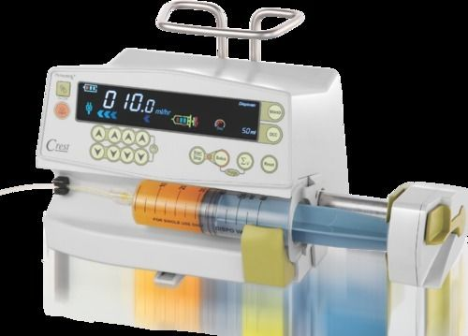
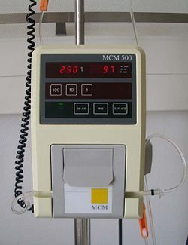
Here are some images of Smart drug injector.

Slide 4
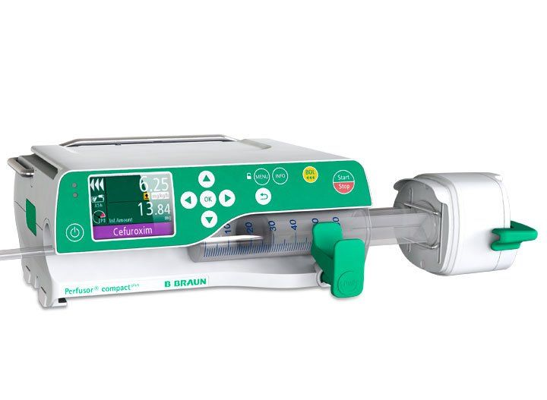
Sometimes that is not possible to provide drug accurate time. To avoid this type of issues smart drug injector in modern hospitals.

Slide 5
Smart drug injector consists different types of instruments namely Buzzer, LED, Power Supply, Arduino UNO, Motor etc.
The working of this device is based on programme.
When the amount of drug is gradually decreases, this device provide needed amount of drug in sufficient way.

Slide 6
On the top of that, when the bottle is empty this device make a sound which provides by buzzer. Thus, the nurses came to know that the patient need to next drug dose.
In the nutshell, this device helps to the inject drug in a smart way. There-by the device is known as Smart Drug Injector.
For Example, When the glucose delivered to patient by bottle this device automatically inject drug after 10 – 15 minutes as per needed.

Slide 7
Thank You.

