Slide 1



Water Quality Prediction
NAME: PUJA DEY
AICTE Student ID: STU682743158b4df1747403541
AICTE Internship ID: INTERNSHIP_1746416864681834e0e35d8

Slide 2

Learning Objectives
To build a machine learning model that accurately predicts multiple water quality parameters based on environmental input features using real-world datasets, with a focus on clean code practices and reproducibility.
Understand and apply machine learning techniques for regression problems.
Explore the use of MultiOutputRegressor for multi-target prediction.
Learn preprocessing techniques suitable for environmental datasets.
Gain hands-on experience with Random Forest Regressor.
Understand evaluation metrics such as MAE, MSE, RMSE, and R².
GOAL
Source :
www.freepik.com/

Slide 3






Tools and Technology used
Programming Language Used: Python
Libraries Used:
Pandas & NumPy – for data processing
Scikit-learn – for modeling (RandomForestRegressor, MultiOutputRegressor)
Matplotlib & Seaborn – for visualization
Platform: Google Colab, Streamlit
Version Control: GitHub

Slide 4
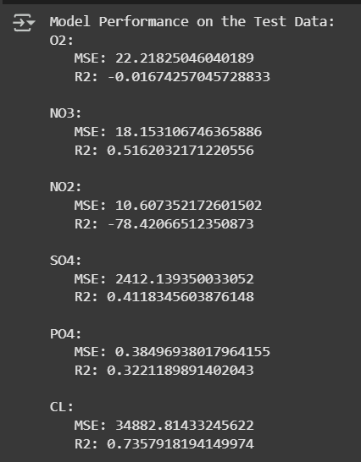
Methodology
Data Collection: Water quality dataset with multiple numeric features and target labels.
Data Preprocessing:
Handling null/missing values
Encoding and feature scaling
Model Building:
MultiOutputRegressor with RandomForestRegressor
Training and Testing:
80-20 train-test split
Evaluation:
Used MAE, MSE, RMSE, and R² for performance
Local Deployment Result

Slide 5
Problem Statement:
Access to clean and safe water is a fundamental necessity, yet regular manual testing of water quality is expensive, time-consuming, and often delayed in delivering actionable insights. Traditional laboratory methods are not scalable for real-time monitoring across diverse water bodies such as rivers, lakes, industrial discharge points, and municipal pipelines.
There is a pressing need for an intelligent and automated solution that can predict multiple water quality parameters—such as pH level, turbidity, dissolved oxygen, conductivity, and hardness—based on existing environmental data. The goal is to develop a machine learning model capable of accurate, multi-output regression to support rapid water quality assessment and early detection of contamination risks.
Real-World Applications of the Problem:
Smart City Monitoring: Real-time monitoring of water supply quality in urban households through sensor-integrated ML systems.
Industrial Wastewater Management: Predict pollutant levels before release to ensure industries meet environmental compliance standards.

Slide 6
Solution:
To address the challenges of manual water quality testing, a machine learning-based predictive model was developed using a MultiOutputRegressor wrapped around a Random Forest Regressor. This approach allows for the simultaneous prediction of multiple water quality parameters such as pH, turbidity, hardness, and more.
The model was trained on a structured water quality dataset, with data preprocessing steps including handling missing values, feature scaling, and data splitting. The Random Forest algorithm was chosen for its robustness, ability to handle non-linear relationships, and effectiveness in multi-target regression tasks.
The model was evaluated using key performance metrics like Mean Absolute Error (MAE), Root Mean Squared Error (RMSE), and R² score, ensuring accuracy and reliability for real-world use cases. The entire workflow is modular and reproducible, allowing for easy integration with live data sources or sensor-based platforms in future enhancements.

Slide 7
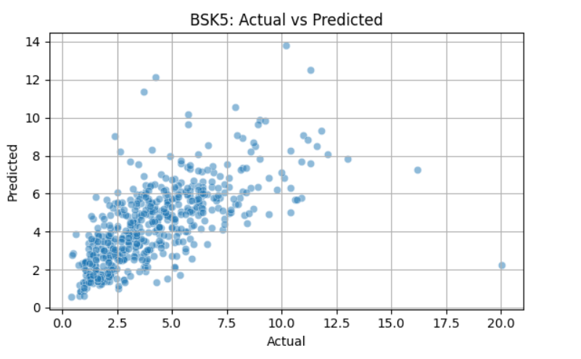
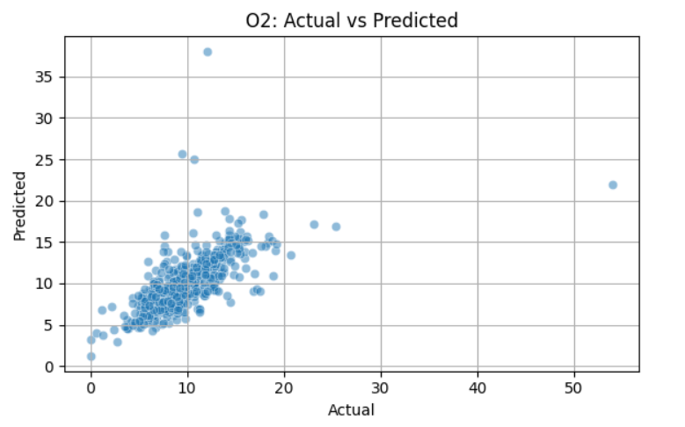
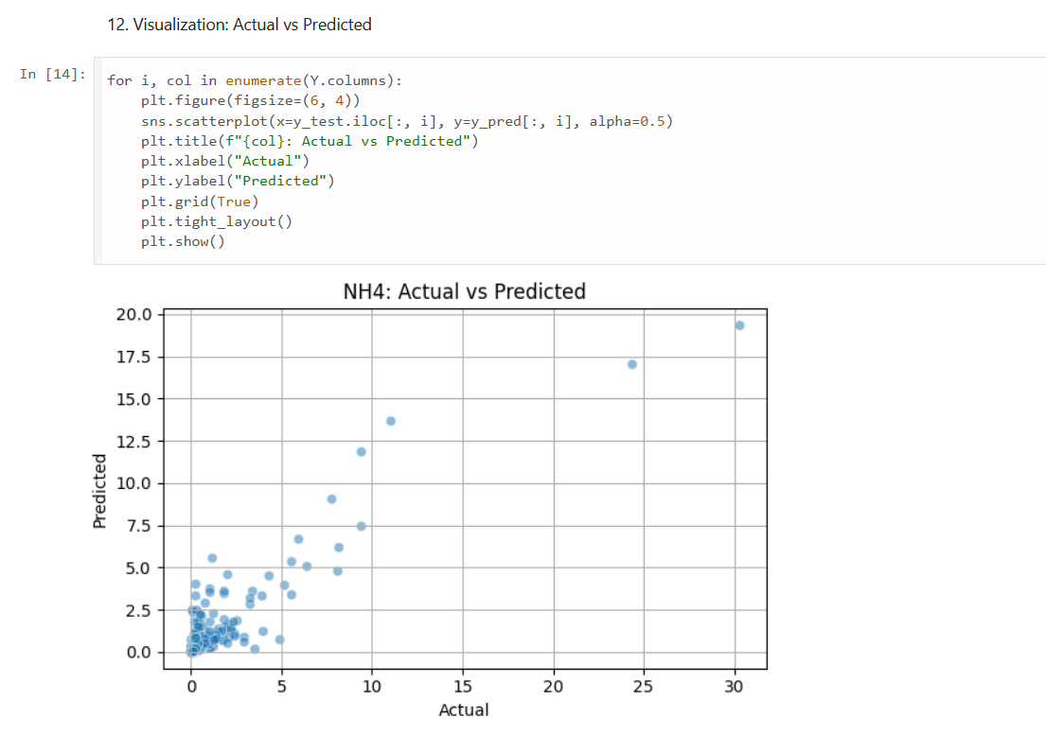
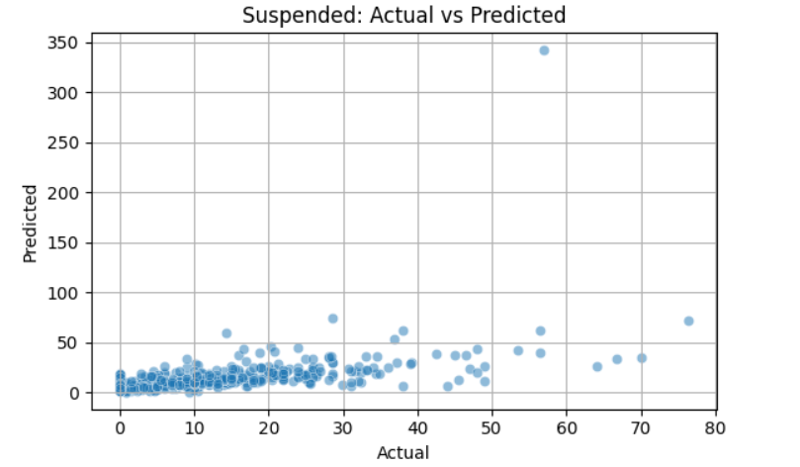
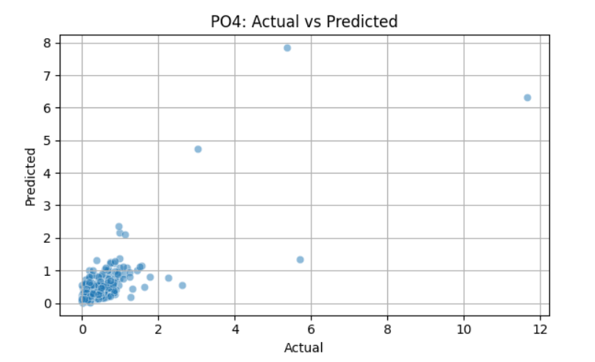
Screenshot of Output:

Slide 8
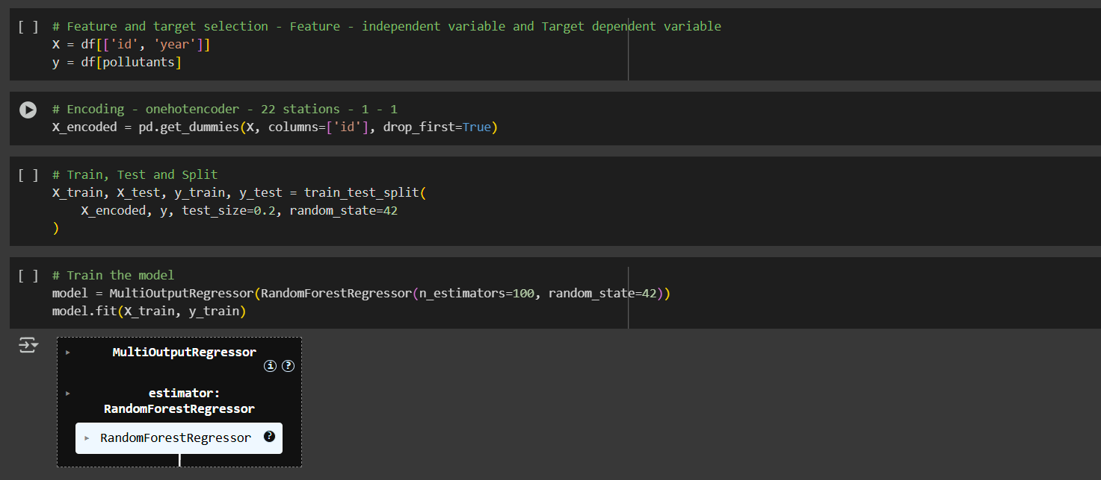
Screenshot of Output:

Slide 9
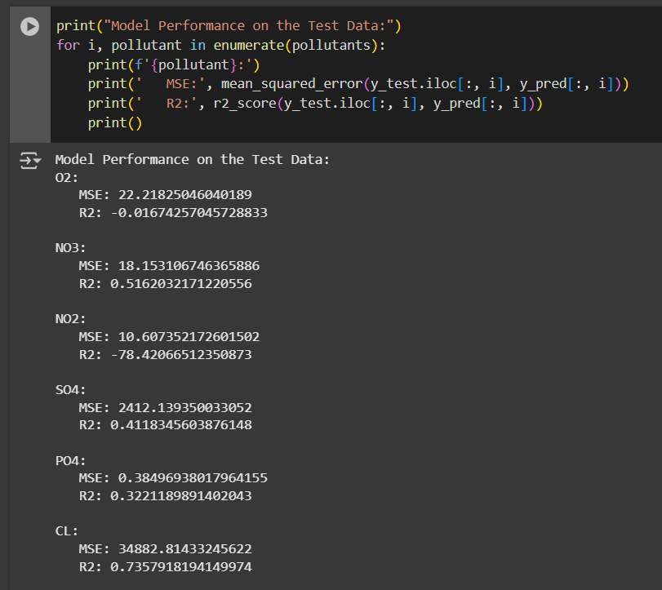
Screenshot of Output:

Slide 10
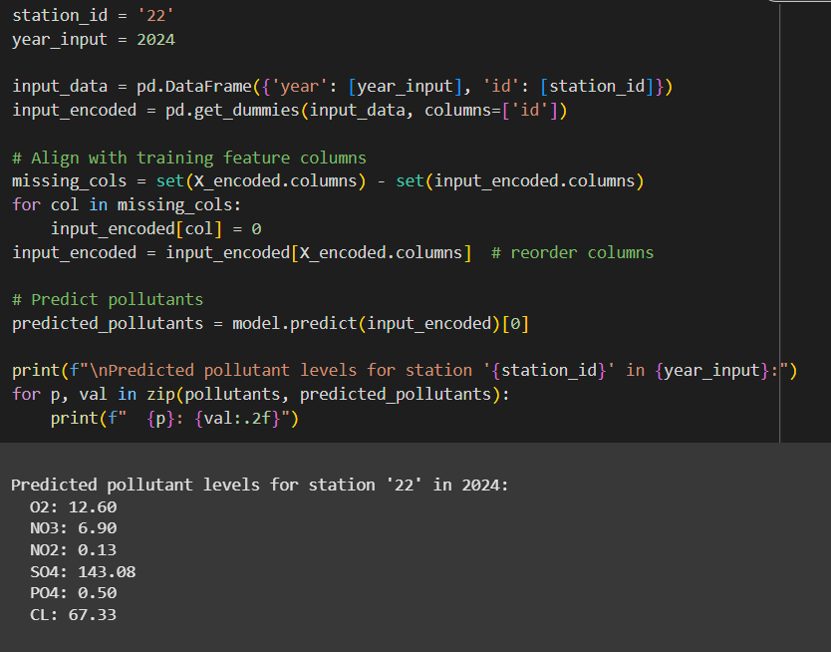
Screenshot of Output:

Slide 11
Future Scope:
The current model lays the foundation for intelligent water quality monitoring, but there are multiple opportunities for further enhancement and real-world deployment.
Real-Time Data Integration:
Connect the model to IoT-enabled water sensors for continuous, real-time prediction and alert generation.
Model Deployment as a Web/API Service:
Convert the ML model into a deployable web application or REST API to allow access for municipalities, researchers, or public health officials.
Addition of Advanced Algorithms:
Experiment with deep learning models (e.g., LSTM, CNN for time-series data) to improve prediction accuracy and adapt to changing patterns.
Geographical Expansion:
Apply the model to region-specific datasets (e.g., rural vs. urban areas) for more localized predictions and policy planning.
Cross-Domain Integration:
Extend the framework to predict air, soil, or agricultural water quality using similar techniques.
User-Friendly Dashboards:
Develop interactive dashboards with visual analytics for easier interpretation by non-technical stakeholders.

Slide 12
Conclusion:
This project demonstrates the potential of machine learning in solving critical environmental challenges such as water quality monitoring. The developed model efficiently predicts multiple parameters at once, offering a scalable and cost-effective alternative to traditional testing methods.
Key outcomes include:
Successful application of multi-output regression to environmental data.
High model performance with strong accuracy and generalization.
A workflow that can be extended for real-time water quality analysis using sensor data.
Future Scope of improvements:
Deployment as a web or mobile app for community use.
Integration with IoT-based water sensors for real-time analytics.
Expansion to cover other environmental factors like air or soil quality.

