Slide 1
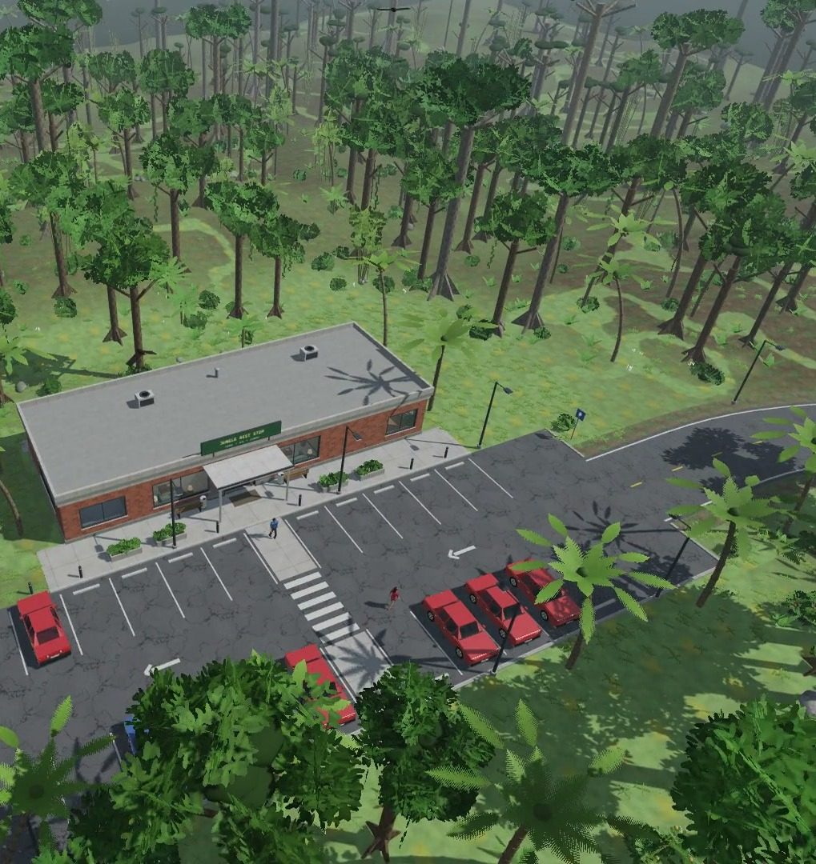
CSE 4102 | Computer Graphics and Image Processing Laboratory
Jungle Rest Stop
An interactive 3D scene built only from basic shapes with OpenGL 3.3
vending machine · ATM · coffee machine · library
SUBMITTED BY
Md. Nayeem
Roll: 2107050
Dept. of CSE, KUET
SUBMITTED TO
Md Tajmilur Rahman
Lecturer, Dept. of CSE, KUET
Md. Mubtashim Abrar Nihal
Lecturer, Dept. of CSE, KUET
12 October 2026
Notes:
Introduce the project: a rest stop in a jungle clearing, built only from basic shapes (cubes, cylinders, spheres ...) with OpenGL 3.3. Three rooms: lounge with vending machines, coffee and TV; ATM room; library with an aquarium.

Slide 2
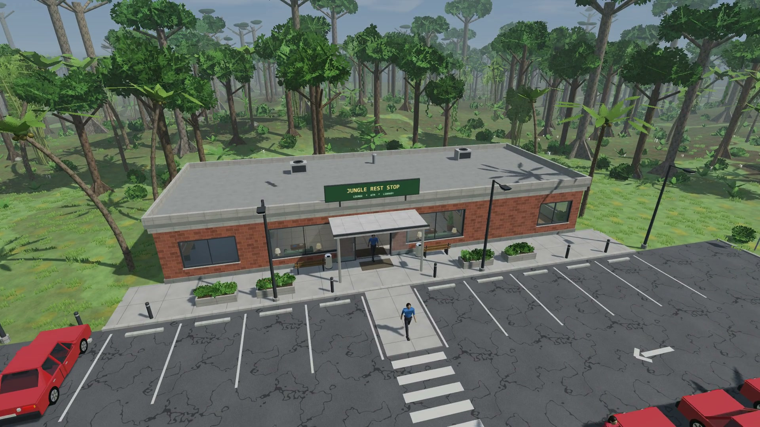
Notes:
Video chapters (pause at any point to explain):
0:00 The rest stop in its jungle clearing (aerial)
0:07 A visitor arrives by car and parks (NPC, Bezier parking)
0:19 The player walks to the entrance (third person); the sliding doors open
0:28 ATM: insert card, PIN 1234, withdraw Tk 1,000, take card, cash and receipt
0:46 Coffee machine: cappuccino - cup drops, grinding, pouring, steam
0:56 Vending machine: Tk 50 note, code A1, OK, spiral turns, can drops, push flap, take change
1:07 Television: change the channel
1:11 Visitors living in the lounge
1:16 Library: feed the fish, they swim up
1:24 Basic <-> Enhanced rendering (key B)
1:31 Day turns into night (time-lapse)
1:39 Night: the player switches the lounge lights off and on
1:44 A car leaves with its headlights on
1:49 Roof cut-away view of the lit rooms

Slide 3
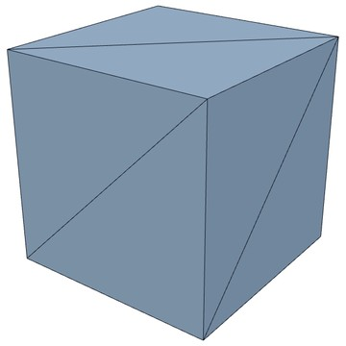
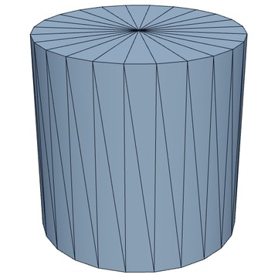
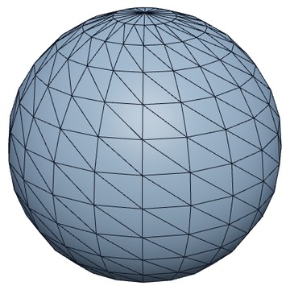
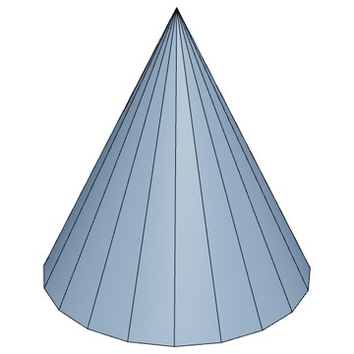
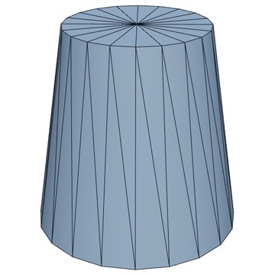
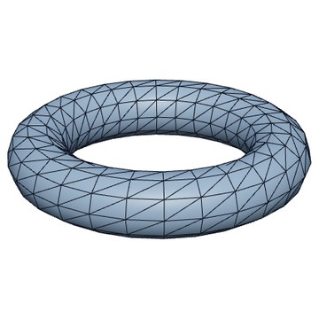
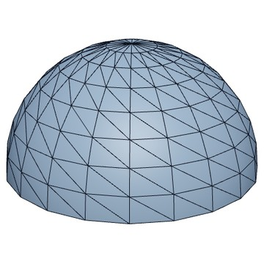
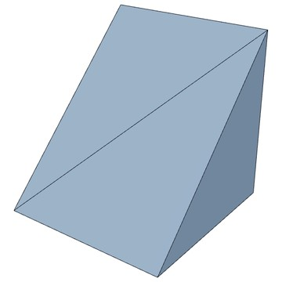
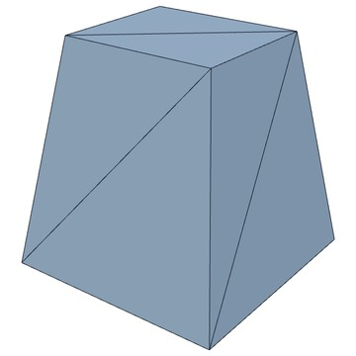
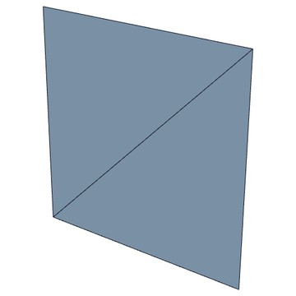
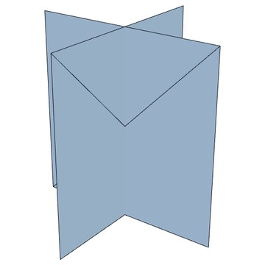
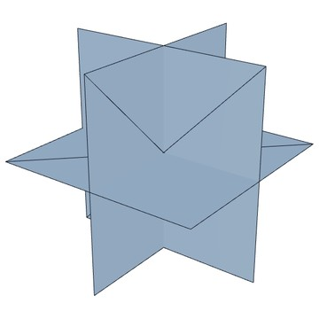
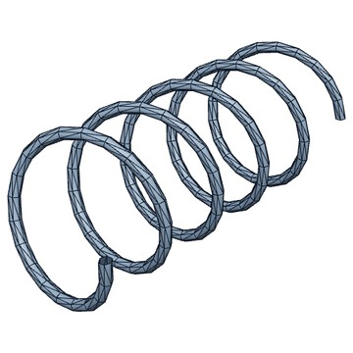
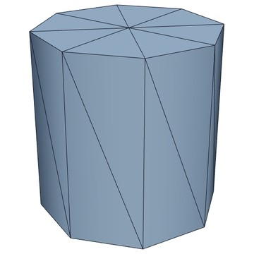
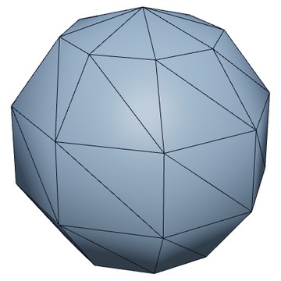
Basic Shapes and Transformations
Transformations used
Translation
move a part to its place
cube
cylinder
sphere
cone
truncated cone
Rotation
about x, y, z and any axis
Scaling
size of a part; negative = mirror
Composite
scale, then rotate, then move
torus
hemisphere
wedge
tapered box
quad
Hierarchical
child nodes follow their parent
Viewing
camera (lookAt)
Projection
perspective and orthographic
cross card
leaf card
coil
low cylinder
low sphere
Notes:
15 unit meshes generated in code; the dark lines are their triangles. Every part: M = Mparent * T * R * S. Rotation uses Rx, Ry, Rz or Rodrigues for any axis; normals use (M^-1)^T. Camera: lookAt view matrix; perspective projection for the view, orthographic for the shadow map and the HUD.

Slide 4
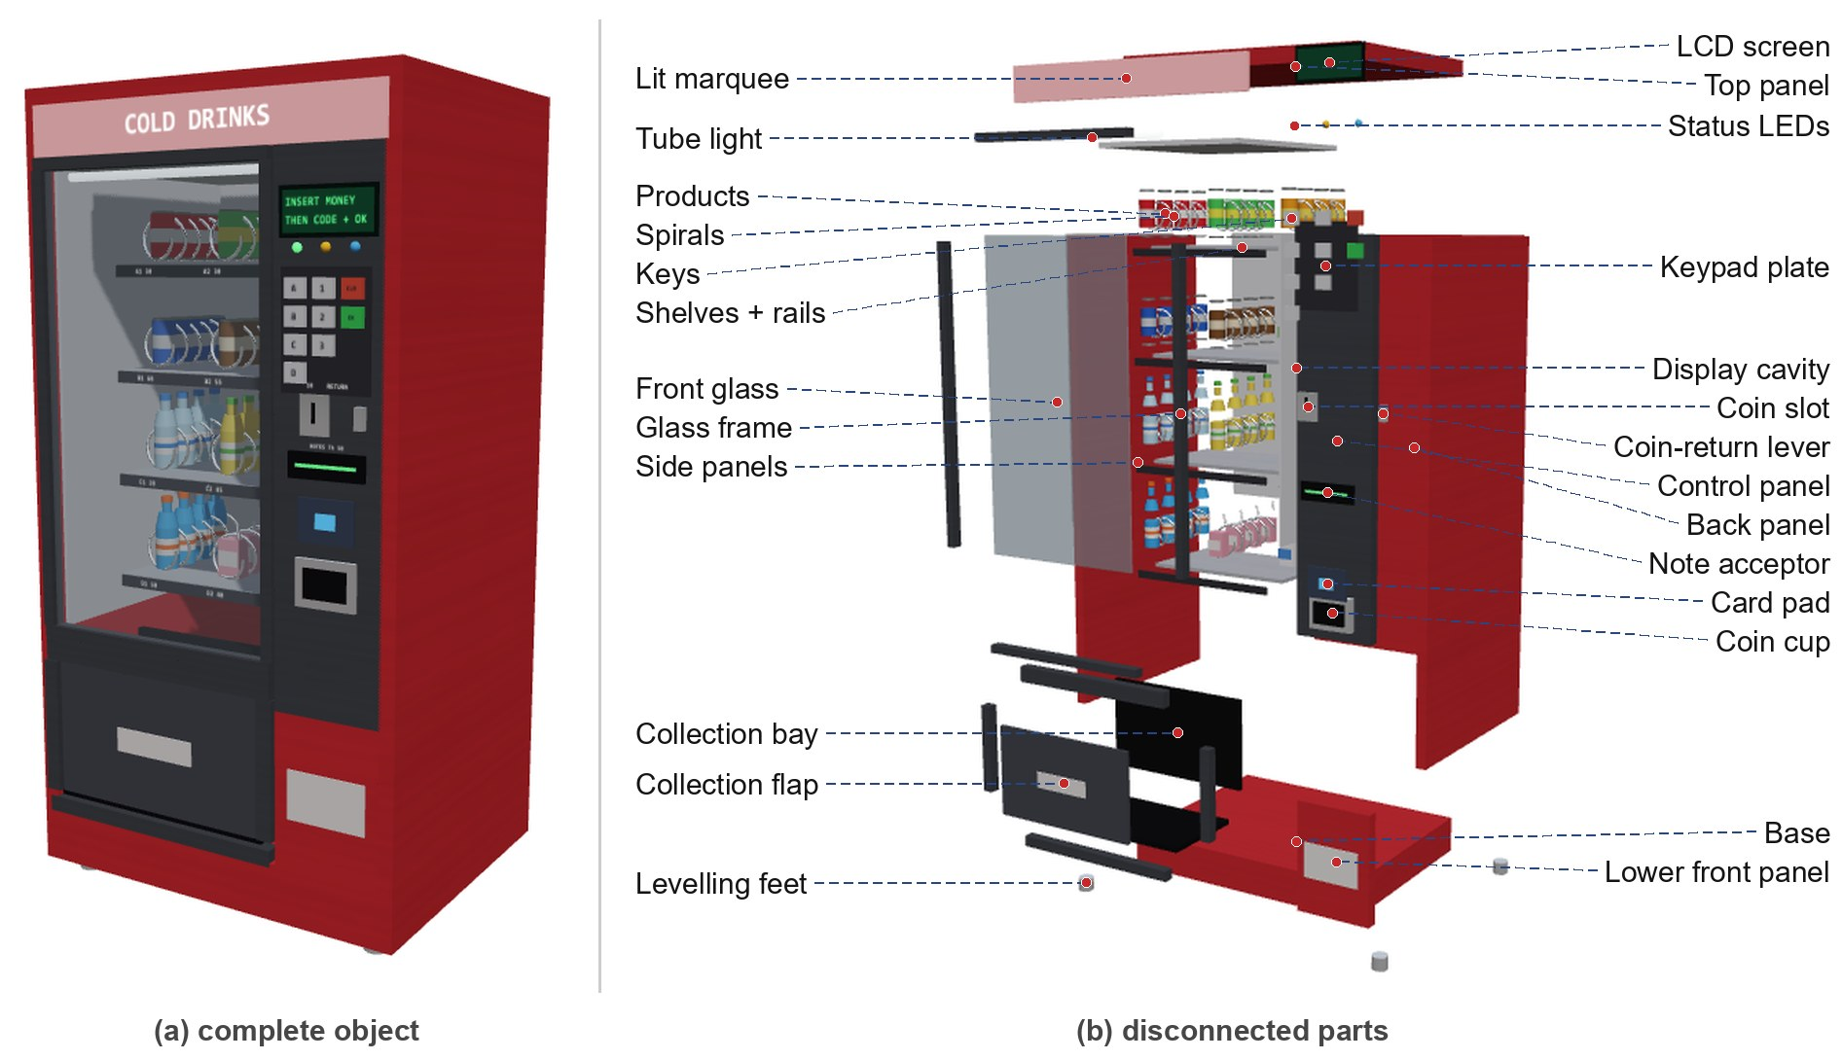
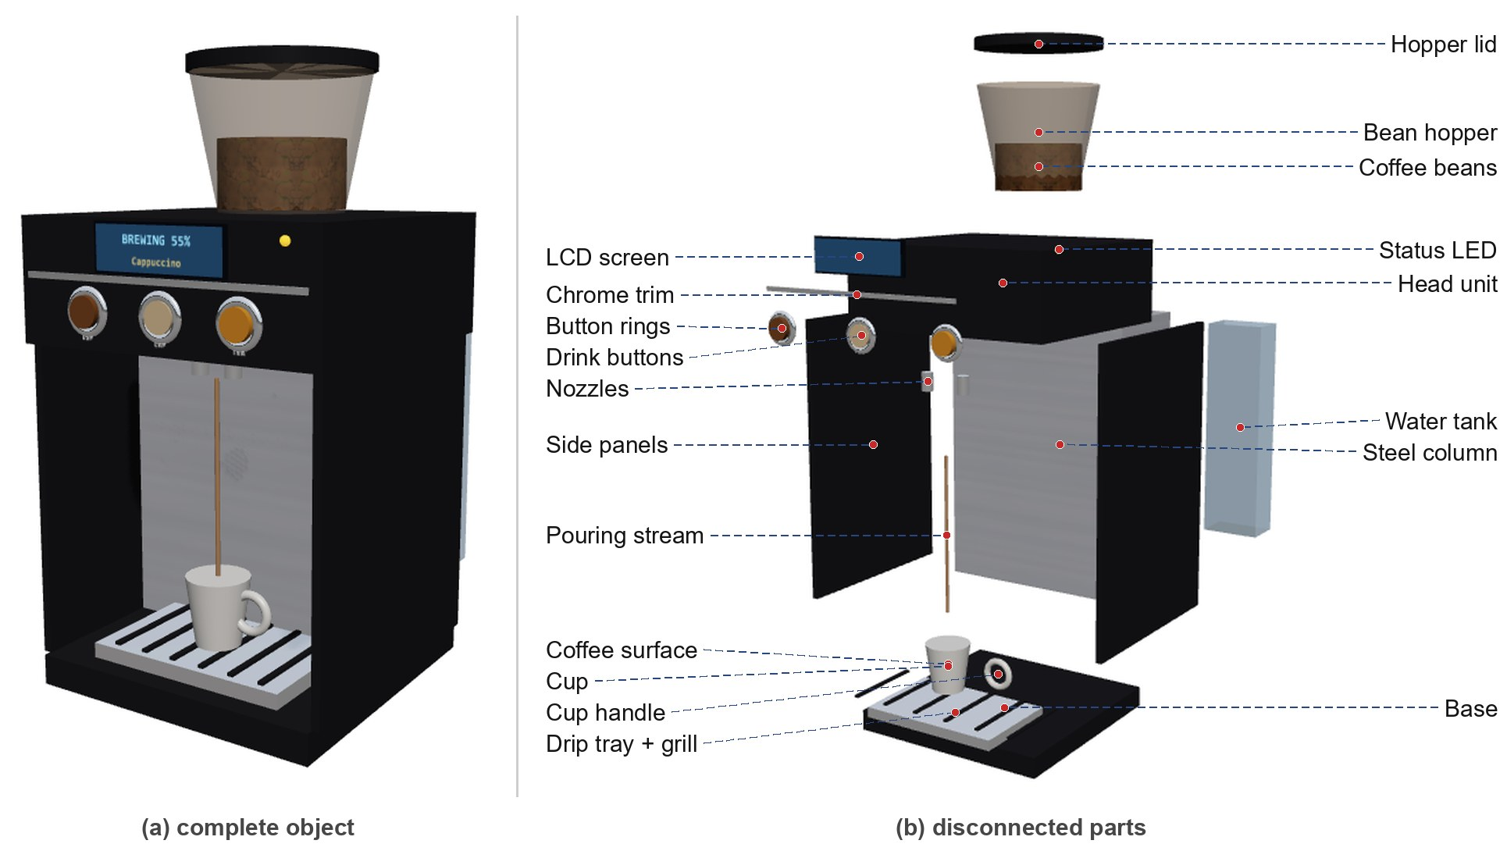
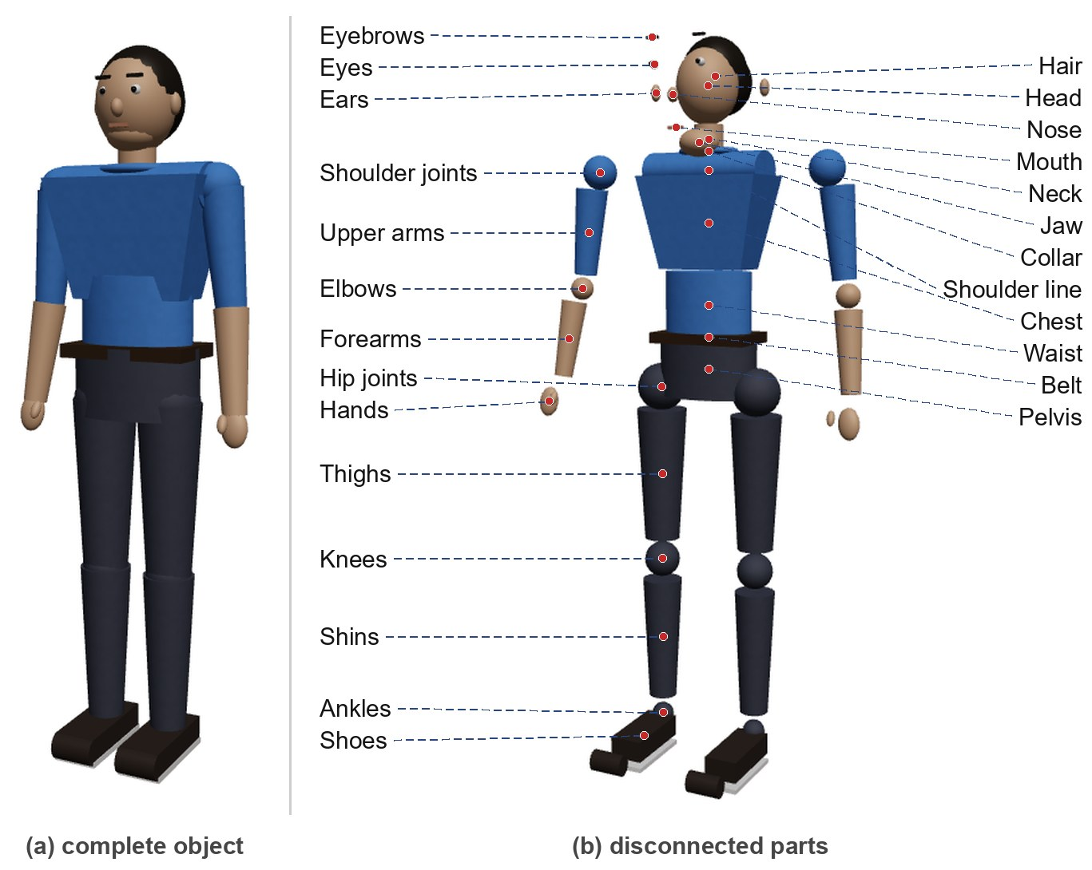
Decomposition: Vending Machine
Coffee machine
Man
Notes:
Vending machine: 287 basic shapes. (a) complete, (b) every named group pulled away from the centre. The cabinet is static; spirals, products, keys, LEDs, flap and coins are child nodes that move. Coffee machine and the man use the same method; the man's joints are spheres and limbs truncated cones.

Slide 5
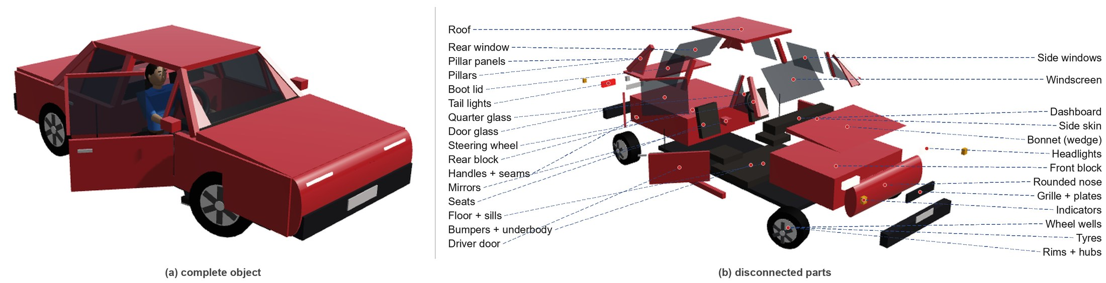
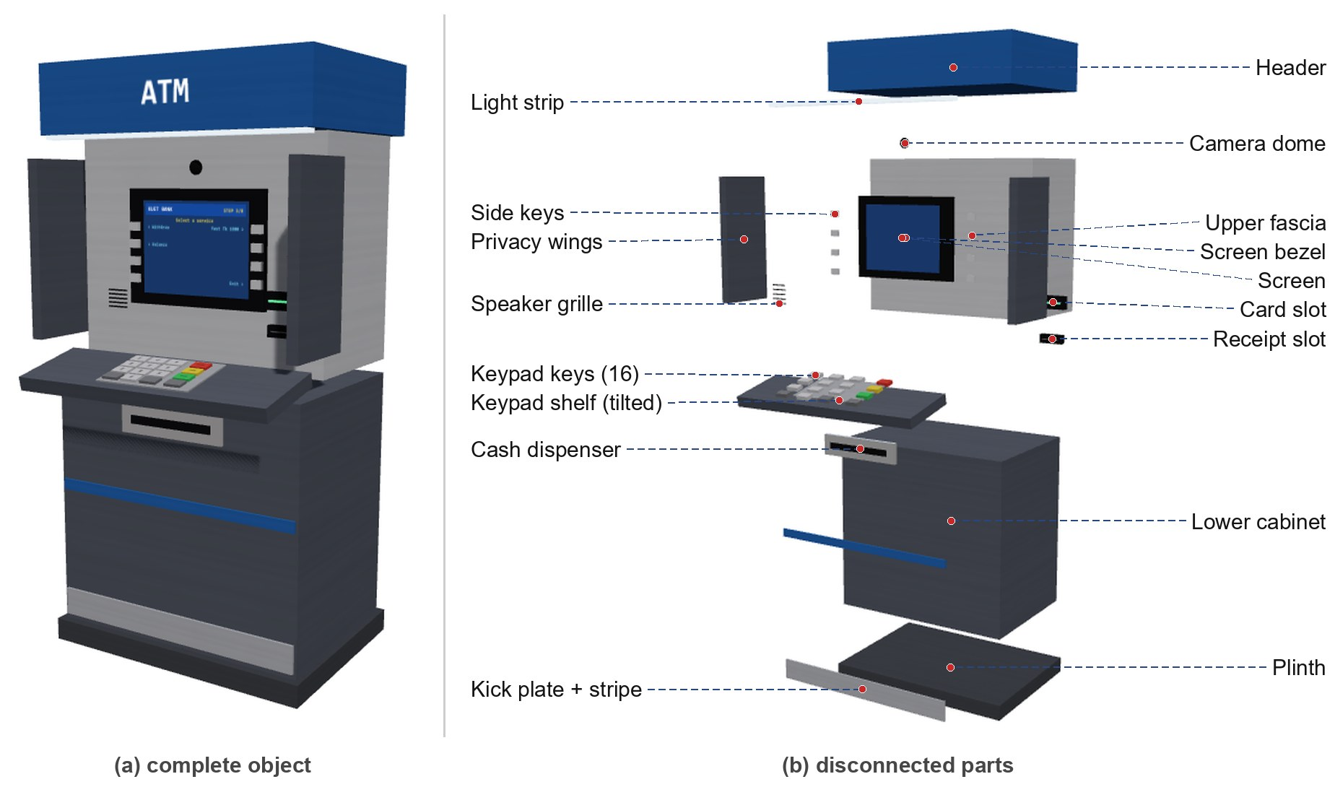
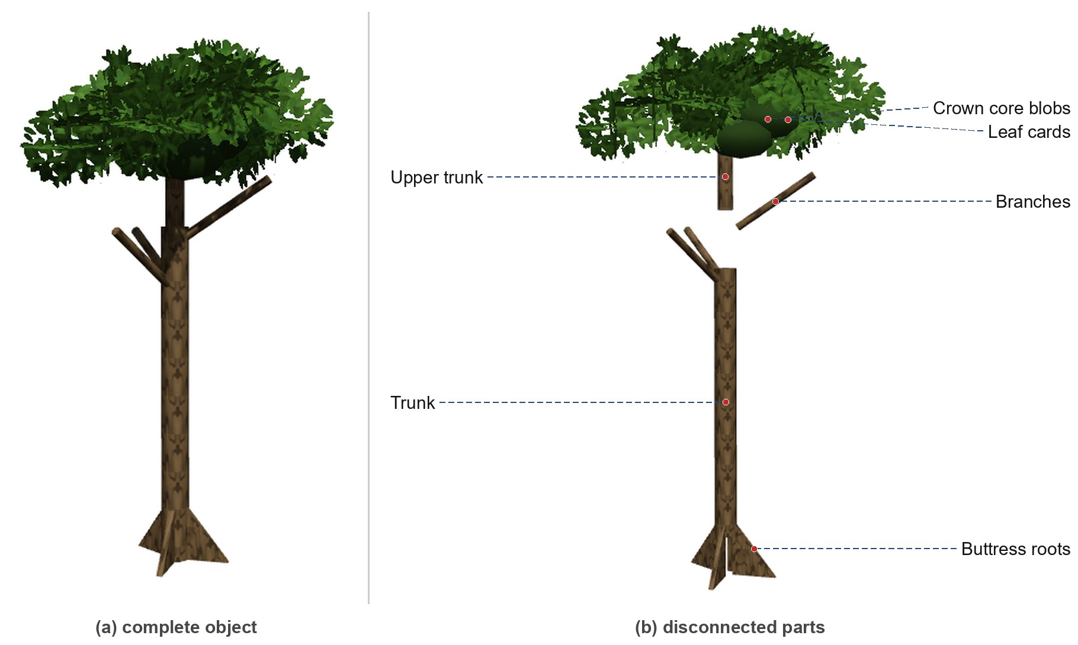
Decomposition: ATM
Car
Rainforest tree
Notes:
ATM: 49 shapes. The keypad shelf is a child node tilted by Rx(12 deg), so the 16 keys follow the slope. Car: door is a child node T(hinge) Ry(angle); wheels spin with Rx and steer with Ry; windows are built from corner points. Tree: 4 buttress roots are wedges turned by Ry(90 i); the crown is leaf cards on an ellipsoid.

Slide 6
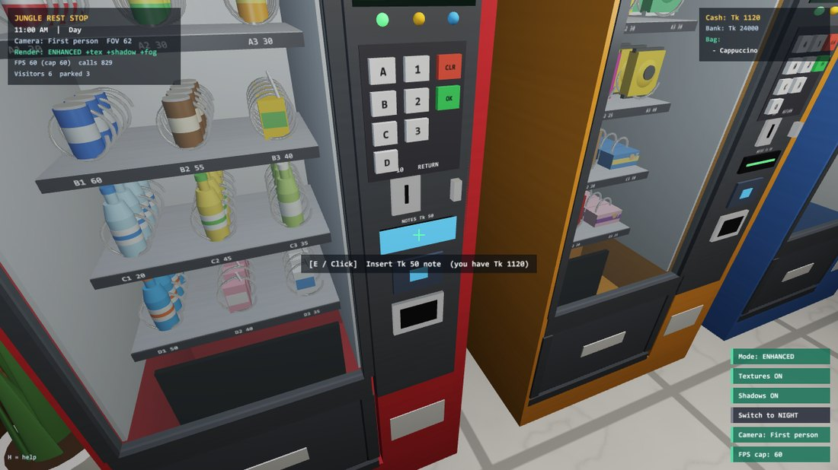
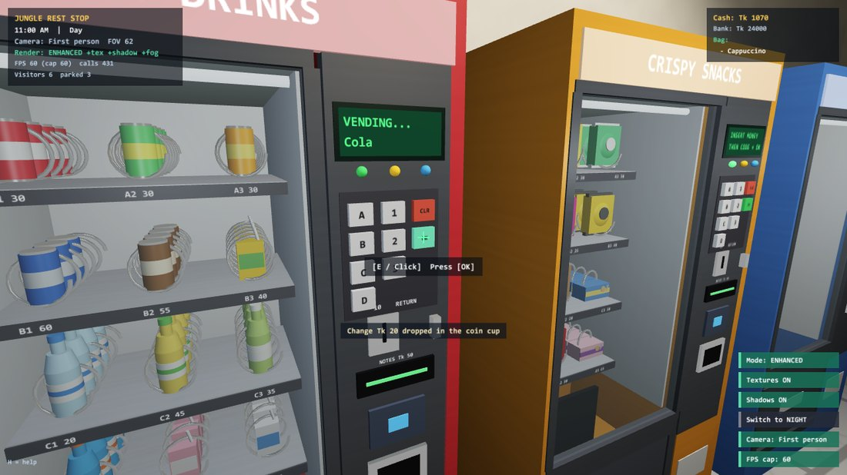
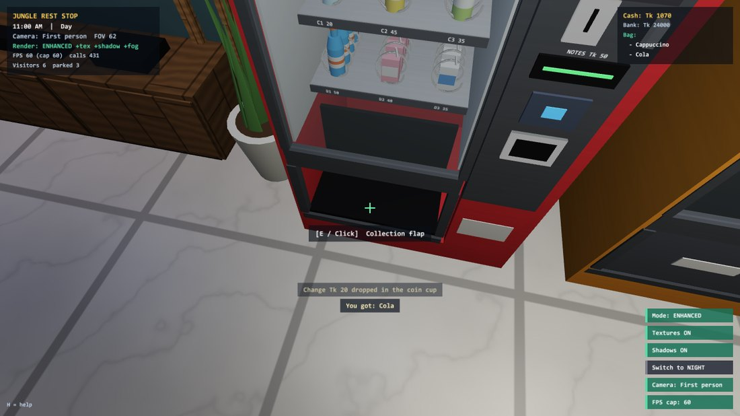
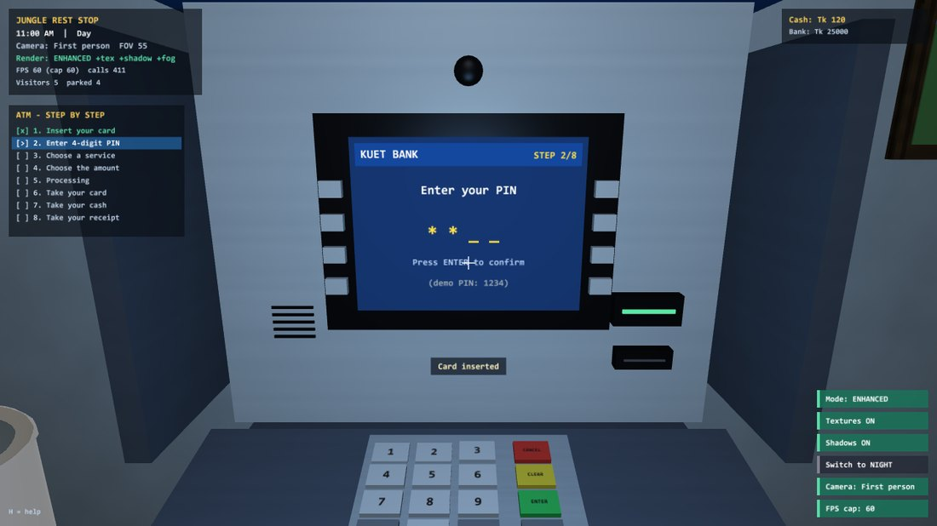
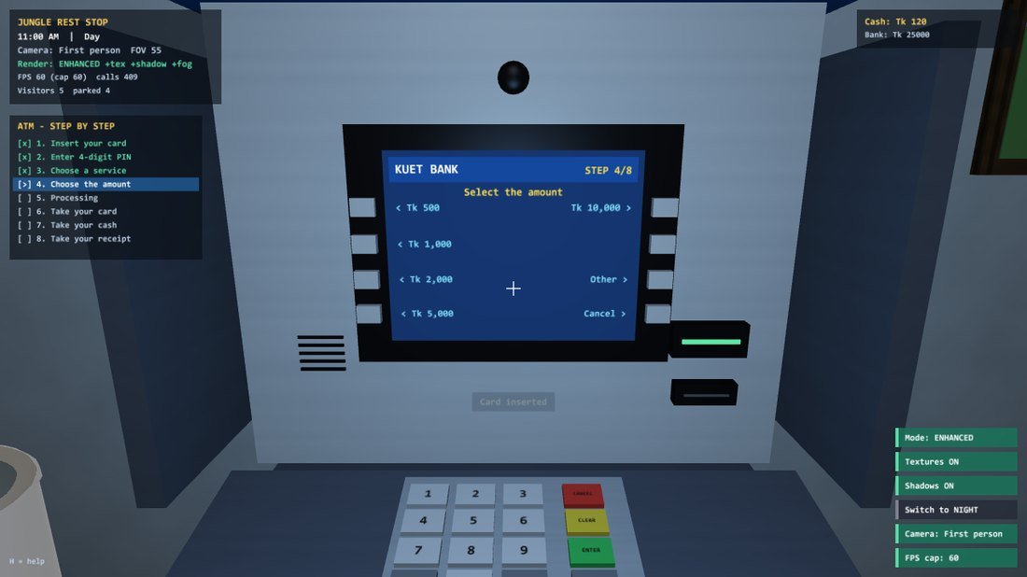
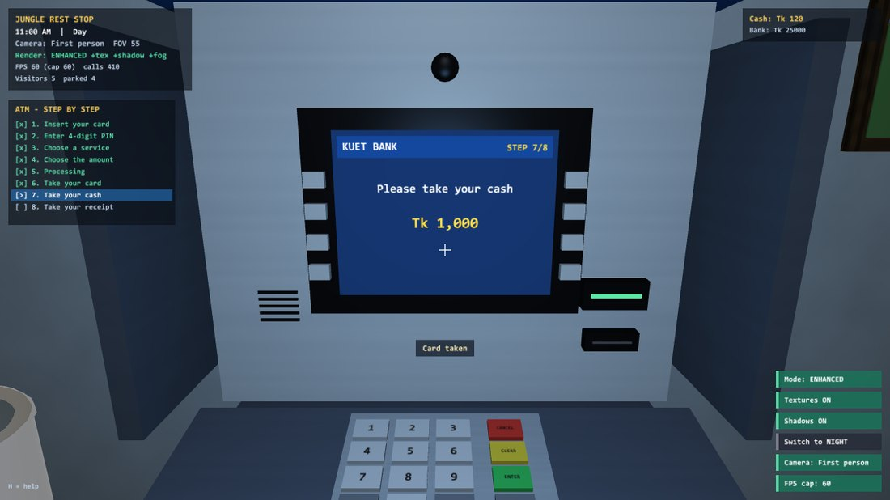
How the Vending Machine and ATM Work
Vending machine
ATM
Insert coin / note
States: IDLE → VENDING → DROPPING → READY
Money kept as whole Taka; change falls as coins
Drop: gravity 9.81 m/s², bounce ×0.32
Empty slot refilled after 40 s
1. Insert card
5. Processing
Type code + OK
2. PIN 1234
6. Take card
Spiral turns 360°
3. Choose service
7. Take cash
Item falls, bounces
4. Choose amount
8. Take receipt
Push flap: item to bag
Card always comes back before the cash; cash goes to the wallet.
Notes:
Both machines are state machines driven by the same picking: look at a part and press E. The HUD lists the 8 ATM steps and highlights the current one. Visitors use the same functions, so the ATM screen shows every step when a visitor uses it.

Slide 7
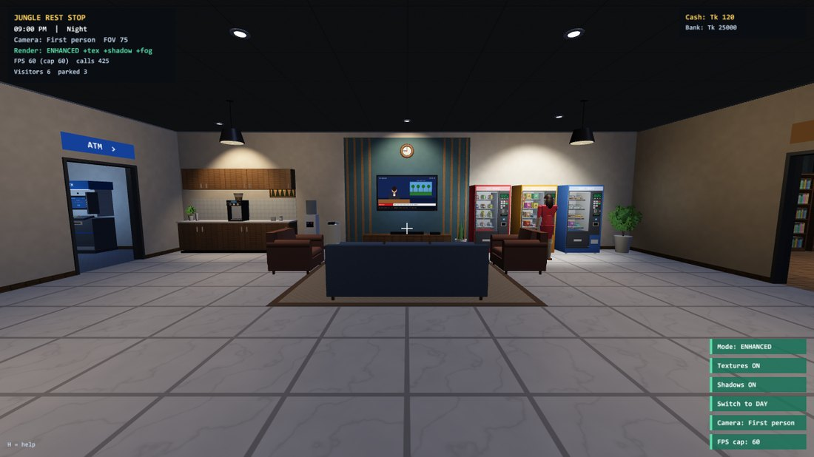
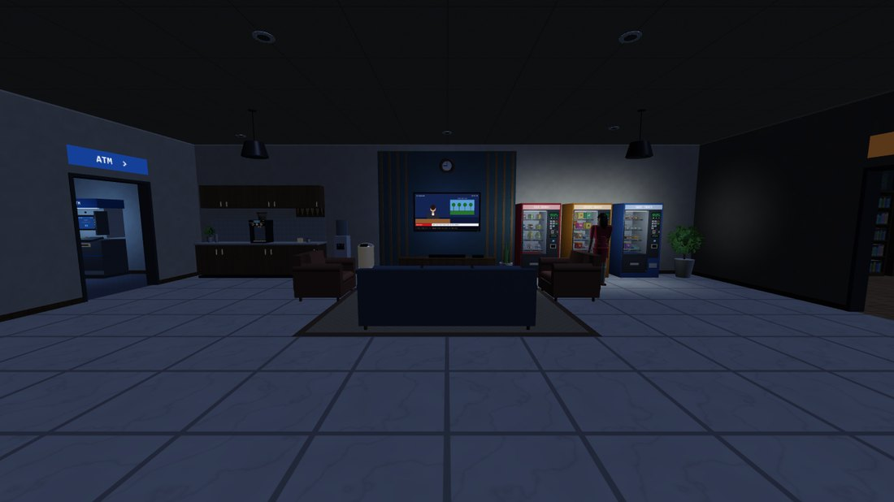
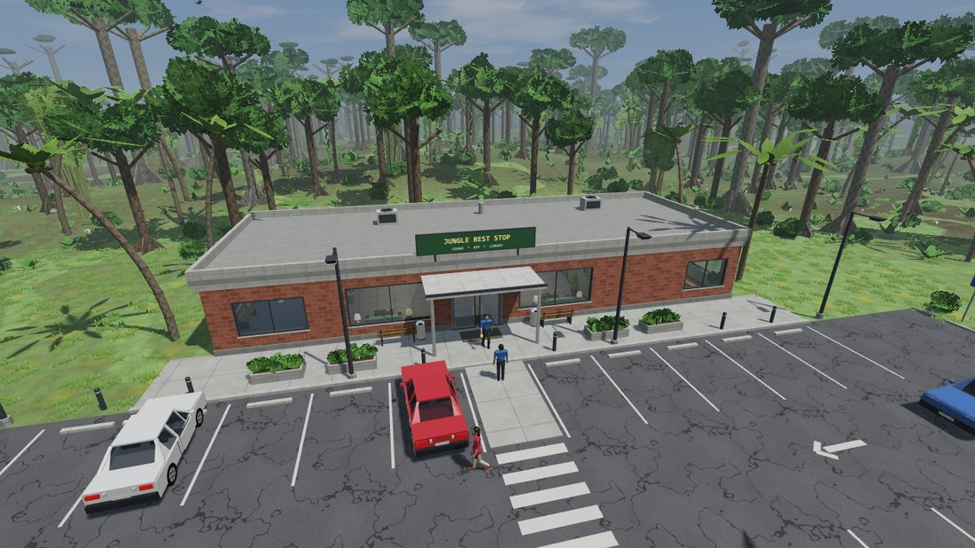
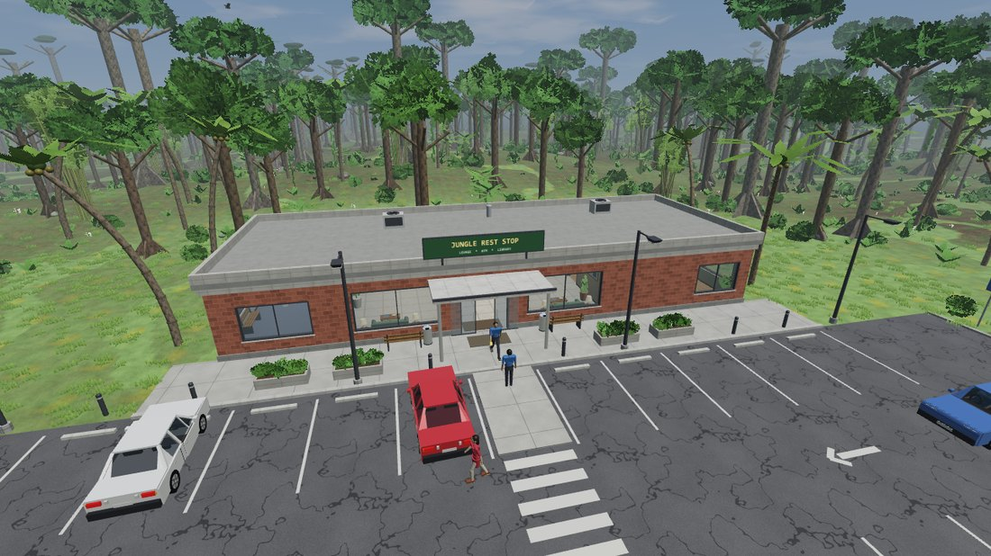
Illumination, Lighting and Shading
Blinn–Phong illumination
Ambient
light from everywhere; sky above, ground below
Diffuse
brightness from the angle to the light (Lambert)
Specular
shiny highlight; moves with the viewer
Point + spot lights on
Lamps off: only glow and moon
Phong shading (per pixel)
Vertex shader
position, normal
Rasteriser
interpolate
Fragment shader
light per pixel
Shadow mapping on
Shadows off
Lights: sun / moon · point · spot · emissive · ambient
Notes:
Illumination model = Blinn-Phong: ambient + diffuse (Lambert, N.L) + specular (N.H)^n with H = normalize(L+V). Attenuation a(d) = clamp(1-(d/r)^4)^2/(1+d^2); spot cone smoothstep. Shading = Phong: normals are interpolated across each triangle and the light is computed for every pixel. Shadows: depth map from the sun, 5-sample PCF.

Slide 8
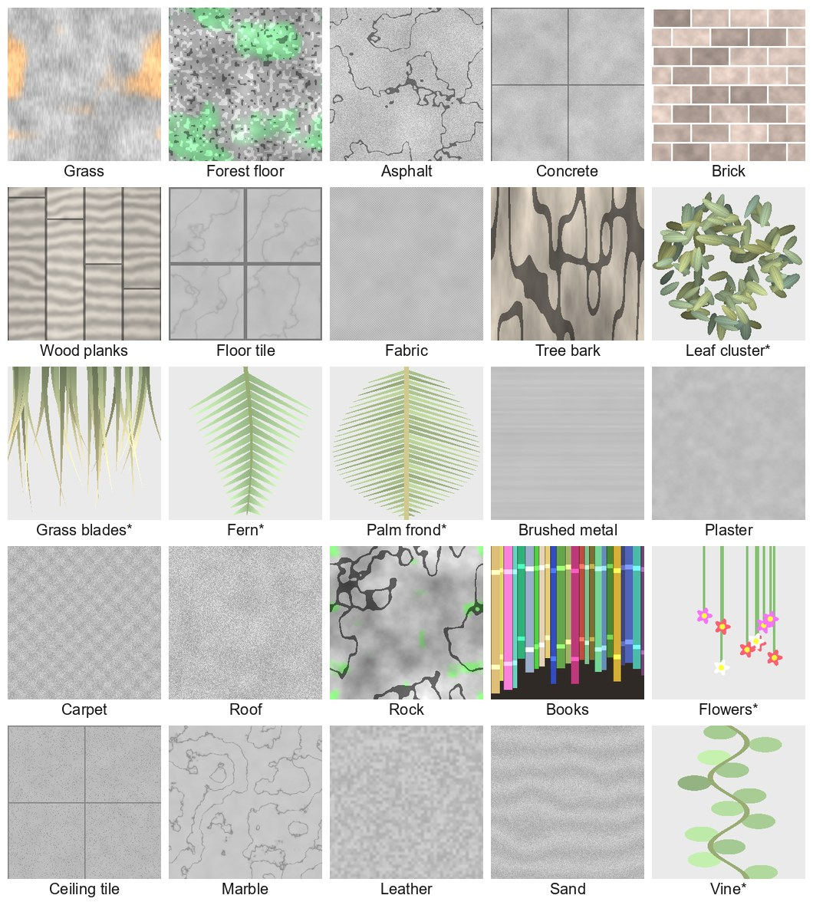
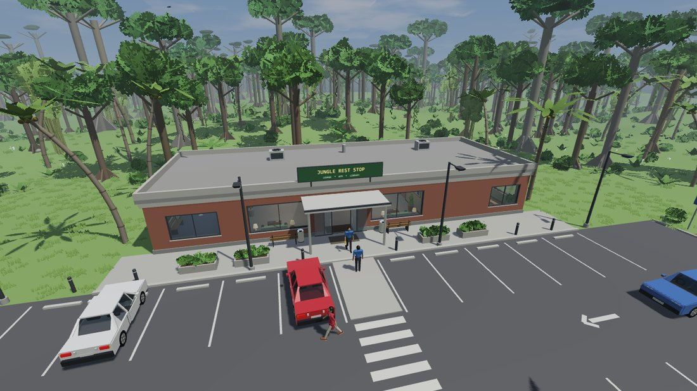
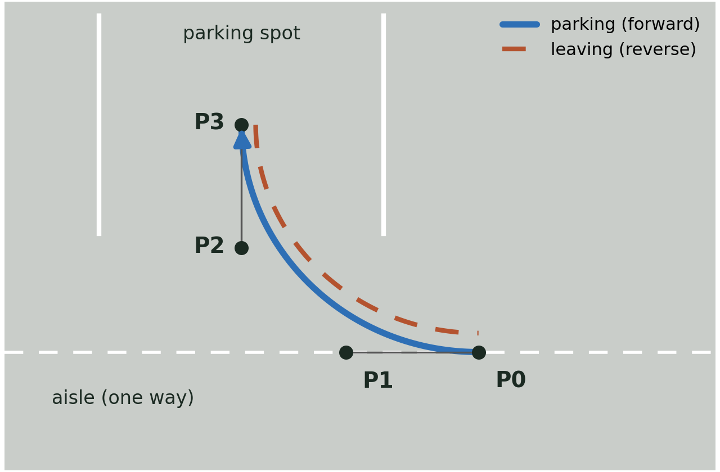
Textures and Bézier Car Parking
25 procedural textures
Parking along a cubic Bézier curve
without textures
with textures (box mapping)
B(t) = (1−t)³P0 + 3(1−t)²t P1 + 3(1−t)t² P2 + t³P3
P0→P1 along the aisle, P2→P3 into the spot: the turn is smooth
leaving: a second curve driven in reverse
Notes:
Textures are generated at start-up from value noise (fbm). Object-space box mapping: u,v from the local position times the object's scale, so a long wall gets more bricks. Leaves use alpha cut-out. Parking: tangents at both ends match the aisle and the spot because B'(0) = 3(P1-P0) and B'(1) = 3(P3-P2).

Slide 9
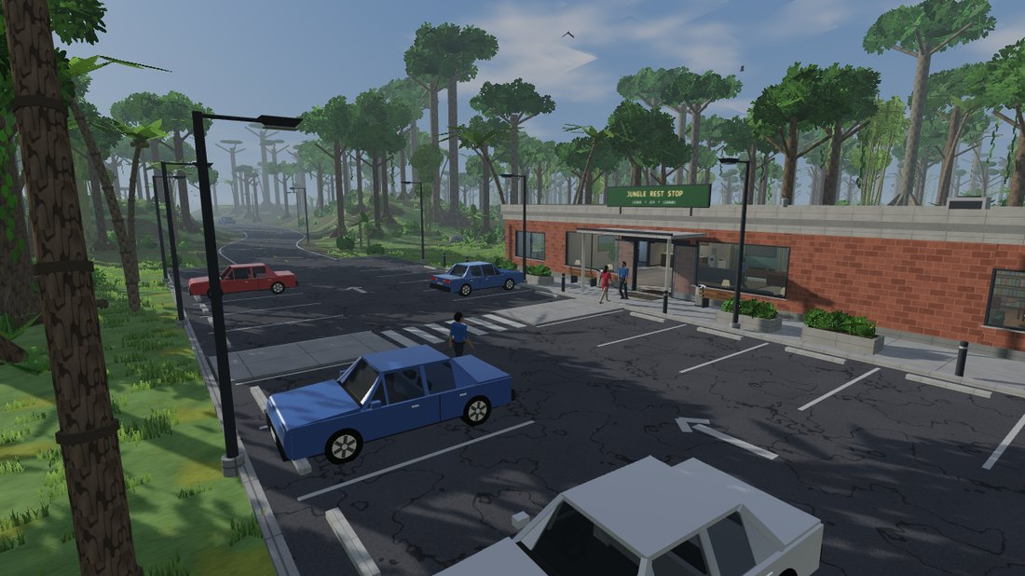
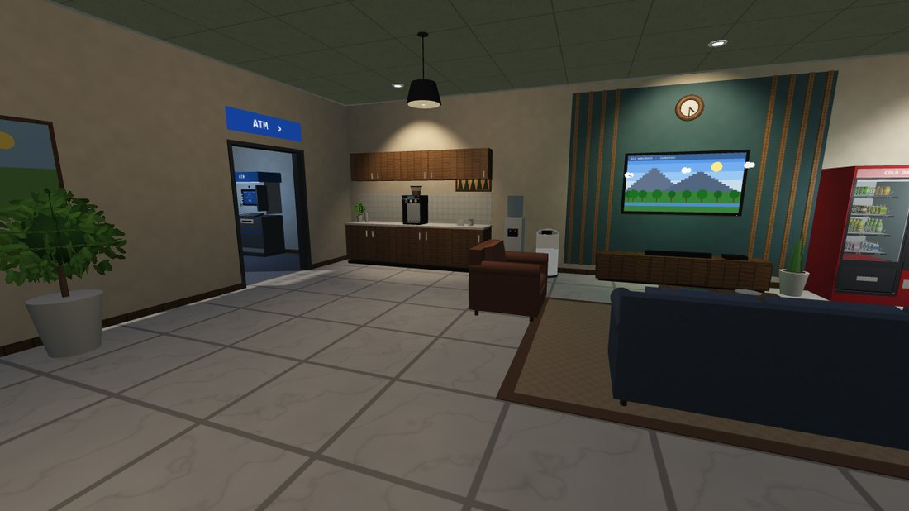
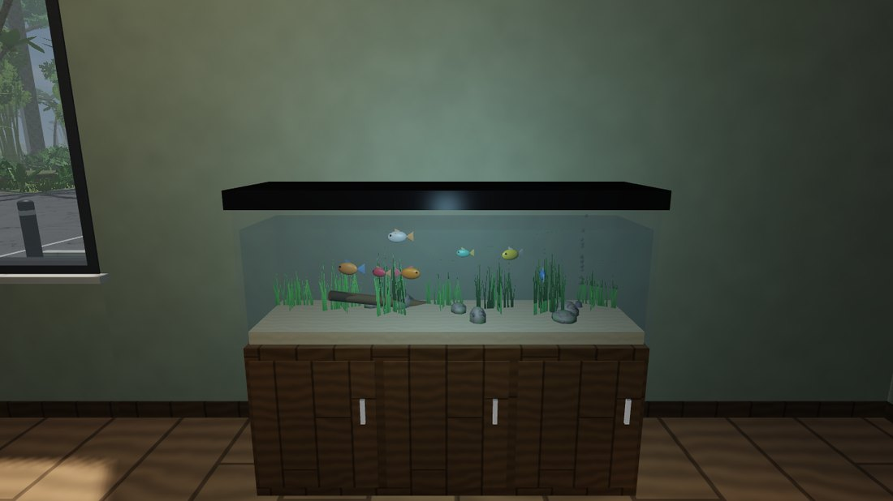
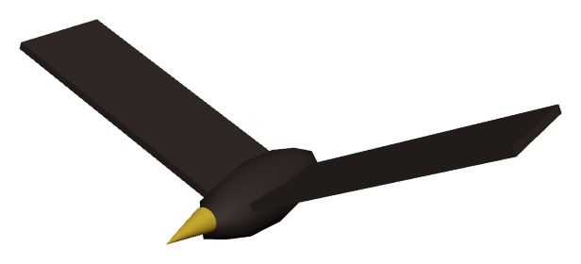
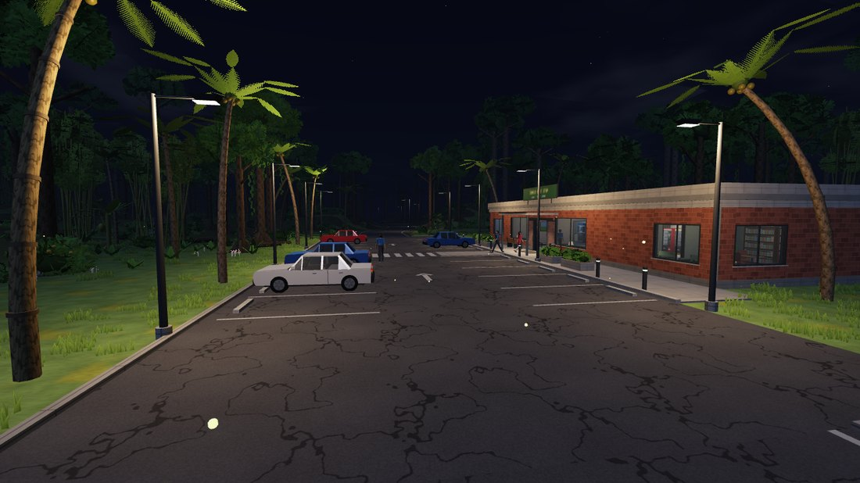
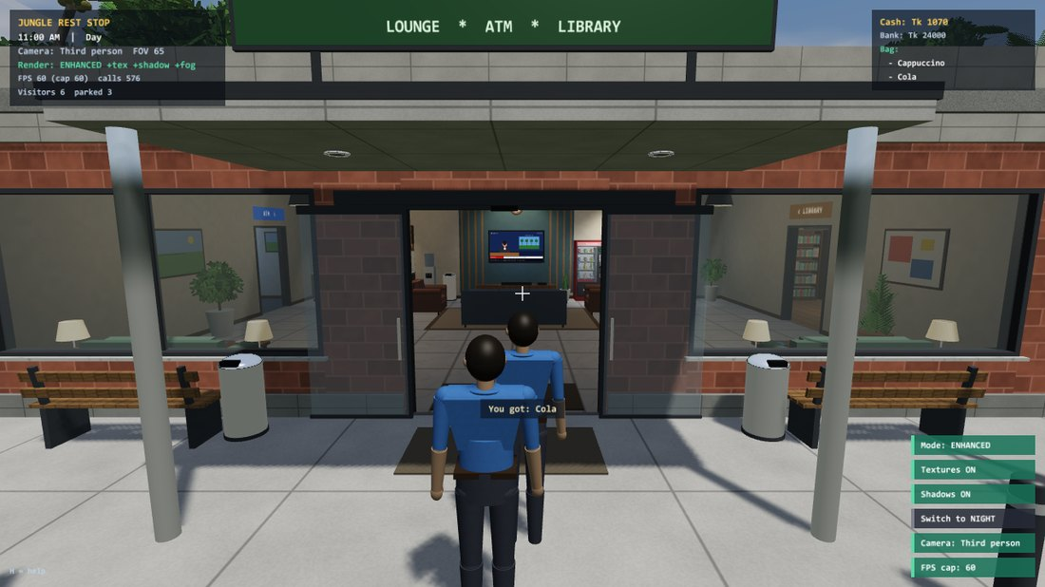
NPC and Object Behaviour
Visitors (person + car)
Fish
Birds
7 fish on ellipses
tail wags ±25°
swim up to food (12 crumbs)
9 birds on circles
radius 10–28 m, 16–30 m high
wings flap ±35°
Drive in
Park (Bézier)
Walk (Dijkstra)
Use / sit / read
Leave
Fireflies
Doors and devices
up to 6 visitors; a new car every 8–18 s
car: 9 m/s road, 4 m/s lot, 1.8 m/s parking; stops 7.5 m behind cars, 5.5 m before people
person: 1.35 m/s on a graph of 18 nodes, 22 edges
1–3 activities: vending, coffee, ATM, TV, reading, fish
machines and seats are reserved first; one car parks at a time
110 glowing spheres
night only, outdoors
blink, drift near the camera
doors open within 2.2 × 2.8 m
camera pans ±30°
clocks show game time
Notes:
Every character is a state machine plus a movement rule. Visitors: reserve, walk with Dijkstra, run the machine's own state machine. Cars: path following by length s, speed limit v <= sqrt(2 a s_left). Fish: x = rx cos(phi), z = rz sin(phi), heading atan2(dx, dz). Birds: wings are child nodes rotated Rz(+-35 sin flap). Fireflies: position wrapped around the camera, blink 0.5+0.5 sin(3t).

Slide 10
Thank You
Notes:
Thank the teachers and invite questions.

