Slide 1

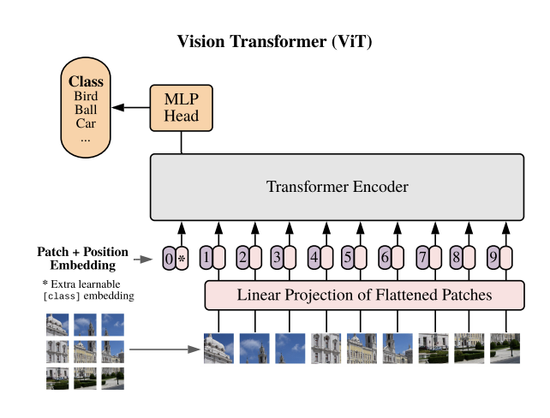
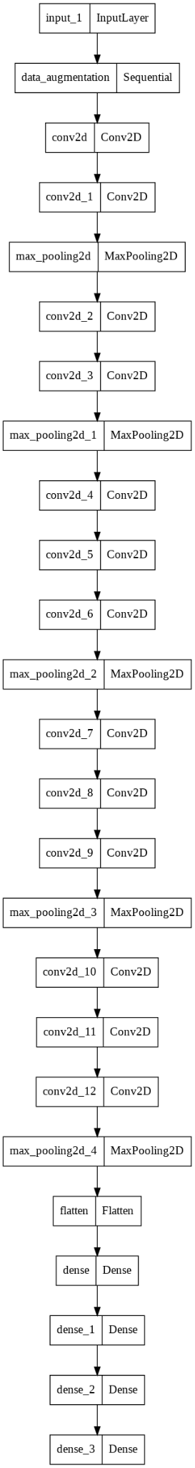
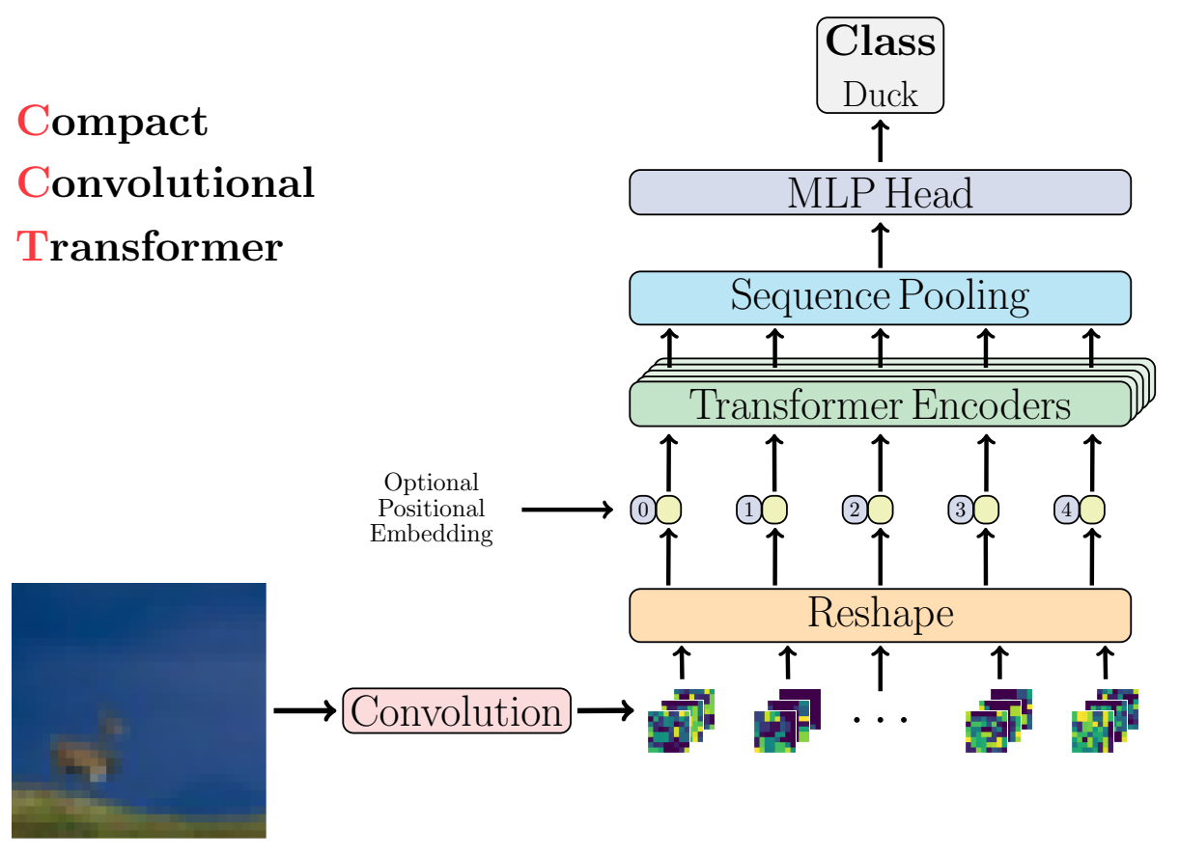
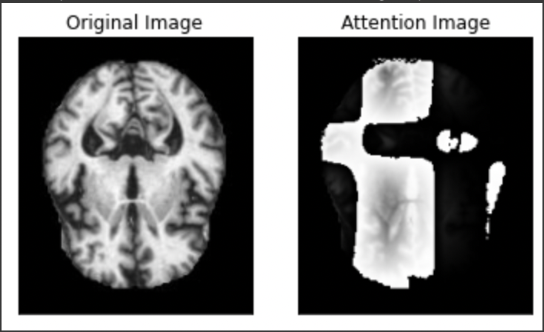
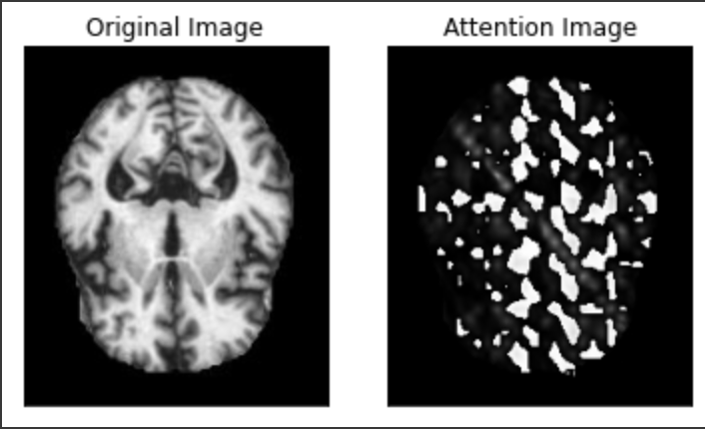
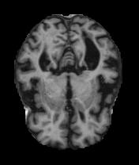
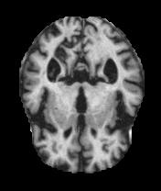
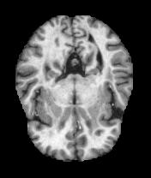
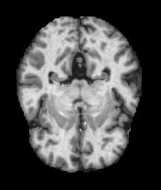
Alzheimer's diagnosis using Attention-based Models
Harshit Khandelwal, Arpita Ajit Welling,Sai Giridhar Rao Allada, Purna Chandra Sanapala
Luddy School of Informatics and Computing, Indiana University
1. Introduction
3. Methods
5. Results
Alzheimer’s disease is a very devastating neurological disease which is caused as a result of abnormal built up of proteins in and around brain cells.
Recently, transformers for computer vision have been widely used.
Attention mechanism attempts to focus on the parts of the images that are useful for the goal.
Using these methods, we have implemented 2 models Vision Transformer and Compact Convolutional Transformers to understand use of attention in detecting Alzheimer’s.
We also compare our results with the state of the art architectures like VGGNet, ResNet, and AlexNet.
We classify images into 4 classes: Mildly Demented, Very Mildly demented, Non-demented, Moderate Demented.
The GIF to the right shows what the vgg model focuses on in the MRI image
https://arxiv.org/abs/2010.11929
VGG
https://arxiv.org/pdf/2104.05704.pdf
4. Experiments & Results
Model | Training Accuracy | Validation Accuracy |  | Training Loss |  |  |  | Validation Loss | Training Parameters
CCT | 66.11% | 59.19% |  |  | 0.9007 |  |  | 1.0015 | 130 epochs, 64 batch size, 0.0001 learning rate
ViT | 71.12% | 55.9% |  |  | 0.6373 |  |  | 0.9815 | 250 epochs, 32 batch size, 0.005 learning rate
VGGNet | 98.32% | 74.59% |  | 0.0510 |  |  |  | 1.5493 | 50 epochs, 32 batch size, 0.0001 learning rate
VGGNet(pre-trained) | 99.79% | 69.27% |  | 0.0670 |  |  |  | 0.9508 | 200 epochs, 0.0000001 learning rate
ResNet | 100% | 66.37% |  | 4.2386x10e-9 |  |  |  | 3.74082 | 200 epochs, 0.001 learning rate
AlexNet | 84.03% | 63.17% |  | 0.35 |  |  |  | 1.3373 | 200 epochs, 0.000001 learning rate
ViT
CCT
2. Motivation
The above image shows how the attention mechanism works and where it focuses on. It is observed that it was able to focus on some of the affected part of the brain.
Advancement of the medical diagnosis using advanced Computer Vision models
Reducing the False positive and False negative rates in the medical diagnosis
Attention models have been used to detect other diseases like Glaucoma.
Using the attention mechanism to help model focus more on the problem ares than other irrelevant areas
6. Conclusion & Future Work
Attention models require more data for better accuracy
Currently, due to lack of data, our attention models have accuracy of 59.19% by CCT and 55.9% by ViT.
VGGNet is giving the highest accuracy of 74.59%.
We would like to extend this project on a larger dataset to conduct our research.
The above table gives training accuracy, validation accuracy, accuracy loss and validation loss for all 6 models.
All models use Adam optimizer, Categorical cross-entropy for loss and categorical accuracy as metric.

Slide 2
THANK YOU

