Slide 1
Harshit Khandelwal Maharaja Agrasen institute of technology, ip university
ZS DATA-A-THON
All the images used in this presentation are screenshots of the jupyter notebook used to generate the ML model.

Slide 2
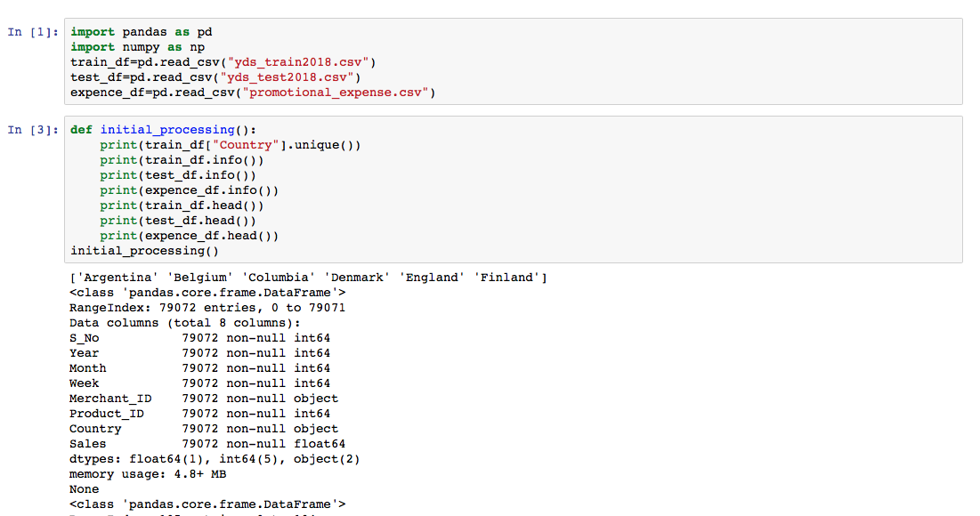
Data preprocessing steps
The very first step was playing with the data to get to know how the data it structured, what needs to be done to make the best of the available data. The following shows a few popular method used to get the gist of the data:-

Slide 3
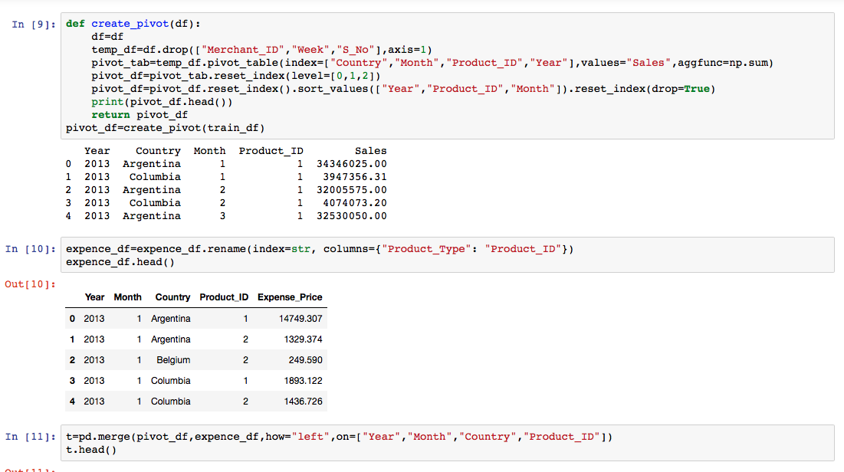
Next step after getting to know the data is to generate the frame or structure in which the answer is requested by the client or the customer.
Here, this involves the removal of the weekly resolution and converting the data into a monthly resolution with respect to the “Sales” column. This is achieved by using a pivot table.

Slide 4
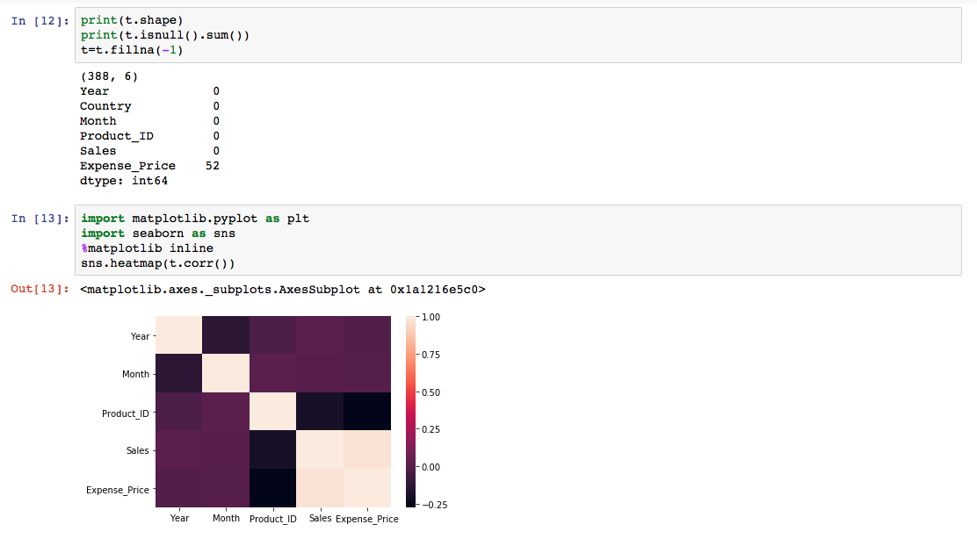
Then the Product_Type column of the expense needs to be changed as we need the expense column to predict the Sales. Therefore the dataframe that was created from the pivot table is merged with the expense dataset using ‘left’ most join on the columns Product_ID, Year, Month and Country.
The null values that were created as a result of the merge of the 2 datasets are filled with the value ‘-1’ and a heatmap of the correlation between the columns is created

Slide 5
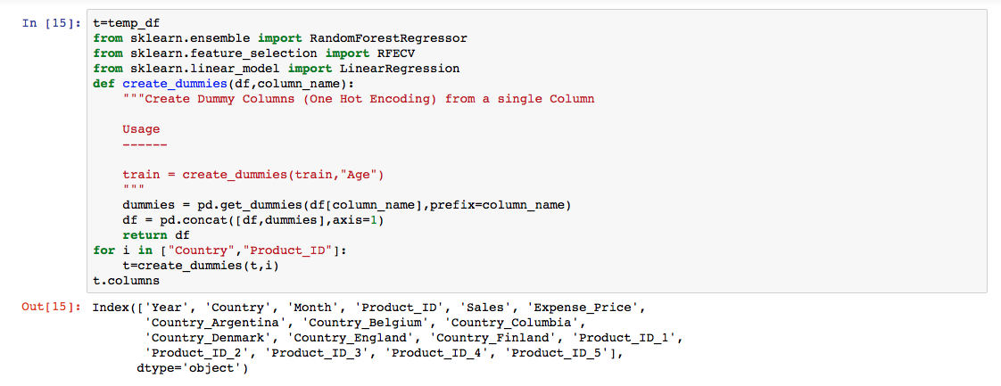
Feature Selection
Feature selection plays a very vital role in developing a good model
In machine learning and statistics, feature selection, also known as variable selection, attribute selection or variable subset selection, is the process of selecting a subset of relevant features (variables, predictors) for use in model construction. Feature selection techniques are used for four reasons: simplification of models to make them easier to interpret by researchers/users,shorter training times,to avoid the curse of dimensionality,and enhanced generalization by reducing overfitting

Slide 6
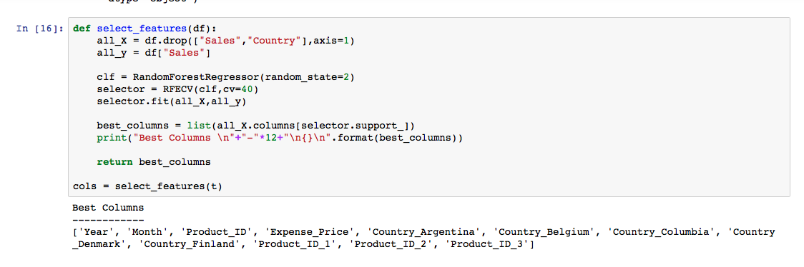
For selectiong and reduction features RFECV method which stands for Recursive feature elimination with cross-validation is used.
The feature selection method from the preprocessing module of the sklearn libraray is used after the conversion of the Country column in a multi binomial categorical columns. This was need because of mainly to reasons, first, the content of the column was not enough to treat it as a column of continuous data and second, for a regression Machine model- all the features that are used to fit the model need to be of Integer type. But Country column was a String and was converted into dummy columns and concatenated to the main dataset.
The reason Year column was not converted into the binomial dummy categorial was because the training dataset contained year ranging between 2013-2016 while the test data set contained years from 2015-2017. Therefore there would a few columns missinf\g from each dataset after conversion which would obstruct In making a good ML model.

Slide 7
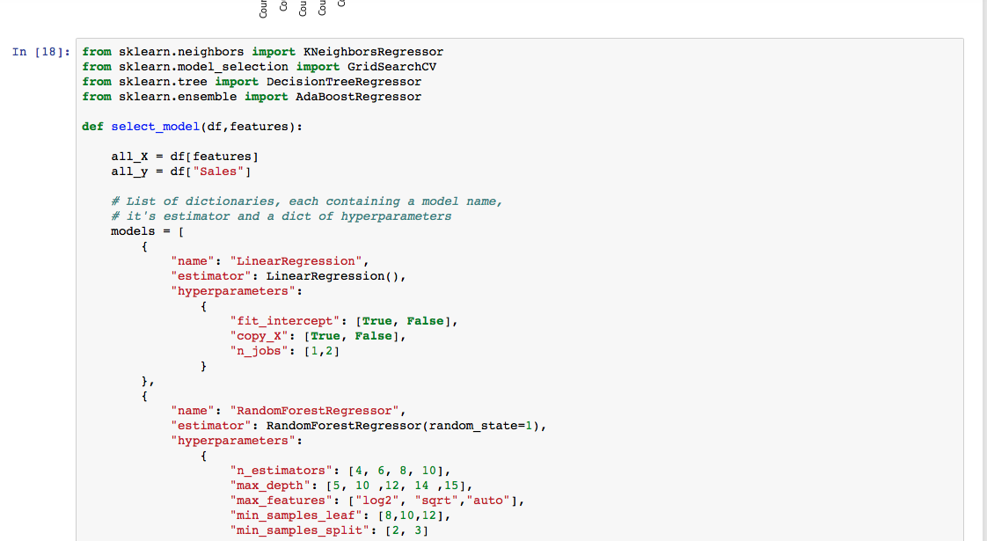
Machine Learning Model
Cross-validation is when you reserve part of your data to use in evaluating your model. There are different cross-validation methods. The simplest conceptually is to just take 70% (just making up a number here, it doesn't have to be 70%) of your data and use that for training, and then use the remaining 30% of the data to evaluate the model's performance. The reason you need different data for training and evaluating the model is to protect against overfitting. There are other (slightly more involved) cross-validation techniques, of course, like k-fold cross-validation, which often used in practice.
Grid search means you have a set of models (which differ from each other in their parameter values, which lie on a grid). What you do is you then train each of the models and evaluate it using cross-validation. You then select the one that performed best.

Slide 8
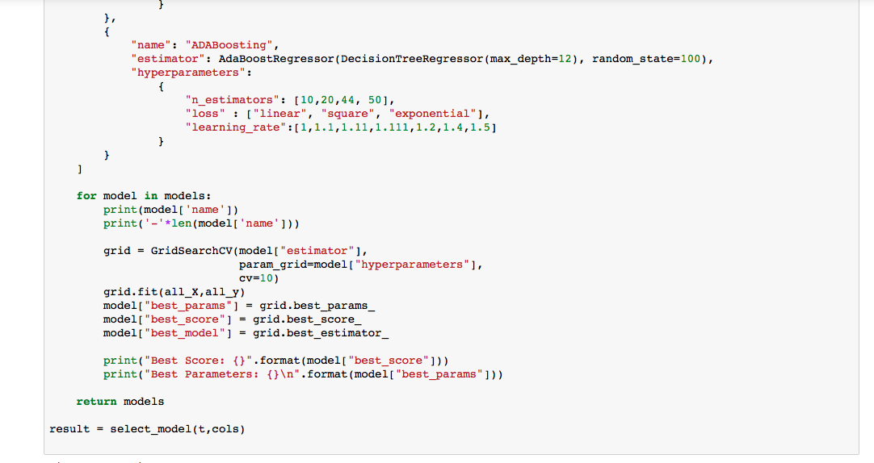
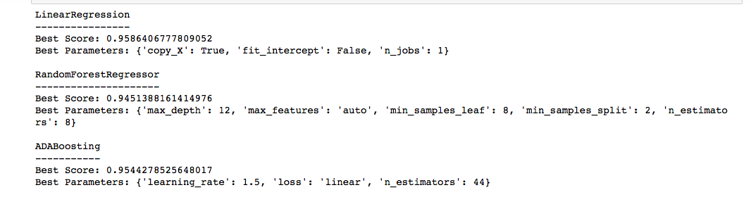

Slide 9

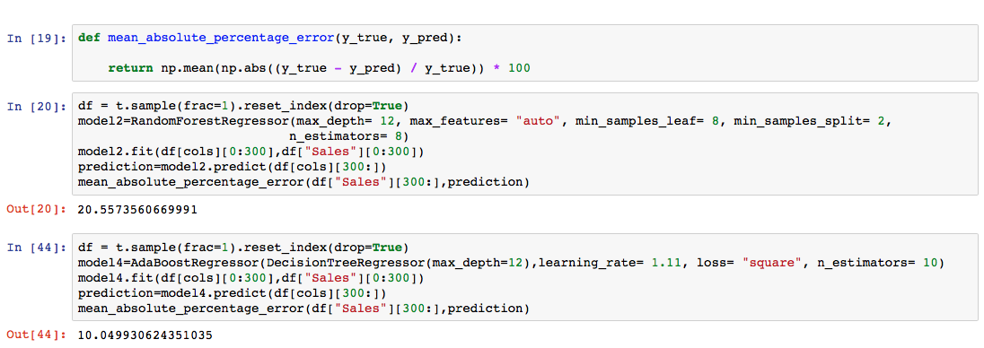
Evaluation Method
The evaluation matrix for this competition is sMAPE (Symmetric Mean Absolute Percentage Error). SMAPE is calculated as:
The leaderboard score is based on SMAPE. Lower the SMAPE, higher is your score on the leaderboard.

Slide 10
Final Step
Developing the Machine learning model after all the careful steps to generate a model
Of good precision.
After the model has been made and the predictions for the test dataset made convert the resulting dataset into csv file for evaluation.

Slide 11
ThanK You

