Slide 1
Twitter Sentiment Analysis
Apple vs Google
Non-Technical Business Presentation

Slide 2
Business Context
In today’s digital era, customer opinions are shared widely on platforms like Twitter.
This project analyzes tweets related to Apple and Google to classify them as positive, negative, or neutral.
Goal: Enable real-time tracking of public opinion for better decision-making.

Slide 3
Stakeholders & Benefits
- Marketing Teams: Monitor sentiment changes after campaigns.
- Product Managers: Spot product issues early.
- Customer Support: Respond to spikes in negative sentiment.
- Executives: Track brand perception against competitors.

Slide 4
Data Sources
Twitter data related to Apple and Google.
Data collected from public tweets mentioning brand names, product names, or hashtags.
Includes text content, date, and sentiment labels.

Slide 5
Method & Approach
1. Collect tweets mentioning Apple and Google.
2. Preprocess text to remove noise (hashtags, links, punctuation).
3. Apply Natural Language Processing techniques.
4. Train a machine learning model to classify sentiment.
5. Visualize sentiment trends for business insights.

Slide 6
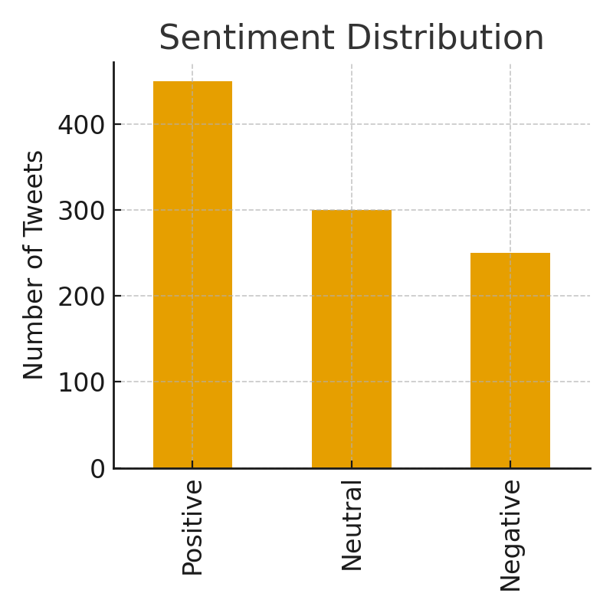
Sentiment Distribution

Slide 7
Business Value & Recommendations
- Real-time monitoring of sentiment improves responsiveness.
- Identifying negative sentiment early prevents PR crises.
- Positive sentiment trends can guide marketing strategies.
- Use insights to enhance customer satisfaction and brand loyalty.

