Slide 1
A Deep Neural Network for SAT using BERT
Antonio Laverghetta Jr
Animesh Nighojkar

Slide 2
Boolean Satisfiability
A fundamental NP-complete³ problem in Computer Science
Given a Propositional Calculus formula in CNF form, determine whether is satisfiable or unsatisfiable.
Major advances have been driven by
Conflict-Driven Clause Learning (CDCL), of which there are many variants
Look-ahead
Cube and conquer
Survey Propagation
However, in recent years progress on SAT solvers has slowed down

Slide 3
Neural Networks Applied to SAT
Should be possible, since Neural Nets are Turing Complete¹
However, SAT problems have rich semantics despite a simple syntactic representation²
SOTA is currently NeuroSAT, which is highly experimental
Can we apply recent advances in NLP to the SAT problem?

Slide 4
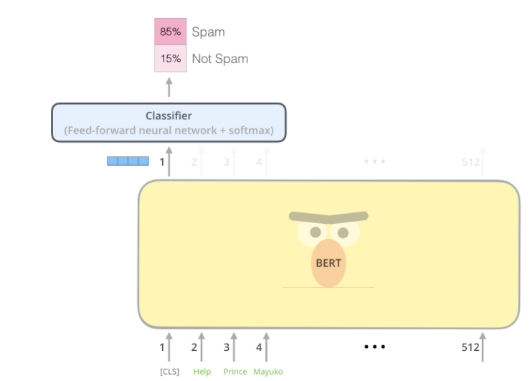
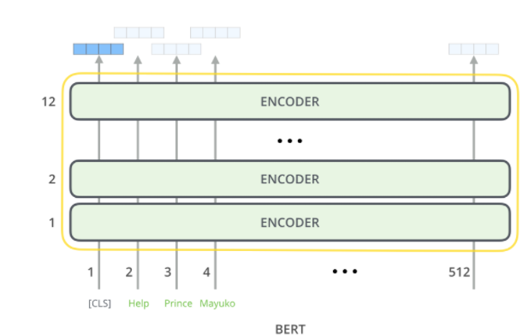
A BERT Crash Course
BERT: Bidirectional Encoder Representations from Transformers⁴
https://jalammar.github.io/illustrated-bert/
Notes:
Use BERT encoder layers for unsupervised feature learning, and train the linear model head for the actual SAT task.

Slide 5
Dataset
Using NeuroSAT⁵ we generate a dataset of 200,000 SAT problems
These are constructed such that predicting satisfiability cannot be done trivially
Gold labels are found using MiniSat⁶
The outputs is in DIMACS format, which we convert to S-expressions

Slide 6
Training Methodology

Slide 7
Results and Discussion

Slide 8
References
¹Pérez, Jorge, et al. “On the Turing Completeness of Modern Neural Network Architectures.” International Conference on Learning Representations, 2019.
²Selsam, Daniel. Neural Networks and the Satisfiability Problem. Diss. Stanford University, 2019.
³Cook, Stephen A. "The complexity of theorem-proving procedures." Proceedings of the third annual ACM symposium on Theory of computing. 1971.
⁴Devlin, Jacob, et al. "Bert: Pre-training of deep bidirectional transformers for language understanding." arXiv preprint arXiv:1810.04805 (2018).
⁵https://github.com/dselsam/neurosat
⁶Een, Niklas. "MiniSat: A SAT solver with conflict-clause minimization." Proc. SAT-05: 8th Int. Conf. on Theory and Applications of Satisfiability Testing. 2005.

